Slide 1
Dynamoth: A Scalable Pub/Sub Middleware for Latency-Constrained Applications in the Cloud
ICDCS’15
Julien Gascon-Samson, Franz-Philippe Garcia, Bettina Kemme, Jörg Kienzle
School of Computer Science, McGill University

Slide 2
Introduction: Pub/Sub System
Pub/ Sub is popular , and it has been used at many applications e.g. Facebook, Twitter, and Google Cloud Messaging (GCM).
Pub/Sub has two categories:
Content based: publications are tagged with a set of attribute/value pairs, and subscriptions are expressed as preferences over attributes
Channel (Topic) based: Users declare interest in content by submitting subscriptions to specific channels. Publishers tag their publications with a channel name, and all users that have subscribed to that channel receive the message.

Slide 3
Large-scale Channel based Pub/Sub
Move to cloud for cost efficiency and elasticity
Minimizing processing time for strict response time requirement, e.g. virtual environment
For load distribution, consistent hashing is adopted
Consistent hashing is a special kind of hashing such that only a small portion of keys remapped when a hash table is resized

Slide 4
Why Consistent Hashing Doesn’t Work ?
Each server has a set of virtual ids, and channels are hashed to the closet virtual id of servers
Each server is responsible for an equal number of channels
Consistent hashing prevent remapping all channels, but it works when channels are equally distributed across all virtual ids

Slide 5
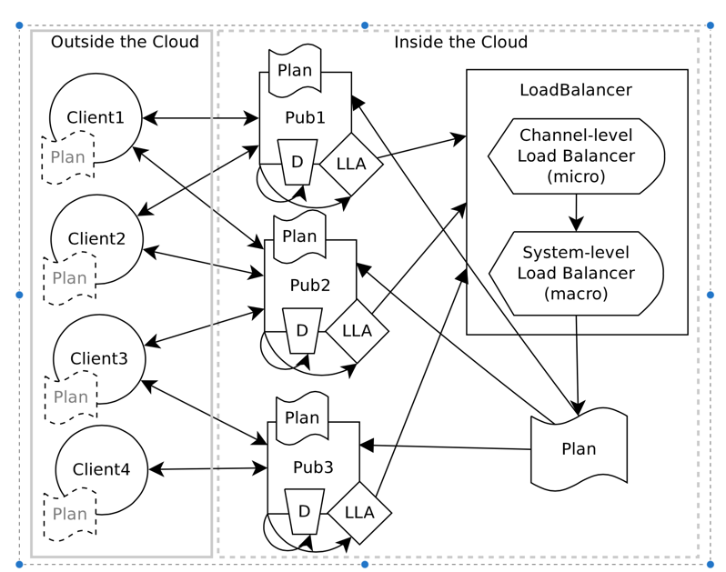
Dynamoth Middleware Architecture
Local Load Analyzer (LLA): real time monitoring the pub/sub server load
Dispatcher (D): messages forwarding during system reconfig
A Load Balancer (LB) aggregates metrics from LLA and determine config change
Client interact with system through standard pub/sub API while Dynamoth uses Redis API

Slide 6
Mapping Channels to Pub/Sub Servers
A channel c is assigned to a pub/sub server in most cases
If the number of subscribers/publishers or publications are too large for a single server, it may lead to serious processing delay
Dynamoth performs load balancing on channels by allowing channel replication that more than one pub/sub server to map a given channel

Slide 7
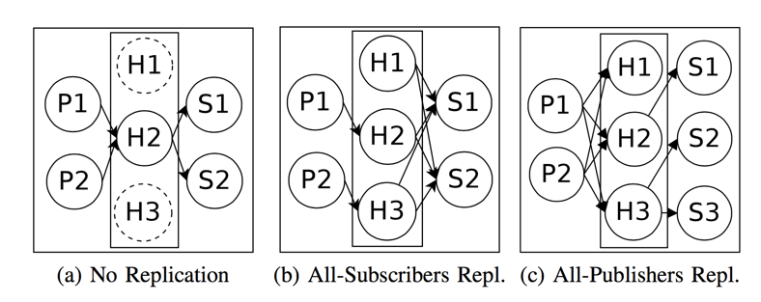
Channel Replication

Slide 8
All-Subscribers Replication
Very high number of publishers or messages on channel c, but the number of subscribers is within the limit of a pub/sub servers
Scenario: players publish position and state update in high frequency, and the game servers perform interest management

Slide 9
All-Publishers Replication
Very high number of subscribers or messages on channel c, but the number of publishers is within the limit of a pub/sub servers
Scenario: a game server broadcasts some worldwide events that are of interest to all players. A single pub/sub server might take a long time to disseminate such a publication to all subscribers

Slide 10
Bootstrapping for Plans
Consistent hashing is used to generate an initial global plan that maps channels to pub/sub servers
Each client maintains a local plan and updates it in lazy manner when global plan changes
Minimizing the local plan size also enables the middleware to support multiple applications concurrently

Slide 11
Local Load Analyzers
LLA periodically gathers load metrics for every channel managed by the pub/sub server
It’s notified when the pub/sub server receives (un)subscriptions
Why run locally?
Very limited CPU overhead
Outgoing bandwidth saturates more quickly than the CPU

Slide 12
Generating a New Plan
Upon receiving the metrics from all LLAs , the load balancer (LB) computes the load ratio for all pub/sub servers
The load ratio LR_{i} for a given server i is defined as the measured outgoing bandwidth M_{i} divided by the maximum outgoing bandwidth supported by the server T_{i}
LR_{i} = M_{i}/T_{i}
The LB determines whether Dynamoth needs a new plan

Slide 13
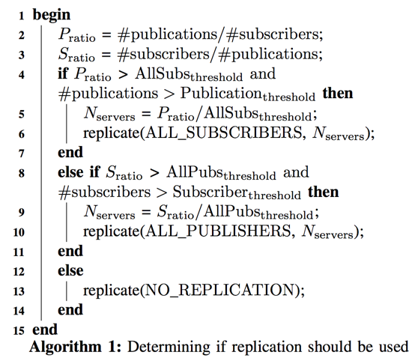
Channel-level Rebalancing
Consider a corner case: the number of publishers and subscribers are both high
Use all-subscribers scheme, since all-publishers causes messages sent to all pub/sub servers

Slide 14
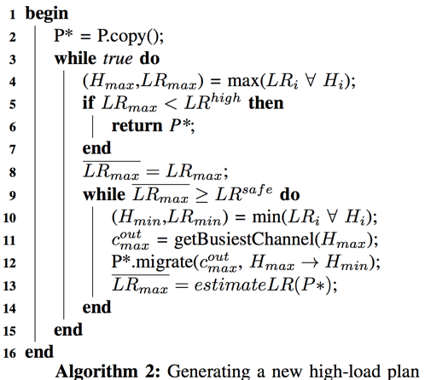
System-level Rebalancing
Obtain the pub/sub server with highest load ratio
Obtain the busiest channel
Migrate channels in the new plan
Estimate the new load ratio

Slide 15
Reconfiguration
Upon determining that a new global plan P∗ should be applied, all clients need to be informed
However, sending a new global plan to all clients at reconfiguration time would create a huge message overhead
Using a lazy scheme
At connection time, clients use consistent hashing to determine pub/sub servers
They know the right server for a channel only when they actually send their first message for this channel

Slide 16
Reconfiguration: Setup
Each dispatcher has connections to all other pub/sub servers to forward messages
Whenever a new global plan P* is created, the LB sends it reliably to all dispatchers.
Upon receiving a new plan P* such that server H₀ was responsible for channel c in the old plan and server H₁ in the new plan P*, the dispatchers of both H₀ and H₁ subscribe locally to channel c to receive all publications.

Slide 17
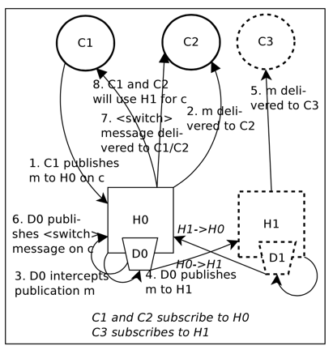
Reconfiguration: Incorrect Pub/Sub Server
Incorrect server H₀
There is no central authority that knows the local plan
Both H₀ and H₁ might have subscribers of channel c at the same time
H₀ forwards all messages to its remaining subscribers and H₁

Slide 18
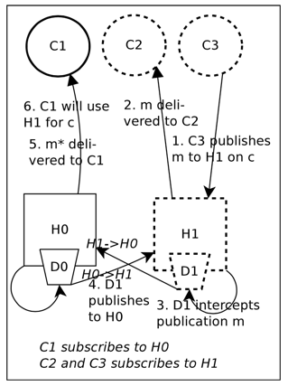
Reconfiguration: Correct Pub/Sub Server
H₁ forwards all messages to its subscribers and H₀ until it doesn’t have any subscribers

Slide 19
Dispatcher Subscriptions and Messages Forwarding
The dispatcher on H₁ c H₀ if there are still clients that are subscribed to H₀
The dispatcher on H₀ c H₁ if publishers don’t know the plan switch
Why not tell all publishers about the new server H₁ ?
To avoid the dispatcher on H₀ must be subscribed to c forever, a timeout mechanism is designed to reset timers on client when receive/send messages or the server changes

Slide 20
Implementation of Dynamoth
110 Java classes and 10000 lines of code
All inter-component communications are done using the pub/sub primitives offered by the Dynamoth API.
The dispatcher and local load analyzer modules reuse the pub/sub interface
Standard Redis instances are used as the pub/sub servers

Slide 21
Application Built on Mammoth and Dynamoth
Use a muliplayer online game (MOG) application built on Mammoth
Mammoth requires the network engine to provide a channel-based pub/sub API as messages to updated players, messages to send replicas to clients and general broadcast messages
A specific testing game: players are controlled by a simple AI. It repeatedly chooses a random point on the map, and moves the player towards that point

Slide 22
Experiment Setup
All experiments are conducted on 80 machines which have at least 4 GB of RAM and dual-core
Pub/sub server node received exclusive access while client nodes share machines
Both client and server nodes are run in the same LAN
To emulate the WAN access latency from client to server, King dataset [1] is adopted
[1] K. Gummadi, S. Saroi., S. Gribble,”King: Estimating latency between arbitrary internet end hosts.” In Proc. of ACM SIGCOMM Workshop on Internet Measurment (IMW). pp. 5–18 (2002)

Slide 23
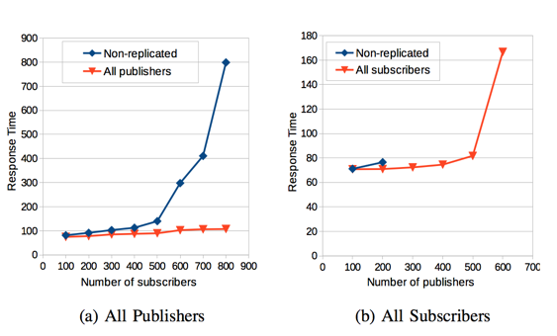
Experiment 1: Channel-level Scalability

Slide 24
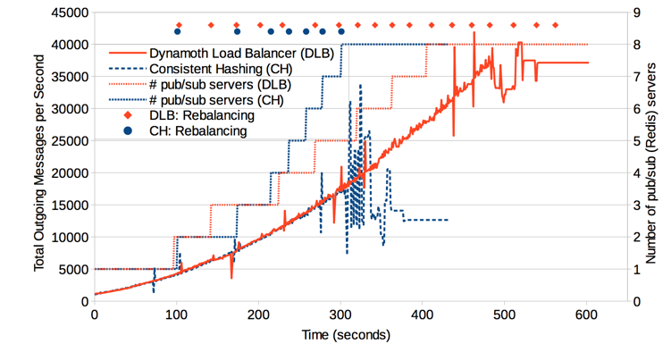
Experiment 2: Scalability-Total Outgoing Messages

Slide 25
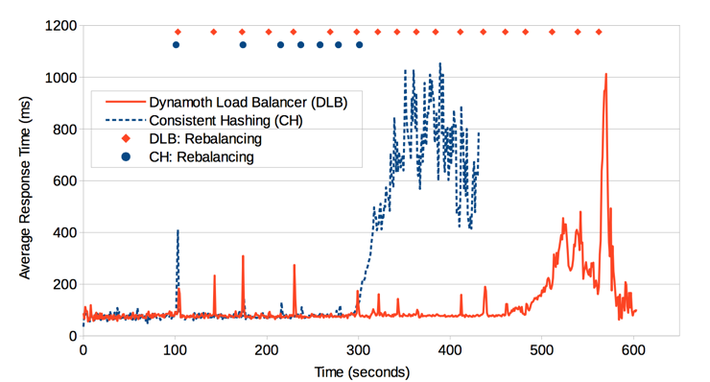
Experiment 2: Scalability-Average Response Time

Slide 26
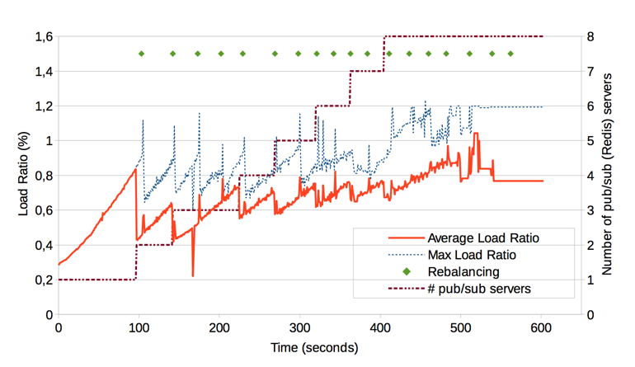
Experiment 2: Scalability- Pub/Sub Server Load

Slide 27
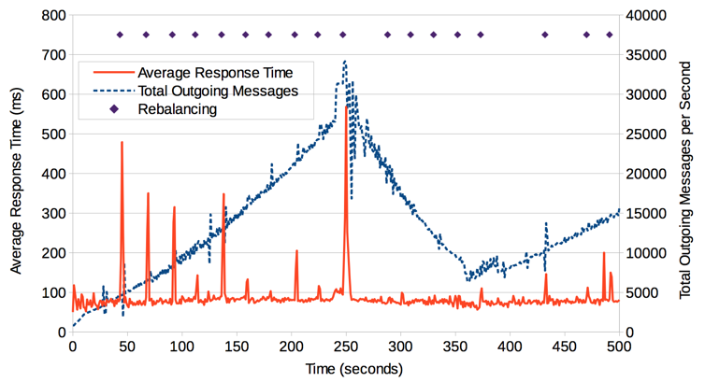
Experiment 3: Elasticity

Slide 28
Conclusion
A two-level load balancing mechanism is proposed
Highly loaded channels can be replicated across pub/sub servers
Channel assignments can change and servers can be added/removed from the workload-triggered reconfiguration
Real implementation and experiment for MPG application

