Slide 1
B4: Experience with a Globally-Deployed Software Defined WAN
Google
SIGCOMM’13

Slide 2
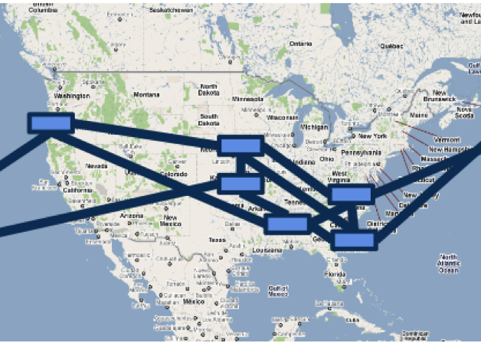
Google B4 -- Topology Assumption
Each B4 site consists of multiple switches linking to remote sites
TE abstracts each site into a single node with single edge of given capacity to each remote site.
To achieve this topology abstraction, all traffic crossing a site-to-site edge must be evenly distributed all across its links

Slide 3
Google B4 -- Application Assumptions
Google categorizes applications into three classes
copy user data to remote data center
remote storage access for computation, e.g. Mapreduce
large-scale data push synchronization across multiple data center
Each class has different weight (priority)
user data copy has highest priority

Slide 4
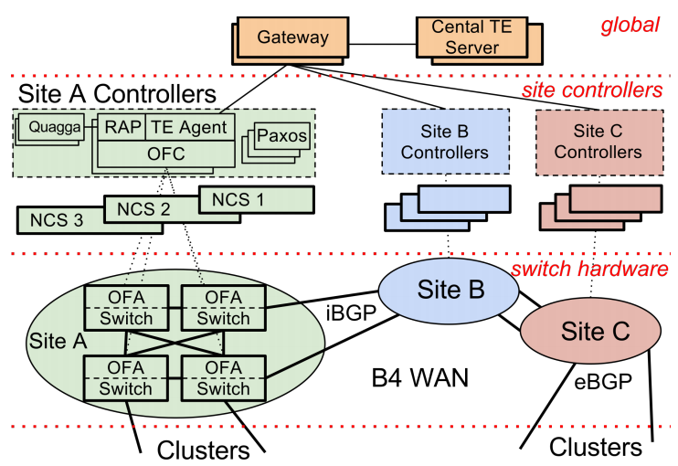
Google B4 -- System Architecture

Slide 5
Google B4 -- TE
TE server receives topology events from multiple sites. ( sites is vertices and site to site links is edges)
This abstraction reduce the size of the input to the TE optimization algorithm
Terms
Flow Group (FG): a group = {src, dst, QoS}
Tunnel: represents site-level path, e.g. A-->B-->C
Tunnel Group (TG): map FG to a set of tunnels with different weight
Bandwidth Functions: Next Page

Slide 6
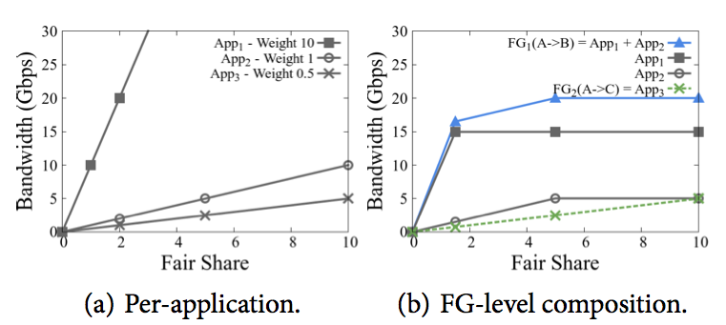
Google B4 -- Bandwidth Functions
Fair share
different application has different weight (slope)
each application has its upper bound of required b/w
in figure (a) all applications has unlimited upper bound. in figure (b), App1 needs 15 Gbps, App2 needs 5 Gbps

Slide 7
Google B4 -- TE Algorithm
Fair share optimization problem
How to allocate FS to possible tunnels (TG) of multiple flow groups (FG) across B4 network (16 sites)
Steps
find preferred tunnel which is the minimum cost path without bottleneck edge
freeze all tunnels which cross the bottleneck edge and recursively do the same thing until no available edge or satisfying all FGs

Slide 8
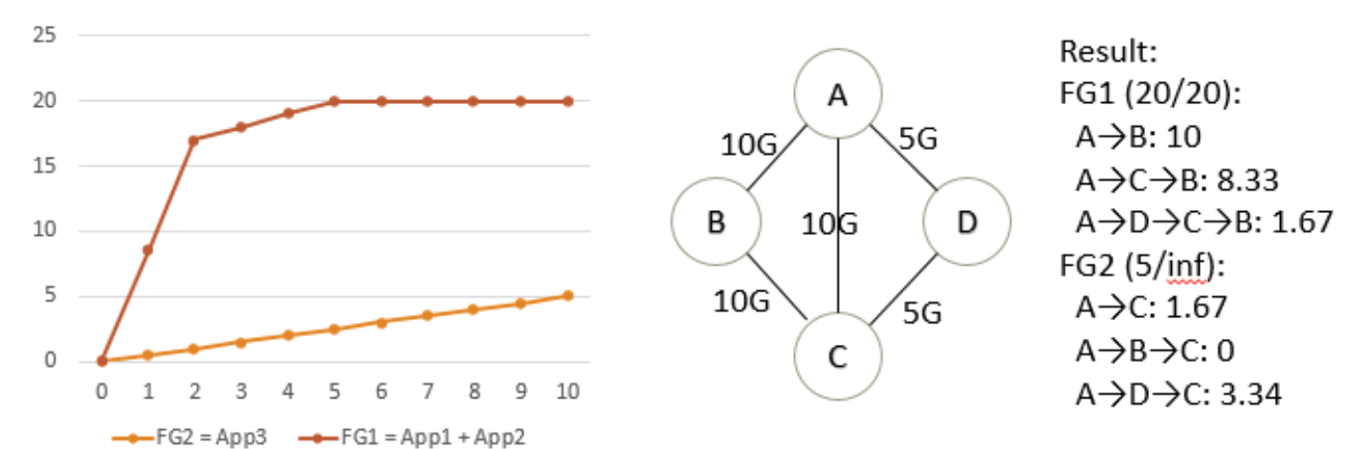
Google B4 -- Algorithm Example
Example:
Final Round: all edges are freezed and FG1 is satisfied, so that FG2 get remaining resources
 | FG1 prefer | FG2 prefer | Fair Share | FG1 get/need | FG2 get/need | Bottleneck links | Freeze tunnels
1 round | A->B | A->C | 0.9 | 10/20 | 0.45/inf | A->B | A->B, A->B->C
2 round | A->C->B | A->C | 3.33 | 8.33/10 | 1.22/inf | A-C | A->C, A->C->B
3 round | A->D->C->B | A->D->C | Final Round | 1.67 | (5-1.67) | all | all

Slide 9
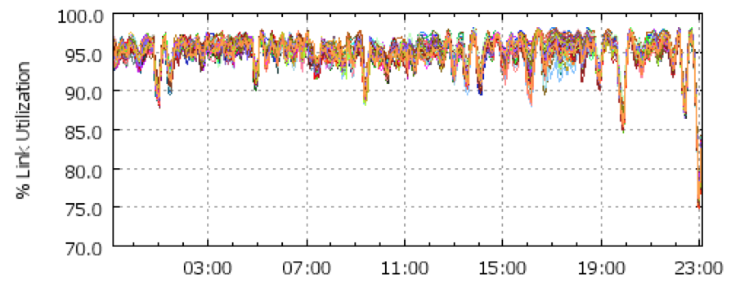
Google B4 -- Evaluation
Utilization for a site-to-site edge: 100%
Load-balance traffic across all links (evenly distribute traffic) 75% of site-to-site edges’ link utilization gaps are less than 5%

