Slide 1
Identifying Traffic Differentiation in Mobile Networks
Kakhki et al.
ACM IMC 2015

Slide 2
Key Challenges
The inability to test arbitrary classes of applications
A lack of understanding of how traffic shaping devices work in practice
the limited ability to measure mobile networks from smartphones and tablets

Slide 3
What is Traffic Shaping
Computer network traffic management technique which delays some or all datagrams to bring them into compliance with a desired traffic profile
Notes:
Traffic shaping (also known as "packet shaping") is a computer network traffic management technique which delays some or all datagrams to bring them into compliance with a desired traffic profile.

Slide 4
Differentiation?
Traffic differentiation affecting network performance as perceived by applications
Previous work focus on protocols, e.g. BitTorrent
Assumption: the trigger of differentiation can be
Port numbers
Payload signature
Bandwidth and Delay

Slide 5
Methodology
Trace record-replay methodology to reliably detect traffic differentiation for arbitrary applications in the mobile environment
Consider bidirectional application-layer payloads
Control or exposed trials that intend to be differentiated
VPN is used for control messages

Slide 6
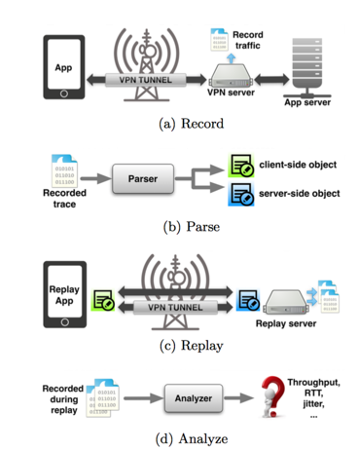
System Overview

Slide 7
Methodology Validation
Does the proposed method captures salient features of the recorded traffic ?
Does the replay trigger differentiation?

Slide 8
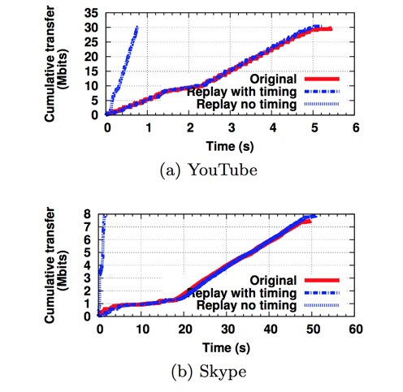
Record/Replay Similarity

Slide 9
Replayed Traffic Triggers Traffic Shaper (1/2)
The gateway presents the illusion (to the packet shaper) that it routes traffic to and from the public Internet

Slide 10
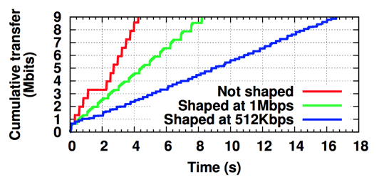
Replayed Traffic Triggers Traffic Shaper (2/2)
1Mbps line: YouTube replay in plaintext
512Kbps: YouTube replay with randomized payload and ports
Not shaped line is YouTube replay with string “youtube” being replaced by a random string
Notes:
haped at 1Mbps line is the YouTube replay in plaintext where shaper correctly detects as YouTube and shapes at 1Mbps. Shaped at 512Kbps is YouTube replay with randomized payload and ports, where shaper detects as P2P and limits at 512Kbps. The Not shaped line is YouTube replay with string “youtube” being replaced by a random string, which the shaper detects as “HTTP” and does not limit

Slide 11
Observations
Non-standard ports may still be subject to differentiation
Traffic shaping decisions are made early
HTTP request: on the first packet
UDP traffic: ~10th packet
HTTPS does not preclude classification

Slide 12
VPN Overhead
VPN overheads can stem from
IPSec encapsulation
latency added by going through the VPN

Slide 13
Detecting Differentiation
Expect behaviour of traffic differentiation detector
Region 1: always identify differentiation
Region 3: never identify differentiation
Region 2: possible to detect differentiation, but the impact of this differentiation will depend on the application

Slide 14
Statistical Tests (1/2)
Glasnost: Maximum throughput test
identifies differentiation if the maximum throughput for control and exposed flows differ by more than a threshold
NetPolice: Two-sample KS Test
using the maximum distance between two empirical CDF sample sets for a confidence interval α

Slide 15
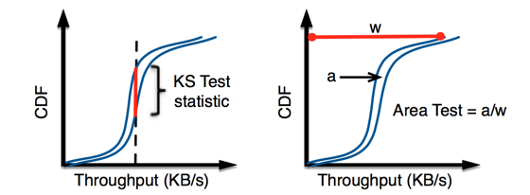
Statistical Tests (2/2)
Proposed: Area Test
The KS Test only considers the difference between distributions along the y-axis, even if the difference in the x-axis (in this case, throughput) is small

Slide 16
Testbed Environment
Vart shaping rate from 0.1 to 30 Mbps (9% to 3)
Emulate noisy packet loss using the Linux Traffic Control (tc)
Network Emulation (netem): add bursty packet loss according to Gilbert-Elliott (GE) model
Loss rate: no loss, 1.08% loss, 1.45% loss

Slide 17
Evaluation
Evaluate applications based on
TCP: Youtube, Netflix
UDP: Skype, Hangout
Criteria
Overall accuracy: # of correctly identified samples/all samples
Resilience to noise

Slide 18
Low Noise Results
KS Test and Area Test have similarly high accuracy in both regions 1 and 3
Glasnost performs poorly in region 3 because it will detect differentiation, even if the shaping rate is above the maximum

Slide 19
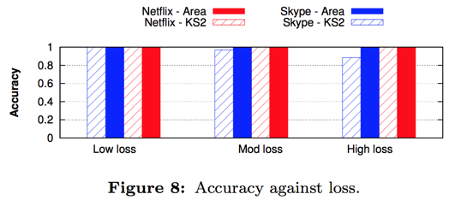
Impact of Noise

Slide 20
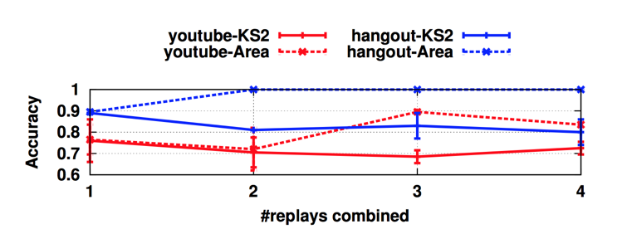
Impact of Number of Replays
In moderate or high loss, increasing the number of replays improves accuracy, particularly for a short YouTube trace
The accuracy does not significantly improve past 2 or 3 replays

Slide 21
Region 2 Results
Glasnost consistently identifies differentiation, the Area Test consistently does not detect differentiation, and the KS Test is inconsistent.

Slide 22
System Implementation
A replay client in an Android app called Differentiation Detector which does not require any root privileges
The app consists of 14,000 lines of source code, which includes the Strongswan VPN implementation
The server coordinates clients to replay trace by side-channel connections

Slide 23
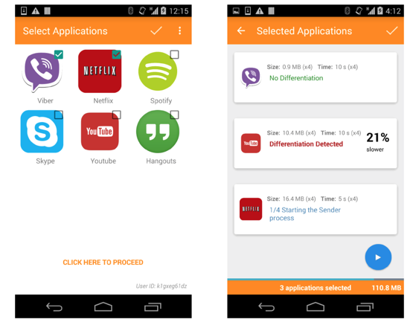
Screenshots

Slide 24
Challenged in Operational Networks
Per-client management
NAT behavior
“Translucent” HTTP proxies
Content-modifying proxies and transcoders

Slide 25
Differentiation Results: Dataset
This dataset consists of 4,786 replay tests from Differentiation Detector Android app
Traces from 6 popular apps:
YouTube (YT), Netflix (NF), Spotify (SF), Skype (SK), Viber (VB), and Google Hangout (HO)

Slide 26
Differentiation Results: Dataset
Cellular providers:
Most major cellular providers and MVNOs in the US
Idea (India), JazzTel (Spain), Three (UK), and T-Mobile (Netherlands)
Use VPN traffic and random payloads (but not random ports) as control traffic

Slide 27
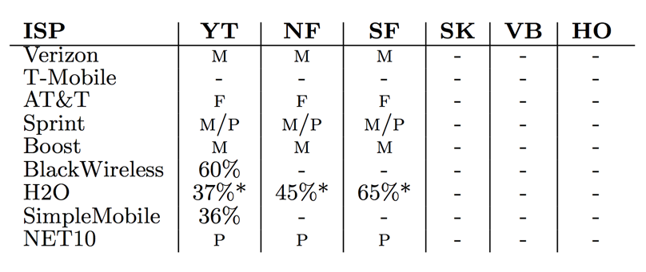
Three Cellular Providers Do Differentiation
dash (-) indicates no differentiation
(f) means IP addresses changed for each connection
(p) means a “translucent” proxy changed connection behavior from the original app behavior, and
(m) indicates that a middlebox modified content in flight between client and server.

Slide 28
Conclusion
The author presented and evaluated a new tool for accurately detecting differentiation
Using a VPN to record and replay traffic generated by apps to improve transparency in mobile networks

