Slide 1
Improved Access Point Selection
Yatin Chawathe, Mike Y. Chen,
Brian D. Noble, David Wetherall
2006 Mobisys

Slide 2
Motivation
Common operating systems simply scans for APs and then chooses the unencrypted one with the highest signal strength
This method may not select an available AP automatically
We want our wireless clients to quickly examine all available connection points, and automatically select one of them

Slide 3
Field Study
Choose 3 different area with different population density in Chicago.
Walk a 1.3 ${km}^{2}$ grid of city streets with a PDA containing an 802.11 wireless card.
A reference server (RS) was a machine directly connected to the Internet, used to estimate round-trip-time and test open ports

Slide 4
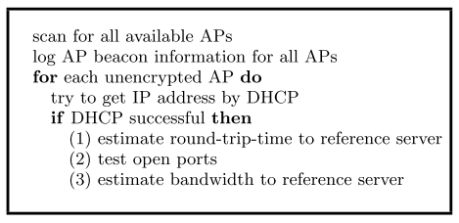
Field Study Script

Slide 5
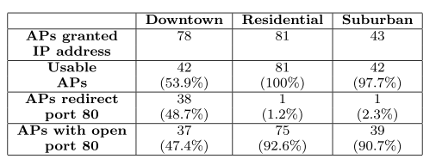
Field Study Result

Slide 6
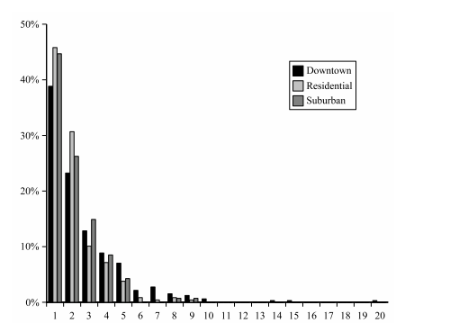
AP number Per Scan

Slide 7
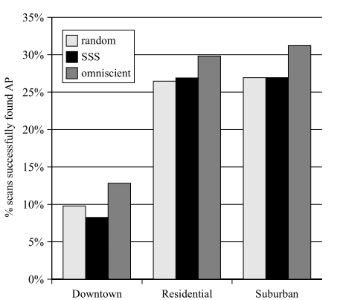
Missed Connectivity Opportunities
SSS sometime worse than random → signal strength is not a good predictor

Slide 8
VIRGIL
A new AP selection system
Scans for available APs, then quickly and cheaply probes each AP
Virgil stores test results in a local database, it improves performance by not rescanning too often

Slide 9
VIRGIL’s algorithm
Scan for all available APs
Test each unencrypted AP in the scan set
Get AP properties (SSID, MAC address, signal strength, etc.)
Try to get DHCP address from AP
If successful, probe the AP
Store test results in a local database
Select the “best” AP, based on test results

Slide 10
Probing an AP
Bandwidth to the reference server via this AP
Port traﬃc that this AP blocks or redirects
Round-trip-time from client to remote server

Slide 11
Access Point Info Refresh
Virgil saves the AP’s information in a local database
Virgil periodically re-scan APs
If find an AP that is already in the database, it doesn’t re-scan it but updates its timestamp ﬁeld
The user conﬁgures two thresholds:
maximum time that should pass between rescans
maximum number of times seen.

Slide 12
AP Selection
Virgil creates a candidate set that
the AP granted a DHCP address to the client
at least one port was found to be open
Add the following APs to the candidate set
pay hotspots which devices subscribe
Encrypted APs which devices holds a key
Choice a tie breaker according to the application
browsing the web or transferring large amounts of data → bandwidth
Latency-sensitive applications → RTT
Application need speciﬁes port → open ports

Slide 13
Prototype
Implemented on Linux, and have cross-compiled it for both x86 laptops and ARM-based handhelds
AP scanning happens when the current AP becomes unusable
Set up a single reference server
Use bandwidth to the reference server as the tie breaker

Slide 14
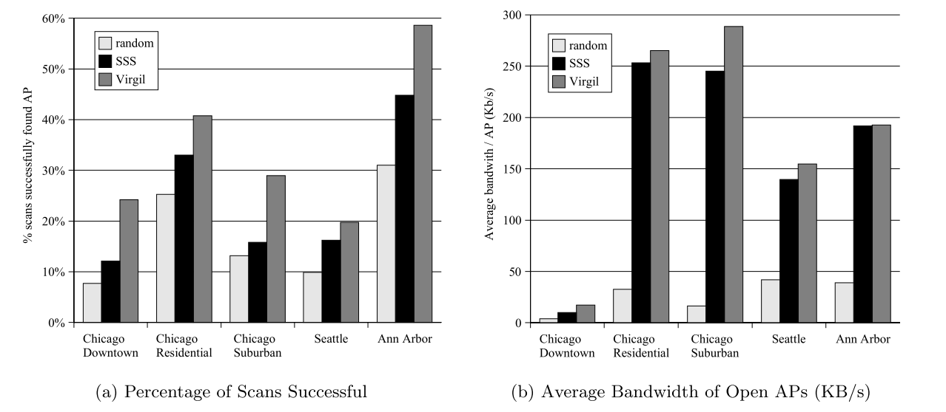
Connection Time and Quality

Slide 15
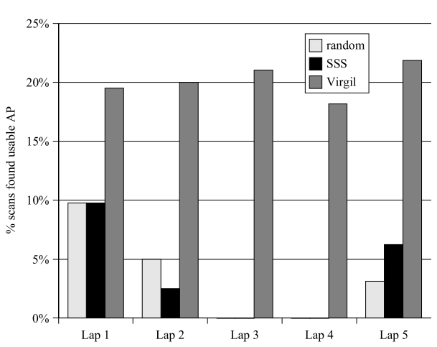
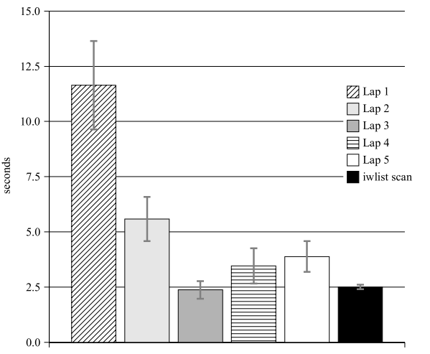
Beneﬁt of tracking AP History

Slide 16
Related Works
Spider: improving mobile networking with concurrent wi-fi connections – 2011 SIGCOM
Context-Based Network Estimation for Energy-Efficient Ubiquitous Wireless Connectivity - IEEE Transactions on Mobile Computing 2011
Wifi-Reports: Improving Wireless Network Selection with Collaboration - IEEE Transactions on Mobile Computing 2011

