Slide 1
Implementing MPLS with Label Switching IN Software-Defined Networks
John Bellessa
Thesis for the degree of master of C.S. Dept.
University of Illinois at Urbana-Champaign, 2015
Advisor: Prof. Roy H. Campbell

Slide 2
Motivation
Problem:
Rule matching in SDN compatible switches is very memory intensive
Does not provide sufficient flexibility to the networks
Challenge:
Core of the network should be kept as simple as possible.
Solution:
label-based switching
MPLS
Notes:
Compared to current core network technologies which make it costly to adapt , Rule matching in SDN compatible switches is very memory intensive
All flows are identified in the whole network by parameters of the header set by the host.

Slide 3
Introduction
hybrid-OpenFlow implementation of MPLS
Built on top of a simple layer-2 label mapping technique
Implement MPLS supplementary protocols such as LDP, RSVP-TE
The labels do not require any modifications to packet structure, it can be deployed using only commodity switches in the core network

Slide 4
Fabric Networks
One possible solution to the current limitations of SDNs
Label switching , simplify core network
Reduced the required memory in core switches by simplifying forwarding rules
E.g. migration from IPv4 to IPv6 can be done on edge network
Notes:
This work adopts the idea of label switching concept and
separates addressing and controlling the core network from access network.
Ingress / egress edge switches s idea not only reduced the required memory in
core switches by simplifying forwarding rules, but let edge and core networks
involved separately. For example, migration from IPv4 to IPv6 can be done
on edge network, without requiring any hardware or software updates in core
network.

Slide 5
Layer 2-labels
Shadow MACs, a project done at IBM, uses layer-2 (L2) addressing to implement the fabric network
commodity switches has larger memory and more efficient implementation for L2 address matching than OpenFlow header matching

Slide 6
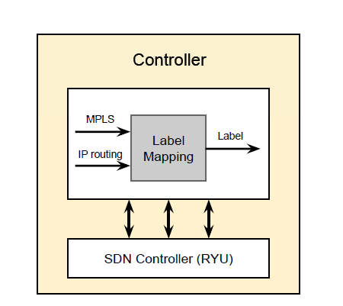
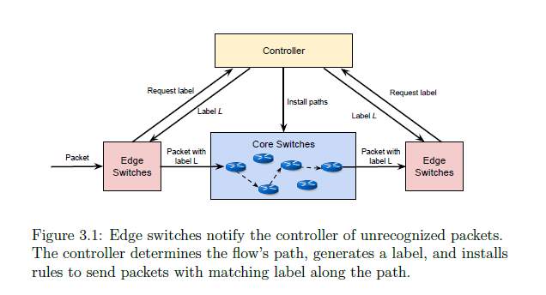
Implementing MPLS-like

Slide 7
Two way for forwarding Implementaion
TCAM (ternary content addressable memory)
forwarding rules are added to TCAM memory as a OpenFlow entries
Each entry has the label value as the L2 destination
Action to a specified port
Only choice in OpenFlow environment
MAC Address Table
Forwarding rules are added as a static ARP entries
Contains label -> destination port

Slide 8
Their solution
This path is implemented as sets of
forwarding entries installed in core switches ( MAC Address Table)
OpenFlow rules on the edge switches (TCAM)
Why?
Our goal for supporting as much commodity hardware as possible
cheaper switches with smaller TCAMs
Drawbacks of using MAC Table
find a way to side-load labels into the switches' MAC tables
lack of support for partial wildcard lookups

Slide 9
Leverage MAC Address
Store the switching label in the packet's destination MAC address field
Hardware look-up table for MAC -> Fast operation
MAC Address Table larger than TCAM (Used for routing or Openflow rules)
All forwarding decisions are determined by the switching label

Slide 10
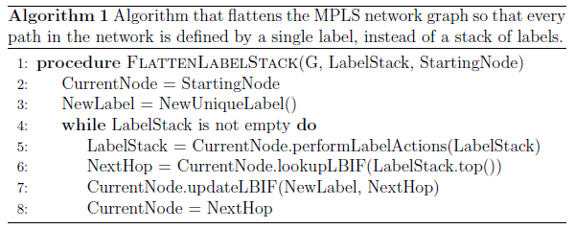
Find Path
First generating MPLS network with MPLS label (Stack of labels)
Label Flattening Operation: Every path through the graph is identified by a single label
Label Matching can be generated online based on DFS after user request
Runtime: O(UN):
ingress routers U and the total number of nodes in the system N

Slide 11
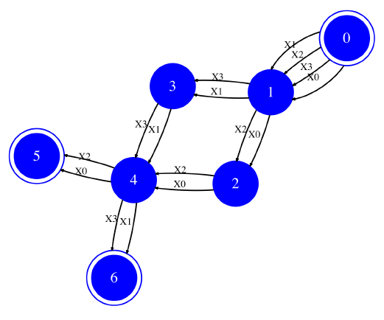
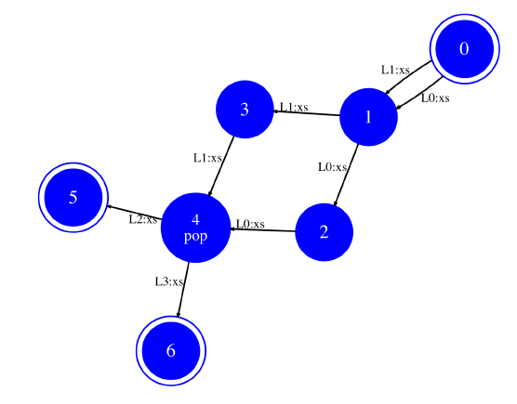
Algo.
Original MPLS stacked Label
Modified label

Slide 12
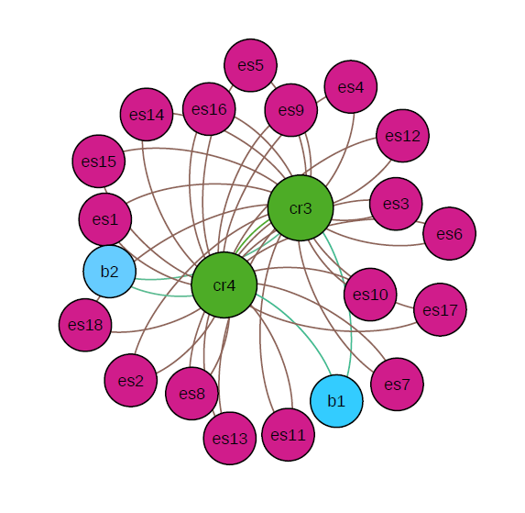
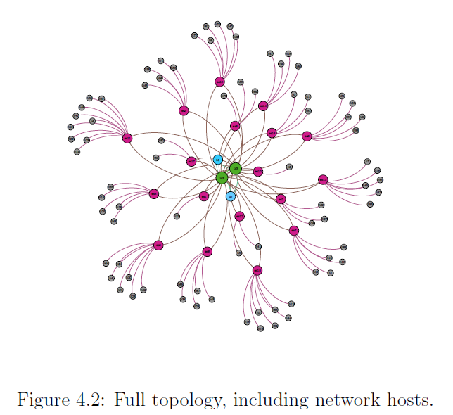
Evaluation
Data set from actual data center traffic [18]
Switch topology built by Mininet
Edge switches
Core switches
Gateway
[18] T. Benson, \Quality of service networking."

Slide 13
Experiment
if the switch does not have a matching rule, and additional latency is introduced
When a switch's flow table was filled, we used a random eviction policy to make room for the next flow rule.
The rule list was generated using an LDP-based scheme ( Label Distribution Protocol )
966,000 packets with 404 unique labels over a 110-second timespan

Slide 14
Total flow misses
Core switches

Slide 15
Hits rate

Slide 16
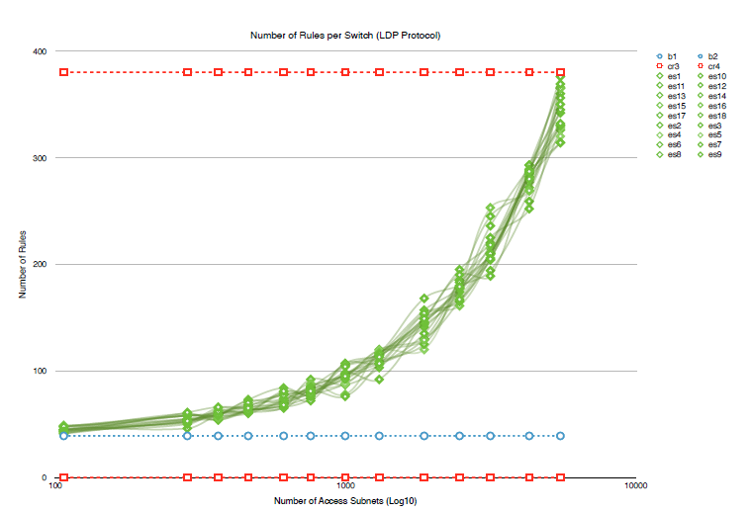
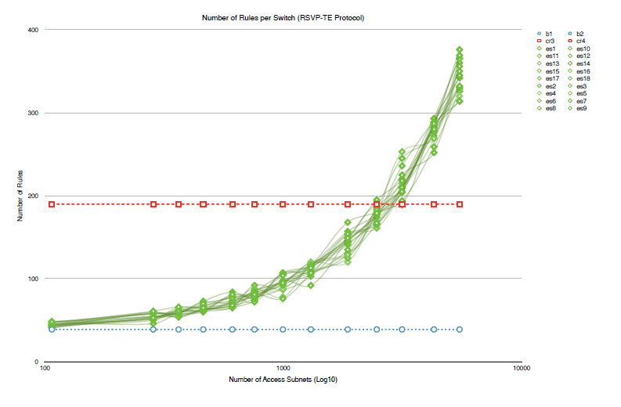
Number of rules per Switch
LDP scheme
RSVP-TE：Resource ReSerVation Protocol-Traffic Engineering

Slide 17
Question
Casts doubt on our initial reasoning for choosing to implement label matching in the MAC tables of core switches ?!?!

Slide 18
Different to our solution
Their solution | Our MPLS Tunnel
Store label in packet’s dest. MAC address field | MPLS label field
Store Path info. in MAC address Table | Insert path in Path table (using TCMA)
Using MPLS Algo. To find the path first | Consider link utilization on tunnel finding
DFS to find path | BFS to find tunnel
NA | Using pre-built tunnel to lower initialization time
NA | Using Binary search to find minimized utilization

Slide 19
To-do
Symbol table
Change Link duplicated policy to let each link can support k tunnel
Summarize related work
Prepare for QAC

