Slide 1
Measurement Study of Multi-party Video Conferencing
Yue Lu, Yong Zhao, Fernando Kuipers, and Piet Van Mieghem
Delft University of Technology, P.O. Box 5031, 2600 GA Delft, The Netherlands

Slide 2
Agenda
Introduction
Survey
Experiment Set-Up
Measurement Result
Worst-case Study
Summary and conclusion

Slide 3
Introduction
Investigating the mechanisms, analyzing the system performance, and measuring the quality of free multi-party video conferencing applications are important objectives for researchers, developers, and users.

Slide 4
Aim to do
This paper focus on study free applucations that provided multi-party (>2 users) video conferencing (VC) on the Internet.
The questions:

Slide 5
Survey

Slide 6
Set-Up
Mebeam
web-browser based S/C with a single server center.
Qnext (version 4.0.0.46)
centralized P2P. The node which hosts the meeting is the super node.
Vsee (version 9.0.0.612)
decentralized full-mesh P2P.
Nefsis (free trial version)
S/C, network of distributed computers as servers.

Slide 7
Experiment
Two type of experiments
local lab experiments
Composed of standard personal computers participating in a local video conference.
global experiments
learn more about the network topology, traffic load and quality of experience(QoE), when a more realistic international video conference is carried out.

Slide 8
Experiment (cont.)
To retrieve results, they used the following applications at each participant:
Jperf
to monitor the end-to-end available bandwidth during the whole process of each experiment.
e2eSoftVcam
to stream a stored video via a virtual camera at each VC participant.

Slide 9
Experiment (cont.)
Camtasia Studio 6.
Because all applications use an embedded media player to display the Webcamera streaming content, we have to use a screen recorder to capture the streaming content.
Wireshark
to collect the total traffic at each participant.

Slide 10
Measurement result
Login and call establishment process
Mebeam
uses TCP to transfer the signals, and RTMP to transfer video and audio data.
Qnext
uses TCP for signaling and UDP for video communication among participants.

Slide 11
Measurement result (cont.)
Login and call establishment process
Vsee
The communication among users is usually of the P2P type using UDP, with automatic tunneling through a relay if a direct connection is not available.
Nefsis
uses TCP for signaling and delivering streaming data.

Slide 12
Average traffic load

Slide 13
Average traffic load (cont.)
Observations
The traffic does not necessarily increase as more users join the conference.
Hence, we believe that in order to support more simultaneous conference participants, the overall traffic has to be controlled.

Slide 14
Quality of Experience (QoE)
Video Quality
In the objective measurements, we use bVQM (Batch Video Quality Metric) to analyze the VC’s video quality off-line.
bVQM takes the original video and the received video and produces quality scores that reflect the predicted fidelity of the impaired video with reference to its undistorted counterpart.
The bVQM score scales from 0 to approximately 1. The smaller the score, the better the video quality.

Slide 15
Quality of Experience (QoE)

Slide 16
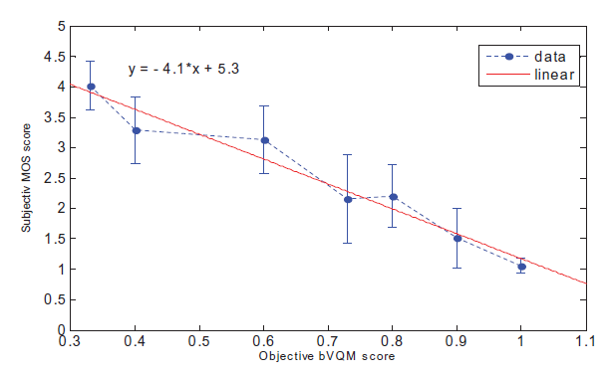
Quality of Experience (QoE)
average Mean Opinion Score (MOS)
5=excellent, 4=good, 3=fair, 2 = poor, 1 = bad.

Slide 17
Quality of Experience (QoE)
Audio-Video Synchronization
Interactivity (communication delay)
Large communication delay implies lack of real-time interactivity in our global multi-party VC experiments.

Slide 18
Video delay

Slide 19
Worst-case study
The four free multi-party VC application all cannot provide good quality in unstable Internet connections.

Slide 20
Conclusion
It seems that the Server-to-Client architecture with many servers located all over the world is currently the best architecture for providing video conferencing via the Internet, because it introduces the least congestion at both servers and clients.

