Slide 1
Network Store: Exploring Slicing in Future 5G Networks
Navid Nikaein, Eryk Schillerx, Romain Favraud, Kostas Katsalis, Donatos Stavropoulos, Islam Alyafawix, Zhongliang Zhaox, Torsten Braunx, and Thanasis Korakis
EURECOM, University of Bern
ACM MobiArch’15

Slide 2
Motivation
5G technologies aim to provide
End-to-end infrastructure that will include all aspects of the network
Provisioning processing power on-demand
Key enabler
Network Abstraction => (Software-Define Networking)
Virtualization => (Network function virtualization)

Slide 3
Problem of current cellular networks
Does not fit the cloud concept in terms of scalability and reliability
Strong coupling between control and data planes
State-full design
Dependency to dedicated hardware (expensive)

Slide 4
Introduction
Design of a 5G-ready architecture
NFV-based Network Store that can serve as a digital distribution platform for 5G application use-cases
provide programmable pieces of code that on-the-fly reserve required resources
deploy and run the necessary software components
Configure and program network elements according to the SDN and NFV
Provide the end-user with a 5G slice that perfectly matches the demands

Slide 5
Network Store
Service-oriented network architecture
Programmable and extensible in terms of infrastructure, network services, and applications
Network slicing to operate virtual networks on top of physical infrastructures, with virtual resource isolation and virtual network performance guaranties.

Slide 6
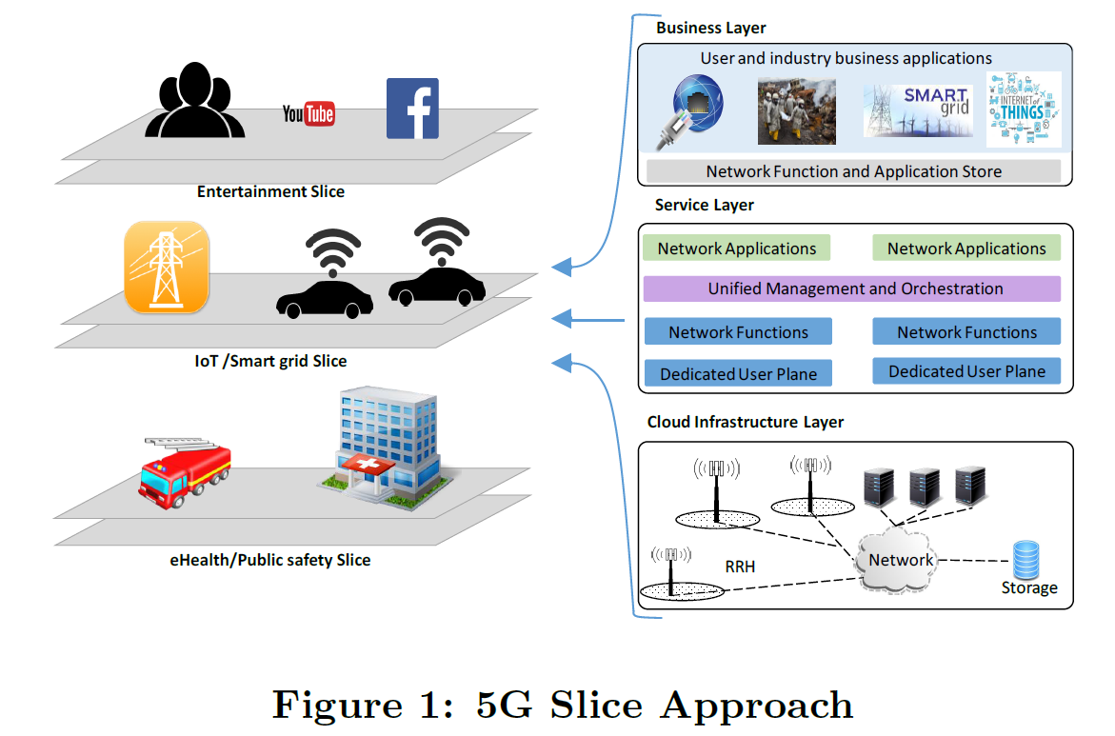
Slicing-Enabled 5G Architecture
Business Layer: creates the slice that encodes all the details required to deploy the service bundle
Service layer supports the creation, and configuration of the service bundle
Infrastructure layer supports the real-time reconfigurable cloud ecosystem and virtualization

Slide 7
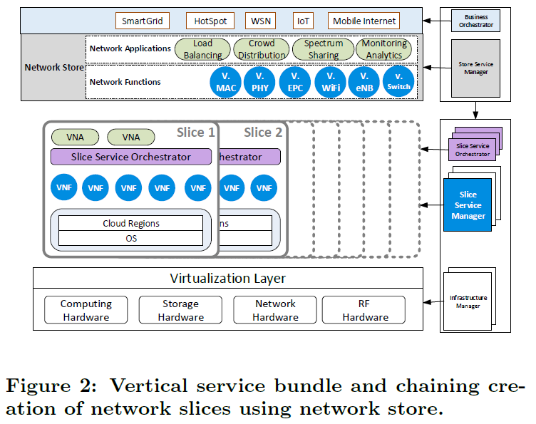
Network Slice

Slide 8
Infrastructure Layer
Programmable Computing, Network and Storage Hardware
maximize the infrastructure utilization => dynamically and freely relocate hardware resources on demand
NFV enables for extreme flexibility when it comes to the micro-service
leverage SDN technologies and programmable data plane technologies to support advanced programmability
E.g. JUJU Charm framework that
model, build and scale each service bundle on any cloud
Metal As a Service (MAAS) are able to program physical severs
Enabler for programmable cloud

Slide 9
Infrastructure Layer
Programmable RF Hardware
RRH can be equipped with the Field Programmable Radio Frequency
(FPRF) technology (e.g., FPGA-based Myriad-RF) to allow for RAN programmability
Radio Fronthual Archi.
Ethernet-based fronthaul network will significantly simplify and lower the price of the cloud network infrastructure for telecommunications

Slide 10
Service and Business Layer
Business layer provides functionalities for both the infrastructure and business layers through a Network Store
Network Function Store: VNF programming (such as virtual eNB, EPC, HSS of the LTE network)
Network Application Store: Provide a feature-rich service (Localization services, Caching application) *Depending on the timing requirements, they can be placed either close to (particular) VNFs at the edge cloud or close to other VNA at the centralized cloud.

Slide 11
LTE as Service(LTEaaS) - Prototype
Portable OpenStack-based data center, with a specific configuration that satisfies the needs of deadline critical applications
Intel Linux (Ubuntu), low-latency 3.17
OpenStack with Heat to manage the entire life-cycle of a virtual infrastructure and applications
LTEaaS slice using a single Heat orchestration Template
Specifies the LTE network elements
initial parameters
Networking requirement

Slide 12
LTE eNB requirements
OpenStack to use LXC as its virtualization technology to achieve a near bare metal performance
In LTE-FDD, the total RX (UL) + TX (DL) processing should take less than 3 ms to comply with HARQ deadlines
Processing load is mainly dominated by uplink and increases with growing PRBs and MCSs

Slide 13
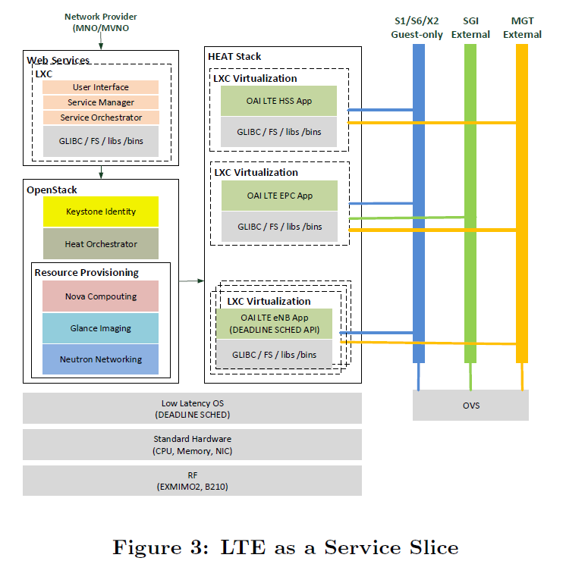
Provisioning of LTE eNB
OAI platform on LXC
50 PRBs => 10 Mb/s
Only 4 uplink sub-frames (SFs) are granted by the eNB
two Linux OS schedulers are used, namely SCHED FIFO and SCHED DEADLINE
Dongle as UE
Using iPerf

Slide 14
Results
OS is not loaded

Slide 15
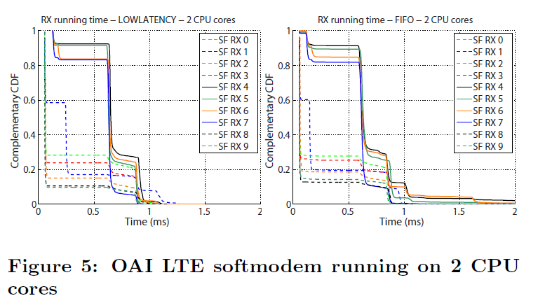
Loaded
0.6% of lost SFs caused by the scheduler not meeting
the deadlines

Slide 16
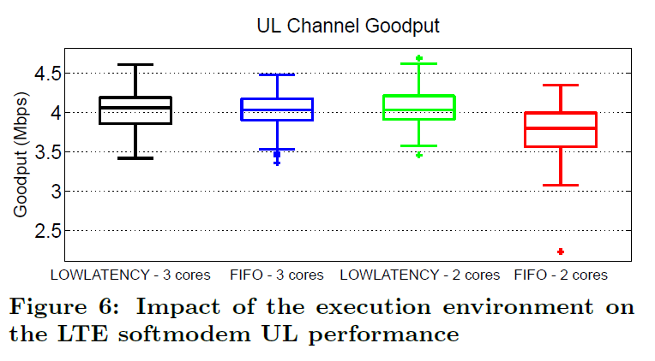
it reduces the average goodput by more than 6%

Slide 17
Conclusion
Slice-based 5G architecture
NFV, SDN, and cloud-computing to efficiently manages network slices
‘’Network Store in a programmable cloud“ allowing for dynamic network slicing.

