Slide 1
On Scalability of Software-Defined Networking
S.H. Yeganeh, A. Tootoonchian, Y. Ganjali
University of Tronto
IEEE Communication Magazine

Slide 2
Motivations
There have always been concerns about performance and scalability about SDN
Argue that there is no inherent bottleneck to SDN scalability
Often came from implicit and extrinsic assumption
These problems are also faced by traditional networks
If carefully implemented, these problems can be avoided, ex: implemented as distributed system

Slide 3
Discussed Scalability Issue
Scalability of controller (major)
Flow Setup overhead
Resilience to failures

Slide 4
Controller Scalability
Early benchmark of NOX
Only handle 30K requests while maintaining a reasonable flow install time (sub-10ms)
Two way to solve this problem
Improve the parallelism, improve IO performance
Implement as distributed system

Slide 5
Controller Scalability
Improve the parallelism, improve IO performance
Parallel version of NOX (HOT-ICE 2012)
DIFANE (SIGCOMM 2010)
DevoFlow (SIGCOMM 2011)
Implement as distributed system
Onix (OSDI 2010)
HyperFlow (INM/WREN 2010)
Kandoo (HotSDN 2012)

Slide 6
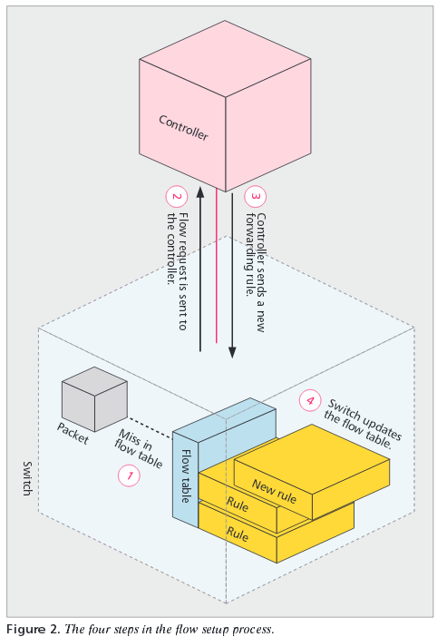
Flow Initiation Overhead
Early design such as Ethane and NOX makes people think flows have to be reactive
This is not true
Two possible way
Aggregate rules
Proactively install rules
DIFANE in some way did this

Slide 7
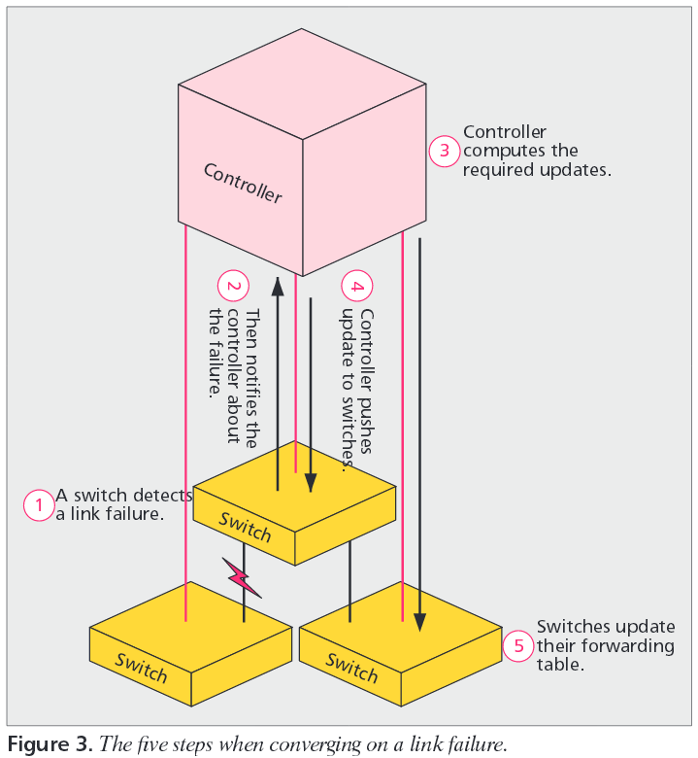
Resiliency To Failures

Slide 8
Resiliency To Failures
Early design use only one centralized controller
This doesn’t have to be the case
Link failure notification
Traditional: flooded across the network
SDN: switch to controller (info propagation delay is no worse, and a controller dedicated to deal with the problem)
Not worse than traditional network
Similar techniques can be applied, ex: preprogrammed backup paths

Slide 9
Scalability In Different Settings
Data Centers
Large number of devices, controller will be overload
Use proactive install rules but sacrifice precision and reactivity
Use distributed system if those can’t be sacrifice
Service Provider Networks
Geographically distributed, worsen the latency issue
Partition into regions
High number of flows
Aggregated rules

Slide 10
Other Topic
Behavioral and Programming Abstractions
Ease of management
Testing and Verification
Ease of troubleshooting
Extensibility
How to support more protocols

Slide 11
Conclusion
Argue the scalability concern
Are neither caused by nor fundamentally unique to SDN
Can be addressed without losing the benefit of SDN
Emphasize the potential gain on other topics

