Slide 1
OpenFlow MPLS and the Open Source Label Switched Router
ITC’11
James kempf et al.
Google.com and Stanford.edu

Slide 2
Introduction
Modify the open flow packet header
MPLS Label stack
Add the actions of MPLS to openflow
Virtual port: allow the data plane to do the actions
Allow controller to control the MPLS path
NetFPGA Implementation
Open source label switched router

Slide 3
Modify the packet header
Increase the size of the tuple used for flow identification to add the MPLS Label stack
Label 1 define the services (ex: VPN), Label 2 define the transport tunnel.

Slide 4
Add the actions of MPLS
Virtual port: an isolated abstraction. Rather than inserting the MPLS protocol actions into the basic OpenFlow packet.
Actions:
Push
Pop
Swap
The OpenFlow protocol was extended with the following messages to allow the controller to program label switched paths (LSPs) into the switches

Slide 5
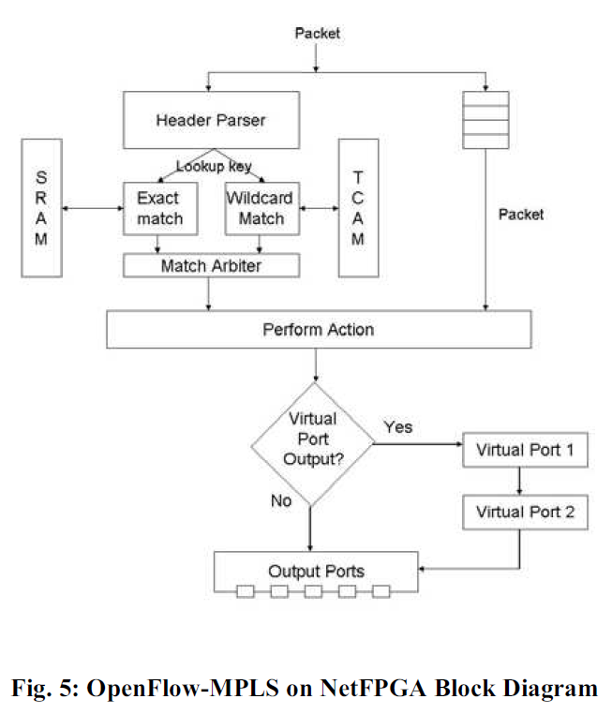
NetFPGA Implementation
2000$ US dollars

Slide 6
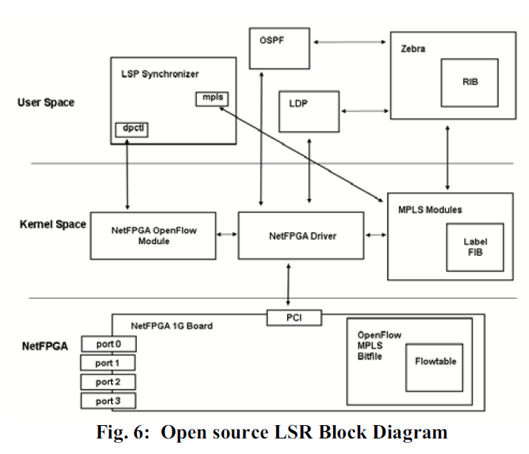
Open source label switched router
NetFPGA: receive the pakcet
LDP daemon: allows two devices to form an adjacency and establish label bindings for label switched paths
LSP Synchronizer: polls the MPLS LFIB in the kernel periodically for changes

