Slide 1
Opportunistic routing in wireless sensor networks powered by ambient energy harvesting
Z. Ang Eu , H. Tan , W. K.G. Seah

Slide 2
Outline
Introduction
Purpose
System model
Protocol
Compare
Conclusion

Slide 3
Intoduction
To Extending network Lifetime. The finite energy sources (e.g. Batteries) will restrict to lifetime.
Using ambient energy harvesting technologies. Make it possible for sensor nodes to rely on energy harvesting devices for power. (i) Power from environment(e.g. Solar, Wind….) (ii) Without human intervention to change batteries. (iii) Perpetually using.

Slide 4
Purpose
EHOR increases goodput and efficiency. Compared to traditional opportunistic routing protocols and other non-opportunistic routing protocols suited for WSN–HEAP (Sensor networks powered by ambient energy harvesting).

Slide 5
WSN–HEAP node
Once the stored energy reaches an useful level, the node will be operable. During the charging phase, the node is idle.
the wakeup timings of the sensor nodes cannot be predicted in advance because the time required to charge up the sensor node fully is dependent on environmental factors.

Slide 6
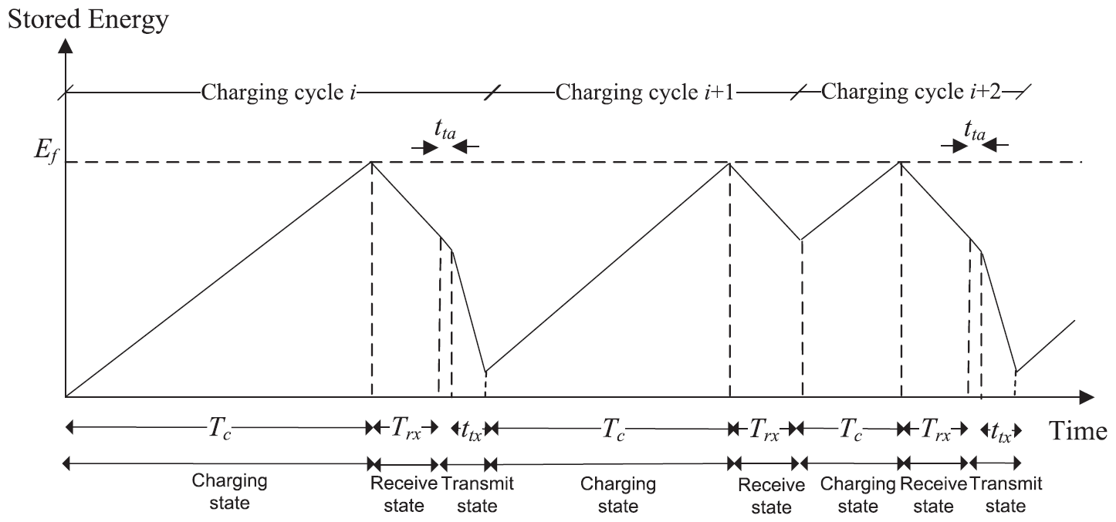
Types of Node
Relay, Source and Sink nodes
Node Status: charging, receive and transmit

Slide 7
Energy Harvesting Opportunistic Routing Protocol (EHOR)
Partitions nodes into regions. region-based approach by grouping nodes together to reduce delay and increase goodput.
Assigns transmission priorities to regions, taking into consideration proximity to the sink and residual energy.

Slide 8
Principle(1/2)
Maximize goodput: increase (i) the number of WSN–HEAP nodes or (ii) the average energy harvesting rate (by using better energy harvesters).
Maximize data delivery ratio: minimizing the number of lost packets.
Maximize efficiency: minimize the number of duplicate packets to sink.

Slide 9
Principle(2/2)
Maximize fairness: Jain’s fairness metric Gi : goodput of ith sensor node ns : number of sensor nodes
If the sink receives the same amount of data from all the sensor nodes, F is 1. If the sink receives data from only one node, then F→0 as n→∞

Slide 10
Regioning in EHOR
Determine the best forwarding candidates to forward the data packets while minimizing coordination overheads and duplicate transmissions.
Challenge: we cannot determine the exact identities of nodes that are awake at any time. => EHOR divides the possible set of forwarding neighbors into several regions.

Slide 11
Region ID
Forwarding region(between sender and sink)
K is number of region
n1:Number of node is a region d :maximum transmission range X :Length of area P :probability that a node receives a packet ttx : Time to send a packet trmax : Maximum time in the receive state tta : Hardware turnaround time from receive to transmmit state E[Tc]: Average charging time
Notes:
size of a data transmission (including all headers) be sd bits and the transmission rate of the sensor
node be a bps.

Slide 12
Region Priority
Determine the transmission priority.

Slide 13
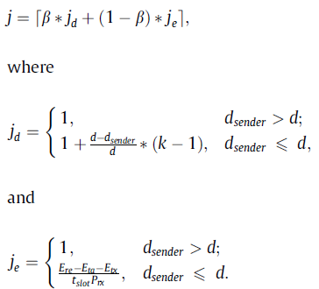
Joint the residual energy
Ere: Remaining energy of the node at the end of the packet reception from the sender Eta:Energy required to change state (from receive to transmit) Etx:Energy required to send a data packet Prx:Power needed when the sensor is in receive state
Notes:
tprop is the maximum propagation delay. change from receive state to transmit state, is denoted by tta. transmit one data packet ttx

Slide 14
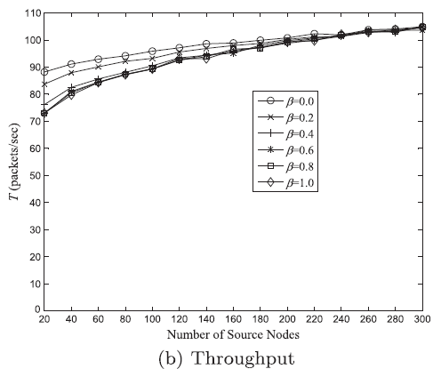
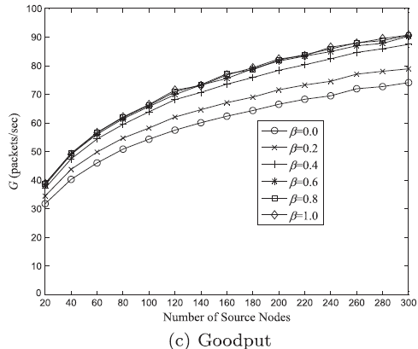
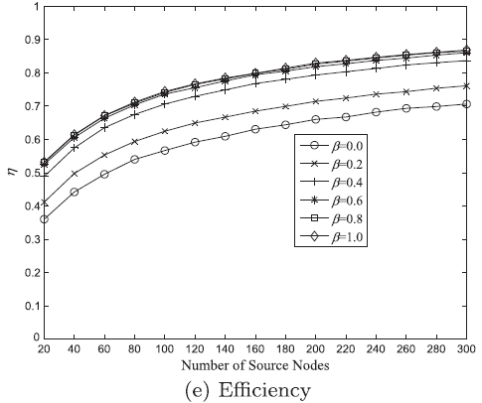
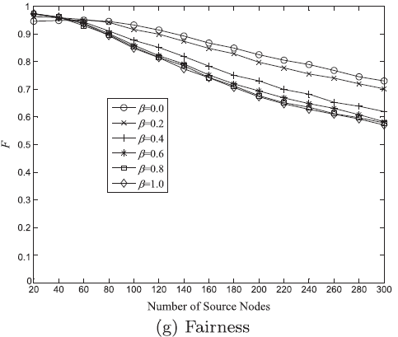
Choose β
Efficiency (g) is the ratio of goodput (G) to throughput (T)
Use Qualnet network simulator to assess the performance
Choose β=0.6

Slide 15
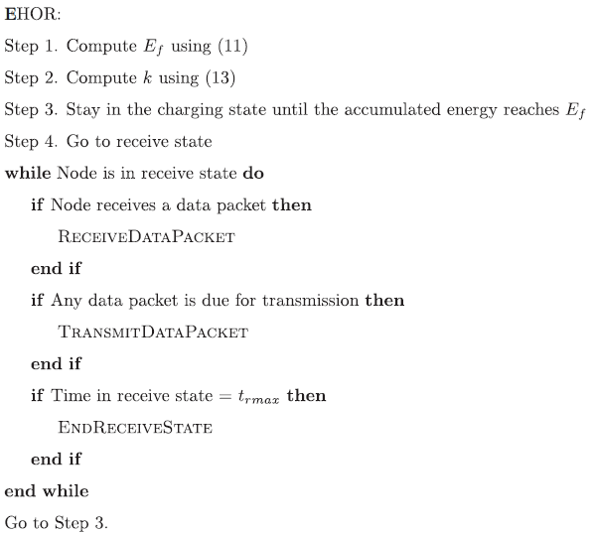
Algorithm(1/2)

Slide 16
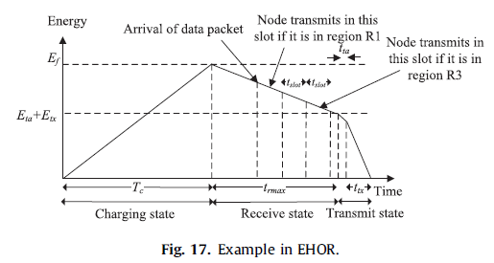
Algorithm(2/2)
Node can only wait for 3 time slots.
If node in R4, it has to drop the data packet since it has insufficient energy to wait for the 4th time slot to transmit.
If node in R1, it will transmit the data packet immediately upon receiving the data packet.
If node in R3, it will wait for 2 time slots in order to overhear whether other nodes in R1 and R2 have relayed the data packet. If it overhears that the data packet has already made progress towards the sink, the node will not relay the data packet.

Slide 17
Compare- OR
Opportunistic routing (OR)
(1) Regioning helps to improve performance by grouping
(2) By considering residual energy, each WSN– HEAP node has a higher probability of forwarding the received packet, thereby increasing goodput.

Slide 18
Compare- GR-DD
Geographic Routing with Duplicate Detection (GR–DD)
(1) The receive period is fixed in GR–DD but is variable in EHOR, thereby reducing the number of MAC collisions through using less transmissions and utilizing more long-distance links.

Slide 19
(2) GR–DD needs non-volatile memory as packets received need to be stored in the buffer for transmission in future. (3)Unlike EHOR, GR–DD is not an opportunistic routing protocol since it does not attempt to overhear whether the packet has already made progress before transmission.

Slide 20
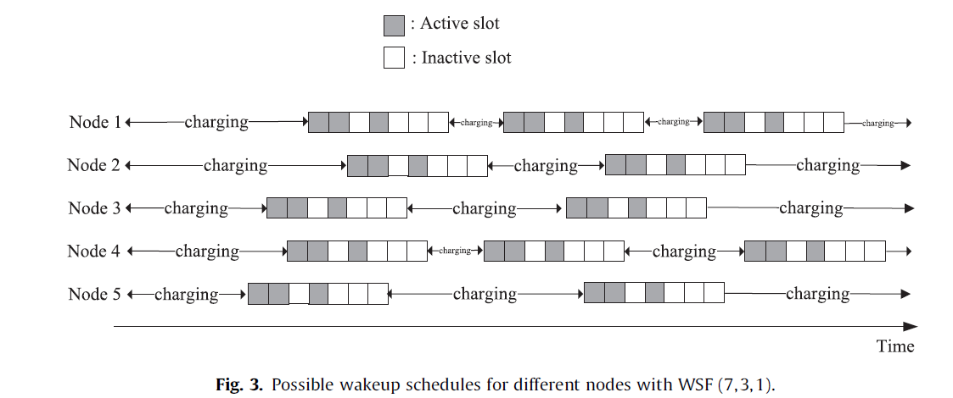
Compare- WSF
Wakeup Schedule Function(WSF)
(1) A successful data transmission requires the reception of three packets: the beacon packet, the data packet and the ACK packet. there would be duplicate packets since the sender has to retransmit the packet to possibly another forwarder. For EHOR, only the reception of the data packet.
(2)EHOR, like other OR schemes in general, uses the broadcast nature of the wireless medium to send the packets to as many forwarding nodes as possible while WSF uses unicast routing.

Slide 21
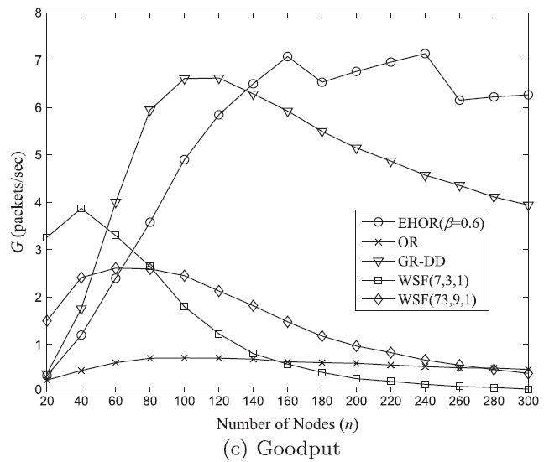
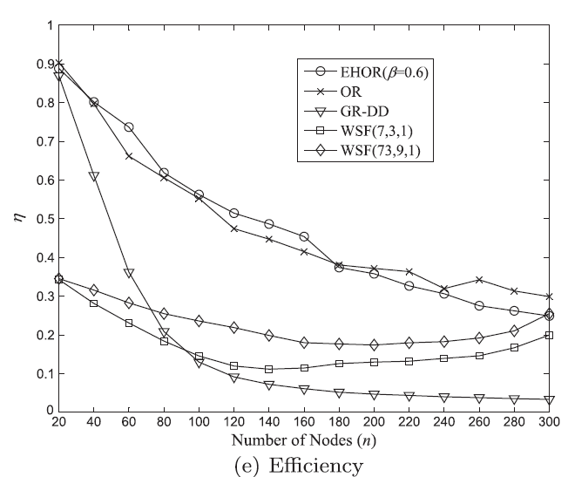
single-source n = 20–300, ns = 1

Slide 22
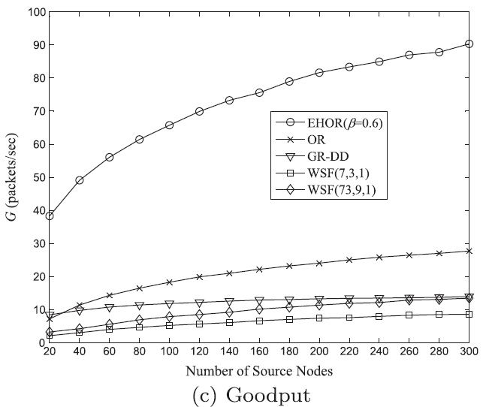
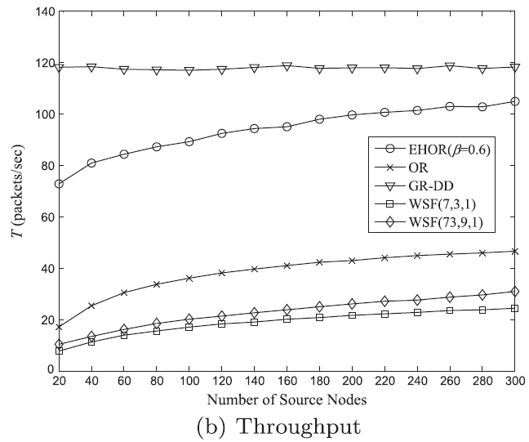
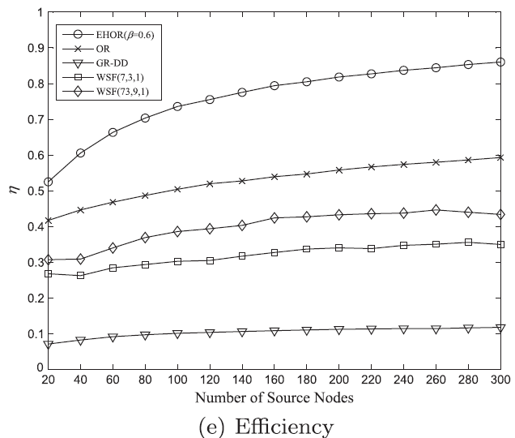
varying number of source nodes n = 300, ns = 20– 300

Slide 23
Conclusion
Use a regioning approach to group nodes together in EHOR to reduce delay and improve goodput
Improve EHOR’s performance by taking into consideration the amount of residual energy in each node in
EHOR achieves high goodput, efficiency, data delivery ratio and fairness.

