Slide 1
Real Time Top-N Recommendation in Social Streams
[ACM RecSys 12]
Ernesto Diaz-Aviles , Lucas Drumond , Lars Schmidt-Thieme , and Wolfgang Nejdl
Presented by
NTHU NMSL Shu-Ting Wang

Slide 2
Agenda
Basics of Recommendation
Introduction
Stream Ranking Matrix Factorization
Experiment

Slide 3
Agenda
Basics of Recommendation
Introduction
Stream Ranking Matrix Factorization
Experiment

Slide 4
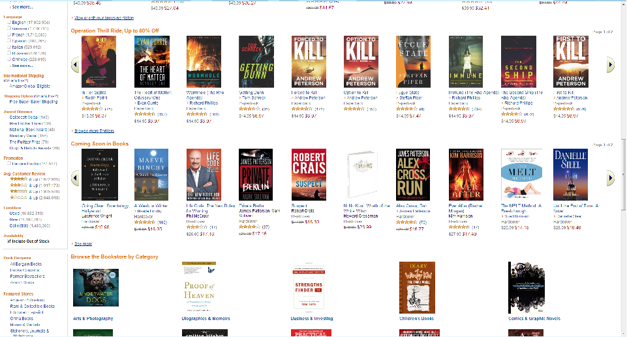
Why Recommendation?
To deal with information overload
EX: Amazon, Youtube…etc
To provide personalized service as a skilled waiter

Slide 5
How To Recommend?

Slide 6
How To Recommend?
Content-based recommendations
Collaborative recommendations
Hybrid approach

Slide 7
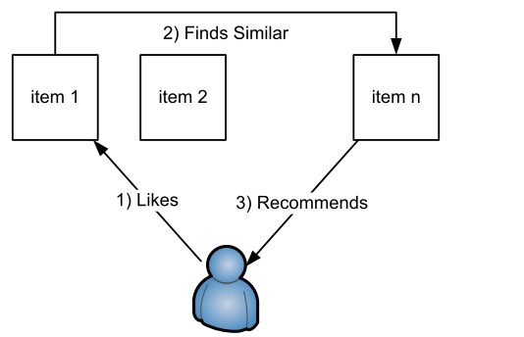
Content-based Recommendations
The user will be recommended items similar to the ones the user preferred in the past

Slide 8
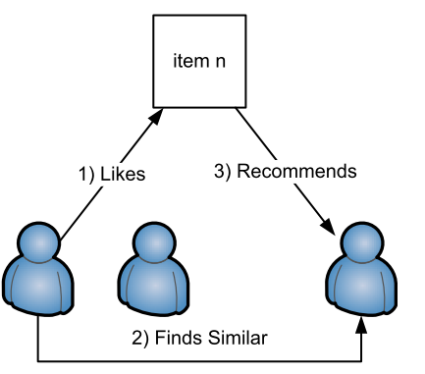
Collaborative Recommendations
The user will be recommended items that
people with similar tastes and preferences
liked in the past

Slide 9
Agenda
Basics of Recommendation
Introduction
Stream Ranking Matrix Factorization
Experiment

Slide 10


Usage Scenario
To ﬁlter a continuous stream of incoming tweets in to recommend topics that match user interests at a speciﬁc moment
Tweets Stream
Matched Topics
Topic Filter

Slide 11
Approach
Use hashtags to represent topic interests of users
Collaborative Filtering(CF) are good at generating low dimensional linear factor models.
With the high precision, CF takes a long time that is not suitable for real time recommendation tasks.

Slide 12
Agenda
Basics of Recommendation
Introduction
Stream Ranking Matrix Factorization
Experiment

Slide 13
Matrix Factorization
Typical CF organizes a tuple(user,item,rating) as a sparse matrix
Low dimensional models are useful for considering only a small number of latent factor
Matrix factorization is a realization of above models.
We interest in pairwise ranking method for matrix factorization.

Slide 14
Main Steps
Social Media Stream
Sample the Stream: Reservoir Sampling
Stream Ranking Matrix Factorization RMFX:
Pairwise Approach for Personalized Rank Learning
Using Selective Model Updates from Small Buffers
Personalized Recommendations

Slide 15
Agenda
Basics of Recommendation
Introduction
Stream Ranking Matrix Factorization
Experiment

Slide 16
Evaluation Metric
Method: leave-one-out holdout
Recall(hit rate): Recall is widely used for evaluating recommender systems
Precision is not considered here, since it is forced taking into account only a restricted number of recommendations

Slide 17
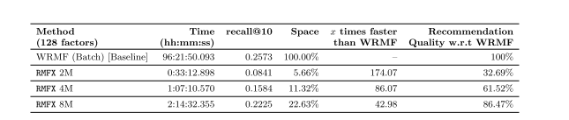
Real Time Performance

Slide 18
Conclusion
Consider real time recommendation with limited buffer that may be deployed to mobile devices with resource constraint.
Provide a way to implement recommendation engine for topics in social stream.

