Slide 1
Using Scalable Video Coding for Dynamic Adaptive Streaming over HTTP in Mobile Environments
Christopher Müller, Daniele Renzi, Stefan Lederer, Stefano Battista, Christian Timmerer

Slide 2
Introduction
DASH
Already exist industry player which are using HTTP streaming server.
Convenience for the an user and streaming provider.
SVC
Enhance the flexibility of segment selection.
Goal
Improve their existing MPEG-DASH.
The buffer model

Slide 3
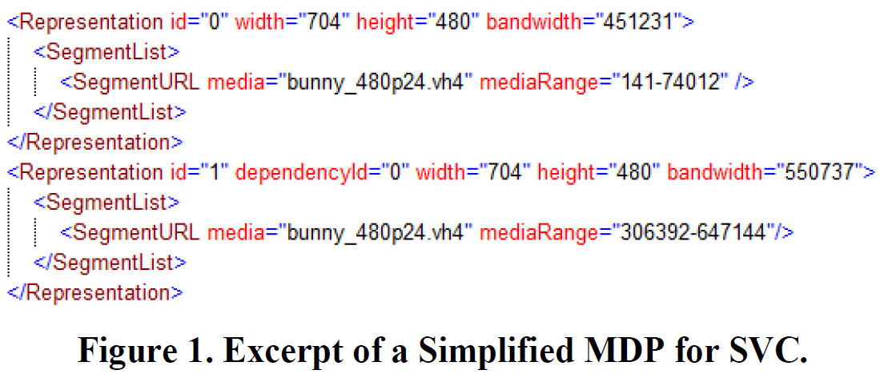
Integration of SVC into MPEG-DASH
Base layer
Enhancement layer
Notes:
Based on ISOBMFF, only used elementary streams and described the layer dependency
ISO Base Media File Format (ISOBMFF)
Elementary streams ??

Slide 4
Experiments (1/5)
DASH Content
AVC
14 different bitrates with X264
GOP size : 48 frames
SVC
13 different bitrates (1 base, 12 enhanc.) with their own encoder
GOP size : 48 frames
Each layer depends on the previous one.
Notes:
AVC : 100, 200, 350, 500, 700, 900, 1100, 1300, 1600, 1900, 2300, 2800, 3400, 4500 kpbs
SVC : 450, 550, 650, 700, 1100, 1300, 1500, 1800, 2300, 2600, 3000, 3500, 4700 kpbs
Selection of Coarse-Grain Scalability (CGS) and Medium-Grain Scalability (MGS)

Slide 5
Experiments (2/5)
Bandwidth Traces
Under three different network emulation settings (tracks 1-3)
Evaluation Metrics
Average bitrate
Number of quality switches
Number of unsmooth seconds
Buffer Level
Notes:
Average bitrate : overall performance of the system
Number of quality switches : high frequent switching indicate decreased Quality of Experience
Buffer Level : current fill state of the buffer, indicator stability of the system.
Number of unsmooth seconds : also influence QoE, can be derived from the buffer level and time of buffer is empty.

Slide 6
Experiments (3/5)
Experimental Setup
Bandwidth Shaping
Control bandwidth for the client
Network Emulation
Control all network parameters such as RTT = 150ms
HTTP server
Apache Web server
All are Ubuntu 10.04

Slide 7
Experiments (4/5)
MPEG-DASH and AVC
Based on their VLC plugin
Content has been generated using DASHEncoder which is a wrapper tool for X264 and MP4Box container.
Use buffer model
Notes:
Buffer model aim to reduce the number of quality switches and to enable a smooth playback

Slide 8
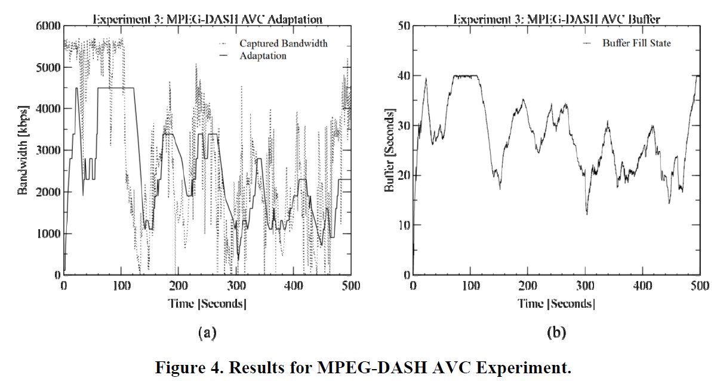
MPEG-DASH and AVC
Notes:
當 buffer 40% 時，只能收 bitrate 小於 900 的 segment，感覺像是想要取得某個 bitrate 的 segment 所以要用的 buffer % 數
虛線是抓到的網路頻寬，實線是選擇的 bitrate 的 segment ，在 190 or 290，有反應 bandwidth 下降的情況，在 150 and 300 的地方，發現可以 bandwidth 提高，所以 quality level 也提升。
Buffer in seconds 應該是存在 buffer 裡的資料可以提供播放的時間，這將不會導致 stall。
Buffer model aim to reduce the number of quality switches and to enable a smooth playback.

Slide 9
Experiments (5/5)
MPEG-DASH and SVC
Client based on Windows.
The dash library only available for windows.
Be able to cancel requested segment
More aggressive buffer model

Slide 10
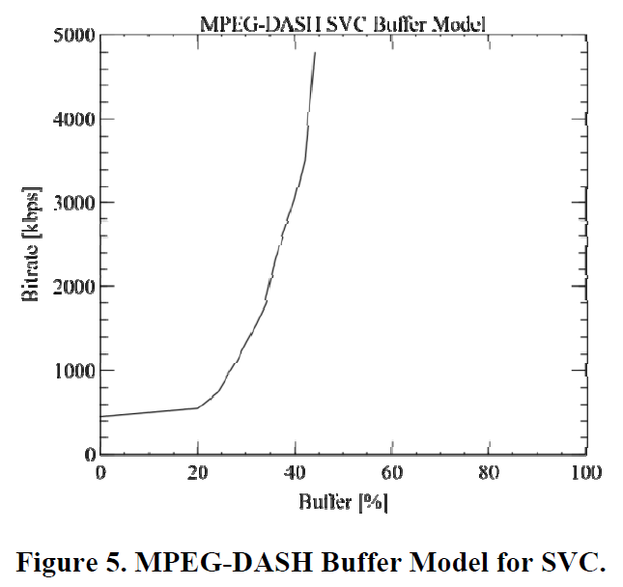
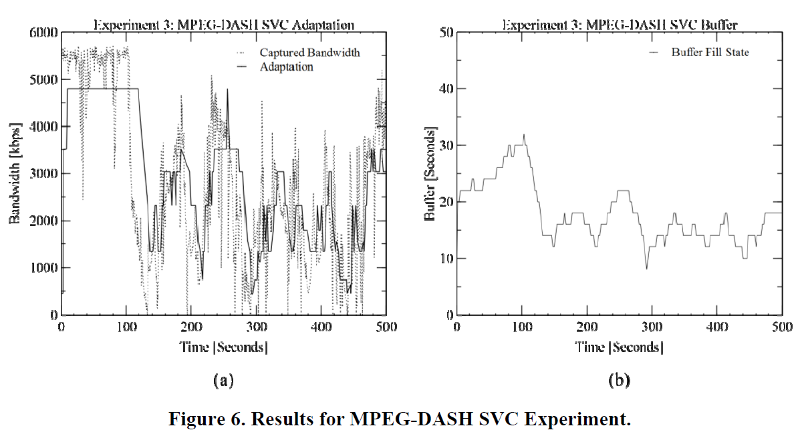
MPEG-DASH and SVC

Slide 11
Comparison with Existing Approaches

Slide 12
Conclusions and Future Work
An exponential buffer model allows for a better utilization of the available bandwidth.
SVC layered coding structure allows for more flexibility.
Actual impact on the QoE is subject to future work.
Help to improve their adaptation logic for DASH.

Slide 13
Related Work
Focus on cache performance and encoding.
iDASH: Improved Dynamic Adaptive Streaming over HTTP using Scalable Video Coding - 2011
ISO Base Media File Format (ISOBMFF)
Implications of the ISOBMFF on Adaptive HTTP Streaming of H.264/SVC. – 2012
Evaluated exist industry player used different test content for each system.
An experimental Evaluation of Rate-Adaptation Algorithms in Adaptive Streaming over HTTP - 2011
HTTP streaming under vehicular mobility within 3G mobile networks.
Empirical evaluation of HTTP adaptive streaming under vehicular mobility - 2011

