Slide 1
Structural Analysis of User Association Patterns in University Campus Wireless LANs
Wei-Jen Hsu, Debojyoti Dutta, and Ahmed Helmy
IEEE Transactions on Mobile Computing

Slide 2
Contributions
Construct representations of user behavior
Quantify similarity metrics between users
User mobility on university campuses as a case study

Slide 3
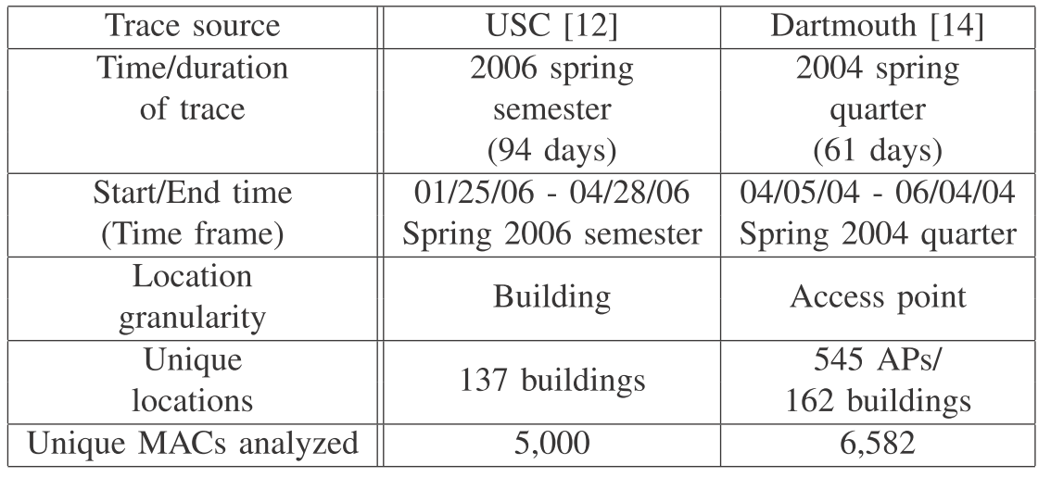
Data Set

Slide 4
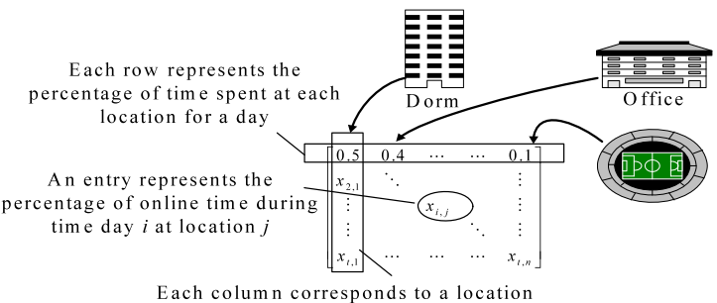
Association matrix representation

Slide 5

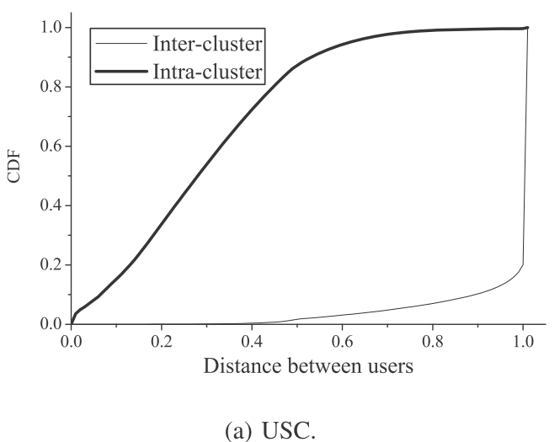
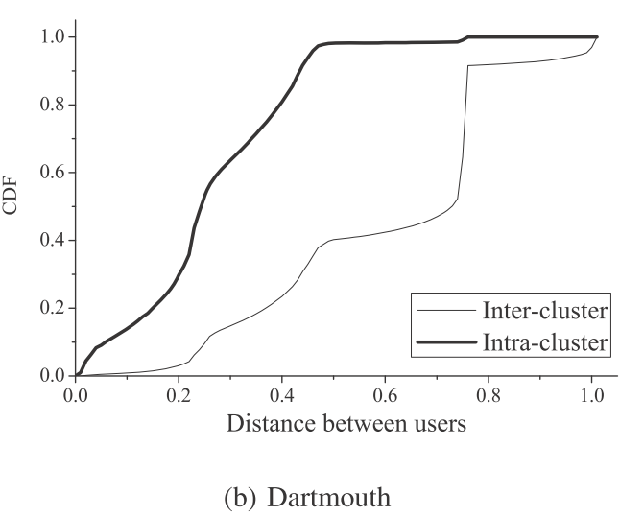
Average minimum vector distance (AMVD)
Complexity: O(N²t²)

Slide 6

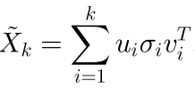

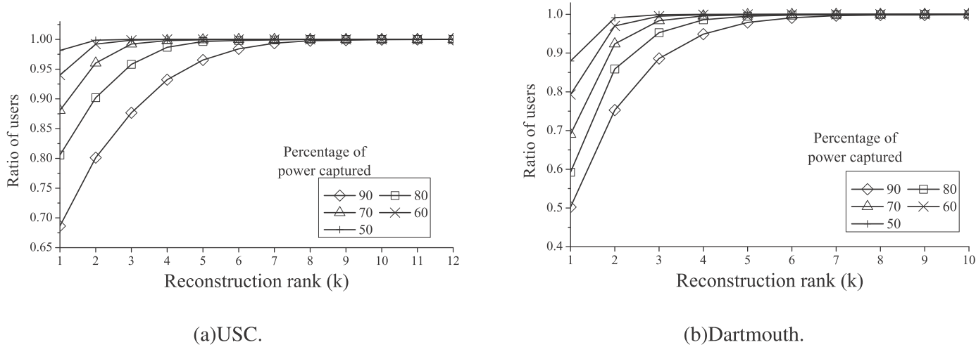
Summarization Methods
Singular Value Decomposition (SVD)
Rewrite SVD to:
Rank-k approximation of matrix X :

Slide 7


Eigen-Behavior Distance
$$w_{j}= {{σ_{j}}^{2}}/{\sum_{i=1}^{r}{{σ_{i}}^{2}}}$$

Slide 8
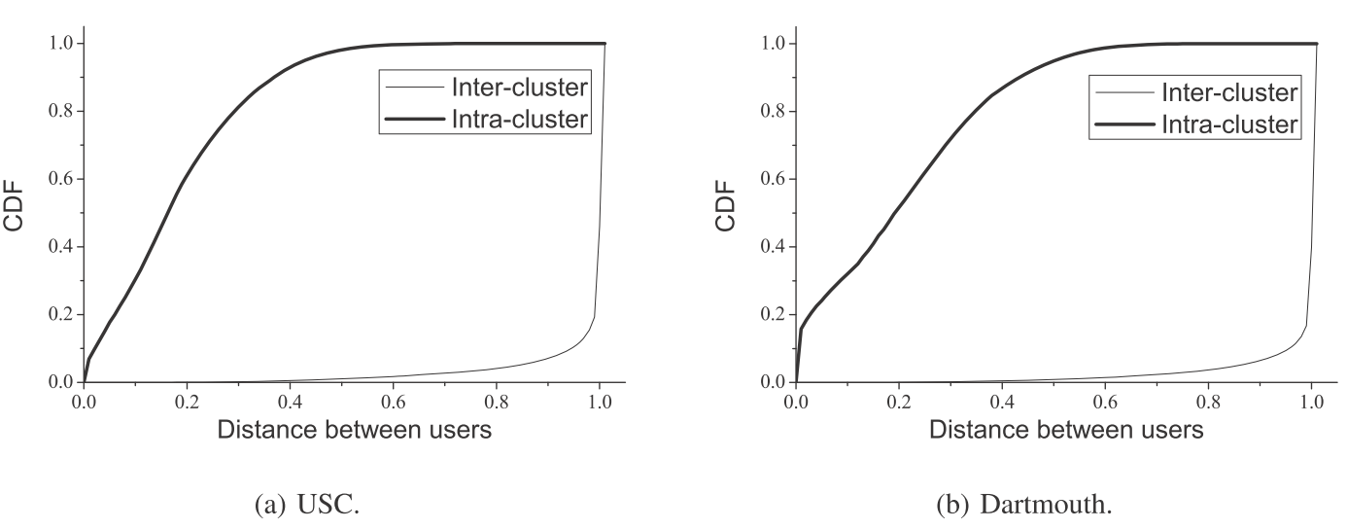
Clustering Users by Eigen-Behavior Vectors
Reduce the distance calculation from O(N²t²) to O(N²)

Slide 9
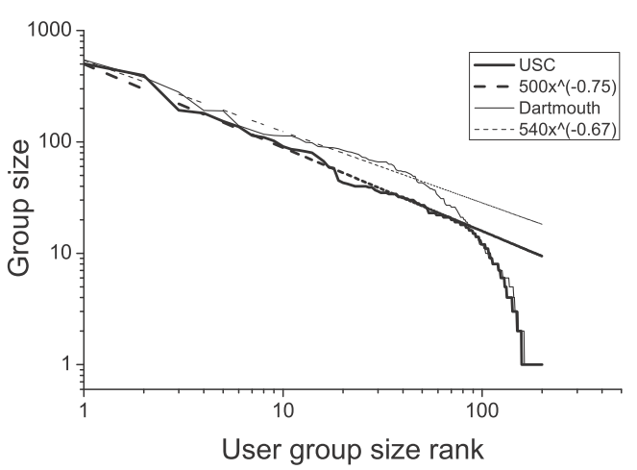
Clustering Users by Eigen-Behavior Vectors (conti.)
The group size follows a power-law distribution

Slide 10
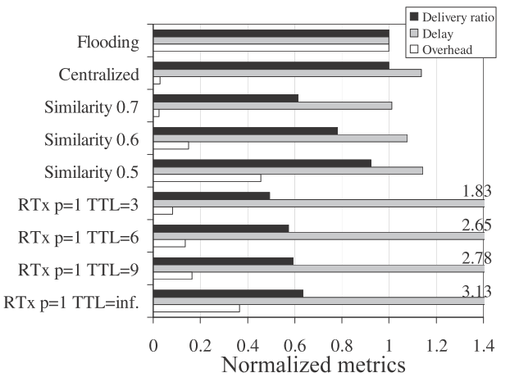
Case Study: Message Dissemination in Mobile Networks
For each group with more than 5 members, randomly pick 20 % nodes as the source nodes sending out a message to all other members in the same group

Slide 11
Compared with Our Propose Work
Difference
  In this paper, the users are from a specific campus
  Location based clustering (buildings)
Similarity
  Consider the WiFi online time for a mobile user

