Slide 1
TCP in Wireless Environments: Problems and Solutions
YE TIAN, KAI XU, AND NIRWAN ANSARI

Slide 2
Introduction
TCP and IP reside in the different layers of the open system interconnection (OSI) architecture
IP
Connectionless best-effort based variable length packet delivery network layer protocol
 reliable, timely, in-order delivery
Routing mechanism based on the addressing scheme
TCP
layer four transport protocol that uses the basic IP services
connection-oriented packet transport mechanism that ensures the reliable and ordered delivery of data

Slide 3
TCP packets
Sequence number
ACKs with sequence numbers of the next expected packets → successfully received in-order packets
Failures
flow control and congestion control algorithms based on the sliding window and additive increase multiplicative decrease (AIMD) [1] algorithms

Slide 4
TCP Reno
Slow start
cwnd is increased by 1 MSS for every ACK received (grows exponentially in round-trip times)
When cwnd reaches ssthresh, the TCP sender enters the congestion avoidance phase
Congestion avoidance
employs a sliding-window-based flow control mechanism
CWND+=1/CWND upon reception of an ACK(linearly)
Fast recovery/fast retransmit
Reduces the size of its congestion window (cwnd) to half and linearly increases cwnd as in congestion avoidance

Slide 5
Challenges in the Heterogeneous Network
Future all-IP networks will most likely be heterogeneous, but the TCP exhibits weaknesses in such hybrid environments
Degradation of throughput, inefficiency in network resource utilization, and excessive interruption of data transmissions

Slide 6
Challenges in the Heterogeneous Network (cont.)
Wireless links
weather conditions, urban obstacles, multipath interferences, large moving objects, and mobility of wireless end devices → much higher BERs
limitations of radio coverage and user mobility require frequent handoffs → temporal disconnections and reconnections between the communicating end hosts during a communication session

Slide 7
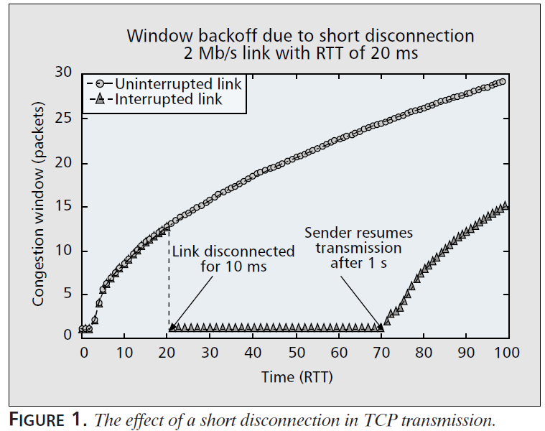
Challenges in the Heterogeneous Network (cont.)
A short disconnection event can actually stall the TCP transmission for a much longer period

Slide 8
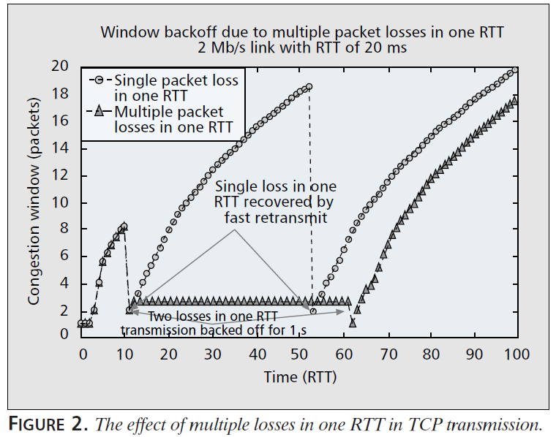
Challenges in the Heterogeneous Network (cont.)
Multiple unsuccessful retransmissions within one RTT would cause the retransmission timer to exponentially back off

Slide 9
Challenges in the Heterogeneous Network (cont.)
Link asymmetry
A sender could mistakenly interpret a bad reverse channel condition as congestion on the forward channel and unnecessarily reduce the sending rate → TCP performance degradation
ACK compression effect
The queuing in the reverse path of a TCP flow can cause the almost instantaneous arrival of successive ACKs at the sender end
→ break TCP’s self-clocking and cause long bursts of packet transmission in the forward direction, and thus possible congestive packet losses

Slide 10
Challenges in the Heterogeneous Network (cont.)
Mobile wireless communications
User mobility as well as limited radio frequency coverage of wireless devices, either base stations or terminals → Handoff
Wireless ad hoc network
Infrastructurelessness and high node mobility of the network → frequent route changes and network partitions
Satellite network
long propagation delay → long-range transmission inefficient

Slide 11
TCP for Different Wireless Applications
Satellite Networks
Ad Hoc Networks
Cellular Network

Slide 12
Satellite Networks
Takes the sender of a TCP connection a fairly long time to reach a high sending rate during the traditional slow start phase
TCP-Peach
Sudden start (slow start)
The reception of ACKs for the dummy packets indicates the availability of the unused network resource
Dummy packets are labeled with low priority → a router would drop the dummy packets first in the event of congestion
Rapid recovery (fast recovery)
Improve throughput in the presence of high link error rate
The sender uses the lower-priority dummy packets to interleave the data packets and inflates the sending window size upon receptions of ACKs for the dummy packets

Slide 13
Ad Hoc Networks
High error rate and frequent route changes and network partitions are typical
ATCP
Implemented as a thin layer inserted between the standard TCP and IP layers
Explicit congestion notification (ECN) to detect congestion and distinguish congestion loss from error loss
ICMP Destination Unreachable message to detect a change of route or temporary partition in an ad hoc network

Slide 14
Ad Hoc Networks (cont.)
The ATCP layer puts the TCP sender into either the persist, congestion control, or retransmit state accordingly
High BER - ATCP retransmits the lost packet so that TCP does not perform congestion control
A route change or network partition - ATCP puts the TCP sender into the persist state waiting for the route to reconnect
Packet reordering - ATCP reorders the packets so that TCP would not generate DUPACKs
Real congestion - TCP enters the normal congestion control stage

Slide 15
Cellular Network
Handoff and high BER
Freeze-TCP
Only requires code modifications at the mobile unit or receiver side
The mobile unit has knowledge of the radio signal strength, and therefore can predict the impending disconnections
In the presence of impending disconnection
Receiver proactively sets the advertised window size to zero → ceases sending more packets while keeping its sending window unchanged
Reconnection - the transfer can resume quickly at the rate before the disconnection occurs

Slide 16
Implementation of Wireless TCP
Split Mode
Divides the TCP connection into wireless and wired portions, and ACKs are generated for both portions separately
The performance on the wired portion is least affected by the relatively unreliable wireless portion
End-to-End Approach
Treats the route from the sender to the receiver as an end-to-end path

Slide 17
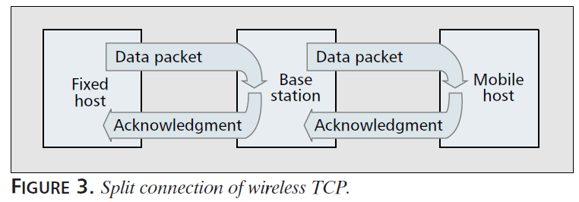
Split Mode
Both end hosts communicate with the intermediate router independently without knowledge of the other end
I-TCP
The congestion window is maintained separately for the wireless and the fixed connections

Slide 18
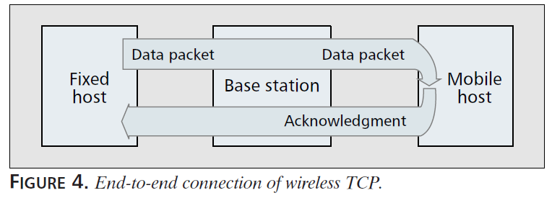
End-to-End Approach
Only the end hosts participate in flow control
The receiver provides feedback reflecting the network condition, and the sender makes decisions for congestion control

Slide 19
End-to-End Approach (cont.)
The ability to accurately probe for the available bandwidth is the key to better performance
Minimum unused link capacity of the flow’s fair share along the path
Congestion control mechanism
Reactive Congestion Control
The sender rectifies the congestion window when the network situation becomes marginal or has crossed a threshold
Proactive Congestion Control
Feedbacks from the network guide the sender to reallocate network resources in order to prevent congestion

Slide 20
Reactive Congestion Control
The congestion window is adjusted based on the collective feedback of ACKs and DUPACKs generated at the receiver
continuously increasing the congestion window gradually until the network reaches the congestion state → TCP fall back to a much slower transmission rate, which may be unnecessary for wireless random loss

Slide 21
Reactive Congestion Control (cont.)
The fast recovery algorithm of Reno takes care of a single packet drop within one window
New Reno
The fast recovery mechanism does not terminate until multiple losses, indicated by the reception of partial ACKs, from one window are all recovered
TCP SACK
It indicates a block of data that has been successfully received and queued at the receiver when packet loss occurs instead of sending a partial ACK
SACK requires modifications at the sender and receiver sides

Slide 22
Proactive Congestion Control
Adjust the congestion window proactively to an optimal rate according to the information collected via feedback
TCP Vegas
Estimates the backlogged packets in the buffer of the bottleneck link
Selects the minimal RTT as a reference to derive the optimal throughput the network can accommodate
The difference between the optimal throughput and the actual sending rate can be used to derive the amount of backlogged data in the network
Sets two thresholds of backlogged data

Slide 23
Proactive Congestion Control(cont.)
TCP Veno
Adopts the same methodology as Vegas to estimate the backlogged packets in the network
Differentiate the cause of packet loss
Below a threshold, the loss is considered to be random → increases the congestion window in a conservative manner
Above a threshold, the loss is congestive → adopts the standard Reno scheme

Slide 24
Proactive Congestion Control(cont.)
TCP Westwood
Deploys an available bandwidth measurement module at the sender side based on the interval of returning ACKs
Congested - sets the slow start threshold to reflect its estimated bandwidth-delay product
Claims improved performance over TCP Reno and SACK while achieving fairness and friendliness
Requires minimum modification at end hosts, and in some cases also the routers

Slide 25
Proactive Congestion Control(cont.)
TCP-Jersey
Available bandwidth estimation (ABE) - continuously estimates the bandwidth available to the connection and guides the sender to adjust its transmission rate when the network becomes congested
Congestion warning (CW) - routers alert end stations by marking all packets when there is a sign of incipient congestion (ECN)
Calculates the optimum congestion window size at the sender

Slide 26
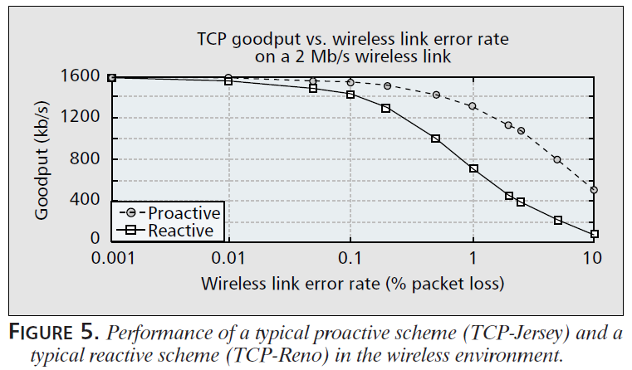
Proactive Congestion Control(cont.)
Proactive schemes, in general, exhibit the ability to handle random loss more effectively
Proactive schemes are able to better distinguish random loss from congestive loss than reactive schemes

Slide 27
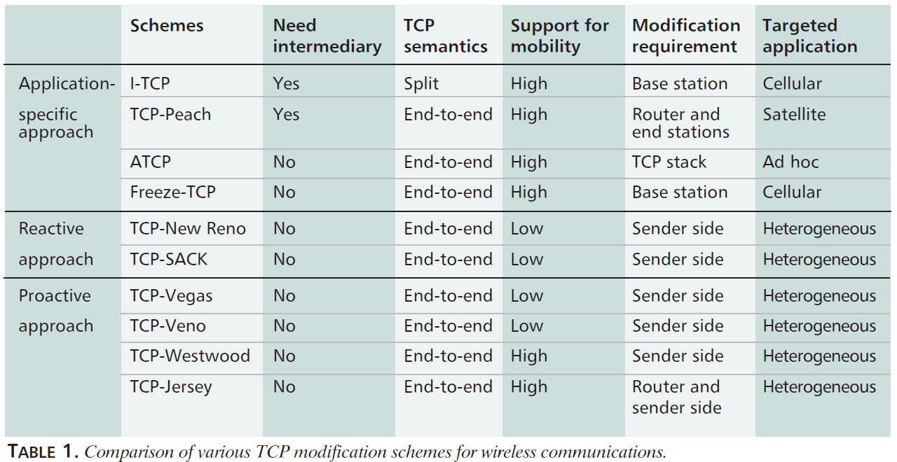
Summary
Illustrating the typical wireless TCP techniques with examples
It is difficult to make an overall conclusive evaluation of one solution vs. another

