Slide 1
Temporal Quality Assessment for Mobile Videos
An (Jack) Chan, Amit Pande, Eilwoo Baik and Prasant Mohapatra
University of California, Davis, CA 95616, USA
{anch, pande, ebaik, pmohapatra}@ucdavis.edu

Slide 2
Introduction
Video quality comprises of both spatial and temporal quality
the temporal quality assessment cannot re-use the existing static image quality measurement techniques (e.g., PSNR, SSIM)
Temporal Variation Metric (TVM)
estimate the motion of objects in the video
Temporal Variation Index (TVI)
measures the temporal quality degradation between the source (original) and the received videos
Mean Opinion Score (MOS)

Slide 3
Motivation
Objective measurement of QoE
Video temporal information
optical flow or motion vectors is unsuitable for embedded devices
Desired properties of a video quality metric
Captures the degradation of the temporal quality
Correlates with user QoE
Low computational cost
Codec independent
Estimates the network impairments such as packet loss and delay
Does not require the original copy of the video

Slide 4
Approach
Temporal Variation Metric (TVM)
compare the similarity of two neighboring (consecutive) frames of video to estimate the motion in video
only record the average similarity score of a whole frame
no-reference
Temporal Variation Index (TVI)
only needs the TVM of the original video

Slide 5
Measuring Temporal Information
Temporal Variation Metric (TVM)
use previous frame of the video as a reference and calculate temporal motion in the video
indicator of motion or temporal variation in the current frame as compared with previous frame
log of mean square value of difference between two consecutive frames (F_{p}−1 and F_{p}) of the video
k is a constant for a video with a particular color depth
d is the mean square difference of the corresponding pixels in two frames, F_{p}−1 and F_{p}

Slide 6
Consecutive Frames Comparison
SSIM (Structure Similarity Index)
measure the structural similarity of two frames
luminance → contrast → structural similarity
TSSIM (Temporal Structure Similarity Index)
measure the SSIM of the two consecutive frame
mean-shifts, contrast-stretch, compression (codec) losses, blurring and salt-pepper noise

Slide 7
Consecutive Frames Comparison
ESS (Edge Similarity Score)
ESS reflect the way that human perceives visual information
spatial-luminance information, edge and contour information
TESS (Temporal Edge Similarity Score)
measures the edge and contour change information of the consecutive frames to evaluate the motion

Slide 8
Consecutive Frames Comparison
VSNR (Visual Signal to Noise Ratio)
capture the human visual system properties
TVSNR (Temporal Visual Signal to Noise Ratio)

Slide 9
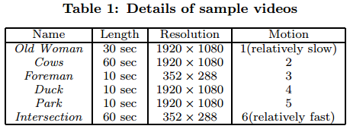
Testing with Videos
six different videos

Slide 10
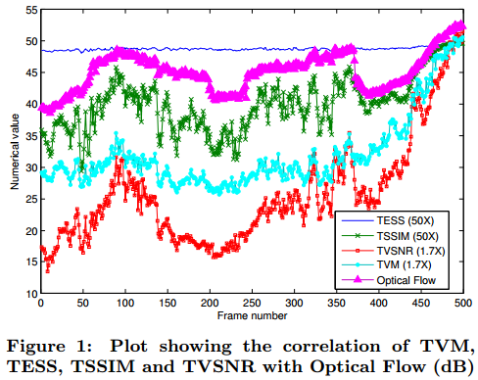
Testing with Videos
TESS has low correlation while the other metrics show high correlation
TSSIM curve shows many uncorrelated high frequency components

Slide 11
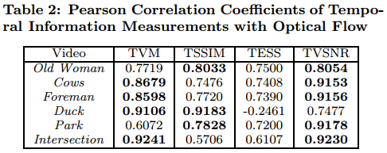
Testing with Videos
optical flow is widely used to measure the actual temporal motion in a video
both TVSNR and TVM have the highest correlation coefficients with the optical flow

Slide 12
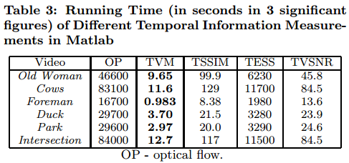
Testing with Videos
computation time required by those metrics on a 12GB 12-core Intel Xeon (dualcore) processor running Matlab release 2011

Slide 13
Testing with Videos
different video content or degree of motion has no obvious effect on the memory requirements
the resolution of the video greatly influences the memory overhead of temporal information measurements

Slide 14
Estimating Video Temporal quality
Temporal Variation Index (TVI)
estimate the temporal quality degradation by comparing the temporal information of the received video with that of the original video
TVM_{r}(t) is the TVM value for the received frame at current time
TVM_{s}(t) is the TVM value of the corresponding frame from the source video
TVI values for some frames in the video are infinite

Slide 15
Subjective Experiments
stream videos over wireless testbeds with different channel conditions
three videos with different degrees of motion
Old Woman(17), Park(17) and Football(16)
17 volunteers as subjects to watch the videos on the smartphone
10-second video clips

Slide 16
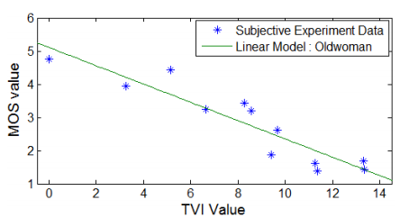
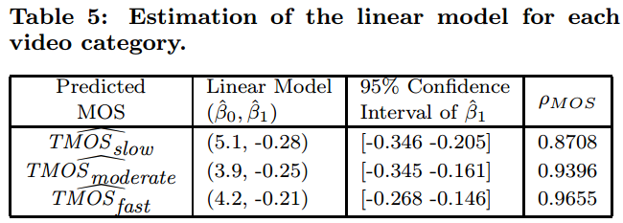
Estimating QoE
Group the video samples to slow, moderate and fast
TMOS is an objective video quality metric based on TVI
TMOS is highly correlated with MOS with an average correlation coefficient of 0.925

Slide 17
Network Evaluation
Experimental Setup
a single-hop wireless testbed
The WLAN configuration for the testbed is IEEE802.11n and the average minimum end-to-end delay is 0.604 milliseconds
three representative videos, one for each motion degree (slow, moderate and fast)
FFmpeg [6] for video coding and VideoLan [18] for video streaming
IPFireWall tool [8] to deliberately introduce packet loss and delay into the wireless link
Packet loss is injected as uniform distributed or as bursty pattern or a combination of both
Delays are injected randomly

Slide 18
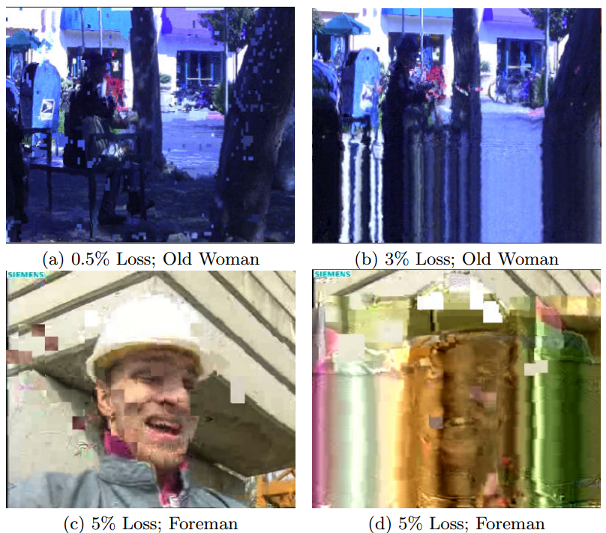
Detecting Packet Loss
Vary the packet loss rate (PLR) from 0.1% to 3% for high-resolution videos and from 5% to 50% for low-resolution videos
High resolution videos have larger spatial coding interdependencies than low-resolution videos

Slide 19
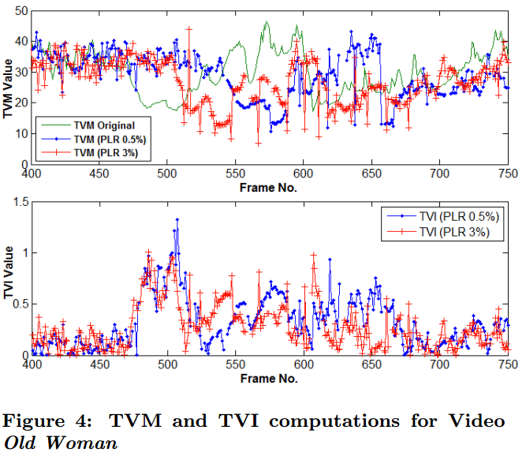
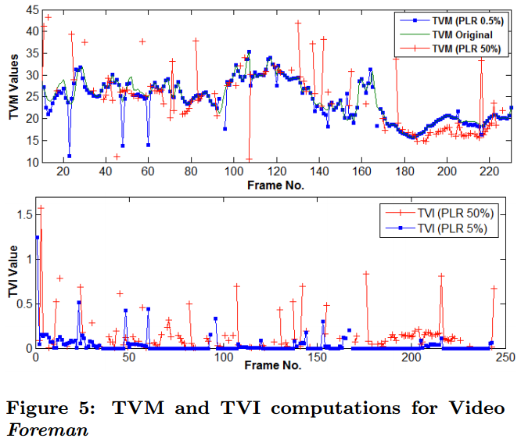
Detecting Packet Loss
increasing PLR leads to higher TVI values, indicating larger temporal quality degradation

Slide 20
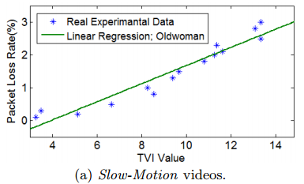
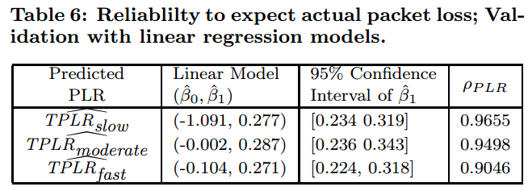
Predicting Packet Loss Rate
when TVI value increases (including the number of INF increases), the packet loss rate also increases

Slide 21
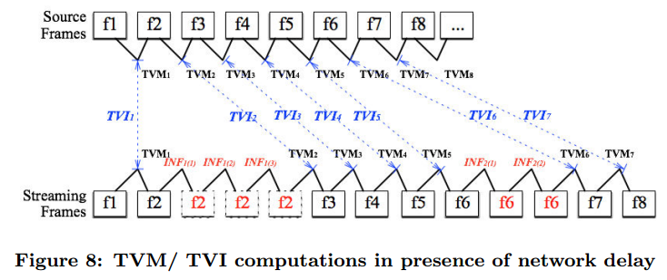
Detecting and Predicting Delay
In order to predict the delay effect, TVM values are calculated first in the receiver end

Slide 22
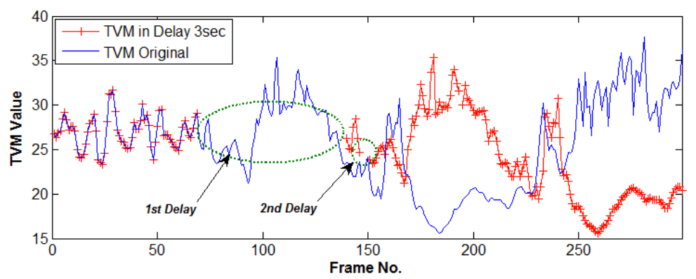
Detecting and Predicting Delay
An prediction of end-to-end delay (D) can be obtained by counting these INFs

Slide 23
Detecting and Predicting Delay

Slide 24
Conclusion
proposed a novel reduced-reference temporal quality metric, Temporal Variation Index (TVI) for mobile videos
TVI also predicts network impairments, such as packet loss and end-to-end delay
Although temporal quality is a unique and important aspect for video, it is also very interesting to integrate TVI with other spatial quality metrics

