Slide 1
Toxicity Detection In Multiplayer Online Games
Marcus Martens, Siqi Shen, Alexandru Iosup, Frenando Kuipers
Best Paper Award NetGames’15

Slide 2
Introduction

Slide 3
Toxicity
Perceived hostility in a player community
Triggered by game events like kills or other mistakes
Verbally assault other players
Degrade the QoE
Focus on MOBA game (such as LOL)
Devise an annotation system f

Slide 4
Contribution
Focus on MOBA games
Such as LOL, Dota 2…e.t.c.
Devise an annotation system
For chats of multiplayer online games
Detect toxicity

Slide 5
Data

Slide 6
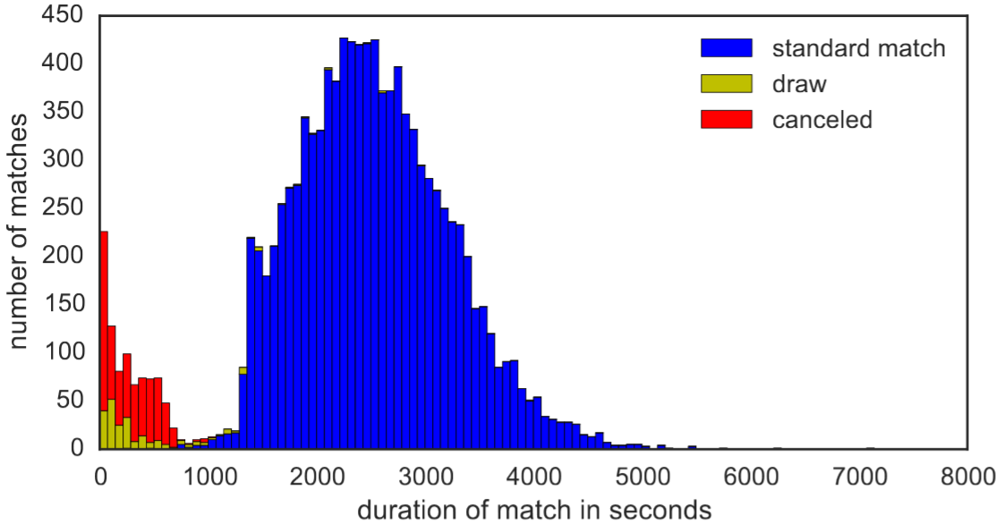
Dataset
A dataset from DotA
Collected from DotAlicious (one of the platform)
2nd to 6th of Feb 2012
Around 12K matches
Contain team channel and public channel

Slide 7
Modelling game communication

Slide 8
Annotation System
Language used
Abbreviated
Does not follow grammar
Little variety in the topic
Repetitive & restricted set of vocabulary
Derive a system to classify the most frequent words
And with their miss-spelled variants
Only consider English

Slide 9
Rules
Pattern
Includes or start with certain symbols
List
Member of a pre-defined list
Letterset
Set of letters of the word equals a pre-defined list

Slide 10
Letterset
Useful to capture unintentionally or intentionally misspelled words
Ex: noob
Common insult, derived from “newbie”
“n”, “o”, “b”
“NOOOOOOOOOOOb”, “nooobbbbb”
224 different way of writing noob in the dataset
Low false positive rate

Slide 11
Percentage Of Annotation
7042112 words
286654 distinct
16% of distinct words are annotated
60% of total words

Slide 12
Annotation Categories

Slide 13
Different Chat Modes
All-chat
All players can see
Ally-chat
Visible only to friendly players
Unable to get player-to-player chat
90% ally-chat, 10% all-chat

Slide 14
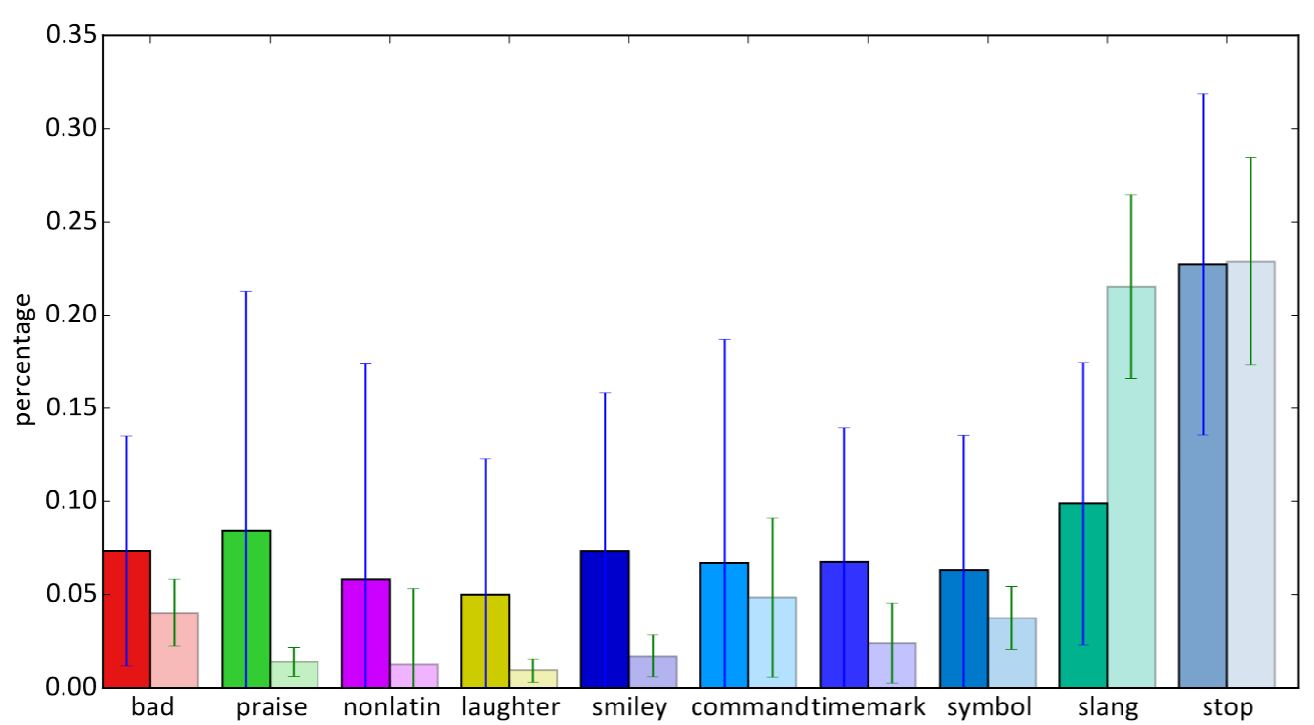
Average Use Of Annotated Words

Slide 15
Average Use Of Annotated Words

Slide 16
Average Use Of Annotated Words

Slide 17
Toxicity Detection
Try to detect toxicity towards teammate
Different from simply detecting bad words
Bad words could also be used for other purposes
Use n-gram
Get 1 ~ 4 continuous words that contain bad words
Manually determine if they’re toxic
List available online
45 unigram, 21 bigrams, 32 trigrams, 36 quadgrams

Slide 18
Analysis of game toxicity and success

Slide 19
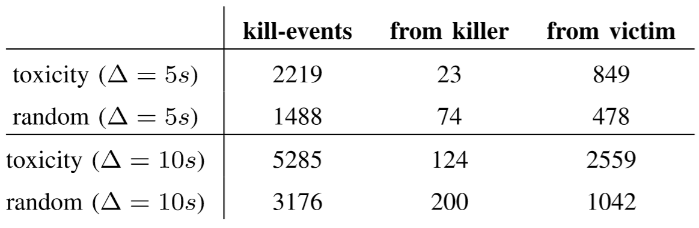
Trigger Of Toxicity
6528/10305 contain at least one toxic remark
At most 5 in 90 (outlier up to 22)
Total of 16950 toxic remark
Try to find the event that trigger toxicity
Kill event?

Slide 20
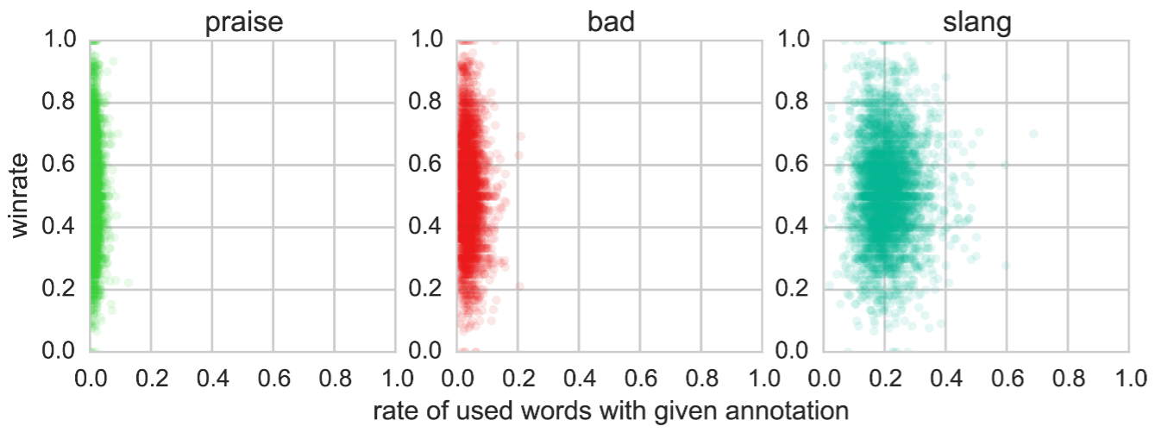
Game Success And Profanity
Does losing cause more profanity?
Only for players with over 10 matches
4900 distinct players
Calculate winrate & word used

Slide 21
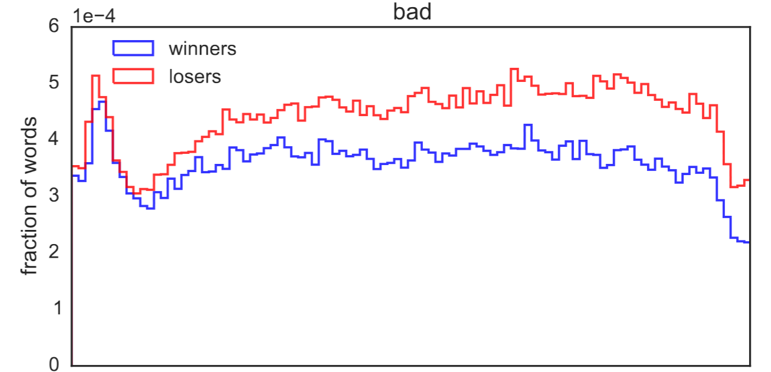
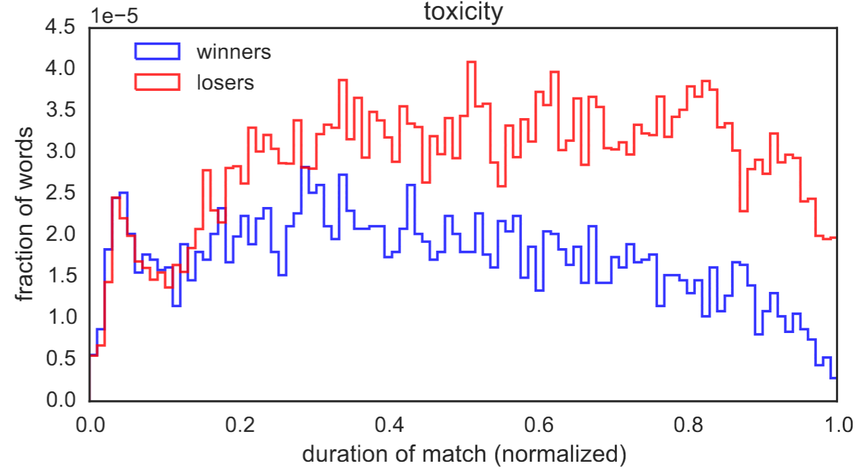
Game Success And Profanity
Overall lower toxicity and lower at the late stage for winning team

Slide 22
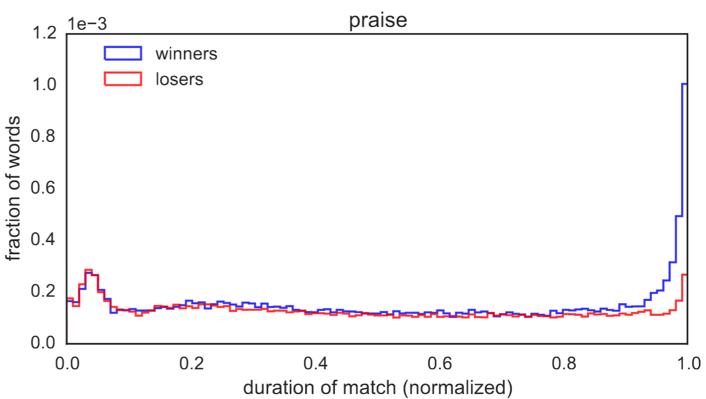
Game Success And Profanity

Slide 23
Predicting Match Outcome
Try to predict outcome using all words
Uses linear SVM
Feature-set based on Term Frequency Inverse Document Frequency (TF-IDF)
Default parameters and no optimization

Slide 24
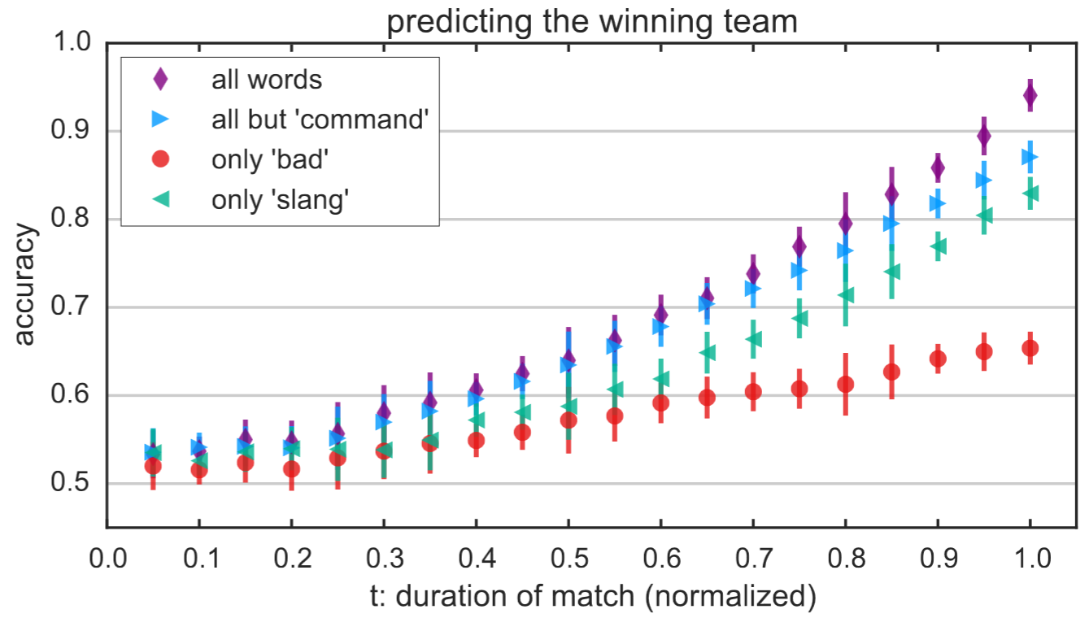
Predicting Match Outcome
Bad is not a good indicator
Slang is a pretty good one
Indicate more teamwork

Slide 25
conclusion

Slide 26
Conclusion
Distinguish simple swearing from deliberate insult
Building block for game monitoring system
Predict the outcome using the chat message
Point out that being successful in-game can still be toxic
Toxicity can be considered in match-making system

