Slide 1
VM Placement Strategies for Cloud Scenarios
CLOUD 2012
Hua-Jun 4/10/2013

Slide 2
Motivation
A fundamental aspect for cloud providers is reducing data center costs while guaranteeing the promised SLA to cloud consumers
SLA (Service Level Agreement) : such as the resource requirements of the VMs , security requirements, availability requirements, etc.
Notes:
目的就是為了幫cloud provider省錢 所以創造了新的vm placement方法

Slide 3
Compare with previous works
The majority of the existing works ignore the dynamic nature of the incoming stream of VM deployment requests to which the cloud infrastructure is subject over time
Notes:
過去也有很多vm placement的方法，但是過去都是直接研究那些特性的VM放在一起會比較好，都沒有考慮到VM是一種stream他會有進來跟離開的問題，這篇PAPER主要就是在研究這個

Slide 4
Placement Problem Formulation
$\sum_{j=1}^{M}{x_{ij}}$(t) = 1, $∀_{i}$ $∈active\left(t\right)$
VM: i, Host: j, Hosts number: M
active(t) = placed(t)-removed(t)+added(t)
$\sum_{i∈active(t)}{x_{ij}(t)}$‧$r_{ik}\left(t\right)≤$ $C_{jk}$, $∀_{j}=1…M,k=1…K$
Resource type: k, Host resource capacity: C
$r_{ik}:VM i requires a minimum amount resources of k$
$\sum_{i∈active(t)}{x_{ij}(t)}$‧$a_{i}\left(t\right)≤$ $C_{jCPU}$, $∀_{j}=1…M$
$a(t)$ to indicate the amount of CPU allocate to VM i at time t
Notes:
It means each VM served by one Host
It means all VM’s requirements cannot exceed than host capacity
實際allocate給VM的總和也不能超過Capacity (CPU為例子)

Slide 5
Placement Problem Formulation(cont.)
$r_{iCPU}≤ a_{i}\left(t\right)≤C_{jCPU}$, $∀_{i}$ $∈active\left(t\right)$
$\sum_{i∈active(t)}{{rel}_{i}\left(t\right)≤maxRelocations}$
reli(t) represents the binary variable assuming value 1 if VM i is relocated to a new position (i.e., xij(t) = xij(t − 1) for some active host j)
maxRelocations: VM relocations can introduce a significant overhead in the network infrastructure and thus deteriorate the performance so we set a threshold ─ maxRelocations
Notes:
最低需求 <= 目前被ALLOCATE <= HOST有的資源
需要做migrate的VM數量不能大於maxRelocations

Slide 6
Placement Optimization Goals
$AR\left(t\right)=\frac{\sum_{i∈active(t)}{a_{i}\left(t\right) }}{\sum_{i∈active(t)}{D_{i}\left(t\right) }}$
$RC\left(t\right)=\frac{\sum_{i∈active(t)}{{rel}_{i}\left(t\right) }}{maxRelocations}$
$LA\left(t\right)=\frac{\sum_{i∈active(t)}{a_{i}∗x_{ji}\left(t\right) }}{C_{jCPU}}$
$LB\left(t\right)=\max_{j∈hosts(t)}\left\{{LA}_{j}\left(t\right)\right\}−\min_{j∈hosts(t)}\left\{{LA}_{j}\left(t\right)\right\}$
High values of LB(t) refer to unbalanced settings while a value close to 0 indicates a good level of balancing.
Notes:
目前被allocate到的資源 和 需要的資源比例 也就是被完全服務到的百分比
要migrate的數量 和 總共可以migrate的最大數量比例
某台Host的CPU使用率
找出host CPU使用率最高的扣掉最低的 Value越大代表 越unbalance

Slide 7
Objective Function
$maximize α_{1}∗AR\left(t\right)+α_{2}∗RC\left(t\right)+α_{3}∗LB(t)$
where |α1| |α2| |α3| represents weights among components. Since the last two components should be minimized we impose that α2, α3 < 0.
Notes:
AR指的是被完全服務的比率 所以越大越好
RC是relocation的比例 所以越小越好
LB是unbalance的比例也是越小越好

Slide 8
Two Phases for Cloud Placement Optimization
Continuous deployment: The placement decisions deal only with the mapping of newly arrived VMs to hosts.
Due to the high responsivity requirement, this phase does not allow relocations of VMs
Ongoing optimization: periodically re-optimize the placement also considering migration of VMs
long periods using a continuous deployment setting might bring the infrastructure to a sub-optimal state which is far from the optimization goal
Notes:
如果每次有VM近來都去考慮要不要做全盤的migration會花很長的時間 所以第一種方法先不考慮做任何migrate的動作 只針對近來的VM去選擇最好的HOST
但是如果時間越來越長，進來和離開的VM數量越來越多，會讓整個VM配置的情況變成不是optimal的狀態，所以他們設了一個週期去做migration

Slide 9
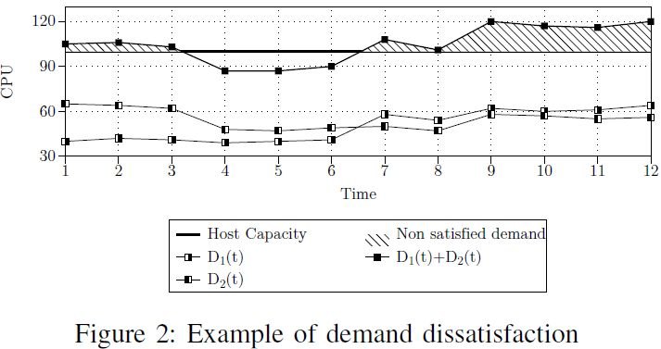
Demand Risk Score (scoring function for algorithm)
$DR\left(h,V,t\right)=\sum_{t=T−TM}^{T}{\sum_{l∈V}{d_{l}(t)/C_{hCPU}}}$
CPU demand for each virtual machine deployed in the cloud infrastructure can be easily obtained with common monitoring tools
Notes:
1. 在同一個host上 在一個時間單位™ 所有VM的總需求量 除以 這個host有的CPU量 叫做demand risk

Slide 10
Heuristic Algorithm
Continuous deployment
Notes:
先把所有要新加入的VM們 依據 需求量由大到小排列
然後找出新的VM加入哪一台host會有最小的demand risk去做分配

Slide 11
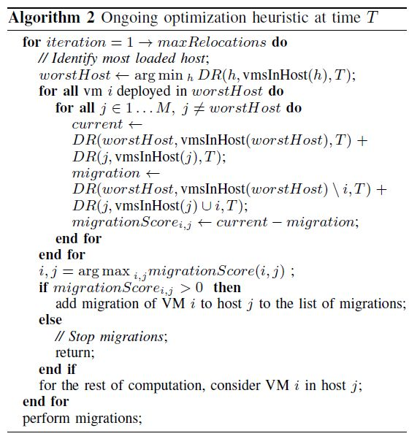
Heuristic Algorithm(cont.)
Ongoing optimization
Notes:
先找出最糟糕的host (也就是demand risk 最大的Host)
然後測量在這個host上所有VM migrate到每台機器會得到的migration score
再把migration score最大的vm移動到相對應的HOST上頭

Slide 12
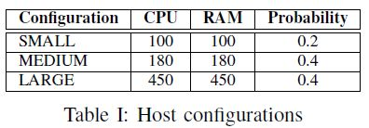
Evaluation (experiment setting)
The input stream of VMs is modeled with three probabilistic distributions (Poisson distributions)
(i) inter-arrival time of deploy requests,
(ii) deploy size (i.e., number of VMs in the deploy request),
(iii) duration of each deploy request (i.e., lifetime)
Each experiment configuration of hosts/VMs were chosen randomly from these tables
Notes:
他說因為有很多實際的系統都告訴我們他們的workload呈現poison distribution的特性 所以他就把VM的input stream model成三個Poisson 機率分布
分別是1.兩個request到達的時間，2.有多少新的VM要加進來 跟 3.每個request的lifetime
然後實驗中的Host跟VM的setting則是隨機的從TABLE中挑出來的

Slide 13
Evaluation
Coefficient:
$α_{1}=100$
$α_{2=}=−10$
$α_{3}=−1$
maxRelocations=4
TM = 100 time instants
Ongoing optimization cycle: 25 time instants

Slide 14
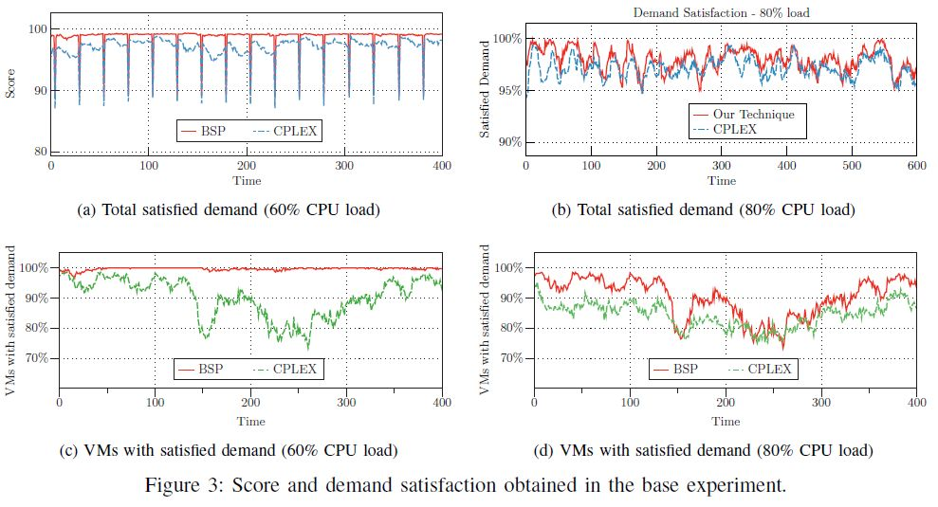
Evaluation(results)
Notes:
(CPU load指的是DATACENTER的負載量 越大自然越難statisfied)
Downward spikes in the figure corresponds to ongoing optimizations having the effect to reduce the score due to VM migrations
(圖裡面會突然往下掉是因為在作migration的關係)
Differently from the CPLEX engine, BSP takes advantage
of historical demand traces by co-locating complementary
VMs into the same physical machine.
(他們的方法會比CPLEX好的原因是因為 除了algorithm以外，他們還根據過去的demand trace(也是用Poisson distribution) 把CPU使用率是complementary的放在一起)

Slide 15
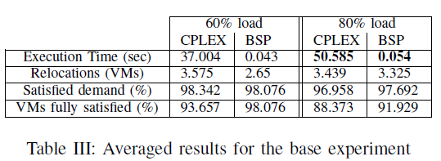
Evaluation(results)

