Slide 1
VMShadow: Optimizing The Performance of Latency-sensitive Virtual Desktops in Distributed Clouds

Slide 2
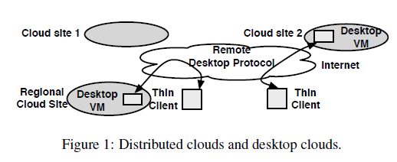
Motivation
Design VMShadow, a system to automatically optimize the location and performance of location-sensitive virtual desktops in the cloud
Location-sensitive virtual desktop: the performance of applications run on the VM is sensitive with the network latency. (ex: games or video streaming)

Slide 3
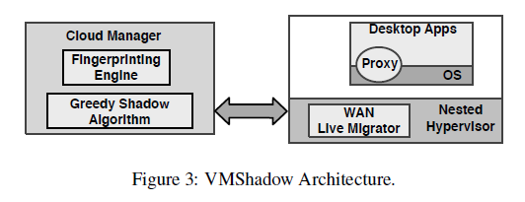
Design Goals
Fingerprinting Engine: Infer location-sensitivity of VMs
Greedy shadow algorithm: migrate highly location-sensitive VMs at the least cost
Proxy: transparent migration of active TCP connections to ensure seamless connectivity despite IP address changes

Slide 4
Black-box VM Fingerprinting
To determine/rank the degree of location sensitivity of each VM.
Fraction of active ports that are flagged to be location-sensitive
fraction of location-sensitive traffic relative to the total network traffic generated by the VM
Bandwidth consumed by the remote desktop protocol between the desktop VM and the thin client
the ranking function computes the rank as a weighted combination of the above factors
Notes:
the more the number of location-sensitive applications within the VM, the greater its rank;

Slide 5
Steps to trigger the migration
Identify potential candidates to move
Given the location sensitive ranks of all VMs.
$T_{h}$: high threshold → candidate for relocation
$T_{l}$ : low threshold → candidate for eviction
Determine new locations for each potential candidate
These sites are then rank-ordered by their network latency as potential locations to move the VM.
Analyze VMs’ cost-benefit for placement decision
Trigger VMShadow Migrations
Notes:
Eviction: moved back to a larger/global site, since resources at the regional site may be limited

Slide 6
The VMShadow Greedy Heuristic
l1 and l2 denote the latency from the current and the new (closest) data center to the end-user, respectively, then benefit B is computed as
S_disk and S_mem denote the size of the disk and memory
r captures the dirtying rate of the VM relative to the network bandwidth
The cost-aware greedy approach then orders all candidate VMs using B/C
Avoiding Oscillations: VM has been moved to a new location, it is not considered for further optimization for a duration T
Notes:
L1-l2=absolute latency decrease
(l1-l2)/l1=Percentage decrease
w1 = 0.6 and w2 = 0.4
Live migration of a VM takes place in rounds: first round: r=1, second, r=r, r=r^2 , r^3, r^4…… = 1/(1-r)
If no enough resource, it will move the non-sensitive VM to another place and insert the high location sensitive VM into the server

Slide 7
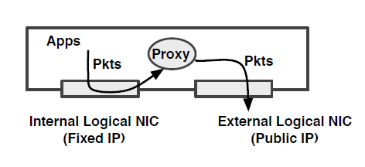
Connection Migration Protocol
The proxy employs dynamic rewriting of packet headers to migrate the VM transparently to the thin clients
both the thin client and the desktop VM need to run the proxy
Notes:
Example on the paper

Slide 8
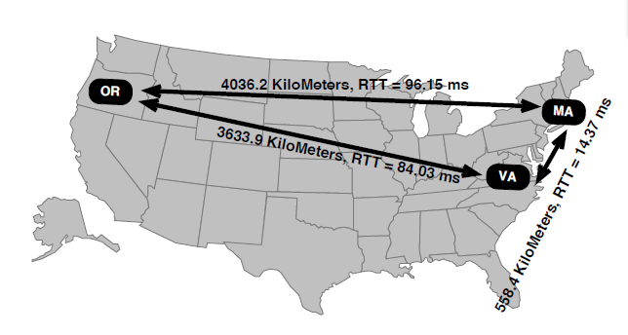
Evaluation
Setup: They implement the system on three cloud sides (Amazon EC2) used for the experiments.
Massachusetts
Virginia and
Oregon

Slide 9
Evaluation (cont.)
Connection Migration Proxy Performance:
Copy time: copy the packet from kernel to user
Rewrite time: rewrite the packet header
Copy time: and copy the packet back to the kernel

Slide 10
Evaluation (cont.)
VM Fingerprinting:
Compare the network traffic between those four different applications: Youtube, local video, browsing, and Text Edit
Notes:
rank as a weighted combination of the above factors

Slide 11
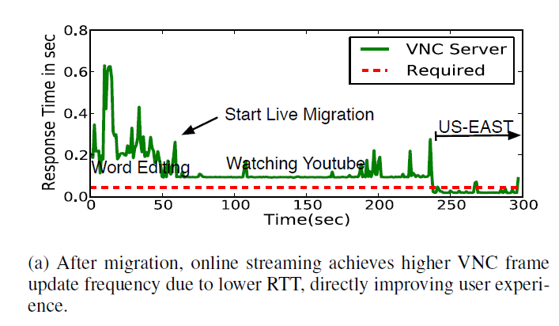
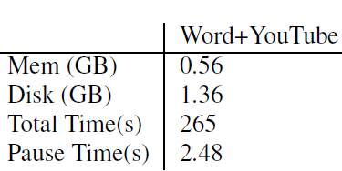
Evaluation (cont.)
Live Migration and Virtual Desktop Performance:
before migration: Response time is about 100ms
After migrate to US-EAST: achieve the required value

Slide 12
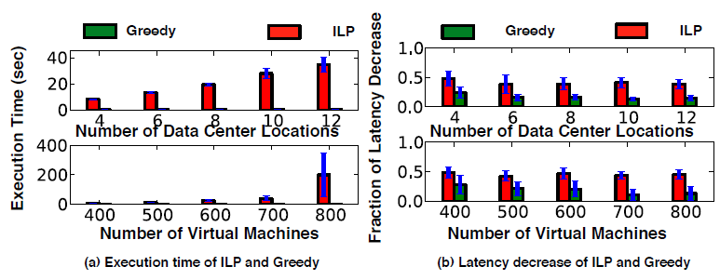
Evaluation (cont.)
Greedy Shadow Algorithm:
Fixed VM: 2000 and DataCenter:2~40
Fixed DataCenter: 40 and VM:100~1200
51-56% effectiveness with marginal execution time compared to “optimal“ ILP approach

Slide 13
What can I exploit?
Avoiding Oscillations
migrate the VM transparently to the thin clients

