Slide 1
Network-Congestion-Aware Video Streaming: A Rest-and-Download Approach
2012 9th Annual IEEE Communications Society Conference on Sensor, Mesh and Ad Hoc Communications and Networks
(SECON’12)

Slide 2
Video Rest-and-Download (VR&D)
An algorithmic framework that optimizes the progressive download of video content to reduce congestion in a wireless network while maintaining smooth playback

Slide 3
Contributions
A mathematical framework for Video Rest-&-Download based on a Discounted Inﬁnite-horizon Markov Decision Process formulation.
Application of that framework in a realistic network environment, validated with real network traces from a UMTS system with HSDPA.

Slide 4
User Types
Base station serves voice and data users.
Voice users are considered to be protected users.
Data users share the remaining resources equally

Slide 5
Network Environment
m_{p} and m_{d} : number of voice and data users.
λ_{p} and λ_{d} : voice and data users arrival rate.
μ_{p} : data users expected service time.
b_{d} : mean file size that data users have.
M_{p} and M_{d} : max number of voice and data users.

Slide 6
Video User
T_{s} : time slot size
f_{b} : number of frame remaining in the buffer
State in a time slot : (m_{d} , f_{b})
B_{v} : video size (bits)
L_{v} : video length (sec)
F_{max} : maximum buffer size that users have.
B_{f} : bits per frame

Slide 7
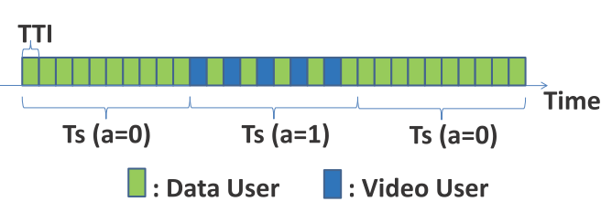
Time Slot
A TDMA system with a slot length of TTI, and an MDP time slot T_{s} = 10TTI.

Slide 8
Problem formulation (1)
Deﬁne the decision policy for VR&D, the decision policy is using MDP.
Value function : V(·)
State : (m_{d} , f_{b})
Actions : a∈ A, with A = {0, 1}

Slide 9
Problem formulation (2)
$\overline{R_{d}}\left(m_{d}\right)$ and $\overline{R_{v}}\left(m_{d}\right)$ : average rate achieved by data users and the video user.
Notes:
Prob of voice and data user arrival

Slide 10
Problem formulation (3)
P(m_{p}) : steady state probability from Eq(2) and (4)
Notes:
Prob of voice and data user leave

Slide 11
Problem formulation (4)
Notes:
Number of frame receive with action “a”

Slide 12
Cost function in MDP
Congestion : the number of data users in the system.
Freezing Time : the amount of time that there is a buffer underﬂow which causes freezes in playback.
Notes:
Kf = 1000 in this paper

Slide 13
Value Function
α is in interval [0, 1)

Slide 14
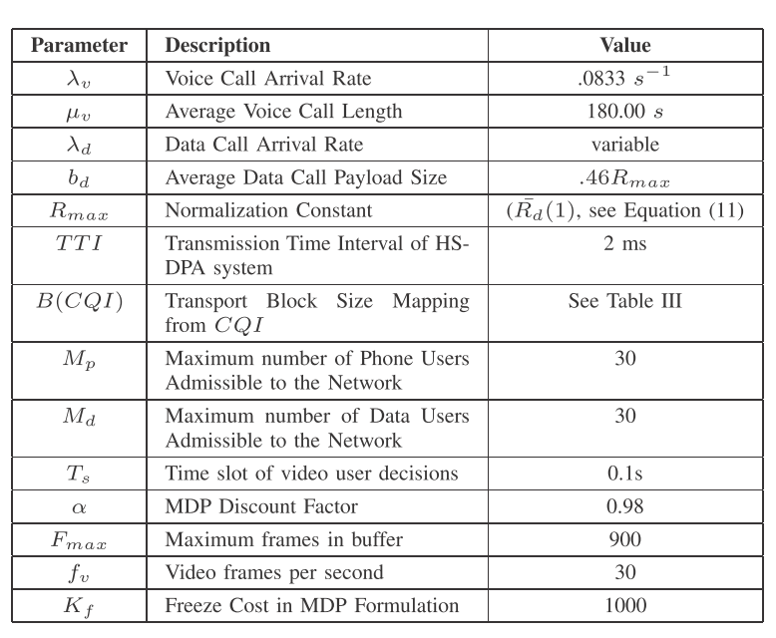
Simulation Environment
Video user is operating in a UMTS network and uses HSDPA for data service.

Slide 15
Cell Trace Description
The cell traces for several UMTS sectors with varying operating environments and parameter settings were collected from the busy hour (5PM) on 8/12/2011
Arrival and departure times of voice calls
The data payloads for data calls,
Power usage for voice and data calls
Distribution of the Channel Quality Indicator (CQI).

Slide 16
MDP Input Calculations

Slide 17
Video Encoding
Use actual video encoder trace data, which obtained by encoding the Foreman video sequence (300 frames, CIF resolution, 30 frames per second)
With an ”IBPB...” group-of-pictures structure
Using the H.264 JM Reference Encoder
Encoded under three different quantization parameters.
Repeated 24 times to obtain 240 sec.

Slide 18
Simulation Setup
Implement a basic progressive download policy called DL First, always download as long as the buffer is less than the maximum buffer size.
Run 1000 runs at each tuple

Slide 19
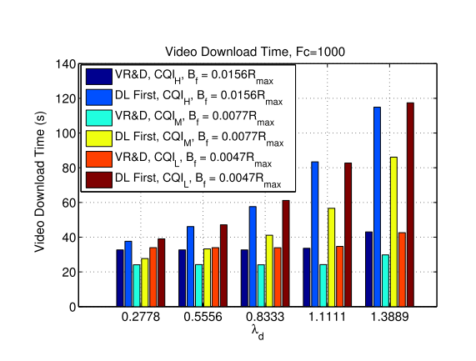
Download Time

Slide 20
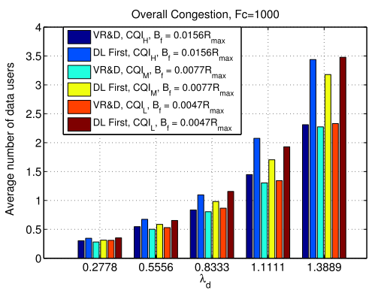
Congestion

Slide 21
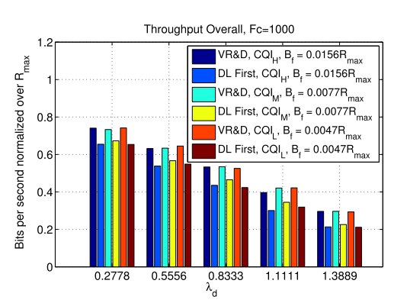
Throughput

Slide 22
Conclusion
This paper presented Video Rest-and-Download (VR&D), a downloading scheme for on-demand video streaming.
Formulated VR&D as a Markov Decision Process
Using real UMTS network with HSDPA trace to created the necessary inputs for the algorithm and network simulation.

