Slide 1
OpenSDWN: Programmatic Control over Home and Enterprise WiFi
Proc. of the 1st ACM SIGCOMM Symposium
on Software Defined Networking Research, 2015.
Julius Schulz-Zander¹, Carlos Mayer¹, Bogdan Ciobotaru¹,
Stefan Schmid², Anja Feldmann¹
¹TU Berlin; Berlin, Germany
²Deutsche Telekom Innovation Laboratories / TU Berlin; Berlin, Germany

Slide 2
Introduction
Increasing demand for WiFi network imposes new requirements
Requirements on security, optimized medium utilization, mobility support, and performance of the last wireless hop
The management and operation of off-the-shelf WiFi networks is inflexible and ignores the specific needs of users and applications
WiFi networks are often deployed in an unplanned and uncoordinated manner

Slide 3
Introduction (Cont.)
SDN + NFV = SDNv2
Software-Defined Networking (SDN) provides the flexibility
Network Functions Virtualization (NFV) aims to virtualize networks functions and deploy software applications on generic computer resources
Current OpenFlow is not well suited for WiFi
Restricted to programming flow table rules on Ethernet-based switches
Not possible to match on wireless frames
Not possible to set per-frame or per-flow transmission settings for WiFi datapath

Slide 4
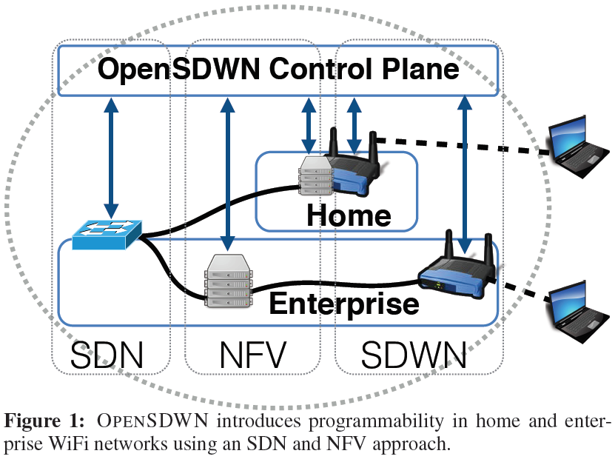
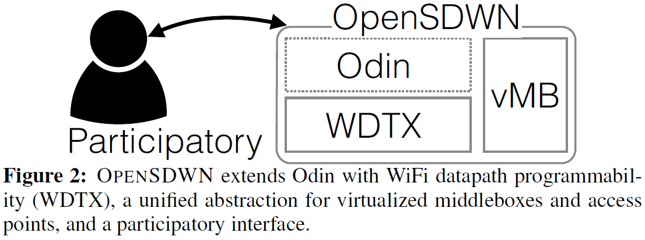
Introduction (Cont.)
This paper proposed OpenSDWN, which introduced Software-Defined Wireless Networking (SDWN) approach
Allow to manage wired and wireless datapaths
Leverages LVAP abstraction and extends Odin[42]
[42] L. Suresh et al., Towards programmable enterprise WLANS with Odin. In HotSDN ’12.

Slide 5
Use Cases
Service differentiation
Offer visibility into the network’s state and support fine-grained control
Mobility and migration
Virtualize per-client APs and the middleboxes
Flexible deployment
Network functions (firewalls, NATs, functionality for service differentiation) can be allocated and deployed flexibly
Flexible control and participatory networking
The participatory interface allows user to specify priorities over different applications, and the control can also be hand over to an ISP

Slide 6
System Components – Wireless SDN
OpenSDWN builds upon Odin and inherits the following features
Light Virtual Access Point (LVAP) abstraction
The client’s association state (BSSID, SSIDs, client IP address, and OpenFlow rules)
Mobility support
By migrating a client’s LVAP between physical APs
Slicing
Accommodate multiple logical networks on top of the same physical infrastructure with different policies and control applications

Slide 7
Prototype Implementation
Describe different radio and middlebox interfaces implemented by OpenSDWN, present the control plane, and discuss the support of reactive and proactive applications
The Radio Agent is implemented in C/C++
The controller is based on Java-based Floodlight OF controller
The MB agent is realized in python and implements a newly defined MB protocol

Slide 8
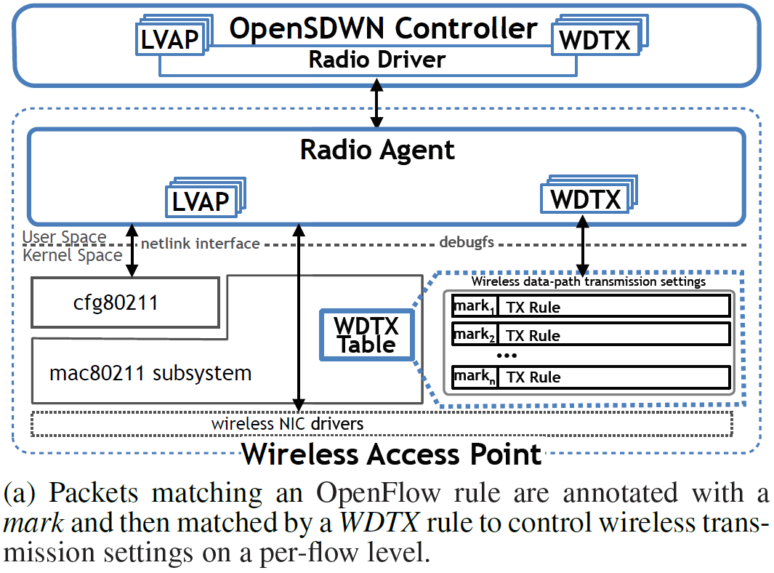
Prototype Implementation - Radio Interface
OpenSDWN’s wireless APs run a radio agent as the necessary hook for the controller and the applications
Time-critical functionalities (e.g., IEEE 802.11 acknowledgments) are performed by the WiFi NIC’s hardware
Non time-critical functionalities (e.g., management of client association) are implemented in software on controller and agent

Slide 9
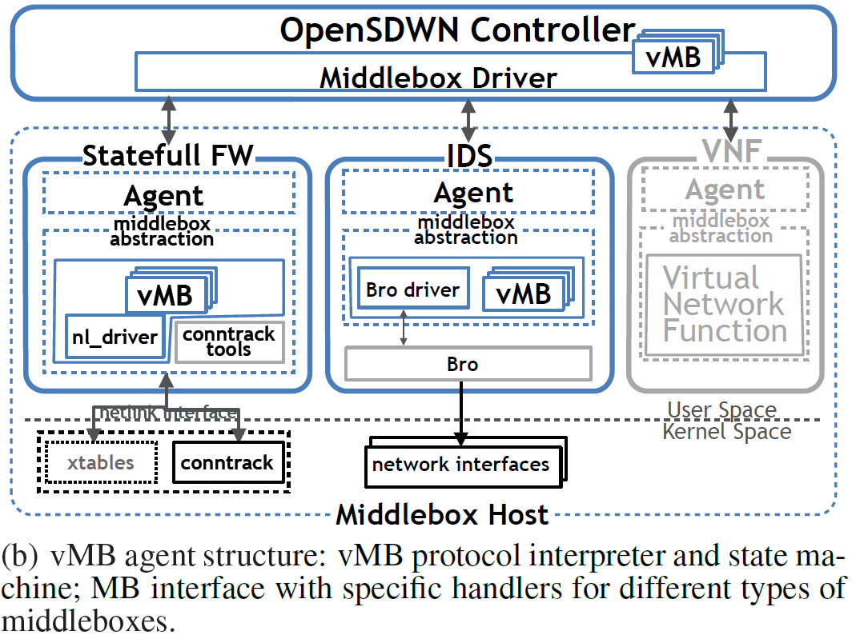
Prototype Implementation – Middlebox (MB) Interface
An MB Agent runs either on a server or WiFi AP for three tasks
Interface the physical resources of MB
Handle virtual middleboxes (vMB)
Expose the control of MB to the control plane

Slide 10
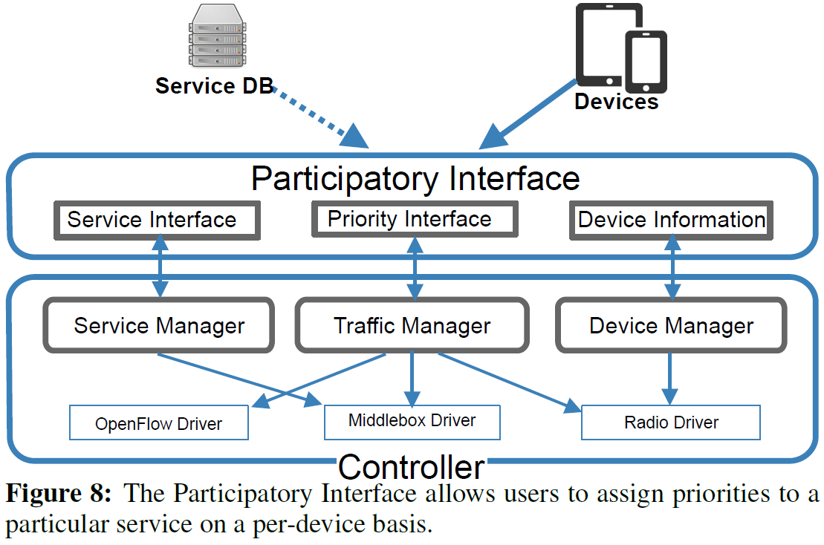
Prototype Implementation – Control Plane
The controller maintains a view of the network including clients, APs, MBs, and OF switches
Participatory interface: new services can be added through this
Reactive and proactive applications: apps on top of OpenSDWN can function both reactively and/or proactively
Middlebox agent interface: request-response model and pub-sub model
OF statistics: provide per flow and port-based statistics for apps to query

Slide 11
Evaluation – Deployments & Methodology
Proof-of-concept implementation of OpenSDWN has been deployed in two real networks
Research group’s indoor WiFi network:
More than 25 IEEE 802.11n enabled APs
Distributed across one floor of an office building
A centrally controlled home network:
A building of ~21500 ft² (1997.42 m²)
Provide internet for about 30 families with more than 70 active devices per day
Use Ethernet and 10 WiFi APs (indoor and outdoor)
All APs run OpenWrt with ath9k Linux driver and Open vSwitch version 2.3.90 supporting OpenFlow version 1.3 and conntrack table management
Off-the-shelf WiFi APs are either based on ARM, MIPS or x86
Variety of WiFi AP hardware ranges from IEEE 802.11g to 802.11abgn boards equipped with one or more WiFi NICs based on Atheros chipsets

Slide 12
Evaluation – Deployments & Methodology (Cont.)
Controller and MBs are non-virtualized servers with 4 CPU cores supporting hyper-threading and at least 8 GB RAM
All servers run a Debian-based OS with OvS 2.0.2 or 2.3.90
Did not hit CPU or memory limitations in any of the experiments
Use three dedicated servers for the performance evaluation:
An OpenFlow controller
A middlebox
A traffic generator

Slide 13
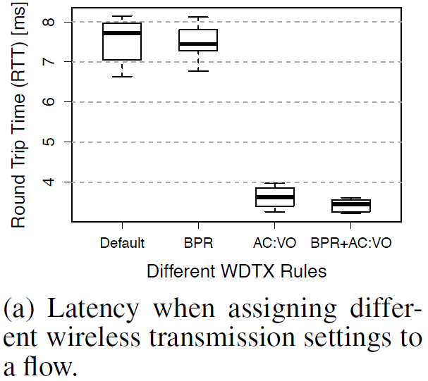
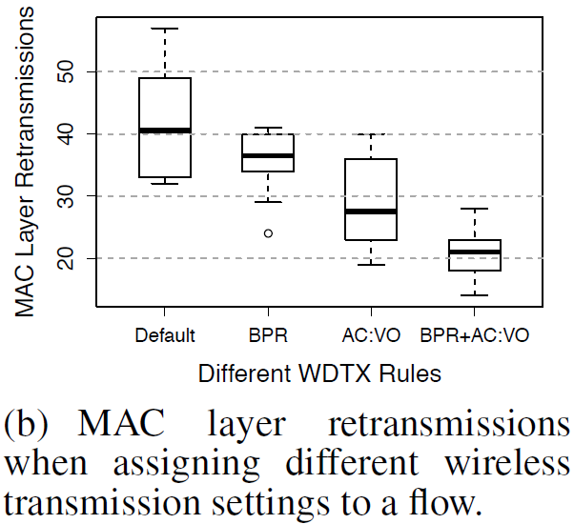
Evaluation – User-Defined Service Differentiation
Prove that the network will be benefited by prioritizing the traffic
Investigate the effect of assigning a meta transmission rate and a medium access priority on the latency and MAC layer retransmission of a single flow
OpenSDWN can achieve a per-flow resource utilization which is better suited for the diverse traffic requirements

Slide 14
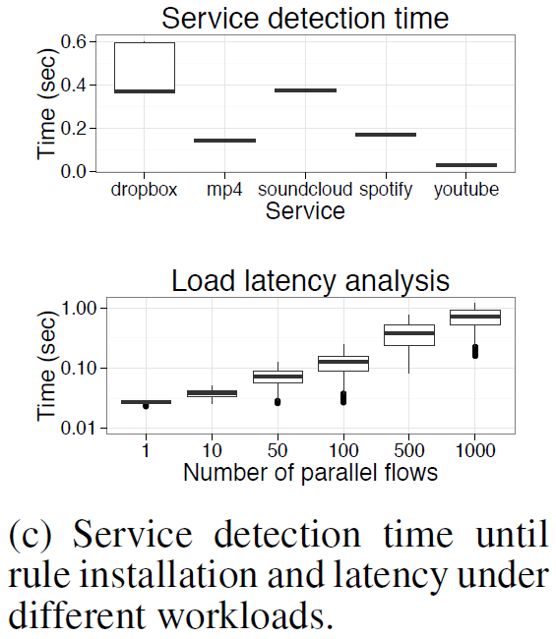
Evaluation – User-Defined Service Differentiation (Cont.)
Understand latency and induced load of service discovery
Use three servers: one for traffic injection, one for running a Bro MB instance, and one for controller with service discovery app
Test two scenarios: controller and MB agent are on the same/not the same server
The system presents a low response time for smaller event rates
The worst performance, for the highest rate, indicates a total delay of around 60 ms

Slide 15
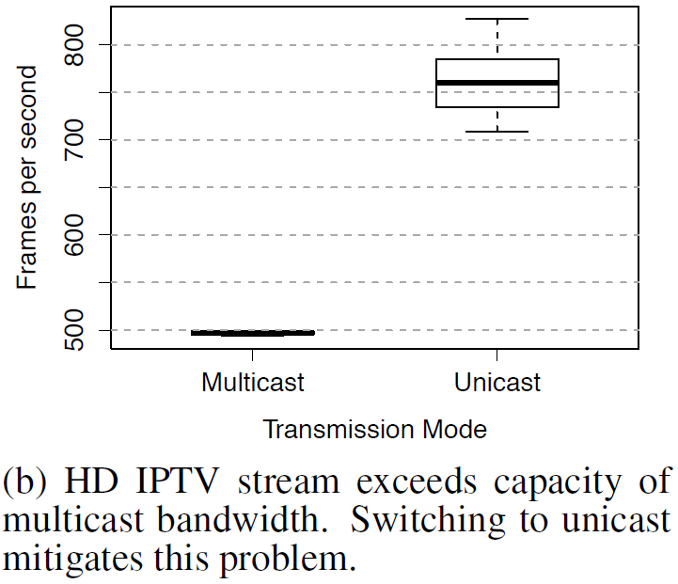
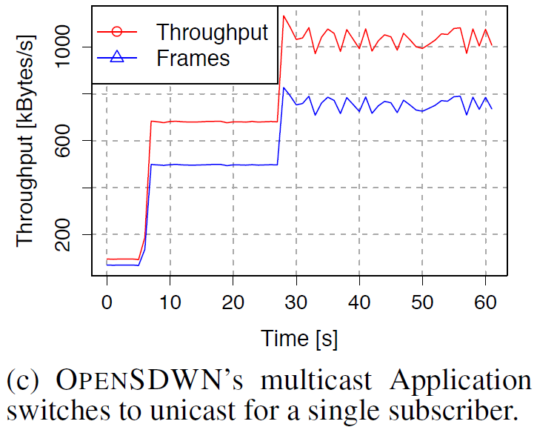
Evaluation – Smart Direct Multicast Service
Wireless networks may benefit from a Direct Multicast Service (DMS) => send 802.11 packets as unicast
With OpenSDWN, the controller can detect # of subscriptions for a multicast service and control the transmission accordingly
Install OpenFlow rule to switch from multicast to unicast for transmission
Add WDTX rule to send data at the maximum common transmission rate

Slide 16
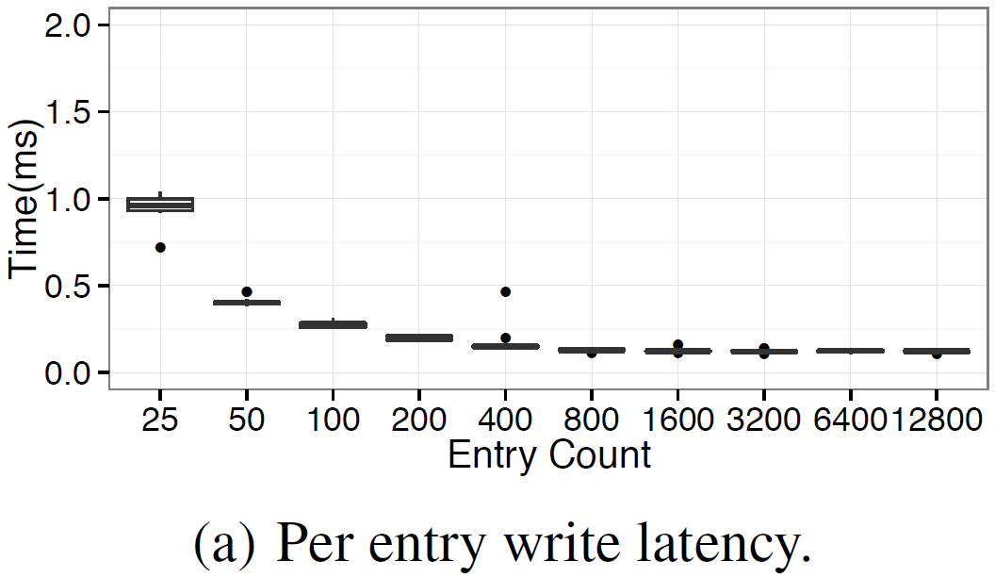
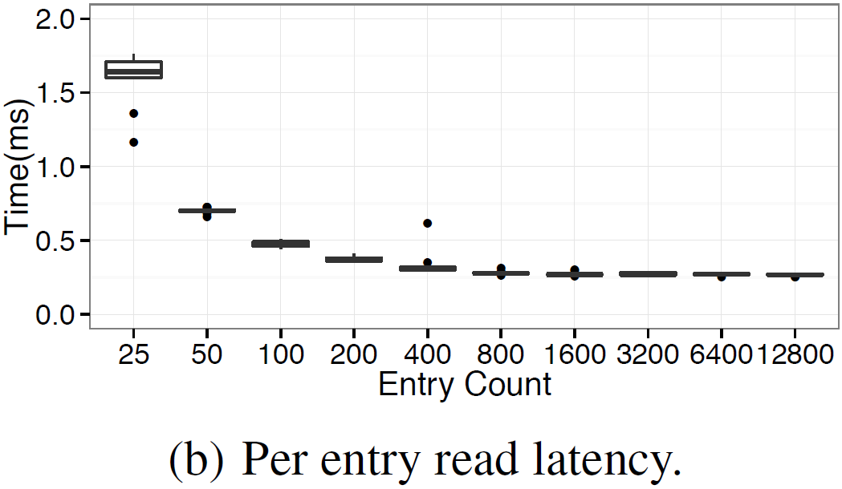
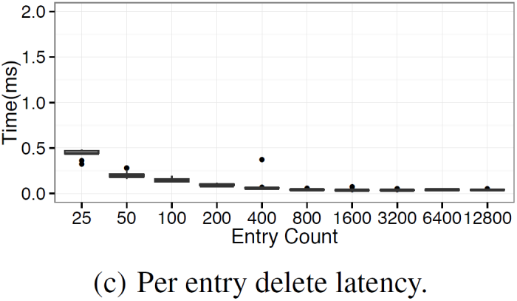
Evaluation – User Mobility
The system migrates a stateful firewall vMB object between MBs
Install the client’s flow state at new AP before or during the handoff
A complete migration requires read, write, and delete operations
Study the performance of vMB stateful firewall module
Vary vMB workloads from 25 to up to 12800 entries
Write (setState): decrease constantly and stabilize at around 130 us
Read (getState): decrease constantly and stabilize at around 270 us
Delete (delState): stabilize at around 40 us

Slide 17
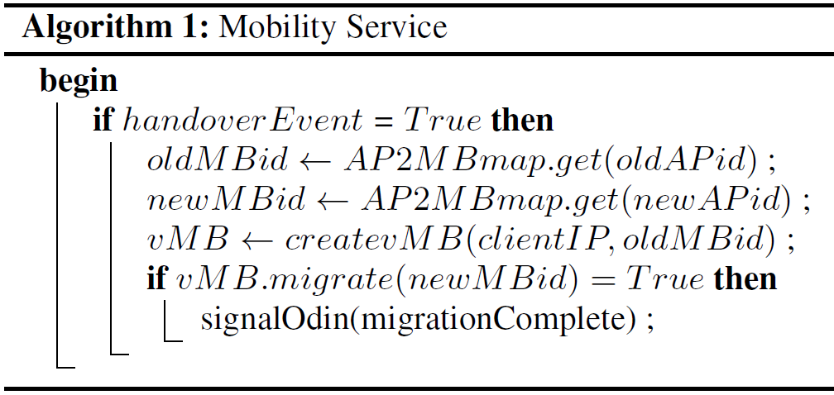
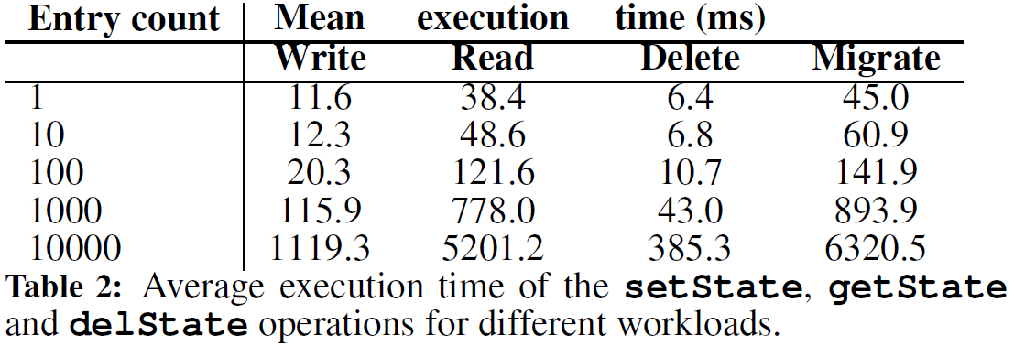
Evaluation – User Mobility Case Study: Firewall State Migration
The application keeps mapping between APs and firewalls
Trigger a handover event when the client is moving to an AP that corresponds to a different stateful firewall than the current
getState call on the serving middlebox
setState call with the target MB identifier as argument
delState call to remove the state

Slide 18
Conclusion
The authors present OpenSDWN, a programmable and virulized WiFi network
The authors proposed use cases of service differentiation, mobility, migration, and flexible control

