Slide 1
Capacity Gain of Mixed Multicast/Unicast Transport Schmes in a TV Distribution Network
Zlatka Avramova, Student Member, IEEE, Danny De Vleeschauwer, Sabine Wittevrongel, and Herwig Bruneel
July ,17,2009

Slide 2
Outline
Introduction
Channel popularity probability distribution and Modeling User Behavior
Two proposed Mixed Multicast/Unicast Deployment
Strategies
three approaches to estimate the resource demand
choose the optimal number of channels to be multicast in the static scenario
Compare Capacity gain in the two scenario
application examples
Conclusion

Slide 3
Introduction
Cable TV => IPTV=> increase demand of resource
Triggered the development of broadcast/unicast technology
Static & Dynamic Scenario
Discussing combined broadcast/unicast to savings on network resource
Proposed three approach:
1.Exact Approach
2.Gaussian Approximation
3.Sumulation Tool
Calculate & compare with the diagram

Slide 4
Channel Popularity Probability Distribution And Modeling User Behavior
k = channel’s rank
d = constant
Heavy tailed
a= active rate (the one add here)
K=0 user is passive

Slide 5
Two Proposed Mixed Multicast/Unicast Deployment Strategies
P (block):the blocking popularity
β:Multicast bandwidth/Unicast bandwidth
(rarely >3)
Static Scenario:
multicasts constantly M most popular channels
unicast on request
Dynamic Scenario:
the transport mode can change frequently according to the number of user

Slide 6
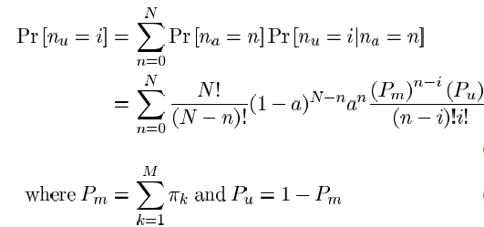
Three Approaches To Estimate The Resource Demand
1.Exact Approach:
A.Static Scenario:
Process:
Result:

Slide 7
Three Approaches To Estimate The Resource Demand
B.Dynamic scenario
(Random variable)

Slide 8
Three Approaches To Estimate The Resource Demand
2. Approximation with the normal distribution
A.Static Scenario:
V[nu]:
B.Dynamix Scenario

Slide 9
Three Approaches To Estimate The Resource Demand
3.Simulation Tool
Use language C
Parameter:
a= active rate
πk=probability of channel k is selected
Pblock&Rs&Rd

Slide 10
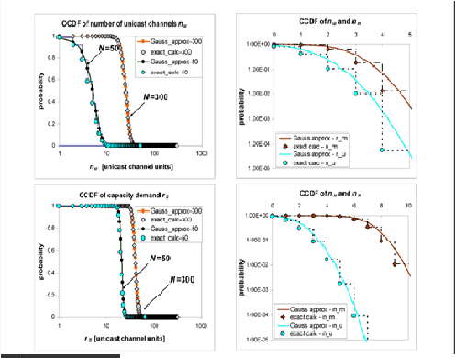
Comparison Of The Three Approach
A.Gaussian approximation V.S.Exact Calculation
In the two Scenario
In the different
Numbers of sample
Result: Gaussian is
Better!!!!(efficient)

Slide 11
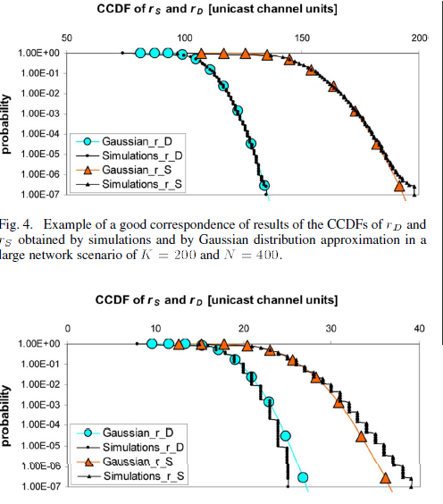
Comparison Of The Three Approach
B.Simulation V.S.Gaussian
big sample
small sample

Slide 12
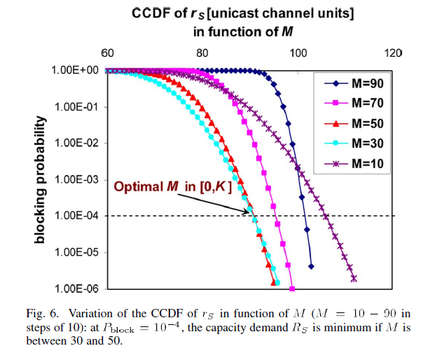
Choose the optimal numbers of channels to multicast in static scenario
With different M K=100,a=0.7,α=0.9,β=1 N=200

Slide 13
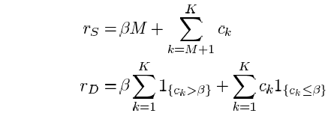
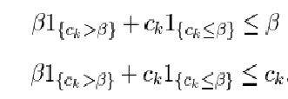
Superiority Of The Dynamic Scenario And Definition Of Capacity Gain
Proof in calculation
definition
result

Slide 14
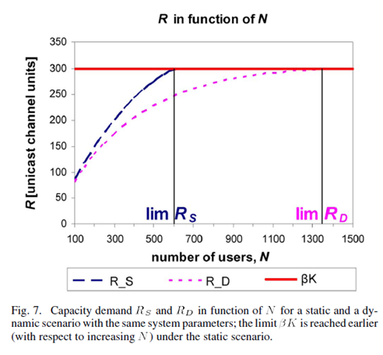
Superiority Of The Dynamic Scenario And Definition Of Capacity Gain
Illustration:

Slide 15
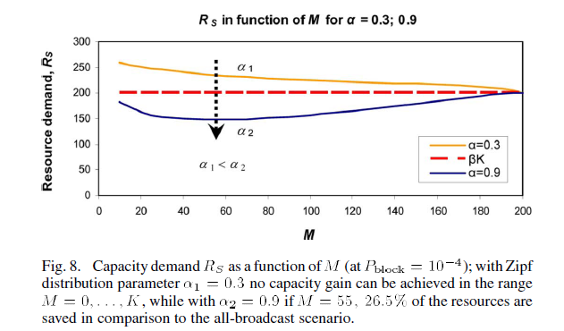
Superiority of the Dynamic scenario and Definition of Capacity Gain
Definition of Capacity Gain
Zipf distribution

Slide 16
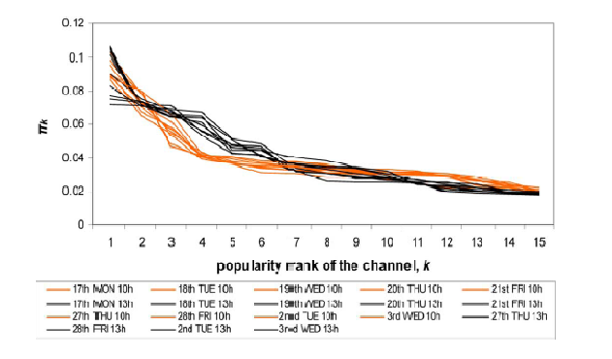
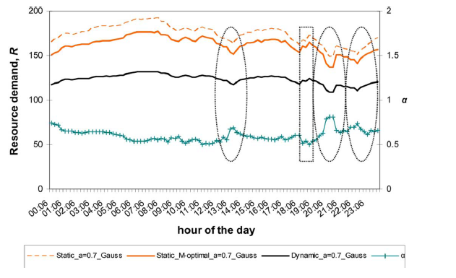
Capacity Demand Over One Day
96 measurements per day

Slide 17
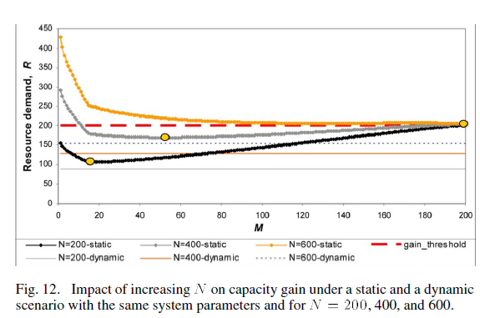
Influence Of The Model Parameters On The Capacity Demand
Increasing number of users

Slide 18
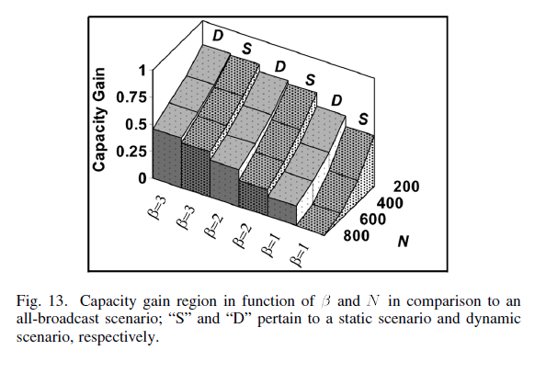
Influence Of The Model Parameters On The Capacity Demand
Influence Of β:

Slide 19
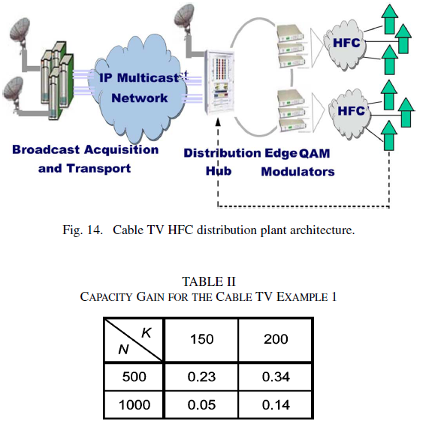
Application Examples
Hybrid fiber-coax(HFC)TV
MPEG-2
QAM
Has a return channel

Slide 20
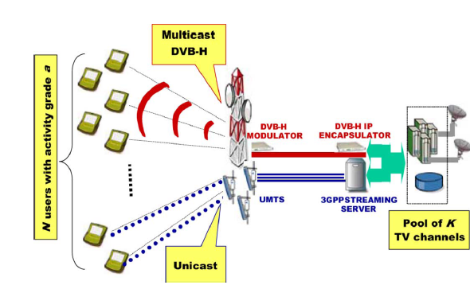
Application Examples
The mobile TV network
DVB-H
UMTS spectrum

Slide 21
Conclusion
Measurement: Gaussian is better
Dynamic scenario
The capacity demand in a given day

Slide 22
WiMAX MAC Layer Network Entry
Notes:
priority大概都一樣，那在wireless上面因為每一個人的距離，離base station的距離不一定會一樣，所以每一個人的data rate並不會一樣，不會一樣所收看到的品質也不一定會一樣， 所以這個東西撥下去，是以甚麼為主？這就是一個問題，大概就是這樣，那我們目標基本上是在WiMax上面提供這個IPTV service，然後我們，基本上是希望提供這個multicast的service，而且我們希望是針對WiMax的特性來做這件事情，那因為這個是最主要的目標，然後我們作的基本上是在做resource allocation的部分，最主要是在做這個radio resource allocation，最主要是做allocation的部分，那我們也做了一點點的scheduling，那scheduling不是我做的，所以我們在這邊就不談，那這個是max的部分，然後此外，我們這個team也表示是外層的，他會告訴我們說，當你channel condition是甚麼樣的狀況之下，我要用哪一樣的這個coding或encoding的skin來做這件事情，那他會提供給我，我們只要告訴給你說，我user測量到的訊號等級是甚麼，就可以告訴我，我們應該怎麼用，他這個其實是有另外一個在做的，所以這個基本上，就是我下層會量到之後會跟上層講，上層就會visa他的這個量到的information來做相對的這個scheduling，所以我們這個基本上是一個parse air演算的一個架構，那這個基本上其實我們去年就結案了，就說第一次結案了，那我不知道大家對這個熟不熟。

Slide 23
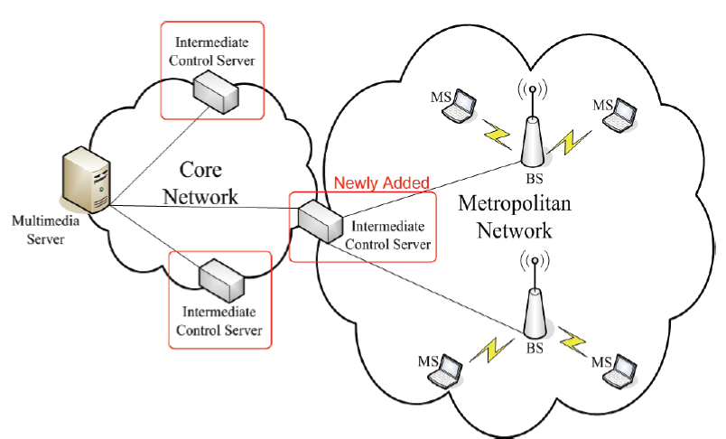
How do WiMax support multicast on base station
ICS(Intermediate Control Server)
Notes:
When an MS requests a video, it sends the messages to the BS, and the BS then forwards the request to the mul-timedia server. When adapting SVC, which encodes a frame into several layers, the multimedia server which stores the videos performs the encoding procedure and transmits the layers to the BS. For all MSs who are
watching the same video, the BS grouped them based on their feedback channel condition. The group with better channel condition gets more layers. On the contrary, the group with worse channel condition gets fewer layers. However, the BS can not distinguish the layer ID re-ceived from the multimedia server. In order to solve this problem, an Intermediate Control Server (ICS) is newly added in the system, see Figure 4. A WiMAX network is served by an ICS. After executing the videos in the mul-timedia server, the ICS forwards the SVC-encoded layers to BS.
In our proposed scheme, SVC is implemented to en-code a frame into three layers. Layer 0 is meant to be the base layer, which contains the most important informa-tion. Layer 1 and layer 2 belong to the enhancement lay- er, which carries less information as compared to layer 0. In order to assure the video quality perceived by user within worse channel condition, layer 0 is encoded to carry 50% information of the original frame. After re-ceiving and decoding layer 1 with layer 0, the containing information is refined to 75%. Users with best channel condition get all three layers, the frame which is decoded by combining layer 0, layer 1, and layer 2 is the same as the original transmitted frame. The retrieval frames are shown in Figure 5.
3.2. The ICS Signaling
The multimedia server encodes the video into three lay-ers in the application layer. All layers are packetized and added different protocol headers from the upper layer to lower layer, the BS could not distinguish the layer ID. An ICS is used to solve this problem. An ICS is indi-vidually set between multimedia server and the BS for flexibility and extensibility of many applications pro-vided by different operators in the future. The major task of ICS is to re-packetize the packets received from mul-timedia server so that the BS recognizes the layer IDs. The proposed system model with network layers is shown in Figure 6.
When the ICS receives the SVC-encoded layer packet, it decodes the packet in the application layer and gets the layer ID information. While transmitting to the BS, the ICS re-packages the SVC-encoded frame by adding the layer ID information in the reserved filed of each net-work protocol header. The Network Abstraction Layer (NAL) unit [15], shown in Figure 7, defines the interface between the encoded video data itself and the possible transport layers or storage formats. Each NAL unit re-gardless of its type is encapsulated in the RTP/UDP/IP packet. The encapsulation of NAL unit is shown in Ta-ble 3. Three bits in NAL unit are used to indicate the layer ID.
When the packet transmits by RTP (Real-time Trans-port Protocol), there are seven bits in the payload type filed [16]. The RTP header format is presented in Figure 8. The reserved values in payload type, which is dis-
played in Table 4, are 72 to 76 [17]. We use three values, 72, 73, and 74, to indicate the layer ID. In UDP (User Datagram Protocol) header format which is shown in Figure 9, there are 8-bit protocol numbers [18]. Part of the assigned protocol numbers is presented in Table 5, the values 72-76 and 80-254 are unassigned [19], and three values, 72, 73, and 74, are used to denote the layer ID. Continuing transmitting to lower layer, the IPv4 (Int- ernet Protocol version 4) header is displayed in Figure 10 [20]. 2-bit reserved field could be used to show the layer ID. ‘00’ denotes layer 0, ‘01’ denotes layer1, and ‘10’ denotes layer2 separately. In this way, MAC layer can clearly distinguish what the received layer ID is.

