Slide 1
EndRE :
An End-System Redundancy Elimination Service for Enterprises
Bhavish Aggarwal, Aditya Akella, Ashok Anand, Athula Balachandran, Pushkar Chitnis, Chitra Muthukrishnan, Ramachandran Ramjee and George Varghese
Microsoft Research India;University of Wisconsin-Madison;CMU;UCSD

Slide 2
Introduction
Corporation
  Lower administration cost
  Increase in network traffic

Slide 3
Introduction
Redundancy Elimination
An alternate approach where RE is provided as an end system service
  End-to-end encrypted traffic
  Last-hop wireless links to mobile devices

Slide 4
Introduction
Middlebox
  Drawback
    Encrypted traffic
    Can’t improve performance over last-hop links in mobile devices

Slide 5
Design
Goal
  Transparent operation
    No changes to data
  Fine-grained operation
    Duplicate byte strings as small as 32-64B
  Simple decoding at client
  Fast and adaptive encoding at servers
    Adapt its use of CPU based on load
  Limited memory footprint at servers and clients

Slide 6
Design
Data block
w
  minimum redundant string
p
  Sampling period
marker
  First byte of chosen candidate string
chunk
  The string between two markers

Slide 7
Design
Data block
w
  minimum redundant string
p
  Sampling period
marker
  First byte of chosen candidate string
chunk
  The string between two markers

Slide 8
Design - Fingerprinting
MODP
Compute fingerprints
Fingerprint table
Packet payload
Window
Packet store
Rabin fingerprinting
Payload-1
Payload-2
Value sampling: sample those fingerprints
whose value is 0 mod p
Lookup fingerprints in Fingerprint table

Slide 9
Design - Fingerprinting
MAXP
Similar to MODP
Only selection criteria changes
MODP
MAXP
Sample those fingerprints whose value is 0 mod p
Choose fingerprints that are local maxima
( or minima) for p bytes region
No fingerprint to represent the shaded region
Gives uniform selection of fingerprints

Slide 10
Design - Fingerprinting
FIXED
  Simply select every p^{th} byte as a marker
  Content agnostic
SAMPLEBYTE
  Content-based
  Table: a byte is chosen as a marker if the corresponding entry in the lookup table is set
  A marker is chosen, skip p/2 bytes

Slide 11
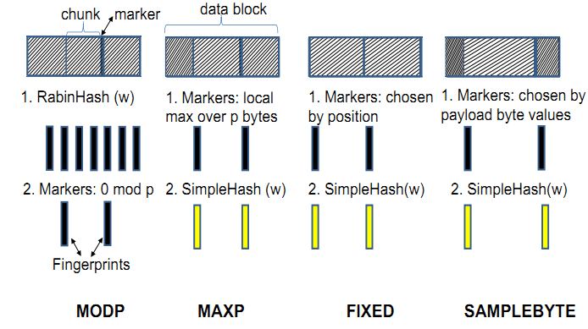
Design - Fingerprinting

Slide 12
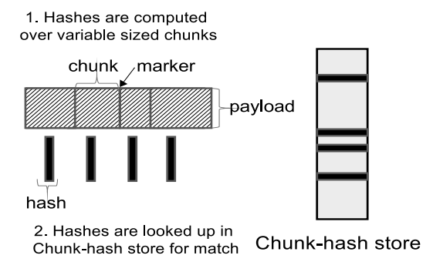
Design - Match
Chunk-Match
  Client: fixed-size circular FIFO log
  Server: emulate client cache per-client basis
  Match → server send 4 bytes <offset, length>

Slide 13
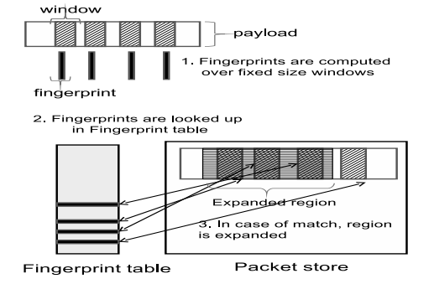
Design - Match
Max-Match
  Try to expend matched region

Slide 14
Implementation
EndRE above TCP
Default fingerprinting algorithm
  SIMPLEBYTE
Packet cache
  1-16MB per pairs
Handle multiple parallel TCP stream
  priority queue
Protocol independent
  between app layer and transport layer
  Windows Filtering Platform
  Mobile
    User-level proxy

Slide 15
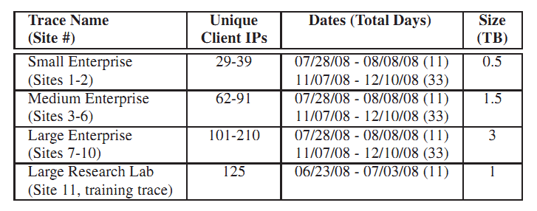
Evaluation approach
Traces
  11 corporate enterprise location
  Small, medium, large

Slide 16
Evaluation approach
Testbed
  Desktop server connected to a client through a router
  Router is a WiFi-AP in wireless experiments

Slide 17
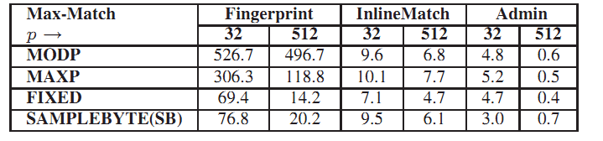
CPU Costs
Micro-benchmarks
  Fingerprint
    Identify marker/fingerprint
  InlineMatch
    Generate fingerprints
  Admin
    Updating the fingerprint store

Slide 18
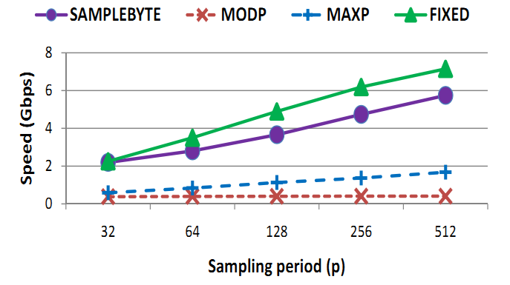
CPU Costs
Trace analysis

Slide 19
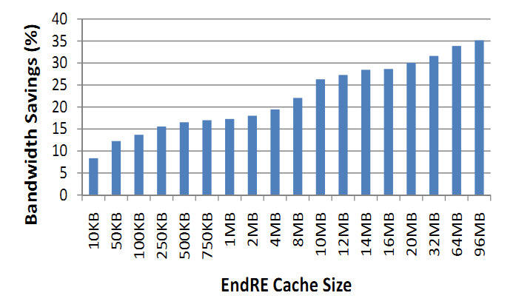
Bandwidth Saving

Slide 20
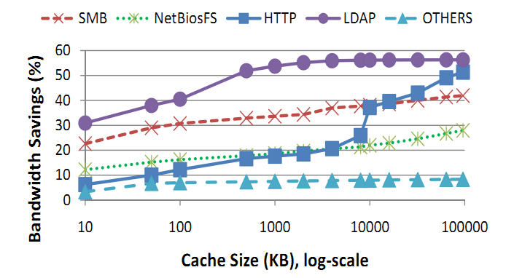
Bandwidth Saving

Slide 21
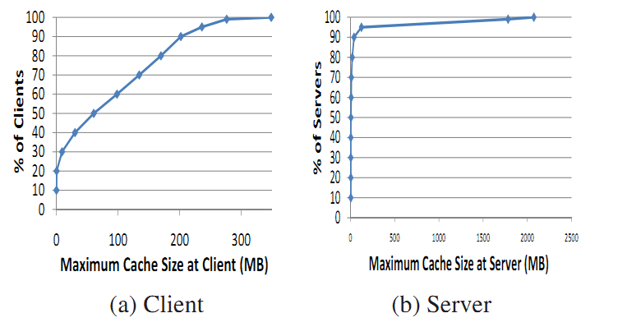
Memory Costs

Slide 22
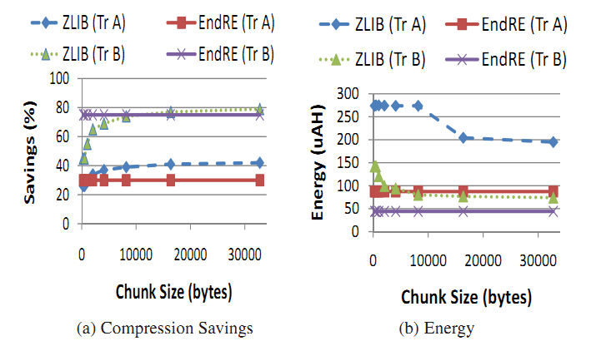
Energy Saving

Slide 23
Conclusion
Avg bandwidth gains 26%
Latency saving 30%
Median memory requirement 60MB
Adapting memory and CPU loading

