Slide 1
Fast failover for control traffic in software-defined networks
GLOBECOM 2012
Author: Neda Beheshti, Ying Zhang
Present: Yi-Ren Chen

Slide 2
Software define networks
Core idea: Separation control plane from forwarding plane
Disadvantage: low reliability, performance, and packet loss (disconnection between control plane and forwarding plane)
How to solve them? Their Ans: appropriate connection controllers and switches

Slide 3
Recent research about failover
Network resiliency: Network with Multi-controllers (partition network)
Controller replacement problem: best location minimize network latency

Slide 4
What they did in this paper?
Goal: Find better link distribution for faster resiliency, reduce the interrupt between controller and switches
Algorithm: improve network topology’s resiliency
Overall: resilience-aware controller placement and control traffic routing

Slide 5
Algorithm assumption
No extra links used for control traffic only
Each node only have one path to the controller in routing tree rooted at the controller
Define:
Upstream node(unique), downstream node
Protected switches
Backup link

Slide 6
Give an example
used
backup
protected
unprotected
Weight of nodes: number of its downstream nodes
routing tree: sum of the weights of all its unprotected nodes
Switch A is protected if and only if there exists switch B in the network such that:
1) Switch B is not in downstream(parent(A))
2) There is a link between A and B, which is not a part of the controller routing tree

Slide 7
example

Slide 8
Optimized placement algorithm
Weight of tree
Only for small network topology
Goal: minimize the weight of routing tree

Slide 9
Approximation placement algorithm
If network topology size is huge enough??
number of protected neighbors of node
NP-hard problem !!
Goal: the maximum number of protected neighbors
the nodes closer to the controller weigh more

Slide 10
Routing algorithm
Number of edge
resiliency-improved routing scheme

Slide 11
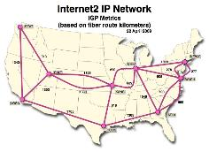
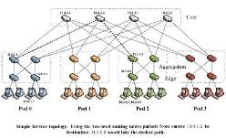
SIMULATION ON PERL
Small ISP
Data center
Large ISP

Slide 12
Impact of the placement algorithm

