Slide 1
FlexCast: Graceful Wireless Video Streaming
S. Aditya & Sachin Katti
Stanford University

Slide 2
Outline
Background
Introduction
Algorithm
Experiment
Conclusion
Reference

Slide 3
Background

Slide 4
Mobile Video Streaming
buffering, lost frames are quite common

Slide 5
Why is Performance Choppy?
Current video streaming (MPEG4..)
Encode video at a specific bitrate (e.g 1mbps+ for HD)
Expect wireless network to deliver that reliable bitrate
Wireless Networks
Do not guarantee a specific minimum reliable bitrate

Slide 6
Introduction

Slide 7
FlexCast
Reconstructs a video even from erroneous packets with quality commensurate with current network quality
Key High Level Principle: Bit Errors in packets should translate proportionally into distortion errors in video
Entropy Coding does not have that property, a few bit errors can completely distort decoded video
Flexcast eliminates entropy coding, uses soft reconstruction and proportional representation to achieve proportionality

Slide 8
Key Insight 1: Soft Reconstruction
PHYs compute soft estimates of decoded bits → probability bit is “1” or “0”
Soft Output Viterbi Decoder, SoftPHY
Leverage soft information to compute expected value of DCT coefficient

Slide 9
Soft Reconstruction
Soft Reconstructed DCT coefficient (9.1) is much closer to the transmitted value than traditional (6)

Slide 10
Key Insight 2: Proportional Representation
Soft Reconstruction is not sufficient since some bits are more important than others
MSB of the low frequency DCT coefficient, single bit error translates to large video distortion
Second Principle: Design a technique that allows sender to provide unequal error protection (UEP) without modifying the PHY

Slide 11
Algorithm

Slide 12
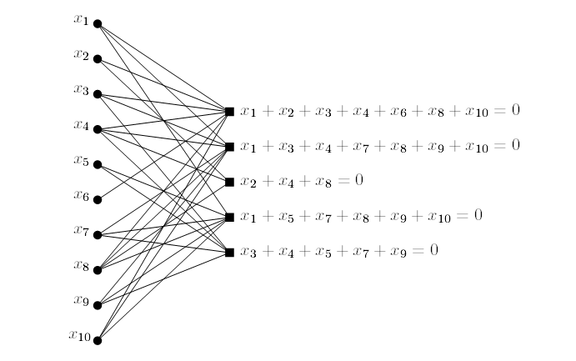
Low-density parity-check code ( LDPC )
LDPC
Low-density parity-check codes
Error correct codes
Low density give a low complexity
N inputs produce r check point
Ex: N=10 r=5

Slide 13
Low-density parity-check code ( LDPC )
Encode
Decode
1
1
1
?
0
0
0
0
0
1
0
?
0
0
0
0
0
1
0
?
1
1
0
0

Slide 14
LT Codes
Bit Node
Check Node
d
2
2
2
1
1
2
1
1
3
1
v
(101000)
(110000)
(000011)
(001000)
(000100)
(000101)
(010000)
(000010)
(100101)
(001000)

Slide 15
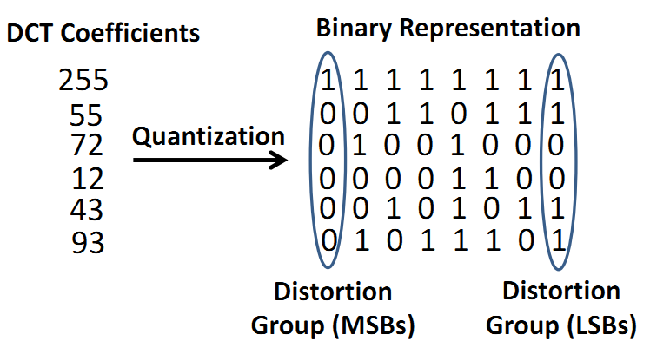
Distortion Grouping
Identify how important groups of bits are by estimating the amount of distortion they would cause if decoded in error

Slide 16
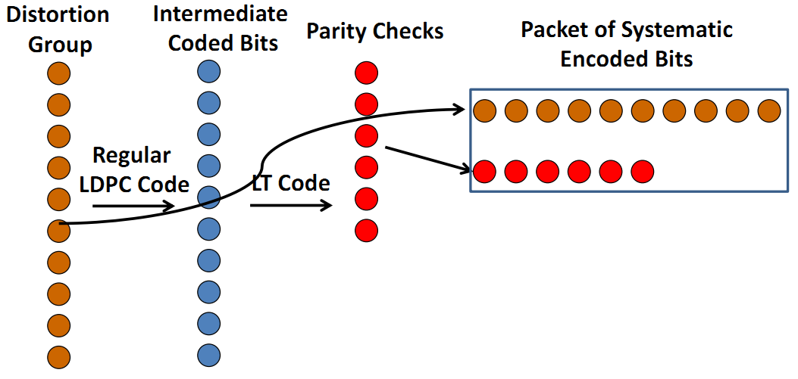
Rateless Code for UEP
To provide UEP, sender encodes each distortion group with a rateless Raptor code

Slide 17
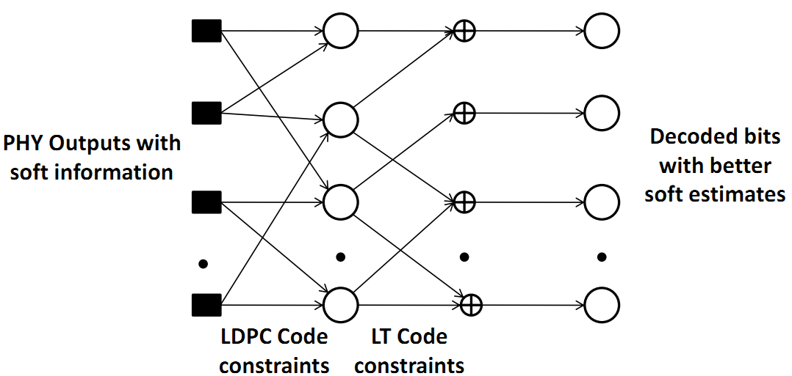
Soft Raptor Decoder
• PHY passes demodulated bits with soft information
• Apply Belief Propagation to decode Raptor Code and compute soft estimate for the DCT coefficient bits

Slide 18
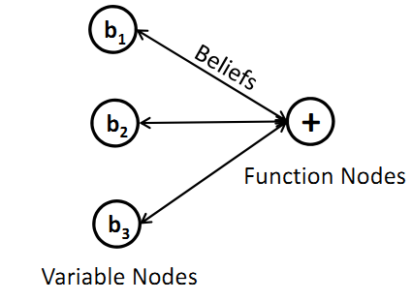
Soft Raptor Decoder
General case
Conflict case

Slide 19
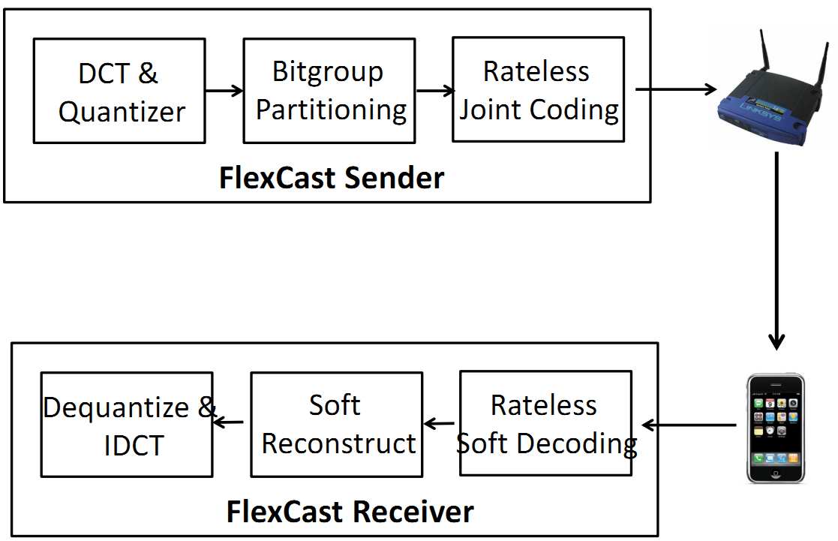
FlexCast Architecture

Slide 20
Experiment

Slide 21
Implementation
FlexCast is implemented by modifying standard MPEG4 implementation
Algorithms have linear complexity and are practical to implement

Slide 22
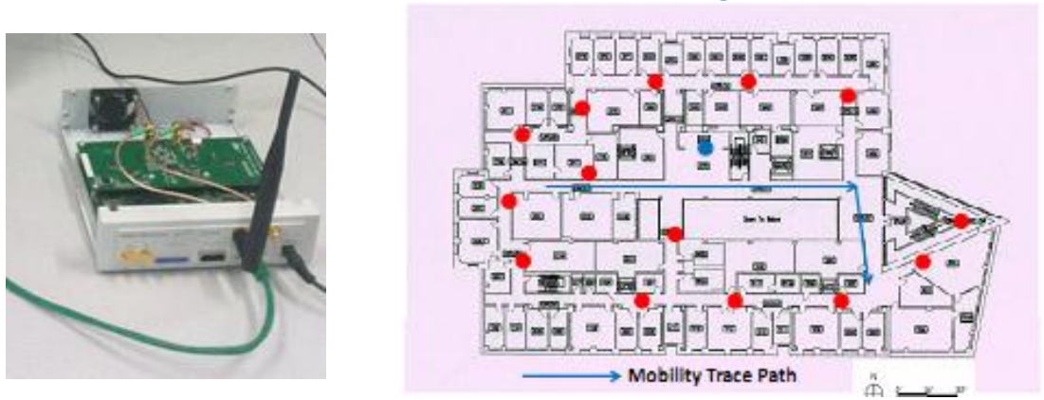
Evaluation Setup
Deployed in an 10 node indoor USRP2 testbed
PHY: WiFi style OFDM, 6.25 MHz channel
Standard WiFi convolutional coding rates

Slide 23
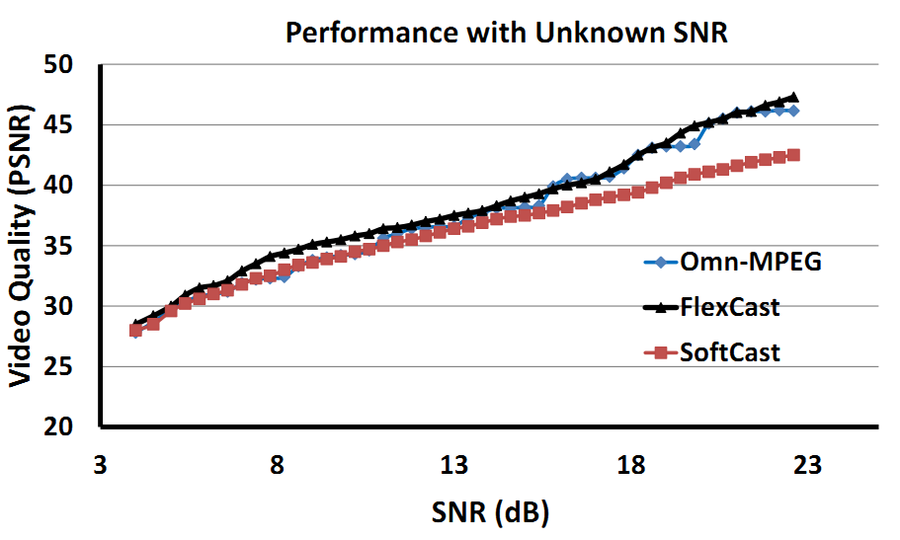
How Graceful is FlexCast?
FlexCast performs as well as the omniscient scheme without requiring any channel state knowledge

Slide 24
Trace Driven Emulation
Stanford RUSK channel sounder
High precision channel measurement
Continuous channel state information
2.426 GHz to 2.448 GHz (WiFi channel 6)
Each trace: 100000 measurements over 100 sec
10 mobility traces at walking speed ~ 3 mph
Simulate mobility by playing trace at increasing speeds

Slide 25
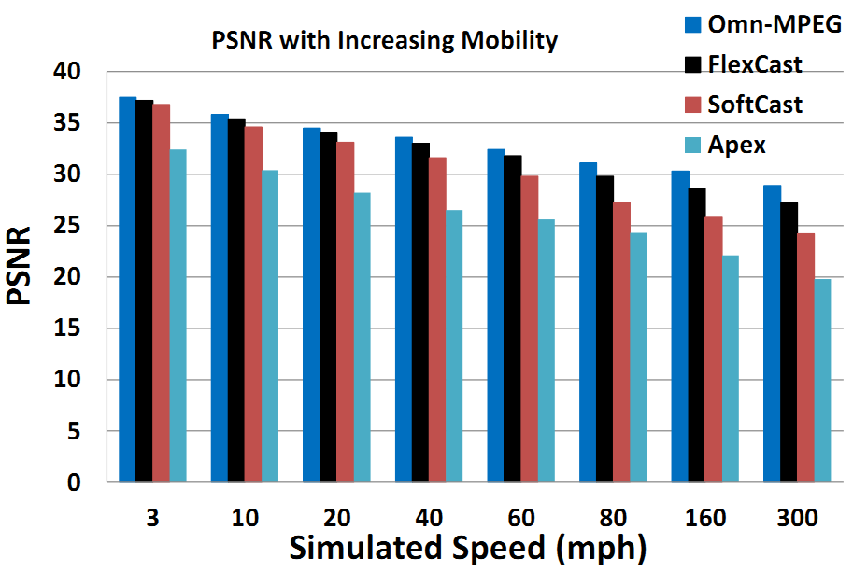
Performance with Increasing Mobility
FlexCast provides near optimal performance at high mobility

Slide 26
Conclusion
FlexCast provides graceful video streaming for dynamically varying wireless networks
Espouses a design philosophy that takes into account wireless channel properties to build modular robust protocols and systems

Slide 27
Reference
FlexCast: Graceful Wireless Video Streaming, S. Aditya and S. Katti, Mobicom'11
FlexCast Slide
http://www.sigmobile.org/mobicom/2011/slides/254-flexcast-slides.pdf
Raptor Codes
http://vod.cs.nthu.edu.tw/ezLMS/show.php?id=341&1313668771

