Slide 1
Improving Energy Efficiency of Wi-Fi Sensing on Smartphones
Kyu-Han Kim
2011/11/23

Slide 2
Abstract
Intermittent connectivity, and battery power drain in mobile devices, inhibits always-on connectivity even in areas with good Wi-Fi coverage.
WiFisense : low-power sensors
WiFisense saves energy consumption for scans by up to 79%
Notes:
斷斷續續的連接 + 電力消耗 都會抑制WIFI的連接，即使處於良好的WIFI區域
此PAPER採用WiFisense，在Scan部分，節省電力消耗高達79%

Slide 3
Introduction
Determine an optimal Wi-Fi sensing frequency for energy-efficient Wi-Fi discovery
Design a practical system that achieves both increased Wi-Fi usage and reduced energy consumption

Slide 4
Introduction
When to sense
User’s movement information
Disconnected sensing algorithms
Determine Wi-Fi scanning frequency adaptively based on user mobility and AP density information
Connected sensing algorithms
Pro-actively identify better APs

Slide 5
Optimal Sensing Interval Analysis
To maximize Wi-Fi discoveries for energy-constrained mobile devices, we need to find an optimal sensing interval that balances increased Wi-Fi access opportunities and sensing induced energy cost

Slide 6
Observations
Movement of mobile users
The velocity of mobile users is an important factor in determining the sensing interval.
Network information
Network information (e.g., AP density) does matter in determining the sensing frequency.
Heterogeneous Wi-Fi Networks
Each network provides different network characteristics (e.g., transmission range, RSS),

Slide 7
The WiFiSense Design
Leveraging user-mobility information
motion sensors
Adaptive use of network information
network information (AP density , RSS )
determines sensing frequency
Proactive sensing
proactively scan Wi-Fi access points (disconnected and connected sensing algorithms)

Slide 8
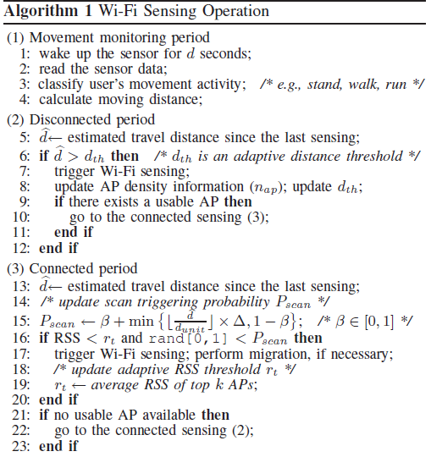
Wi-Fi Sensing Operation

Slide 9
Disconnected Sensing
The increase in user mobility can be translated to a higher number of discovered Wi-Fi access opportunities
There are several challenges to be solved

Slide 10
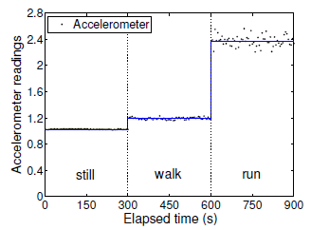
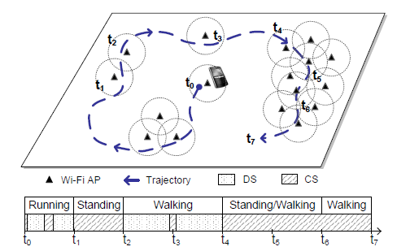
Movement/distance estimation
Accelerometer : lower energy cost
Monitoring network parameters
network information (node density and RSS)
Heterogeneous network environments
Rural -> sparse Wi-Fi -> increase dth ->save the energy

Slide 11
Connected Sensing
CS proactively scans Wi-Fi networks to find better APs with higher RSS as the mobile user moves.
Monitoring of connected state
not only monitor the conditions of the currently associated AP, but also sense other available APs’.
Coping with temporal and spatial RSS fluctuations
CS in WiFisense has to minimize false triggering of Wi-Fi sensing
Overhead for bandwidth estimation
CS needs to be equipped with energy-efficient bandwidth estimation tools

Slide 12
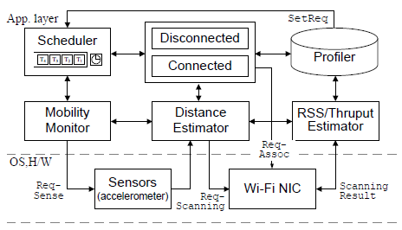
Implement Details
For Android , four major components
mobility module
sensing module
Wi-Fi condition monitor
profiler module

Slide 13
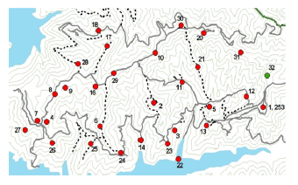
Experimental Setup
Outdoor and indoor
Forest , Visible AP : range from 0 to 8 (disconnected)
California, consists of 15 AP (connected)

Slide 14
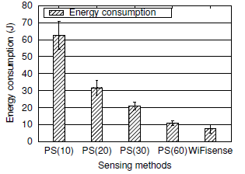
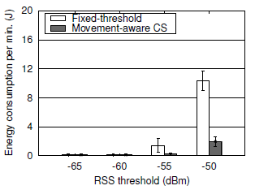
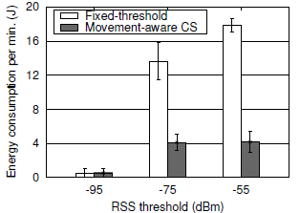
Experimental Results
Energy and delay gains of disconnected sensing
Energy benefit of movement-aware connected sensing
Pros and cons of movement-aware CS
Adaptation of triggering thresholds

Slide 15
Indoor
Stand
Indoor
walk
outdoor
Stand
outdoor
walk
High RSS
Low RSS

Slide 16
Conclusion
Our evaluation results show that WiFisense reduces energy consumption in scanning by up to 79%, while reducing false-triggering to 4.3%.

