Slide 1
J-RoC: a Joint Routing and Charging Scheme to Prolong Sensor Network Lifetime
Zi Li, Yang Peng, Wensheng Zhang, and Daji Qiao
Iowa State University, Ames, IA, USA IEEE 2011

Slide 2
propose
Prolong Sensor Network Lifetime
Find max network lifetime
Consider two part: Data routing, charging path

Slide 3
Routing Cost
Nodes periodically broadcast beacons
The beacons are broadcasted periodically, nodes can dynamically change their parents.
Receiving the costs from neighbor nodes, sensor node i calculates it‘s energy-minimum routing cost
c’i node i routing cost
ETX i,j ,t number of transmissions needed to send a packet successfully
over link (i, j).
Notes:
Beacon 訊號

Slide 4
Charge aware routing cost
Es is the battery capacity
ei,j,t =
Charge energy
estimates the nodal energy consumption rate

Slide 5
Charging Scheduling
First, selects a set of sensor nodes that should be charged in the next Tc interval. Secondly, it determines a sequence in which the sensor nodes are charged so that the movement time is minimized.
Maximize
ρi be the percentage of charging energy that should be allocated to sensor node i in one Tc interval.
Notes:
Ci,t future nodal energy consumption rate ρi be the percentage of charging energy that should be
allocated to sensor node i in one Tc interval.

Slide 6
Future nodal energy consumption rate C i,t =
erx and etx expected energy consumed to transmit and receive a packet
Si,t the set of energy-minimum paths from sensor node i to the sink rj,t future sensory data packet generation rate of node i estimated at time t

Slide 7
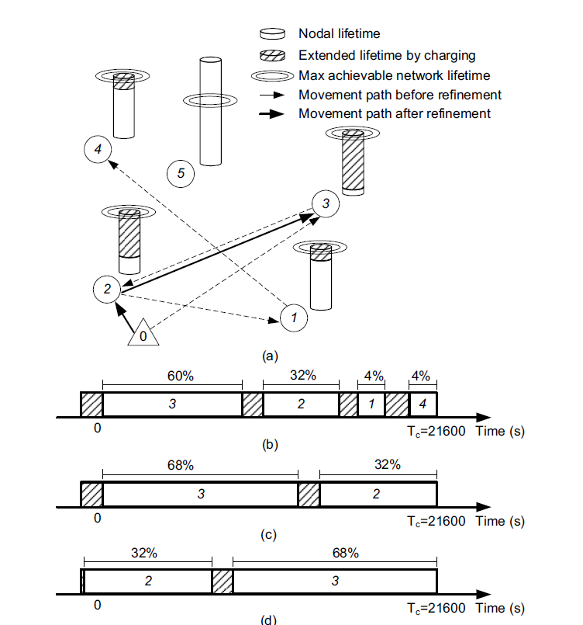
Charging sequence
Merge
VRPTN

Slide 8
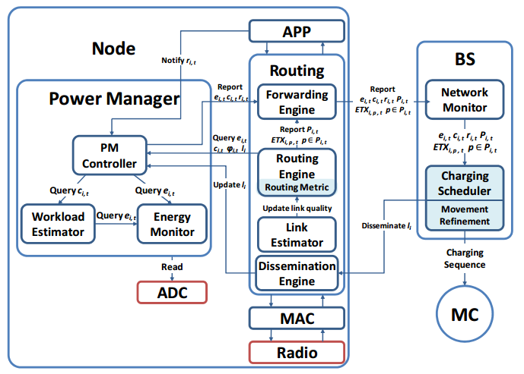
prototype system

Slide 9
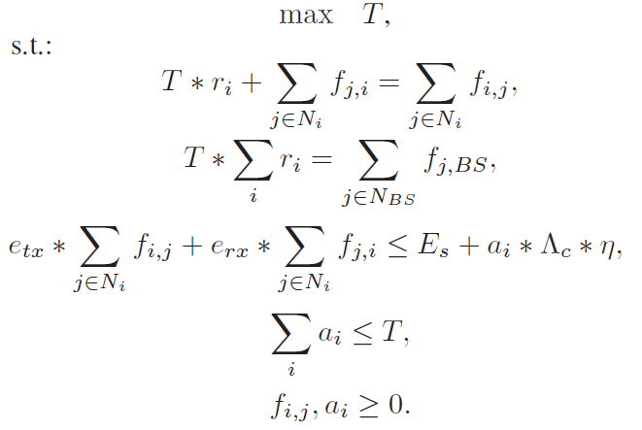
Optimal solution
0
the MC’s movement delay is ignored and the link qualities are perfect
Life time
Flow constraint
Total charge time

Slide 10
Conclution

