Slide 1
Juggler: Virtual Networks for Fun and Profit
Anthony J. Nicholson, Scott Wolchok, and Brian D. Noble
IEEE TRANSACTIONS ON MOBILE COMPUTING 2010

Slide 2
Background
Juggler’s design is based on VirtualWiFi
This system maintains a set of virtual networks and switch between multiple AP or ad hoc network
VirtualWiFi uses the 802.11 power saving mode (PSM) to coerce APs into buffering downstream packets while the client is communicating with another AP or peer

Slide 3
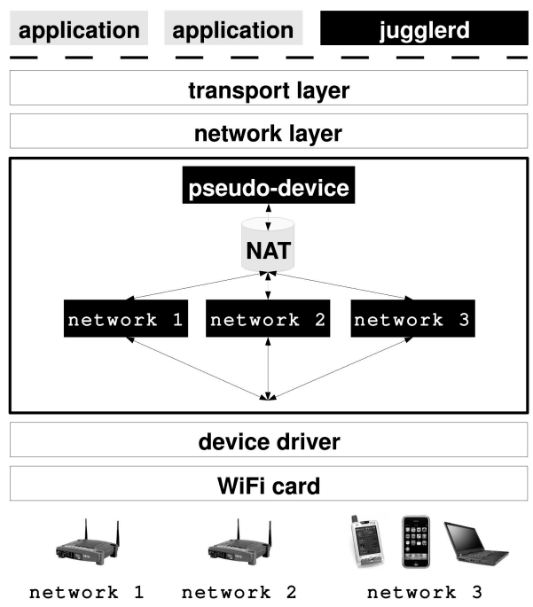
JUGGLER(1)
JUGGLER is added to the network stack between link layer and network layer
Not force all applications to bind their data flows to specific access points

Slide 4
JUGGLER(2)
This system consists of two main parts.
The first is an in-kernel component between link layer and network layer.
The second is an application-level that handles access point discovery and configuration.

Slide 5
JUGGLER(3)
For every configured virtual network, Juggler tracks the following state:
Network type (infrastructure or ad hoc);
SSID;
MAC address (BSSID);
Frequency (channel number);
IP address, default gateway, netmask, DNS server(s);
An outbound packet queue;
An ARP cache; and
Radio duty cycle fraction that the network is active.

Slide 6
JUGGLER(4)
Assigning Flows to Networks
JUGGLER using the SO_BINDTODEVICE socket option to bind a socket to an interface when multiple NICs are available
Sending and Receiving Packets
Juggler use NAT to translate to sending and receiving packets

Slide 7
JUGGLER(5)
Switching between Virtual Network
First, coerce the current access point into buffering packets destined for the client while the radio is communicating with another virtual network.
Next, Juggler updates the radio’s wireless parameters via the device driver.
Juggler then transmits a power-save poll (PSPOLL) frame to the new AP.
If the AP has any enqueued packets destined for the client, it transmits until all enqueued packets have been received.

Slide 8
Implementation
Juggler kernel code is a standalone kernel module, a patch to the Linux 2.6.22.14.
Modify the open-source rtl-wifi driver, which leverages the common Linux IEEE 802.11 software MAC layer.

Slide 9
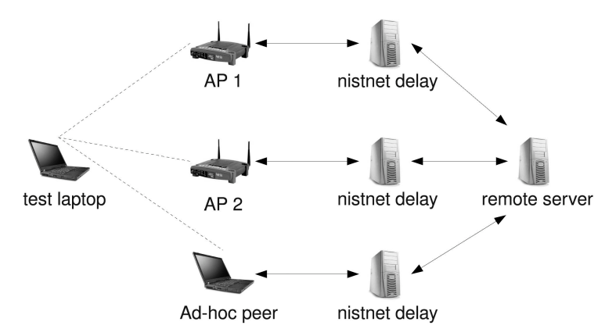
Experiment Set Up
Configured two Linksys WRT54G 802.11g access points on disjoint channels (1 and 11) and different subnets (192.168.0.x and 192.168.1.x)
Install NISTNet on all gateway machines to simulate different network condition

Slide 10
Microbenchmarks
Use an x86 assembly language instruction rdtsc to estimate the number of CPU cycles to switch to different AP.
Connected to two different APs on different channels, and recorded the time required to switch networks over 10,000 times.

Slide 11
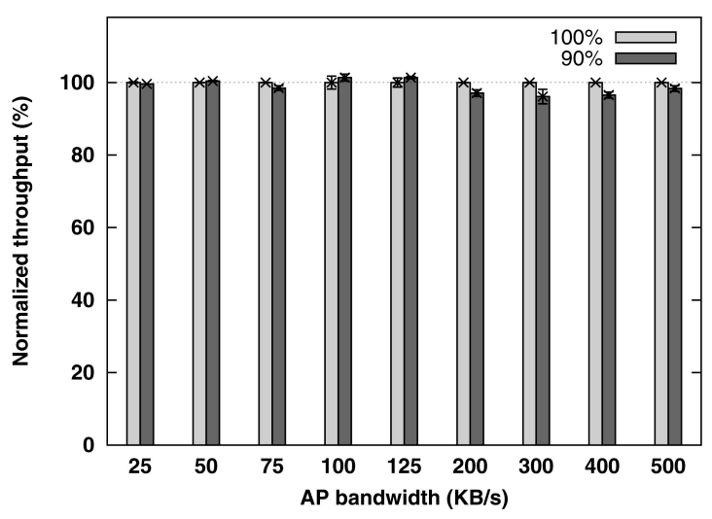
Application Scenarios(1)
Soft handoff between WiFi APs
Assign 90 percent of the radio’s duty cycle to the current “primary” AP.
10 percent of radio cycles are devoted to scanning for new access points and maintaining association with one or more secondary APs.

Slide 12
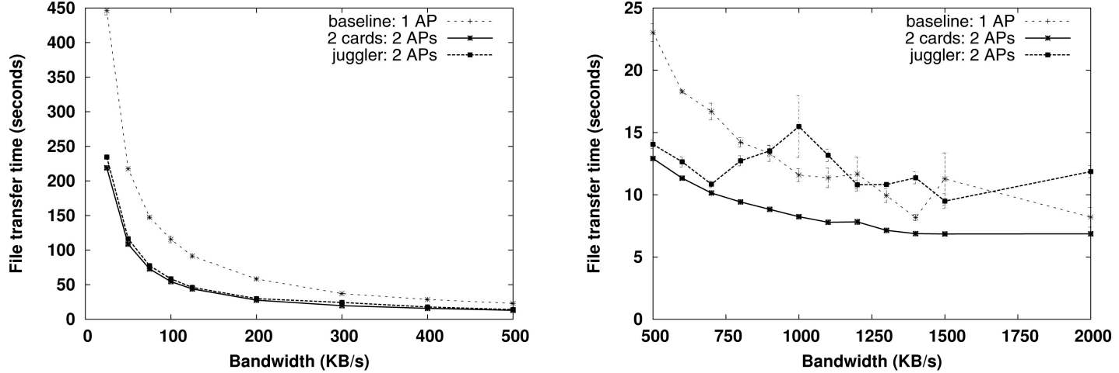
Application Scenarios(2)
Data Striping and Bandwidth Aggregation
Use Juggler to associate with both APs, each with 50 percent duty cycle, switching between APs every 100 ms
Download a 10 MB file from the remote server

Slide 13
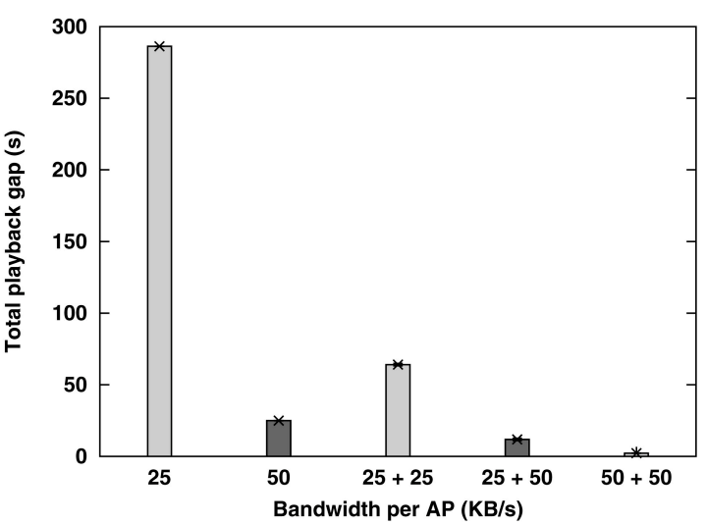
Application Scenarios(3)
Streaming Video
Use a 10 MB video, encoded with 400Kbps bitrate
Streaming over two APs, each 50 KB/s bandwidth, avoids wait time completely for 95 percent compared with baseline.

Slide 14
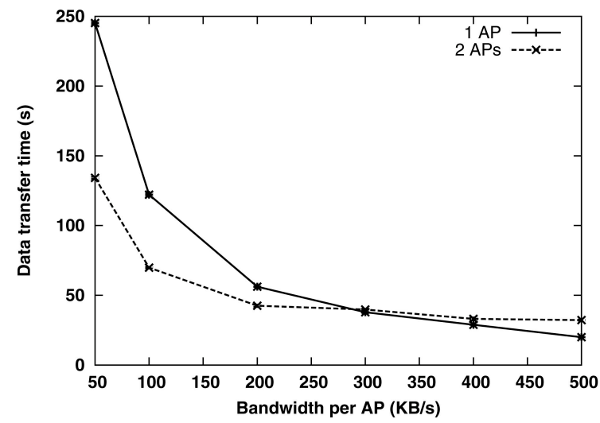
Application Scenarios(4)
BitTorrent
Modify KTorrent 2.4, an open-source BitTorrent client, to evaluate the usefulness of striping a torrent download across multiple APs.
Download a 10 MB file.

Slide 15
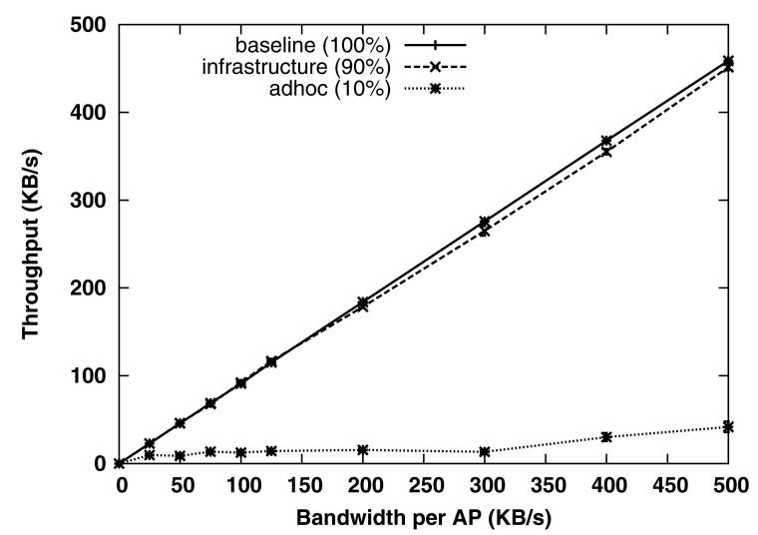
Mesh and Ad Hoc Connectivity
Allocated 90 percent of the radio’s duty cycle to an infrastructure AP.
The remaining 10 percent duty cycle, Juggler connected to another test laptop in ad hoc mode

Slide 16
Conclusion
This paper presented Juggler, a link-layer implementation of an 802.11 virtual networking service.
Juggler switches between wireless networks in just over 3 ms, or less than 400 μs if networks share the same wireless channel.

