Slide 1
Mechanism Design for Spatio-Temporal Request Satisfaction in Mobile Networks
Christine Bassem and Azer Bestavros
February 10, 2012

Slide 2
Outline
Abstract
Introduction
GRS Problem
GRS Games
Performance Evaluation

Slide 3
1)Abstract
Design a mechanism for Geo-temporal Request Satisfaction(GRS) problem.
Objective: Maximize the total profit of the system.
Notes:
Geo-temporal Request Satisfaction (GRS) problem as that of finding the optimal assignment of requests with specific spatio-temporal characteristics to competitive mobile agents subject to spatio-temporal constraints.

Slide 4
2)Introduction
Geo-Presence: the capability of an application to access devices at particular geographical locations and particular times.
Geo-Presence-Capable System
Geo-Presence as a Service (GPaaS) Framework
Notes:
geo-presence is supported through the use of dedicated agents operating in proprietary cyber-physical infrastructures, such as embedded sensors and actuators, or input and output devices that are mounted in physical spaces.

Slide 5
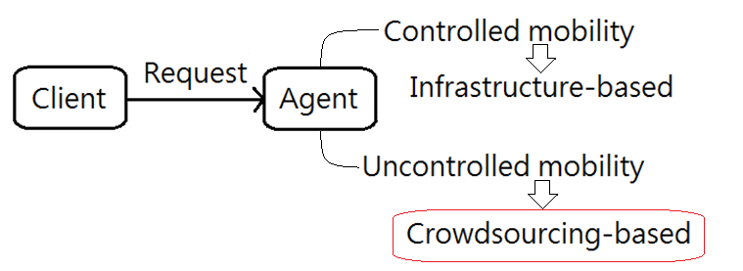
Geo-Presence-Capable System
Notes:
-Controlled mobility
Robotics
Mobile wireless sensor networks
-Uncontrolled mobility
Opportunistic sensor networks
Crowdwoursing applications (Focus on here!!!)

Slide 6
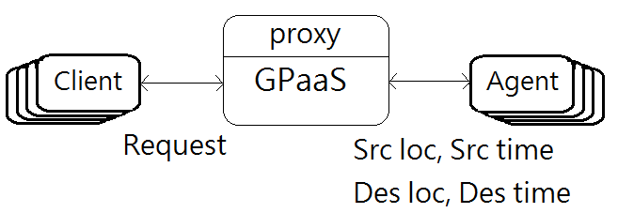
Geo-Presence as a Service (GPaaS) Framework
Notes:
GPaaS framework is on-demand and is non-archival, i.e., data is only collected when requested
and is not stored for future use.

Slide 7
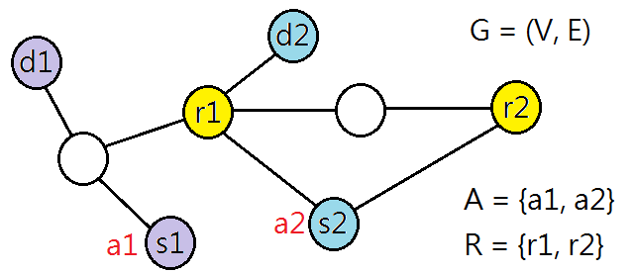
3)Geo-temporal Request Satisfaction (GRS) Problem
Element in A:
Element in R:
Notes:
p(): valuation dunction
c(): cost
t: desired time
The total profit of the system is defined as the difference between the total valuation obtained from the serviced requests as defined by their valuation functions and the total cost incurred by the agents servicing these requests as defined by their cost functions.

Slide 8
GRS problem is NP-Complete
Reduce to the Hamiltonian Cycle problem.
Request:
Agent:
Element in A:
Element in R:
Notes:
|V| = l(el)
there exists a single request for each location in the graph that can be satisfied at any time but only in its desired location.

Slide 9
4)GRS Games
Players take turns in making better response moves that maximize their utility until all players are satisfied with their path choices.
The utility
Domination Rule
Never reach Nash Equilibrium
Notes:
Due to the NP-Complete nature of the GRS problem, we develop a heuristic mechanism that takes into consideration the rationality of the agents, and recasts the problem in a game-theoretic setting.
The objective of the game is to achieve a total profit that is as close as possible to the social optimal

Slide 10
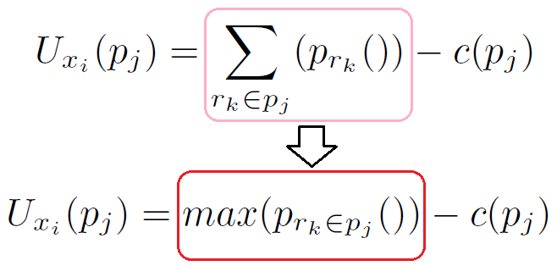
Multi-stage Request Satisfaction Game
The game:
Reaches Nash Equilibrium
Polynomial time
Notes:
The dependability of the player's utility function in the GRS game on the total valuation of all requests serviced on the path chosen is the reason the game does not always converge under better response dynamics.

Slide 11
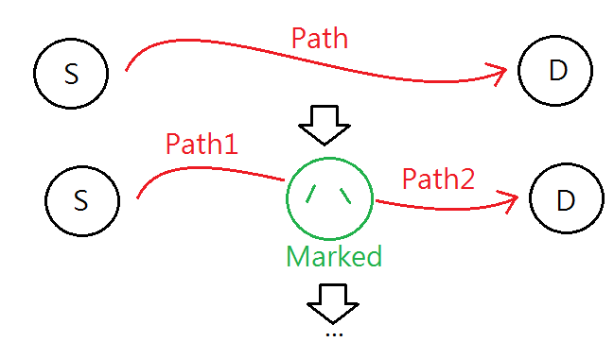
Prove Polynomial Time
By Divide-and-Conquer
the worst case: O(|R|)
Notes:
No requests are satisfied, so the whole GRS1 game ends
Only a single request is satisfied from a total of n requests, thus leaving n -1 requests to be satisfied in the next stage
3) More than one request (i) is satisfied from a total of n requests, thus leaving n-i requests to be satisfied
in the next stage

Slide 12
5) Performance Evaluation
For Simplicity
All requests: Same valuation function
All agents: Same cost function
cost function
Element in A:
Element in R:
valuation function

Slide 13
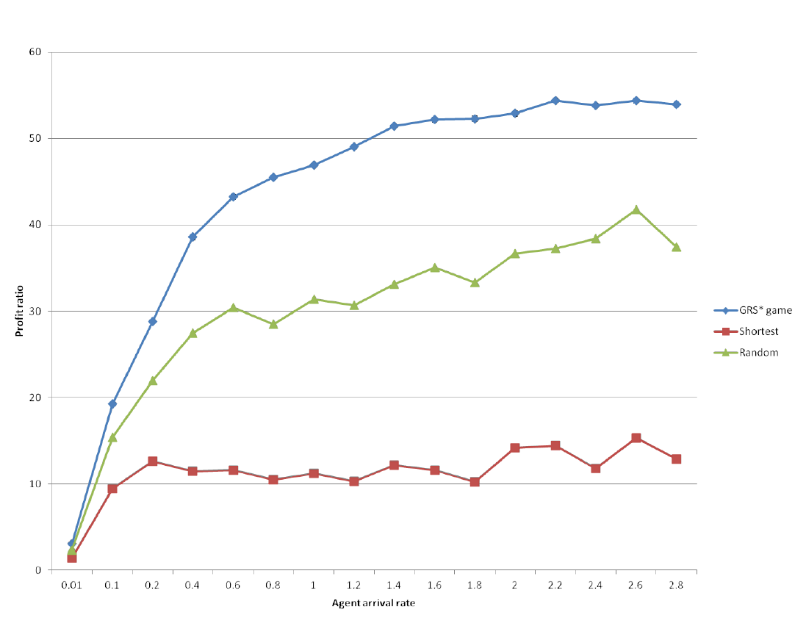
MRS game vs shortest path vs random path

Slide 14
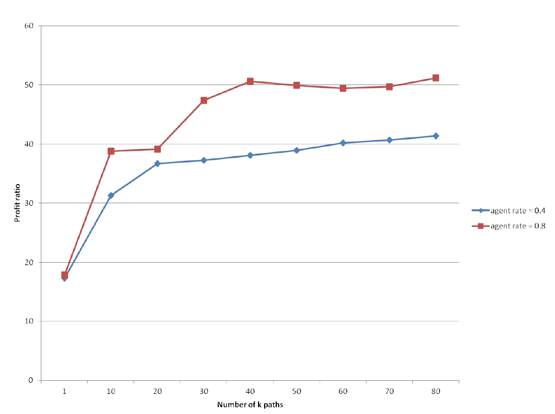
Increasing the number of k-shortest paths
Yen's ranking algorithm

Slide 15
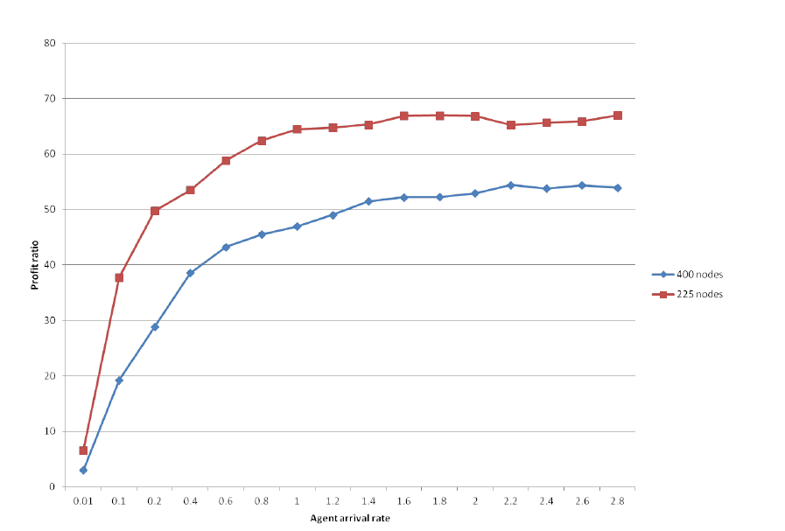
Increasing the agent's density in different sized graphs

Slide 16
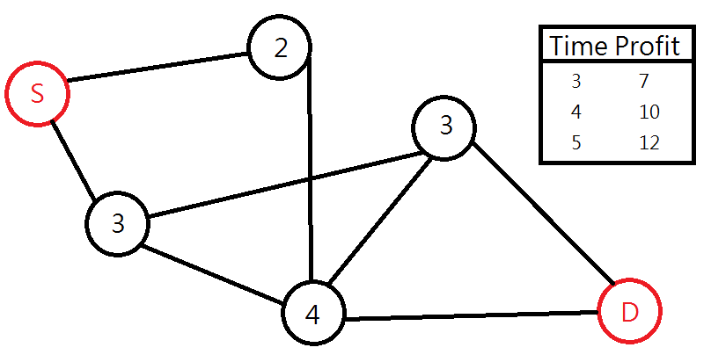
Compared to OP(1/2)
OP: Orienteering Problem
Maximize the total profit
Every vertex is visit at once
Limited time

Slide 17
Compared to OP(2/2)
 |  | GRS | OP
Same | Request | Pay-as-you-go | Pay-as-you-go
Diff. | Goal | Maximum System Profit | Maximum Player Profit
 | Limit | Each spot can be reached more than once | Each spot can be reached just once

Slide 18
Conclusion
They propose a mechanism for game.
Weakness:
It’s heuristic method
Choosing a path is computationally expensive

