Slide 1
Multi-camera Vehicle Tracking Using Local Image Features and Neural Networks
Multimedia Communications, Services and Security. Springer Berlin Heidelberg, 2012.

Slide 2
Overview
Introduction
Moving Object Segmentation
Multi-camera Tracking
Experiments and Results
Conclusion

Slide 3
Introduction
Multi-camera tracking
Local features of objects
An Artificial Neural Network(ANN)
Great generalization capabilities
Fast learning
Small footprint
Notes:
Tracking objects that cross fields of view of multiple cameras is a require feature for advanced surveillance systems.
Most of approaches about multi-camera tracking require a calibrated camera field of view, or some approaches need to site objects first.
The solution described in the paper doesn’t require calibrated fields of view, it utilizes local features of objects and employ an artificial neural networks to learn each object appearance and then to recognize it in another camera.
Why choose artificial neural network?
Comparing to other identification solutions like super vector machine, ANN has great generalization capabilities, fast learning, small footprint.
It will be helpful in real-time video processing system because of these features.
The experiments in this paper were carried out with vehicle images only, but the solution is universal. It means it can be used in tracking on another objects.

Slide 4
Moving Object Segmentation
Reduce amount of data for analysis
Detect moving objects
Movements of the detected objects
Notes:
In order to reduce amount of data for analysis
First, he uses a algorithm based on background modeling method, it can detect moving objects and remove shadow pixels
Then, he uses a method based on Kalman filters that allow predicting object position in the current frame based on observations in previous frames
So only segmented images of moving objects are used for further processing and there is no need to analyze all images of every object.
And an object image is analyzed only if the defined amount of time t elapsed since the last image acquisition and only if the object moved a predetermined distance d
This approach helps to reduce amount of data for analysis 3 to 10 times depending on object movement characteristics.

Slide 5
Multi-camera Tracking

Slide 6
Spatial and Temporal Filtering
Spatial rules involve hot areas in each camera field of view
Time duration of object transition between cameras is limited
Notes:
In order to facilitate the task, spatial and temporal rules are employed.
Spatial rules involve hot areas in each camera field of view.
In a video frame of each camera, hot areas are selected manually.
They represent entry or leave regions in a video frame and are defined as polygons placed on roads.
For an object leaving a video frame in one of hot areas, its data are sent only to the nearest cameras, and new objects in a video frame are treated as candidates for comparing if they appeared in a hot area only.
And the time duration of object transition between cameras is limited

Slide 7
Spatial and Temporal Filtering
Notes:
Look at this picture.
The orange polygons are hot areas.
This condition is met if an object entered the hot area, and then left the hot area, and it moves in the direction of the frame center.
Similarly, the object is considered leaving the camera field of view if it it entered a hot area, left the hot area and moving in the direction opposite to the direction of the frame center.

Slide 8
Object Image Features
Object pose changes and Different optical settings of a camera
Speed Up Robust Features (SURF)
A scale and rotation invariant local image descriptor
Notes:
Object image features chosen for object identification in different cameras’ fields of view should be robust against object pose changes and different optical settings of a camera, So Speed up robust features have been selected for the task.
Speeded Up Robust Features (SURF) [8] is a scale- and rotation-invariant local image descriptor around a selected interest point.
SURF parameters are based on gray-level images therefore they are less sensitive to color differences than color-based features.

Slide 9
Object Image Features
Interest points are chosen automatically with Fast-Hessian detector
Reduce fluctuations in the number of interest points
Modify the detector’s threshold
[DK – 10%, DK + 10%] , DK = 25
Notes:
Interest points are chosen automatically with fast-Hessian detector.
The Hessian detector is a feature detector used in the fields of computer vision and image analysis.
Because the number of interest points may vary significantly for different images, an approach has been implemented to reduce fluctuations in the number of interest points.
When the number of interest points K exceeds the target range [DK – 10%, DK + 10%], where DK = 25, the Fast-Hessian detector threshold is incremented or decremented and the detection is repeated.

Slide 10
Object Identification
An Artificial Neural Network (ANN)
Positive training samples
Formed by the object features
Negative training samples
Formed by features of other objects that passed the field of view of the camera during the last T minutes
Notes:
ANN is trained on images of the single object captured by one camera and then it is used to recognize the same object in images acquired by another camera.
Positive training samples are formed by the object features described in the previous section.
Negative samples are formed by features of other objects that passed the field of view of the camera during the last T minutes.
So the ANN is trained to distinguish one particular object from other, possible similar objects that could be found in the same area and time.

Slide 11
Object Identification
The ANN response
each response r is assigned a weight w
All ANN responses are aggregated
Notes:
In order to identify the object seen in camera in video frames acquired from another camera , it is necessary to find the most similar object out of all candidates for matching. And here’s the equations
The response r represents the similarity of vector to local features of the object.
Each response r is assigned a weight w that represents ANN response reliability.
All ANN responses are aggregated
Object A is matched with object B if it has the highest aggregated response R from all responses of other objects’ images

Slide 12
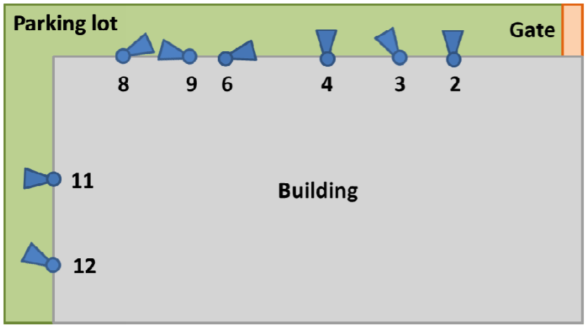
Experiments and Results
Placement of cameras
Sample images of a vehicle entering (upper row) and leaving (lower row) a parking lot
Notes:
For the purpose of experiments, a video surveillance installation covering a part of the parking lot.
The experiments have been used about 10 hours of video streams from each camera.
This is the placement of cameras used for the experiment.

Slide 13
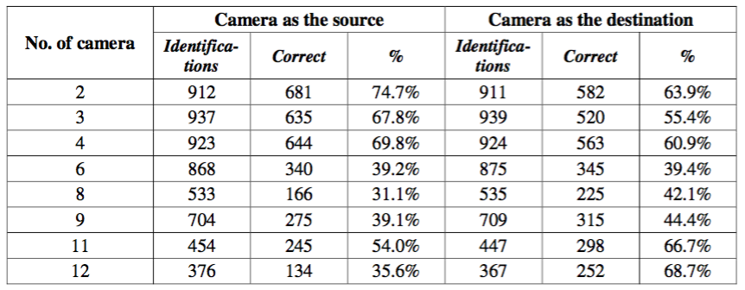
Experiments and Results
Results of vehicle identification for a specific camera as the source and as the destination
Notes:
We can see no.6,8,9,12
Because of the most different orientation from other cameras

Slide 14
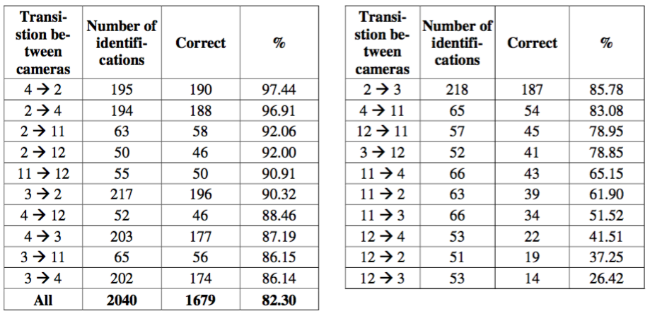
Experiments and Results
Results of vehicle identification for each pair of cameras
Notes:
We can see the transitions originating from camera no. 12 is the worst because its field of view differs the most from other cameras.

Slide 15
Experiments and Results
Statistics of aggregated responses R of ANNs for all images of positive (valid) and negative (invalid) vehicles

Slide 16
Conclusion
The results achieved prove that local image features and artificial neural network is sufficient to identify vehicles provided that the orientations of cameras are similar.
In case of significant different cameras’ orientation from other cameras

Slide 17
Progress update
Done
Establish web UI for smart bike
Todo
Stream the videos on web

