Slide 1
The orienteering problem: A survey (2011)
Pieter Vansteenwegen Wouter Souffriau Dirk Van Oudheusden

Slide 2
Outline
Introduction
Orienteering problem (OP)
Team Orienteering problem (TOP)
Orienteering problem with time window (OPTW)
Team Orienteering problem with time window (TOPTW)

Slide 3
Introduction - Orienteering Problem (OP)
Originate
From the sport game
Known as
The selective travelling salesperson problem (1990, 1998, 2003)
The maximum collection problem (1988, 1994)
The bank robber problem (1998)
Notes:
The sport game- individual competitors start at a specified control point, try to visit as many checkpoints as possible and return to the control point within a given time frame. Each checkpoint has a certain score and the objective is to maximize the total collected score.

Slide 4
OP – Problem Definition

Slide 5
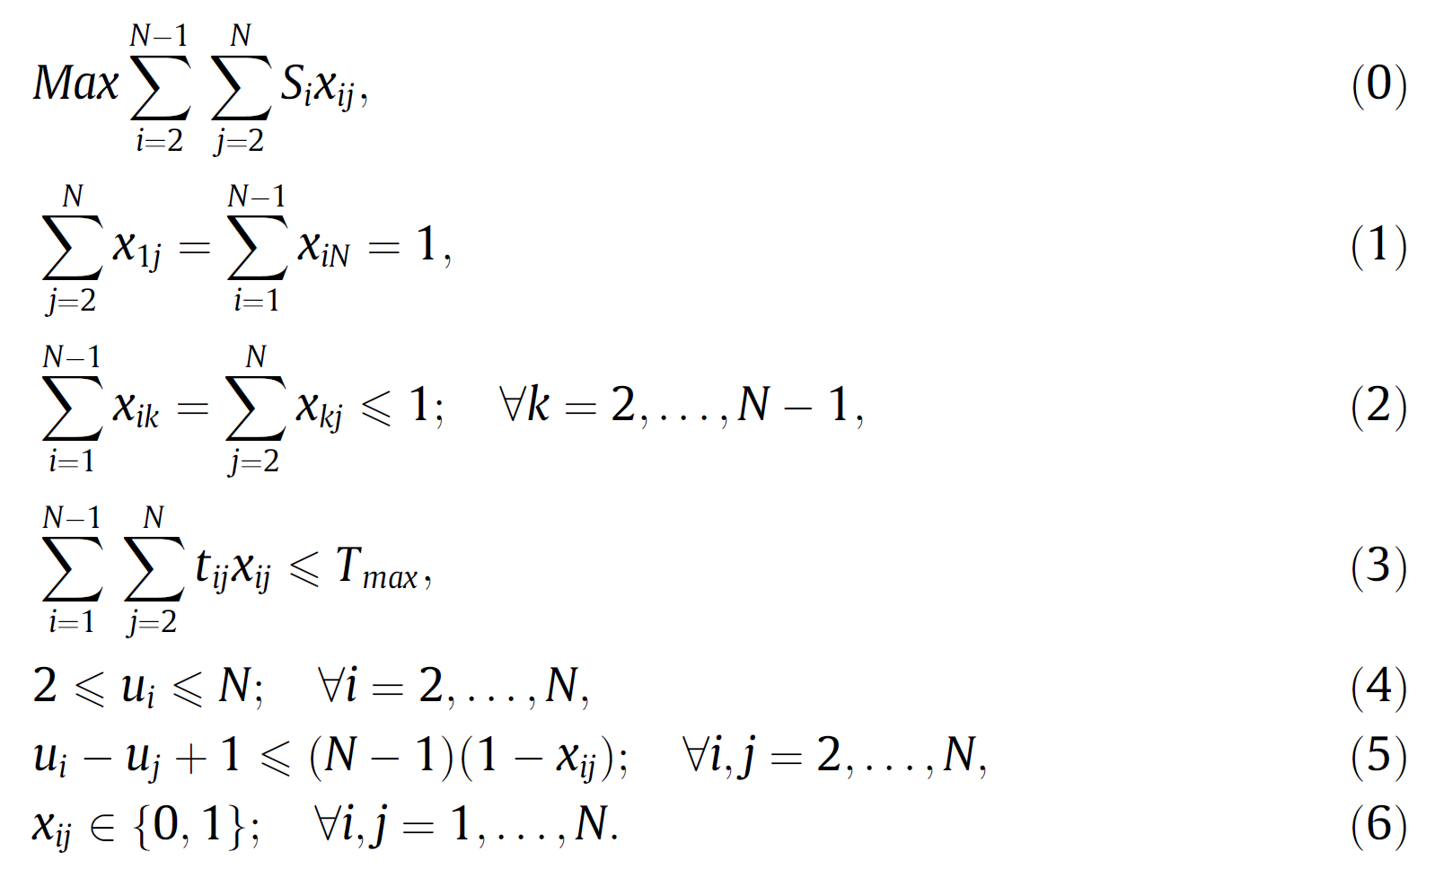
OP – Mathematical Formulation
Notes:
The objective function (0) is to maximise the total collected score.
Constraints (1) guarantee that the path starts in vertex 1 and ends in vertex N.
Constraints (2) ensure the connectivity of the path and guarantee that every vertex is visited at most once.
Constraint (3) ensures the limited time budget.
Constraints (4) and (5) are necessary to prevent subtours.
These subtour elimination constraints are formulated according to the Miller–Tucker–Zemlin (MTZ) formulation of the TSP (Miller et al., 1960).

Slide 6
OP – Practical Application
The home fuel delivery problem (1987)
Tourist trip design problem (TTDP, 2007)

Slide 7
OP – Solution Approach
Exact Algorithm
Branch-and-bound (1990, 1992)
Instances < 20 , 150 vertices
Branch-and-cut (1998)
Instances < 500 vertices

Slide 8
OP – Solution Approach
Heuristic
The stochastic and deterministic Algorithm (1984)
The centre-of-gravity heuristic (1987)
The four-phase heuristic (1991)
The five-step heuristic (1996)
Also published the first heuristic for the TOP
A tabu search heuristic (1998)
A solution approach for a multi-objective variant of the OP (2009)
Notes:
H1)
The S-Algorithm is based on generating m any paths and selecting the best. It uses a Monte-Carlo method to select the next vertex
Both algorithms are extended with a path-improvement algorithm (R-IAlgorithm). to be added to the path.
H2)
The first step is a path construction process
The second step is an improvement procedure which uses 2-Opt (Lin, 1965) and cheapest insertion.
The third step is the centre-of-gravity step
2009) They developed a Pareto ant colony optimisation algorithm and a multi-objective variable neighbourhood search algorithm,
both hybridised with path relinking.

Slide 9
TOP – Problem Definition
Notes:
The TOP corresponds to playing the game of orienteering by teams of several persons, each collecting scores during the same time span.

Slide 10
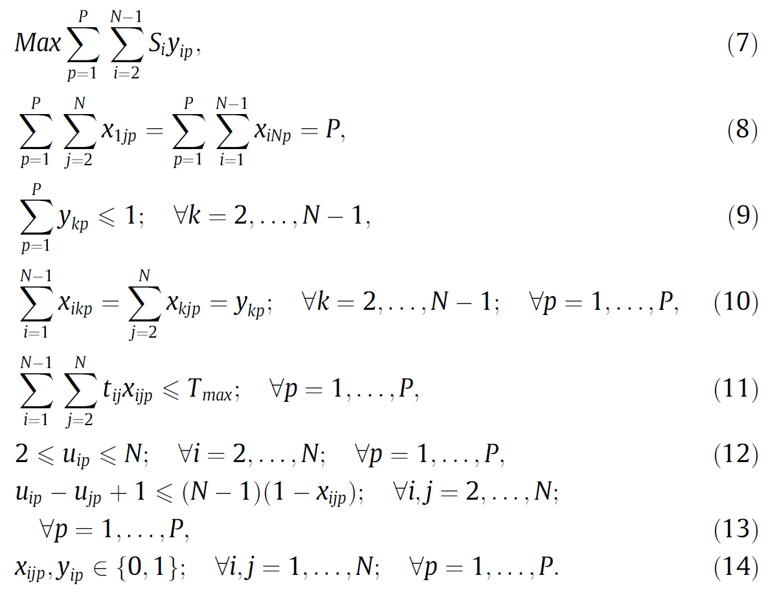
TOP – Mathematical Formulation
Notes:
The objective function (7) is to maximise the total collected score.
Constraints (8) guarantee that each path starts in vertex 1 and ends in vertex N.
Constraints (9) ensure that every vertex is visited at most once.
Constraints (10) guarantee the connectivity of each path.
Constraints (11) ensure the limited time budget for each path.
Constraints (12) and (13) are necessary to prevent subtours.

Slide 11
TOP – Practical Application
Athlete recruitment from high schools (1994)
Routing technicians to service customers (2005)
Notes:
A recruiter has to visit several schools in a given number of days.
He can first assign a score to each school, based on its recruiting potential.
As the recruiter’s available time is limited, he has to choose the schools to visit each day and try to maximise the recruiting potential.
Each TOP path represents a single technician who can only work a limited number of hours in a day.
Thus, not all customers requiring service can be included in the technicians’ daily schedules.
A subset of customers will have to be selected, taking into account customer importance and task urgency.

Slide 12
TOP – Solution Approach
Exact Algorithm
Using column generation (1999)
Problems <= 100 vertices
Branch-and-price scheme (2007)
Limited discrepancy search
Label loading
Meta extensions
Notes:
They start with column generation and couple this with branch-and-bound to obtain a branch-and-price scheme.
Problems with 100 vertices where few vertices can be selected (until around 15 per path), are solved in less than two hours of computation time.

Slide 13
TOP – Solution Approach
Heuristic
A tabu search heuristic (TMH) embedded in an Adaptive Memory Procedure (AMP) (2005)
Two variants of a tabu search heuristic and a Slow and Fast Variable Neighbourhood Search (SVN and FVN) (2007, 2008, 2009)
An Ant Colony Optimisation (ACO) approach (2008)
A Skewed Variable Neighbourhood Search (SVNS) framework (2009)
designed two variants of a Greedy Randomised Adaptive Search Procedure (GRASP) with Path Relinking (in press)
Notes:
Vansteenwegen et al. (2009b,c) were the first to focus on obtaining good TOP solutions in only a few seconds of computational time.

Slide 14
OPTW – Problem Definition
OP with Time Window

Slide 15
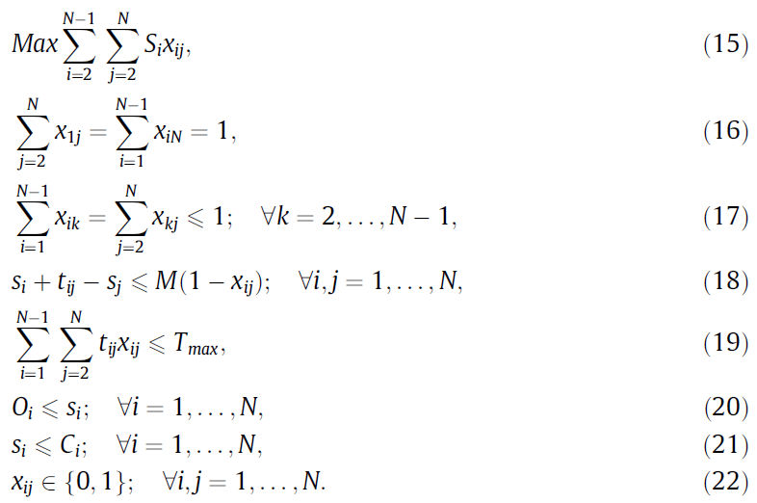
OPTW – Mathematical Formulation
Notes:
The objective function (15) maximises the total collected score.
Constraints (16) guarantee that the path starts in vertex 1 and ends in vertex N.
Constraints (17) determine the connectivity and ensure that every vertex is visited at most once.
Constraints (18) ensure the timeline of the path and constraint (19) limits the time budget.
Constraints (20) and (21) restrict the start of the service to the time window.
The time window of the end vertex N may replace constraint (19).

Slide 16
OPTW – Solution Approach
Kantor and Rosenwein (1992) were the first to solve the OPTW. They first describe a straightforward insertion heuristic.
Righini and Salani (2006, 2009) designed an exact algorithm, bi-directional dynamic programming, to solve OPTW instances to optimality.

Slide 17
TOPTW – Problem Definition
TOP with Time Window

Slide 18
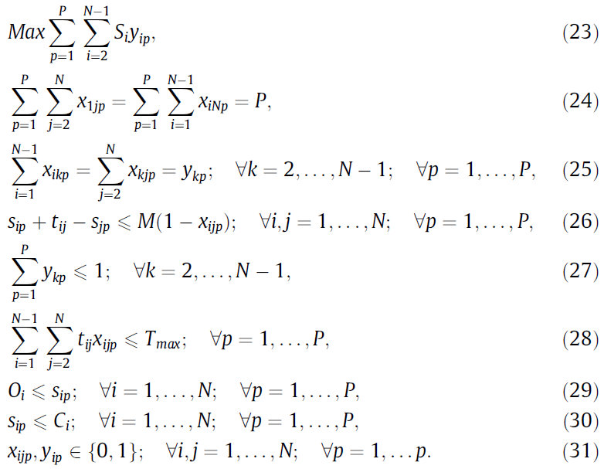
TOPTW – Mathematical Formulation
Notes:
The objective function (23) maximises the total collected score.
Constraints (24) guarantee that all paths start in vertex 1 and end in vertex N.
Constraints (25) and (26) determine the connectivity and timeline of each path.
Constraints (27) ensure that every vertex is visited at most once and constraints (28) limit the time budget.
Constraints (29) and (30) restrict the start of the service to the time window.
Again, the time window of the end vertex N can replace constraints (28)

Slide 19
TOPTW – Solution Approach
Montemanni and Gambardella (2009) based their algorithm to solve TOPTW instances on ant colony optimisation.
Vansteenwegen et al. (2009) designed a very fast Iterated Local Search (ILS) metaheuristic to deal with TOPTW instances.
Notes:
the ILS approach of Vansteenwegen et al. (2009d) has the advantage of being very quick and the approaches of Montemanni and Gambardella (2009) and Tricoire et al. (2010) have the advantage of obtaining high quality solutions

Slide 20
Possible Future Research Lines
New and larger (T)OP test instances should be developed to be able to better distinguish the performance of different and future approaches.
Not much attention is given to the arc routing problem with profits.
Almost all OP papers assume uncapacitated vehicles

Slide 21
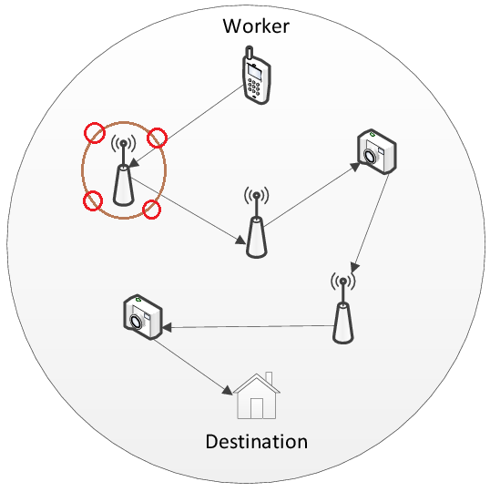
Our Research’s Difference from OPTW
Service time
A node split to multi-node
Cost

