Slide 1
Random Partial Paired Comparison for Subjective Video Quality Assessment via HodgeRank
Qianqian Xu, Tingting Jiang, Yuan Yao, Qingming Huang, Bowei Yan, Weisi Lin,
ACM Multimedia 2011

Slide 2
Problems in Related Works
Mean Opinion Score
  Unable to concretely define the concept of scale
  Dissimilar interpretations of the scale among users
  Difficult to verify false ratings
Paired Comparison
  The number of video pairs to be judged is large
  How to choose pairs ?
  Inconsistency ( A > B > C > A )

Slide 3
Problems in Related Works
Crowdsourcing
  Incomplete data
  Imbalanced data

Slide 4
HodgeRank on Random Graphs
HodgeRank
  Determine global ranking form data
Erdös-Rényi Random Graph
  Set edge between each pair with equal probability p, graph will be covered while p > threshold

Slide 5

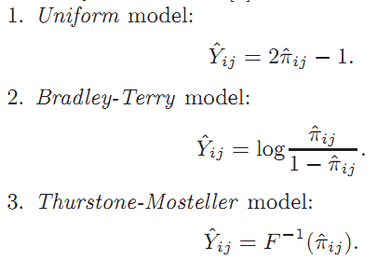
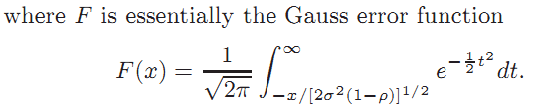

HodgeRank

Slide 6

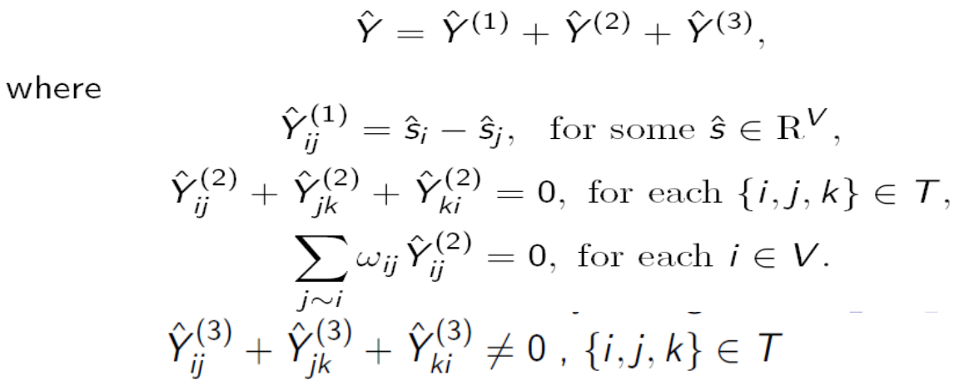

HodgeRank
$χ\left(G\right)=\left(V,E,T\right)$

Slide 7
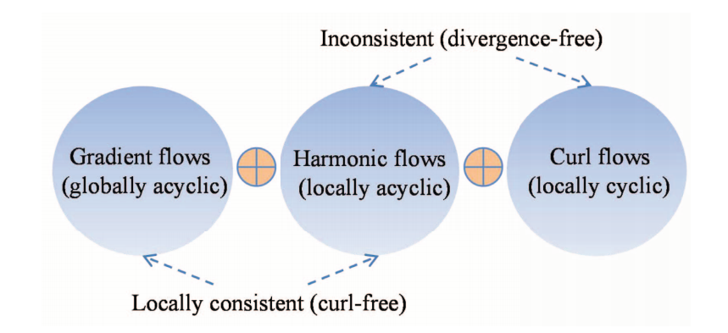
HodgeRank

Slide 8
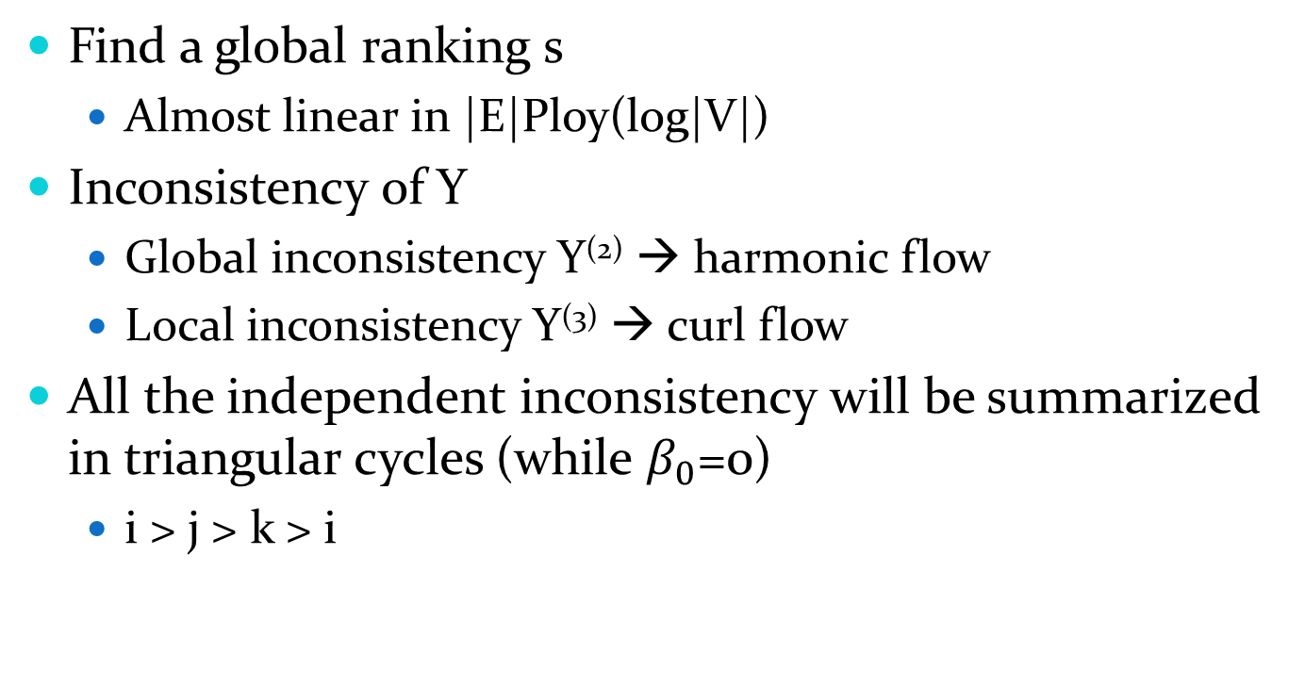
HodgeRank
Find a global ranking s
  Almost linear in |E|Ploy(log|V|)
Inconsistency of Y
  Global inconsistency Y⁽²⁾ → harmonic flow
  Local inconsistency Y⁽³⁾ → curl flow
All the independent inconsistency will be summarized in triangular cycles (while $β_{0}$=0)
  i > j > k > i

Slide 9
Erdös-Rényi Random Graph
Resulting graph should be
  Connected → compare all videos
  Loop free → deal with inconsistency

Slide 10
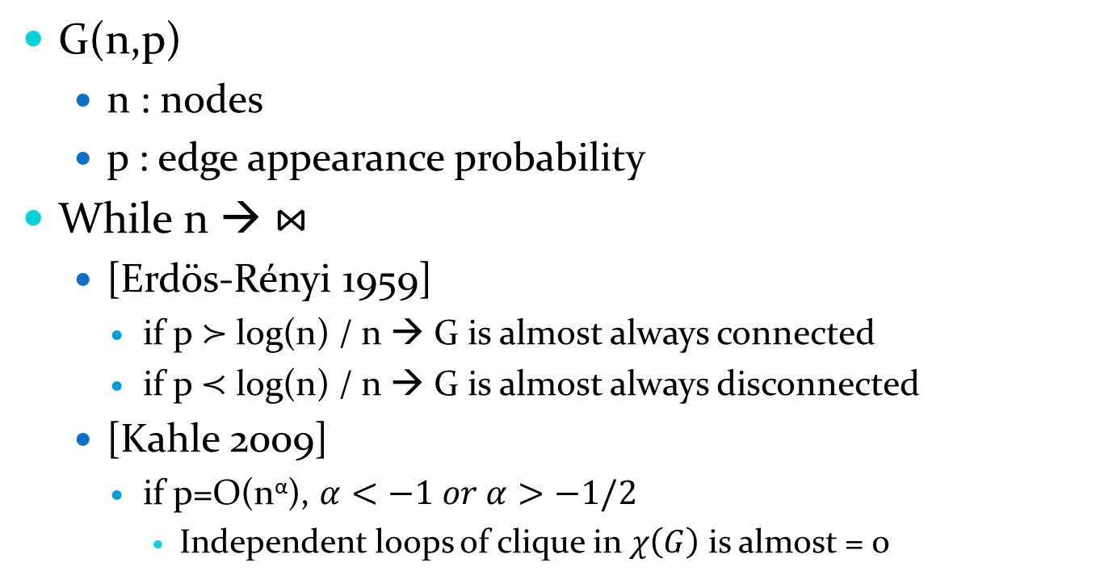
Erdös-Rényi Random Graph
G(n,p)
  n : nodes
  p : edge appearance probability
While n → $⋈$
  [Erdös-Rényi 1959]
    if p $≻$ log(n) / n → G is almost always connected
    if p $≺$ log(n) / n → G is almost always disconnected
  [Kahle 2009]
    if p=O(n^{α}), $α<−1 or α>−1/2$
      Independent loops of clique in $χ\left(G\right)$ is almost = 0

Slide 11

Erdös-Rényi Random Graph
We need to monitor Betti numbers
  $β_{0}$ : the number of connected components
  $β_{1}$ : the number of independent loops

Slide 12
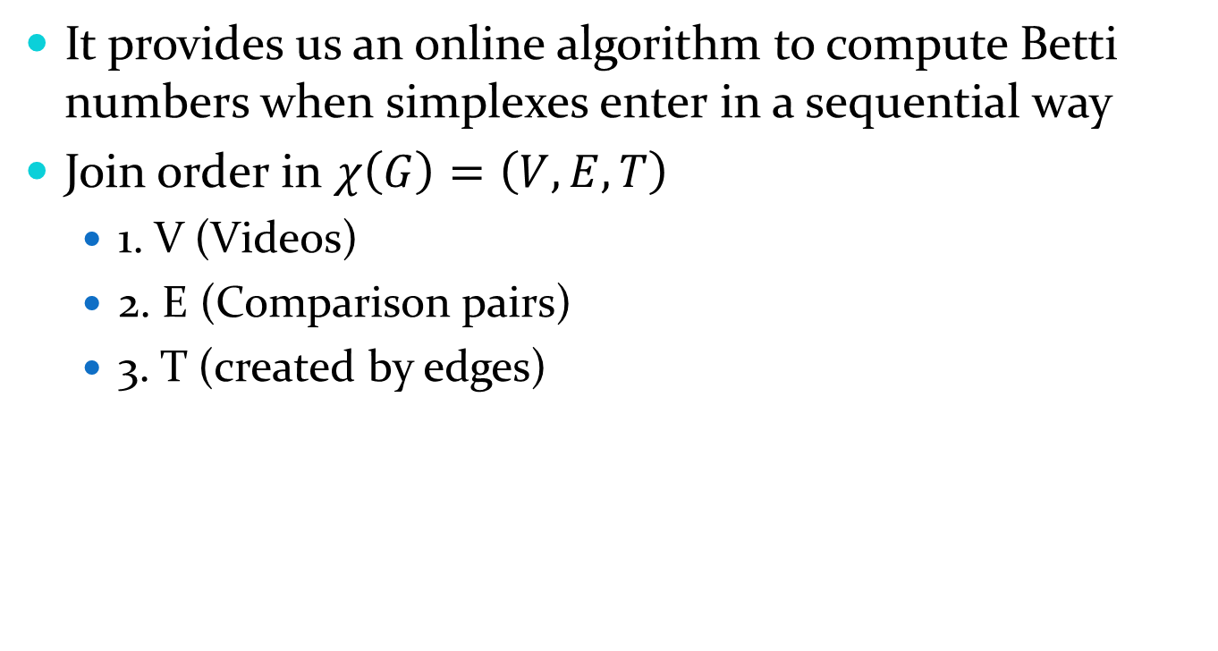
Persistence Homology
It provides us an online algorithm to compute Betti numbers when simplexes enter in a sequential way
Join order in $χ\left(G\right)=\left(V,E,T\right)$
  1. V (Videos)
  2. E (Comparison pairs)
  3. T (created by edges)

Slide 13
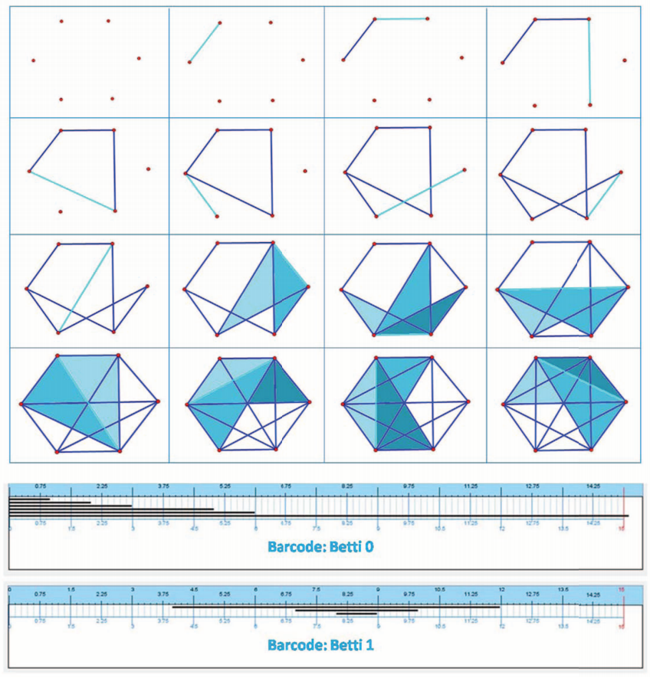
Persistence Homology

Slide 14
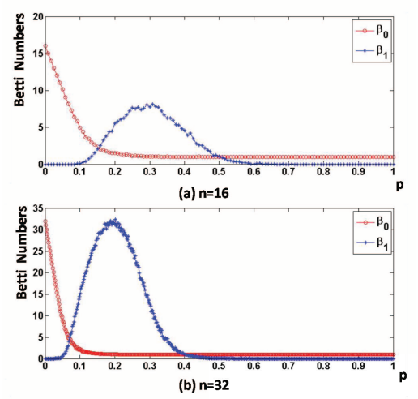
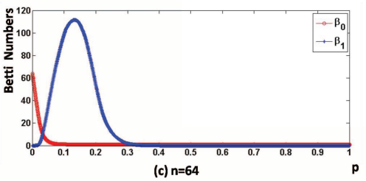
Persistence Homology

Slide 15
Experiments
Dataset
  10 different reference videos
  15 distorted version of each
  About 10 seconds of each
  Wide range objects
    Textures, motions and camera movements

Slide 16
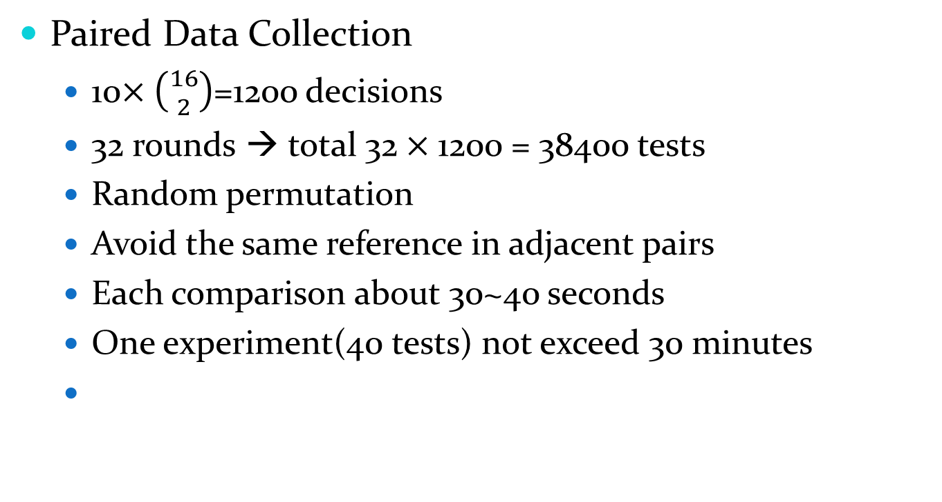
Experiments
Paired Data Collection
  10$×\left({16 \atop 2}\right)$=1200 decisions
  32 rounds → total 32$×$1200 = 38400 tests
  Random permutation
  Avoid the same reference in adjacent pairs
  Each comparison about 30~40 seconds
  One experiment(40 tests) not exceed 30 minutes

Slide 17


Experimental Results
Total inconsistency
Harmonic percentage

Slide 18
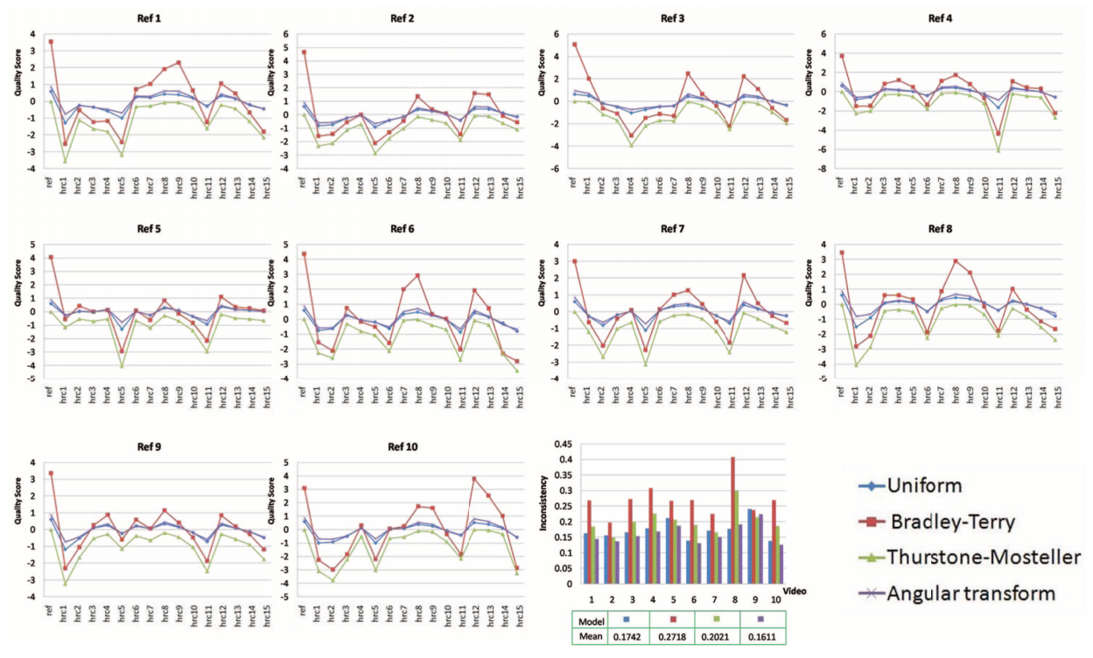
Experimental Results

Slide 19


Experimental Results
Results of Incomplete Data
Kendall rank correlation
  Measure the rank correlation between global ranking from in complete and incomplete data
  Value =
    +1 → correlation
    -1 → perfect inverse
    0 → random ranking

Slide 20
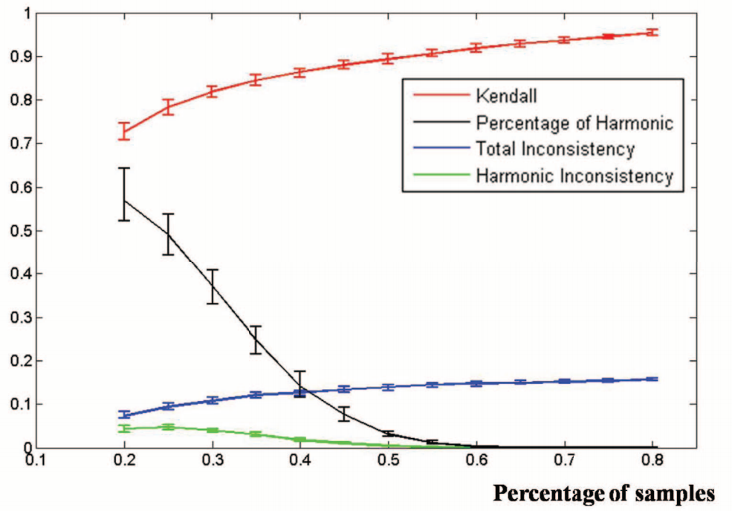
Experimental Results

Slide 21
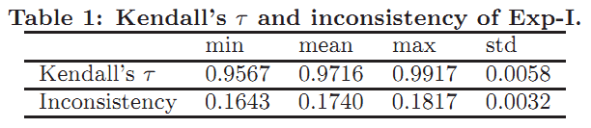
Experimental Results
Random sampling
  Exp-I : group balanced random sampling
    For each of 10 videos, for each of 32 groups, pick 75% pairs
    Each group contains the same number of pairs
    Approximate results of the complete data
      Inconsistency = 0.1611 (Angular transform)

Slide 22
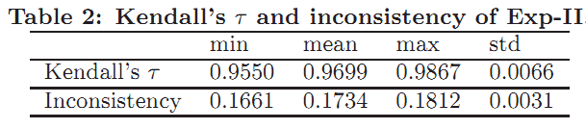
Experimental Results
Random sampling
  Exp-II : group imbalanced random sampling
    For each of 10 videos, pick 75% pairs
    Each group may not contains the same number of pairs

Slide 23
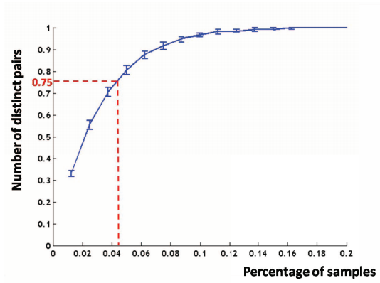
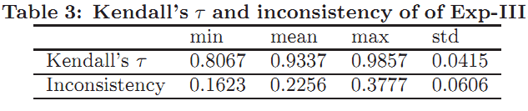
Experimental Results
Random sampling
  Exp-III : sufficient-coverage random sampling
    Random pick pairs
    Only require at least 75% edges of the graph are covered
    Fast and suitable for crowdsourcing

Slide 24
Conclusions
3 sampling schemes inspired by Erdös-Rényi Random Graphs
HodgeRank to analyze the incomplete and imbalanced data
Suitable for group studies and crowdsourcing

Slide 25
Future work
Detect inconsistencies only resulting from careless inputs
Online learning on sampling

