Slide 1
Exploring Source Routed Forwarding in SDN Based WANs
Mourad Soliman*, Biswajit Nandy*, Ioannis Lambadaris*, Peter Ashwood-Smith
* Carleton University, ON, Canada. Huawei Canada, Kanata, ON, Canada
* {msoliman, bnandy, ioannis}@sce.carleton.ca, peter.ashwoodsmith@huawei.com
IEEE ICC 2014 - Next-Generation Networking Symposium

Slide 2
Introduction
Software Defined Networking relies on the separation of control and data planes.
Control and data plane to evolve independently
SDN raises performance concerns regarding
Network convergence time at both flow initiation and failure recovery.

Slide 3
Challenge
Reducing the latency in the communication process between the controller and the switches is usually not an option in a WAN : constrained by
physics regarding propagation speeds
physical topology.
Reduces the volume of communication between switches and controllers

Slide 4
Controller’s placement impacts performance
Performance varies widely with different placement choices
only a small percentage of these choices are near optimal

Slide 5
Source routing methods
Strict Source Routing requires that every hop be included in the header
Loose Source Routing allows for some hop-by-hop behavior mid path
centralized SDN-network controller has a global view of the entire network
it is capable to perform path computations efficiently thus making source routing a natural fit for SDN architecture

Slide 6
Related Work in Conventional Network
AXON [13] proposes a novel source-routed Ethernet protocol
Transfer data through a network of source-routing-enabled Ethernet-compatible devices called Axons
provides greater performance and scalability than conventional switched Ethernet network architectures

Slide 7
SecondNet: MPLS labels
SecondNet [6] introduce the notion that a stack of MPLS labels consumed one by one at each hop
Create Strict Source Routed behavior
Problem:
MPLS labels are large in size; 20 bits, and the stack size upper bounds would limit the diameter of the network
Popping labels hides the path the packet has taken so far, makes network troubleshooting even more difficult and reduces security

Slide 8
SDN based source routing
Rain Man propose a scalable SDN Datacenter solution that also leverages means of source routing and is compatible with architectures like SecondNet.
Segment Routing as alternative source routing based solution to achieve simplicity, better traffic engineering and fast reroute capabilities

Slide 9
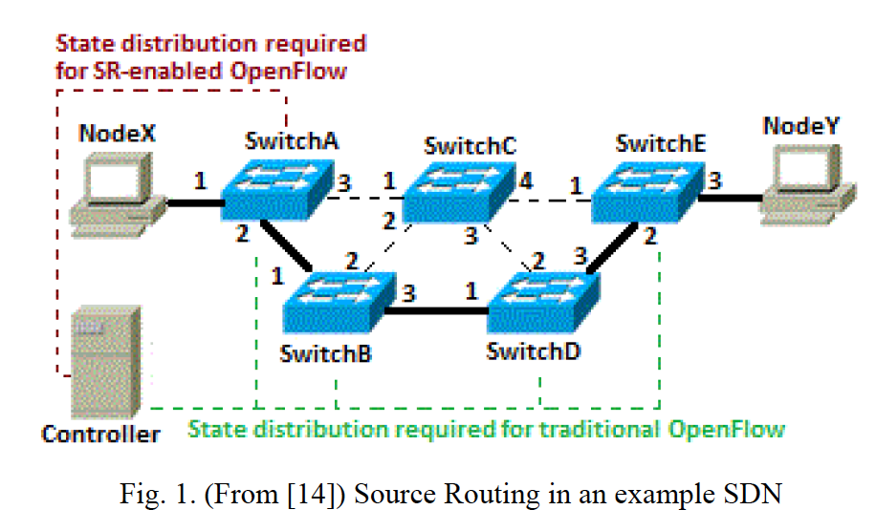
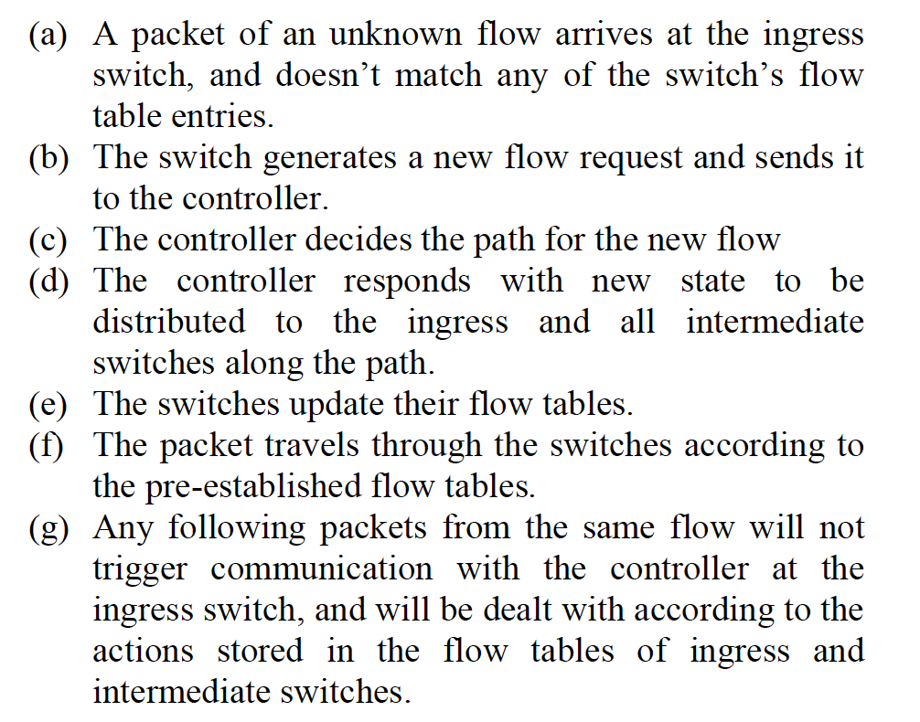
Conventional Hop-by-Hop routed
Reduced by Source Routed

Slide 10
Source Routed
Step (d), takes at least time equal to the maximum RTT between the controller and each of the intermediate
Source routing in a WAN eliminates most of step (d) from the flow setup time
The path information would be put in the form of a source route and pushed down to the ingress switch only.
The source route information will be recorded in the header of every packet in a given flow

Slide 11
Source routed
NodeX to NodeY along the highlighted path, a header can be embedded in the packets with the path expressed as the sequence {2,3,3,3}
v.s. MPLS Tunnel
reverse path calculation and local link failure recovery (Work in progress )

Slide 12
Implementation in SDN
OpenFlow-enabled Switches
new action type is defined to encapsulate a new header : path-header,
Path-headers will hold a sequence of interface numbers that the flow will be forwarded through at each respective intermediate node

Slide 13
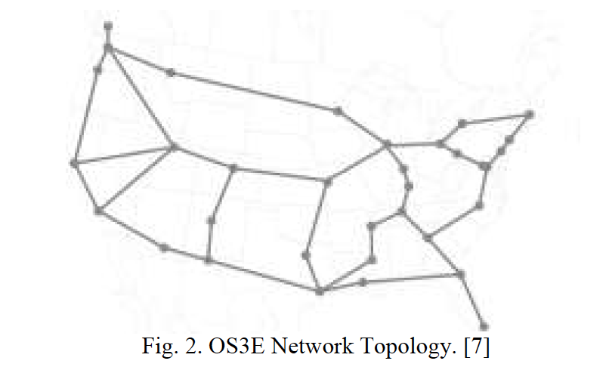
Performance Analysis
The computational performance analysis is based on modeling a production SDN-based WAN.
Internet2 has deployed a 34-node SDN across the US to support advanced scientific research called OS3E [1].

Slide 14
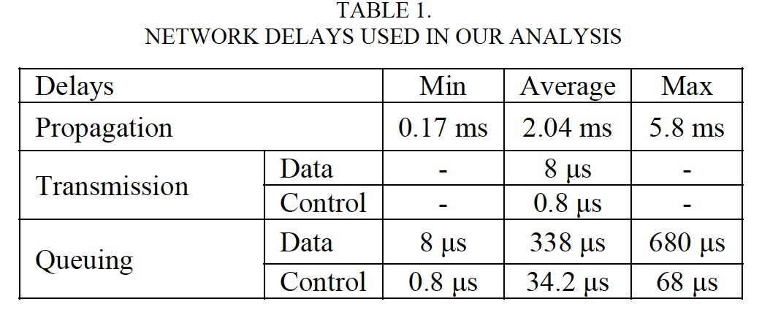
0S3E specification
Different sources of network delays were taken into account such as propagation delays, transmission delays and queuing delays.
state installation delays are relatively small enough

Slide 15
First step: network convergences time using the optimal controller placement
Network convergence time is defined as the total time the first packet of an unknown flow takes from source to destination.
Traditional SDN: the time taken by
the ingress switch to communicate the unknown flow information to the controller
the controller’s processing,
the controller’s state distribution and receiving acknowledgements from intermediate nodes on the selected flow path
packet propagation along the selected path.
Reduced by Source Routed

Slide 16
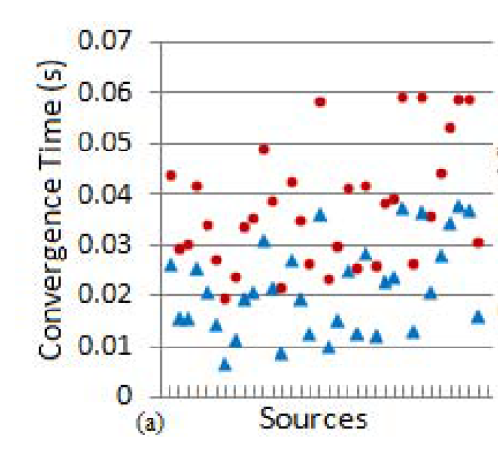
Avg. Convergence time
average convergence time for all the source nodes in the case of source routing is substantially lower than the case of hop-by-hop routing
source routing achieves a 41.7% decrease in the average convergence time compared to hop-by-hop routing
Red dot : hop-by-hop
Blue dot: source routing

Slide 17
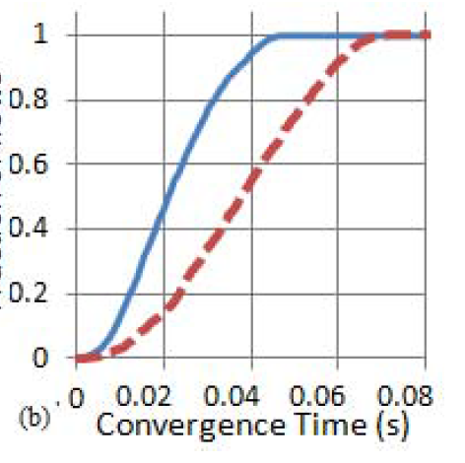
Fraction of flows
source routing 92% of the flows have convergence time less than 40ms, against only 55% for hop-by-hop routing
A significant improvement in overall network convergence performance that directly affects flow initialization as well as network fault recovery

Slide 18
V.S. Proactive mode
network core by installing flow table entries in the core switches explaining how possible flows should be handled ahead of time.
Disadvantage:
Controller communicates with all the network core elements and installs entries about all the possible flows
require storing a large number of entries in the flow tables
Change or failure will require redistribution
Source routing eliminates the need of the above methods

Slide 19
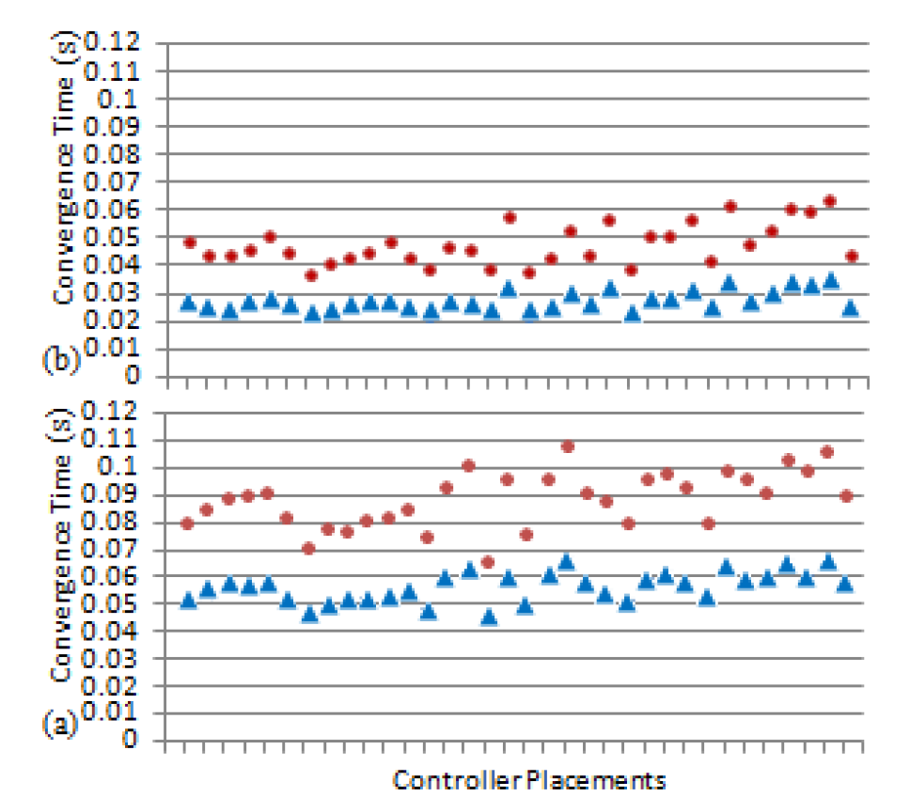
Step two: Controller Placements
Two performance metrics; average and worst case node-to-controller latency
53% reduction in the standard deviation of the average convergence times over all the placements when using source routing
Avg.
Controller placement

Slide 20
Worst case convergence time
As source routing brings a 47% reduction in the standard deviation over all the placements

Slide 21
Source routing Concerns
Header Size:
90 bits are sufficient to capture all next hops for the longest path
This seems acceptable when compared to IP/Ethernet header or MPLS tunnel header sizes
Security:
source routing path headers are only added by the ingress switches.
Ingress switches would be trusted devices that authenticate with the network controller

Slide 22
Fault Management
rapidly adding the alternative source route to the packets at the ingress switch
no need for new state redistribution

Slide 23
Future work
Modeling the OS3E network in the NS3 simulation platform to obtain results to be compared to the computational analysis outcomes.
Link failure recovery techniques
source routing can enable local recovery as a quick temporary response to detour the traffic around the failure until the controller responds with new revised state

Slide 24
Conclusion
Source routing has been demonstrated to provide significant gains in network convergence time
greater flexibility in controller placements
Use less flow entries compare to MPLS tunnel
But Openflow dosen’t support source routing

