Slide 1
SVC parallelization on Android

Slide 2
ENERGY-EFFICIENT MULTI-THREADED VIDEO DECODING

Slide 3
Introduction
Parallelization
Video sequence on different cores
Decoding levels of group of pictures
Independent slice within each frame
Macro block level

Slide 4
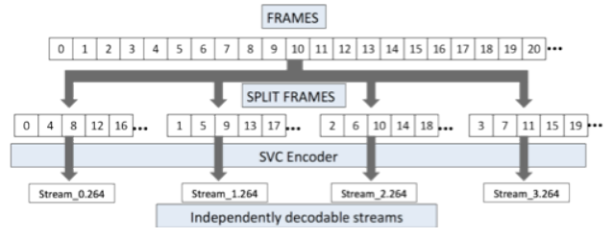
Frame Level

Slide 5
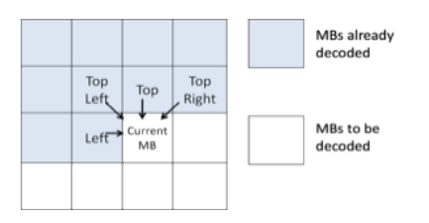
Macro-block Level
Applied for spatially predicted MBs
No such restrictions for temporally predicted

Slide 6
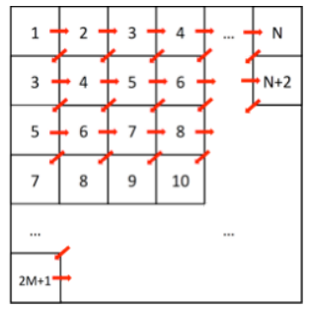
Macro-block Level

Slide 7
Experiment
Intel i7quad-core 1.6G, 6M cache
WattsUp PRO power meter
Use different video in these two experiment

Slide 8
Result – Frame Level
Encoding
MVC mode
Quantization parameter 22
30 fps
Performance Evaluation
Excluding the frame buffer storage time
Energy Consumpton
Subtracting the idel power from the average

Slide 9
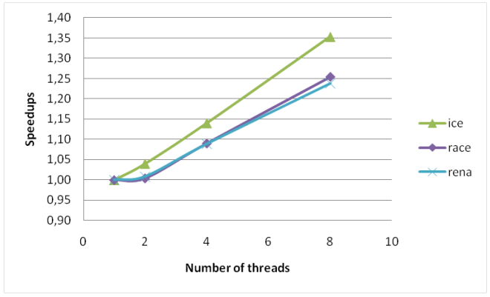
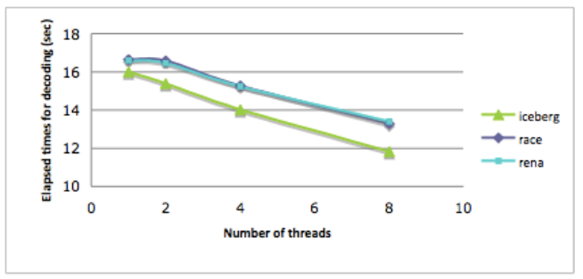
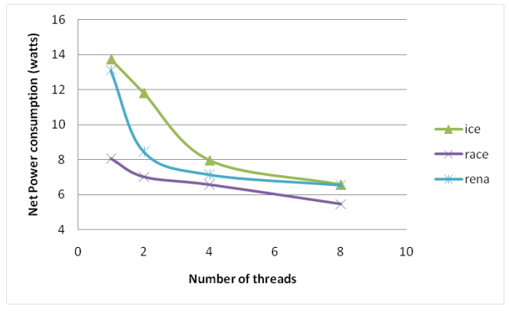
Result – Frame Level

Slide 10
Result – Frame Level
Encoding
SVC encoder with base and enhancement layer
Quantization parameter 46, 34
30 fps
Open SVC decoder with MB decoding algorithm

Slide 11
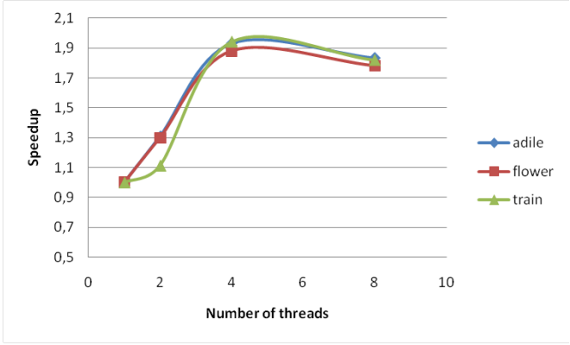
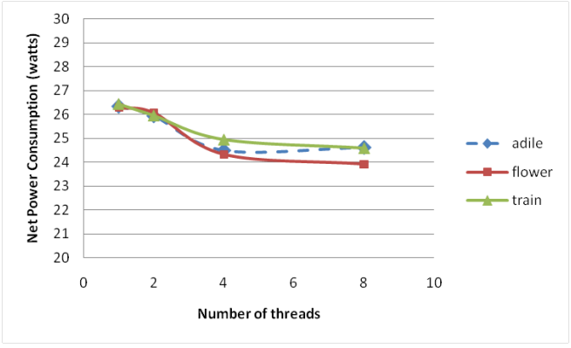
Result – Frame Level

Slide 12
EFFICIENT PARALLELIZATION OF H.264 DECODING WITH MACRO BLOCK LEVEL SCHEDULING
IEEE International Conference on Multimedia and Expo, 2007

Slide 13
Introduction
Macro-block parallelize
Dynamically scheduling task at runtime

Slide 14
Introduction
I - MB : difficult to parallelize
Tight data dependency
P - MB : easily parallelize
No strong data dependency

Slide 15
Technique
Three stage
Preparse
Highly sequential
Render
Significant opportunities for parallelism
Filter
Obviously parallel

Slide 16
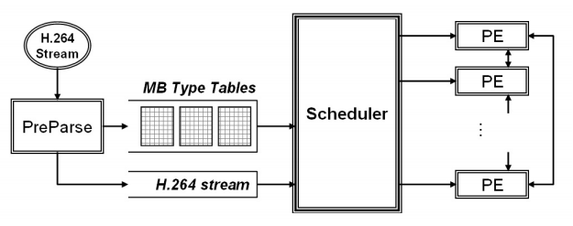
Technique
Prepare stage
Buffer a small amount of recently decoded prediction modes/MVs from neighboring MGs

Slide 17
Schedule
Greedy
Static compile time
Assume equal execution time for all MBs for each MB types
Run time MB level
MB types
Encoded stream sizes

Slide 18
Experiment
Resolution : 320x144
Contains I, P frames
PentiumM 1.5GHz

Slide 19
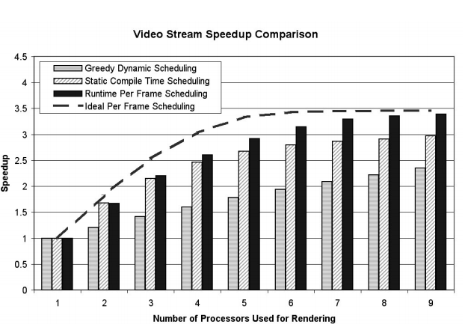
Result

Slide 20
Parallelization of H.264 video decoder for embedded multicore processor
IEEE International Conference on Multimedia and Expo, 2008

Slide 21
Introduction
Balance load
Data preloading

Slide 22
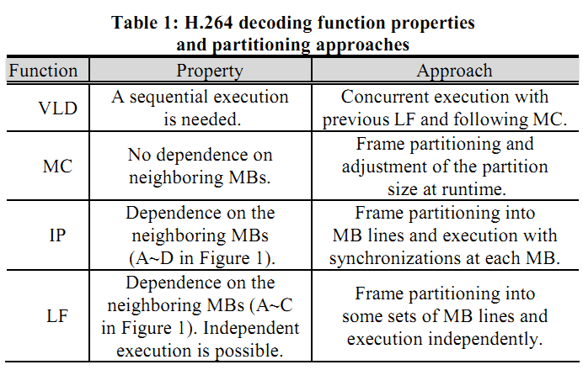
Technique

Slide 23
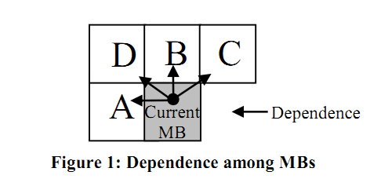
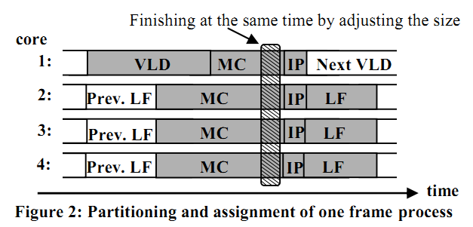
Technique

Slide 24
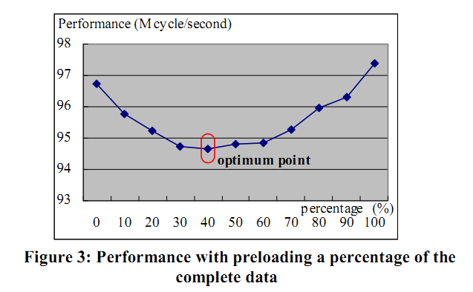
Preload

Slide 25
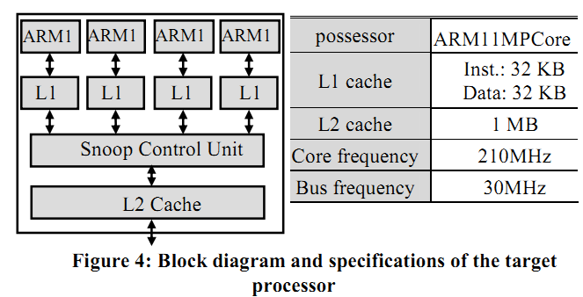
Experiment

Slide 26
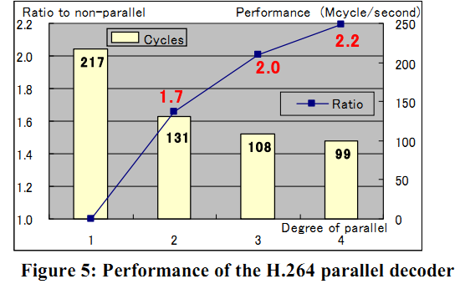
Result

Slide 27
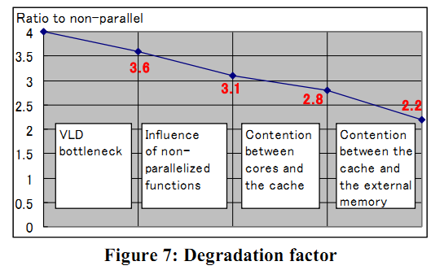
Result

Slide 28
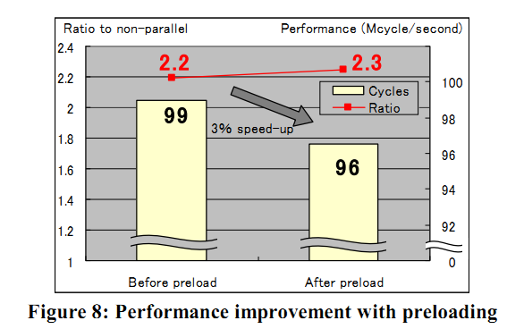
Result with Preload

