Slide 1
Hierarchical Video Patching with Optimal Server Bandwidth
Helmul hlavacs and Buchinger
University of vienna

Slide 2
Outline
Introduction
Related Work
Herachical Patching
Performance Analysis
Combination with Batching
Conclusion

Slide 3
Introduction
Patching:
Using Multicast instead of unicast ,served the parts of the missed video
Minimize the required resource consumption
Server Bandwidth
Client Bandwidth
Client Buffer requirement
Start-up delay

Slide 4
Related Work
Batching:
Piggybacking
Periodic Broadcasting
Average waiting time :h/2
Greedy Patching
Grace Patching

Slide 5
Related Work
2.3Hierarchical Approaches:
Fragmented Patching
Stream Merging
Online & Offline algorithms
2.4 Distributed VOD
Server->clustering

Slide 6
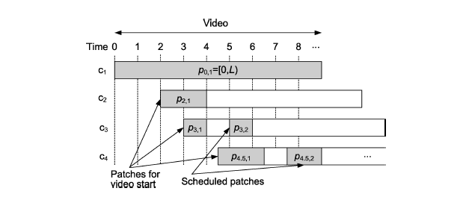
Hierarchical Patching

Slide 7
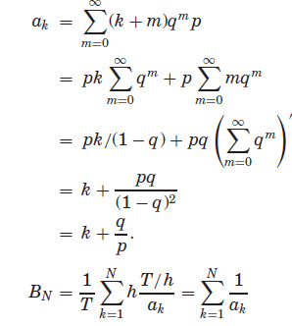
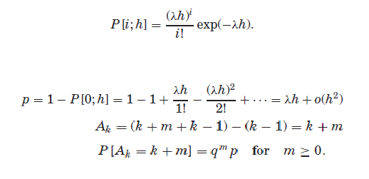
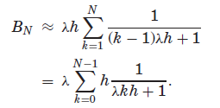
Performance Analysis
Mean Server Bandwidth

Slide 8
Performance Analysis

Slide 9
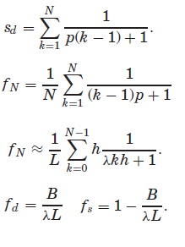
Performance Analysis
Reuse of Ongoing Transmission
fd L = (1 − fs)L

Slide 10
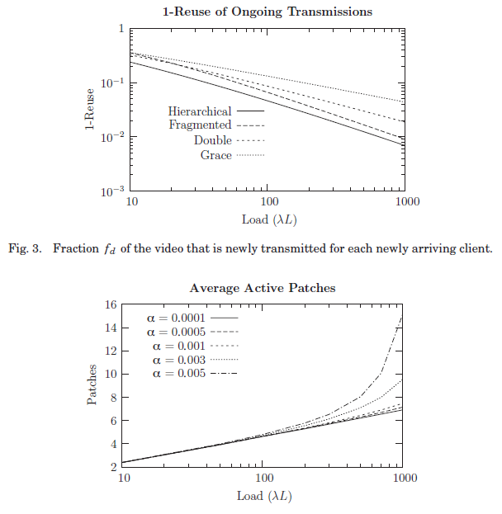
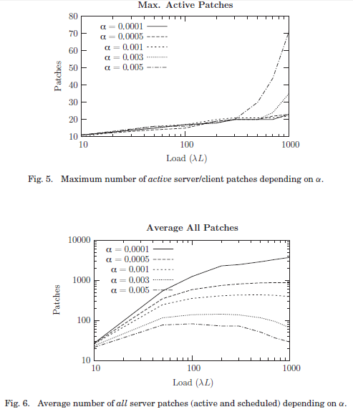
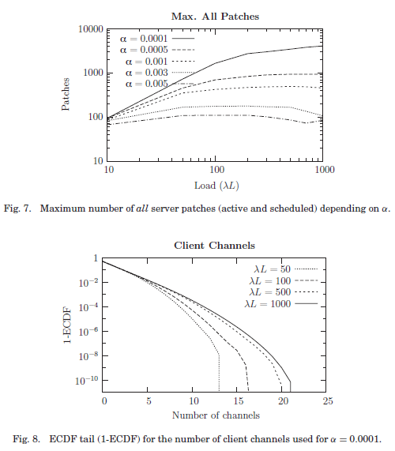
Performance AnalysisPerformance Analysis
4.3 Fragmentation

Slide 11
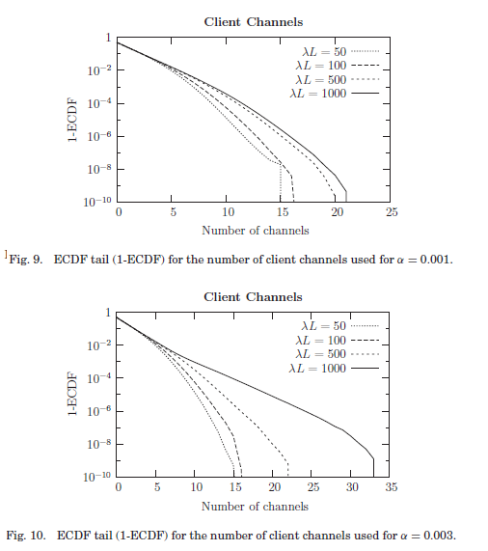
Performance AnalysisPerformance Analysis
4.4Client Channel Distribution

Slide 12
Combination with Batching

Slide 13
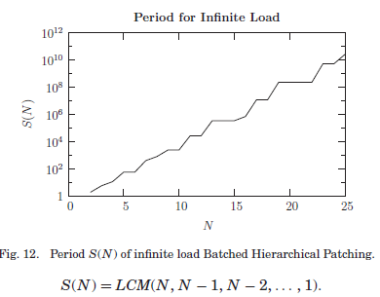
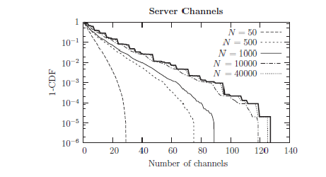
Combination with Batching
Infinite Load

Slide 14
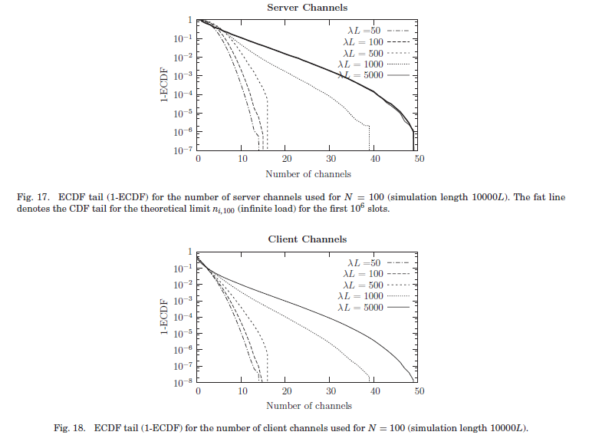
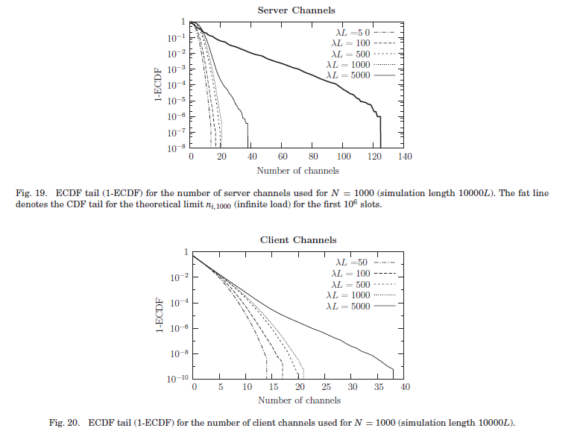
Combination with Batching
Finite Load

Slide 15
Conclusion
If α increase then required bandwidth increase
smaller α reach a optimal bandwifth and number of channels
Trade-Off: α=0.001, λL=1000(patches as low as possible)
Batched Hierarchical Patching used less bandwidth than fixed start point broadcasting
Trade-Off: N=1000, λL=1000 -> 22 channels

