Slide 1
Wireless Recharge and wireless sensor network

Slide 2
Wireless Charge
wireless illumination of a 60 W light bulb from 2 meters away and achieved a 40% energy transfer efficiency.
Two kind:
Mobile charger
Static charger

Slide 3
Mobile charger
Propose
Paper | Propose
On Renewable sensor networks with wireless Energy transfer | Making Sensor Network Immortal | max path : Hamiltonian cycle
Prolong Sensor Network Lifetime through wireless charging | Prolong Sensor Network Lifetime | max network lifetime
J-ROC | Prolong Sensor Network Lifetime | max network lifetime
Qi-ferry | Prolong Sensor Network Lifetime | min path
SURESENSE | Prolong Sensor Network Lifetime | min landmark

Slide 4
constrain
Paper | Vehicle energy capacity | Data Routing
On Renewable sensor networks with wireless Energy transfer | Enough charge by service station | Minimal energy routing
Prolong Sensor Network Lifetime through wireless charging | V=1 m/s consumption: 8W consumption (charge):3W charge by base station | None
J-ROC | V=1 m/s consumption: 8W consumption (charge):3W charge by base station | Minimal energy routing
Qi-ferry | Enough | None
SURESENSE | Enough | None

Slide 5
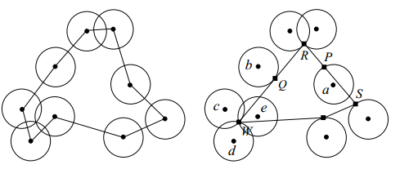
Wireless charge
Paper | Charge distance | Charge time | Charge efficiency | Sensor consumption | Sensor number | Tour
On Renewable | Close | Ti | 5W | Pi | 一次一顆 | 一次走完所有node
Prolong Lifetime | 10cm | Lc | 45mW | X | 一次一顆 | 只走需要的(由BS計算)
J-ROC | 10cm | Lc | 45mW | Ci,t | 一次一顆 | 只走需要的(由BS計算)
Qi-ferry | X | X | X | X | 一次多顆 | 一次走完所有node
SURESENSE | 2m | X | X | X | 一次多顆 | 一次走完所有node

Slide 6
Sensor
Paper | Send data | Send energy info
On Renewable | O | X
Prolong Lifetime | O | O
J-ROC | O | O
Qi-ferry | O | X
SURESENSE | O | X

Slide 7
Algo.
Paper | Path
On Renewable | Hamiltonian
Prolong Lifetime | travelling salesman problem
J-ROC | Charging scheduling algo.
Qi-ferry | QiFP(Qi-ferry wireless charging problem)
SURESENSE | Hamiltonian
Notes:
Covering Salesman Problem

Slide 8
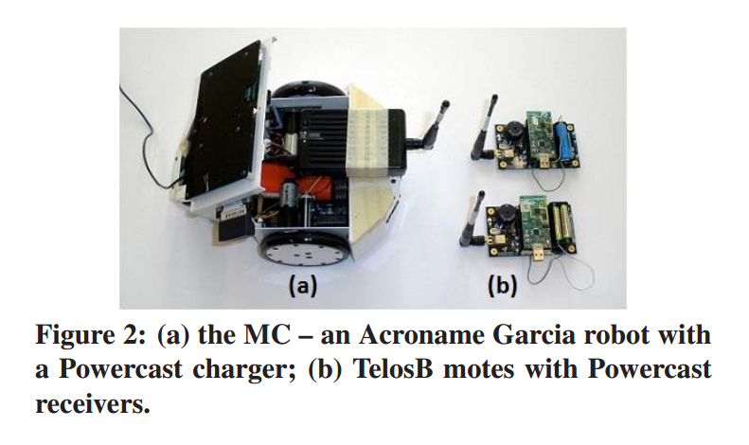
Hardware(by Prolong Lifetime, J-ROC

Slide 9
Static charger
Energy provisioning in wireless rechargeable sensor network* ,IEEE 2011 ->minimize the number of chargers in the net work
On Optimal Scheduling in Wireless Rechargeable Sensor Networks for Stochastic Event Capture ,IEEE 2011
-> maximize the quality of monitoring (QoM)

