Slide 1
Challenges of Real-World Reinforcement Learning
Gabriel Dulac-Arnold
Daniel Mankowitz
Todd Hester

Slide 2
Introduction
In this paper, they present the main challenges that make Reinforcement Learning (RL) in the real-world more difficult than RL in research.
For each challenges, they motivate its importance, specify it, present approaches for addressing the challenge, and provide methods for evaluating that particular challenge.
Finally, they purpose the example environment to deal with this challenge.
Notes:
這篇paper 想要探討的是將RL用在real-world中的challenge，裡面會提到9個挑戰，會分別敘述這些挑戰的重要性、目前應對挑戰的方法，並提供方法去evaluate這些挑戰

Slide 3
Motivation
RL methods have been shown to be effective on a large set of simulated environments, but uptake in real-world problems has been much slower.
Training on real-world is very different from training on a simulated environment.
Notes:
1.已經證明RL方法在大量模擬環境中是有效的，但是在實際問題中表現卻沒有這麼好
2.real-world和模擬環境的訓練非常不同，在模擬環境中data實際上是無限的，在real-world不良action的結果是不存在的，而且還從載著很多挑戰，就是等等會敘述的部分

Slide 4
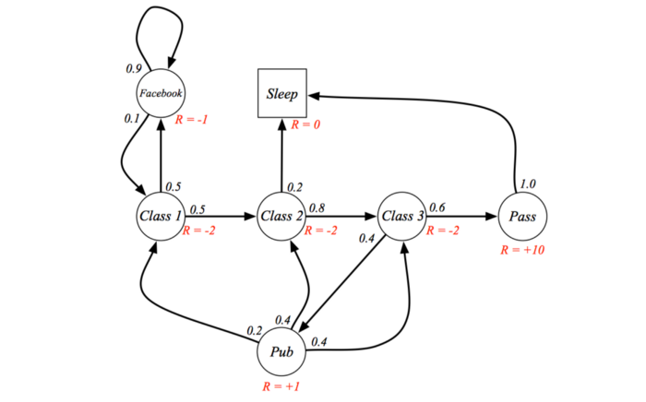
RL(Markov Decision Process)
Environment
State
Reward
Action
Policy
picture from: https://medium.com/@rozendhyan/markov-decision-process-%E4%B8%8A-2b4502f513bf
Notes:
看圖說故事

Slide 5
Challenge

Slide 6
2.1 Batch Off-line and Off-Policy Training
Many systems cannot be trained on directly and need to be learned from fixed logs of the system’s behavior.
This setup is an off-line and off-policy training regime where the policy needs to be trained from batches of data.
Notes:
許多系統不能直接、即時的訓練，他需要固定的系統資料才能夠訓練，而這個過程是off-line & off-policy的，需要從批次的資料中做訓練
off-policy : 會在下一張投影片說明

Slide 7
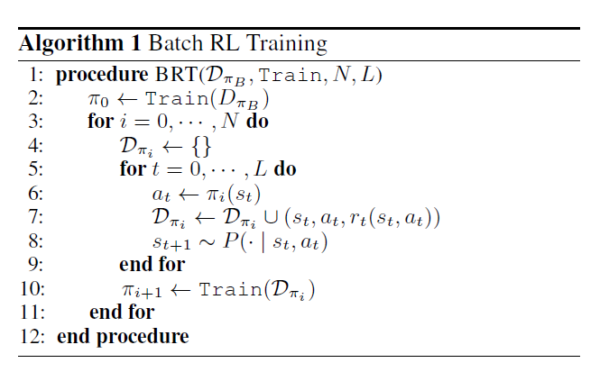
2.1 Batch Off-line and Off-Policy Training
Notes:
解釋他，U can do it!!
照著筆記念

Slide 8
2.1 Batch Off-line and Off-Policy Training
1. Estimating the policy’s performance without running it on the real system is termed off-policy evaluation (Precup et al., 2000).
2. Off-policy evaluation becomes more challenging as the difference between the policies and the resulting state distributions grows.
Notes:
1. 而要測量policy的performance且不跑在real system上的方法稱為 off-policy evaluation
2. 隨著policy與最終state的distribution之間的差異增大， off-policy evaluation變得更具挑戰性。(不太懂為什麼...)

Slide 9
2.1 Batch Off-line and Off-Policy Training
Importance sampling (Precup et al., 2000), which accounts for the difference between the behavior and target policies.
Doubly-robust estimators (Dud´ık et al., 2011; Jiang & Li, 2015) combine both and get the best evaluations from both worlds.
Notes:
目前有幾種off-policy 的測量方式，這裡介紹兩種，一種是Importance sampling，就是直接去計算behavior和target policy之間的差異，另一種是doubly-pobust estimators，就是去train一個transition model 用來測量performance，結合前面說的方式，去取一個較好的evaluation

Slide 10
2.1 Batch Off-line and Off-Policy Training
Notes:
這個是他們purpose的function，可以用來測train algorithm的performance
(D pi B 表示behavior policy的data，train()代表這個train algorithm，R代表algorithm return的得分)

Slide 11
2.2 Learning On the Real System from Limited Samples
All training data comes from the real system, its exploratory actions do not come for free.
approaches that instantiate hundreds or thousands of environments to collect more data for distributed training are usually not compatible with this setup
Notes:
第二個挑戰就是，他的sample是受到限制的，
由於資料都來自real-system，所以只能執行一些合理且安全的action，agent在train的時候就會受到限制
另外，real-system通常只有一個實體，所以沒有辦法用上百或上千個環境去收集資料做分散式的training

Slide 12
2.2. Learning On the Real System from Limited Samples
Almost all of these real-world systems are either slow moving, fragile, or expensive enough that the data they produce is costly
The algorithm must be data-efficent (sample-efficent).
Notes:
還有這些real-world system通常很慢或很貴，所以要拿到他的資料會需要一些成本
綜合以上這些挑戰，得出一個結論，就是在real-system上執行的RL必須是 data-efficient的或者稱為sample-efficient，意思就是說用很少的data就能讓agent完成學習

Slide 13
2.2. Learning On the Real System from Limited Samples
Model Agnostic Meta-Learning (MAML) (Finn et al., 2017) that focuses on learning about tasks within a distribution and then, with few shot learning, quickly adapting to solving a new in-distribution task that it has not seen previously.
Bootstrap DQN (Osband et al.,2016) learns an ensemble of Q-networks and uses Thompson Sampling to drive exploration and improve sample efficiency.
Notes:
目前的話有一些foucus在sample efficiency的研究，
其中一項工作是Model Agnostic Meta-Learning(MAML)（Finn等，2017），側重於學習分佈中的任務，然後運用少量的學習，快速適應解決以前沒見過的任務。
Bootstrap DQN（Osband等，2016）學習了Q-networks，並使用Thompson Sampling來推動探索並提高sample-efficiency。

Slide 14
2.2. Learning On the Real System from Limited Samples
Notes:
這個是他們purpose的function，可以用來測特定方法的data-efficiency
(這function得到的會是在特定得分之上所需要的最少資料量，D->data , R ->得分 , s.t -> 受限於)

Slide 15
2.3 High-Dimensional Continuous State and Action Spaces
Many practical real world problems have large and continuous state and action spaces.
These large state and action spaces can present serious issues for traditional RL algorithms.
Notes:
許多real world的system都有很大量且連續的state 和 action，而這對於傳統的RL alogorithm是一個很大的挑戰
舉例來說，google data centor冷卻系統，裡面有許多的sensor和控制器，其中包含的state和action就會比我們剛剛前面看到的student problem複雜許多

Slide 16
2.3 High-Dimensional Continuous State and Action Spaces
Dulac-Arnold et al. present an approach based on generating a vector for a candidate action and then doing nearest neighbor search to find the closest real action available.
Zahavy et al. propose an Action Elimination Deep Q Network (AE-DQN) that uses a contextual bandit to eliminate irrelevant actions.
Notes:
同樣的，這篇paper也有提出一些現有的研究，像是其中一種方法是產生一個vector，將候選的action都放進去，這樣就可以進行鄰近的search，找到最近且適合的action
另外也有提到一個叫做Action Elimination Deep Q Network的技術，去屏除不相關的action

Slide 17
2.4. Satisfying Safety Constraints
Almost all physical systems can destroy or degrade themselves and their environment.
As such, considering these systems’ safety is fundamentally necessary to controlling them.
Notes:
大部分的系統都有他的安全限制，如果超過那些限制，可能就會傷害系統本身，所以考慮到系統安全限制是基本且必須的要件，也是一個RL在real-system中的挑戰

Slide 18
2.4. Satisfying Safety Constraints
Constrained MDPs , define a constrained optimization problem and can be expressed as:
Notes:
現在讓RL在滿足safety constraints下訓練的方法有很許多研究，這裡介紹兩種，一種就是現在看到的constrained MDP，這個方法限定一個安全限制，目的就是找出在這個安全限制之下的最大Reward(得分)
(K是代表他的限制，V沒說...)

Slide 19
2.4. Satisfying Safety Constraints
Budgeted MDPs, the policy is learned as a function of constraint level.
the user can examine the trade-offs between expected return and constraint level and choose the constraint level that best works for the data.
Notes:
另一個方法是Budgeted MDP，這個方法與上一個不同，這個方法的constraint是可調整的，policy會依照不同的constraint level去學習
user可以在預期收益和constraint level之間的做權衡，並選擇最適合的constraint level。

Slide 20
2.4. Satisfying Safety Constraints
Notes:
這個是他們purpose的function，可以用來測RL algorithm 的safety，然後其實他是base on 剛剛提到的Constrained MDPs，只是把在不同條件下所導致的累計成本算出來，視覺化之後就能很清楚的看出 policy的safety constraints

Slide 21
2.5. Partial Observability and Non-Stationarity
Almost all real systems where we would want to deploy reinforcement learning are partially observable.
For example, on a physical system, we likely do not have observations of the wear and tear on motors or joints, or the amount of buildup in pipes or vents.
Often times, these partial observabilities appear as non-stationarity or as stochasticity
Notes:
接下來要講到的挑戰是，real system常常是partial observability，意思就是說我們不太能去觀察到系統的全部，像是接頭的磨損，或管道的組成，這些是比較難去觀測到的
而partial observability 也就會導致Non-sationarity(不穩定)

Slide 22
2.5. Partial Observability and Non-Stationarity
First is to incorporate history into the observation of the agent.
An alternate approach is to use recurrent networks within the agent, enabling them to track and recover hidden state.
Notes:
然後這個challenge目前有兩個常見的解決方法，一個是將歷史資料納入agent的觀察中。
另一個是使用循環網路，使其能找出隱藏的state

Slide 23
2.5. Partial Observability and Non-Stationarity
Notes:
這個function是他們提出來用來評估穩定度的，用到了k test environment，但我看不太懂他怎麼運作的

Slide 24
2.6. Unspecified and Multi-Objective Reward Functions
When an agent is trained to optimize one metric, other metrics are discovered that also need to be maintained or improved.
Thus, a lot of the work on deploying RL to real systems is in formulating the reward function, which may be multi-dimensional.
Notes:
接著，當RL在訓練的時候，常常只會optmize一個metric，而其他需 要維持或改進metric就會被忽視掉
所以很多工作就專注於formulating reward 的function

Slide 25
2.6. Unspecified and Multi-Objective Reward Functions
Conditional Value at Risk (CVaR) (Tamar et al., 2015b), which looks at a given percentile of the reward distribution, rather than expected reward.
Tamar et al. show that by optimizing reward percentiles, the agent is able to improve upon its worst-case performance.
Notes:
而這裡講的是相關的研究，第一個是評估reward的分配的典型方法，風險條件價值（CVaR），注重reward的distribution的給定百分比，而不是預期的獎勵。
第二個是去優化這個reward的百分比，去提升worst-case的performance

Slide 26
2.6. Unspecified and Multi-Objective Reward Functions
Notes:
(不太懂)這是他們purpose的function，他們假定global reward function是由許多sub-rewards所組成的線性組合，所以他們就將各個rewards表現出來，就可以看出每一項的得分

Slide 27
2.7. Explainability
Policy explainability is important for real-world policies , because user have to know the reason of the approach.
Especially in cases where the policy might find an alternative and unexpected approach to controlling a system
Notes:
再來是explainability的部分，訓練後的agent 要能夠解釋他們行為，尤其是在他採取的方法不合乎常理或期待的時候，使用者必須知道原因

Slide 28
2.7. Explainability
Verma et al. define their policies using a domain-specific programming language, and then use a local search algorithm to distill a learned neural network policy into an explicit program.
Additionally, the domain-specific language is verifiable, which allows the learned policies to be verifiably correct.
Notes:
(看不董)
這裡有個相關的研究是用domain-specific programming language，去讓神經網路的policy變成外顯的程序，
而且這個domain-specific language是可驗證的，可以使learned policy被正確的驗證

Slide 29
2.8. Real-Time Inference
To deploy RL to a production system, policy inference must be done in real-time at the control frequency of the system.
Notes:
下一個challenge，RL用在real-system的時候，他推斷處理的時間必須根據系統的控制頻率，能夠real-time的處理

Slide 30
2.8. Real-Time Inference
There has been literature focused on this problem in the case of robotics.
Hester et al. present a real-time architecture to do model-based RL on a physical robot.
Notes:
現在在機器人領域有些研究focus在這個挑戰，像是有一篇研究就有提出一個real-time的architecture去做model-based 的 RL

Slide 31
2.9. System Delays
most real systems have delays in either the sensation of the state, the actuators, or the reward feedback.
Notes:
最後一個挑戰是system delay，大部分的real system在執行器和reward feedback都有延遲

Slide 32
2.9. System Delays
Hester & Stone focus on controlling a robot vehicle with significant delays in the control of the braking system.
They incorporate recent history into the state of the agent so that the learning algorithm can learn the delay effects itself.
Notes:
這裡有一篇研究是將近期歷史記錄納入agent的state，以便學習算法可以自己學習去處理延遲。

Slide 33
3. Example Environment
They present an example environment from the DeepMind control suite (Tassa et al., 2018), and the modifications required to make it present all of the challenges for real world RL that we have presented in this paper
Their goal is both that this environment and its modifications drive research in real-world RL as well as help evaluate candidate algorithms’ applicability to real-world problems.
Notes:
他們提出了一個example environment，來自一個Deepmind control suite，然後從中修改，使剛剛提到的挑戰被呈現在environment中
這個目的是為了推動real-world RL的研究，方便去評估algorithm在rea-world problem中的表現

Slide 34
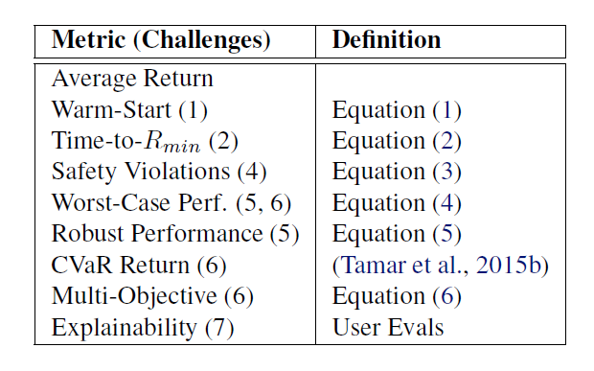
3. Example Environment
Notes:
這是他在example environment中evaulate的部分，就是用剛剛前面每個挑戰中所提到的function來測出每個metric，來測試每個challenge的表現

Slide 35
4. RelatedWork
Hester & Stone similarly present a list of challenges for real world RL, but specifically for RL on robots.
They present four challenges (sample efficiency, high-dimensional continuous state and action spaces, sensor and actuator delays, and real-time inference)
Henderson et al. investigate the effects of existing degrees of variability between various RL setups and their effects on algorithm performance.
Notes:
Hester & Stone他們也有做過一篇類似的研究，他們提出了四個挑戰，包刮 sample efficient , high dimensional continuous stae and action, delay 和real-time inference

Slide 36
5. Conclusion
We have presented nine such challenges for practical RL. For each one, we have motivated the challenge, presented examples, and specified the challenge more formally.
For RL researchers, we have presented an example environment and evaluation criteria with which to measure progress on these challenges.
Notes:
他們present了就個有關於 rea-world RL的challenge，並詳細去闡述、舉例、和針對challenge去講解
對於RL的研究者，他們提出了一個example evironment，讓研究者能夠更容易evaluate 他們的方法在這些challenge上的表現

Slide 37
Research problem
There are many challenge on real-world RL, What is the most important?
In real-world RL, Are there any system that is more suitable for using RL, and which is less suitable?

