Slide 1
Fog Computing for the Internet of Things: Security and Privacy Issues
Arwa Alrawais, Abdulrahman Alhothaily, Chunqiang Hu, and Xiuzhen Cheng

Slide 2
Introduction
The goal of Fog computing is to reduce data volume and traffic to cloud, decrease latency and improve quality of service (QoS).
Fog introduces new security and privacy challenges due to its distinct characteristics such as mobility support.
On the other hand, Fog nodes can be represented as proxies that provide cryptographic computation which can help minimize attacks in IoT environments.

Slide 3
Security and Privacy Challenges in IoT
Authentication: IoT devices don’t have enough computation power to execute the cryptographic operation required for authentication.
Trust: There are no efficient mechanism that can measure when & how to trust IoT device.
Rogue node detection: A rogue IoT node can misuse user’s data or disrupt neighboring nodes.
Privacy: lack of encryption ability, location privacy, user’s usage pattern
Access Control: managing huge number of things & highly distributed data is challenged.
Intrusion Detection: Its hard to detect insider and outsider attack in universal platforms.
Data Protection: Data integrity must be preserved before and after processing

Slide 4
Case study: Resorting to Fog for Certificate Revocation in the IoT
Two certificate revocation schemes: Certificate Revocation List (CRL) & Online Certificate Status Protocol(OCSP)
CRL is a list maintains all revoked certificate serial numbers that should no longer be trusted.
Certificate Authority (CA) releases its CRL with long window could lead to security issue such as accepting a revoked certificate.
CRL file size grows over time and consumes clients’ storage.

Slide 5
Case study: Resorting to Fog for Certificate Revocation in the IoT
OCSP is used to obtain digital certificate status online.
A client submit request containing serial number that needs to be checked to OCSP responder server, and it checks its up-to-date revocation list and respond to the client the status of the certificate.
OCSP overcome many drawbacks in CRL, such as:
Doesn’t require large storage at client
OCSP’s message is small compared to CRL
OCSP provides immediate update about certificate status
OCSP has some drawbacks, such as high latency and may impairs clients’ privacy

Slide 6
Case study: Resorting to Fog for Certificate Revocation in the IoT
When it comes to IoT environment, the 2 schemes above are unsuitable.
For CRL,it imposes high burden of communication overhead and required large storage on resources-limited IoT device.
For OCSP, IoT device cannot afford to communicate each time OCSP server due to resource constraints.
This paper proposes a scheme that uses fog node to improve efficiency of certificate revocation distribution in IoT environments.

Slide 7
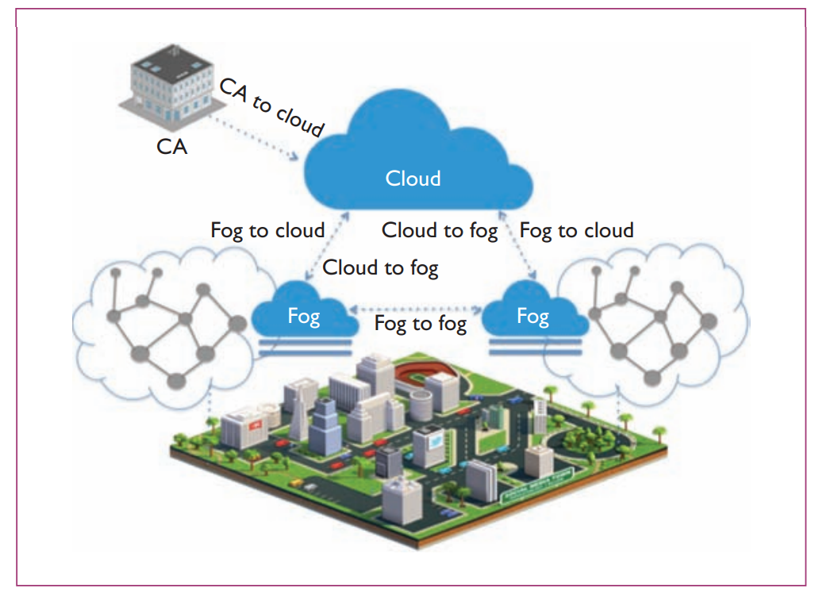
Proposed Scheme

Slide 8
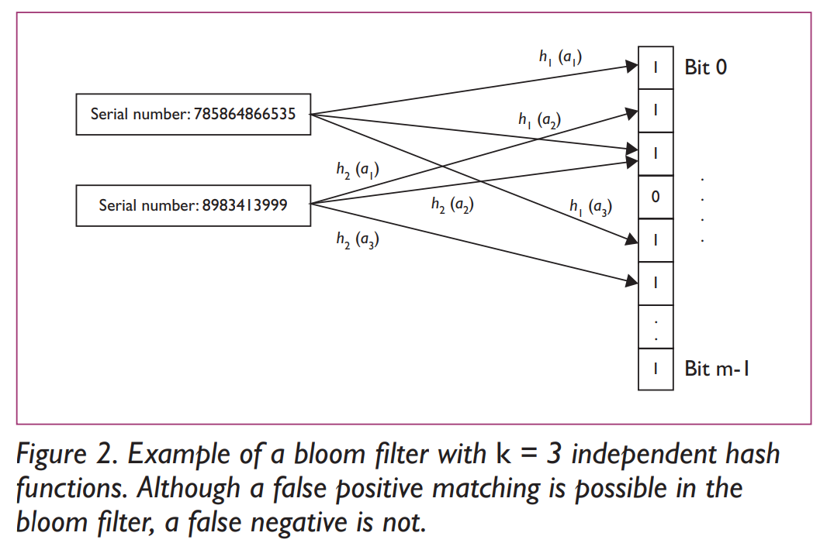
Proposed Scheme
They use bloom filter to create a short list that reduce the revocation list size
A bloom filter is a space-efficient data structure to check whether an element is in the group.

Slide 9
Proposed Scheme
Cloud manages multiple CA’s revocation list and send to intended fog node.
Fog node stores the list and generates the bloom filter and distributes to IoT devices.
IoT device stores the bloom filter for further usage.
Due to the nature of bloom filter, false positive can occurs.
When IoT device finds a certificate identity is in the bloom filter, It will send packet containing the certificate to the fog, and the fog will check this certificate status and replied.

Slide 10
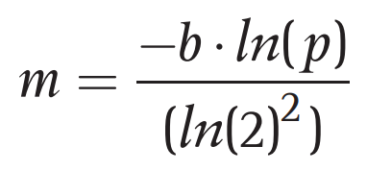
Results and Analysis
Proposed scheme is an up-to-date approach which eliminates the risk of accepting revoked certificate.
Bloom filter reduce the computation and storage overhead with little price to pay (false positive).
Storage :
bloom filter : , where m is number of bits, p is the false positive probability(0.01) and b is average number of revoked certificate each day.
CRL: b * 20 + 700 bytes, where 20 bytes is serial number length and 700 bytes is a CA’s signature
OCSP: since it is online method, it doesn’t have storage overhead.

Slide 11
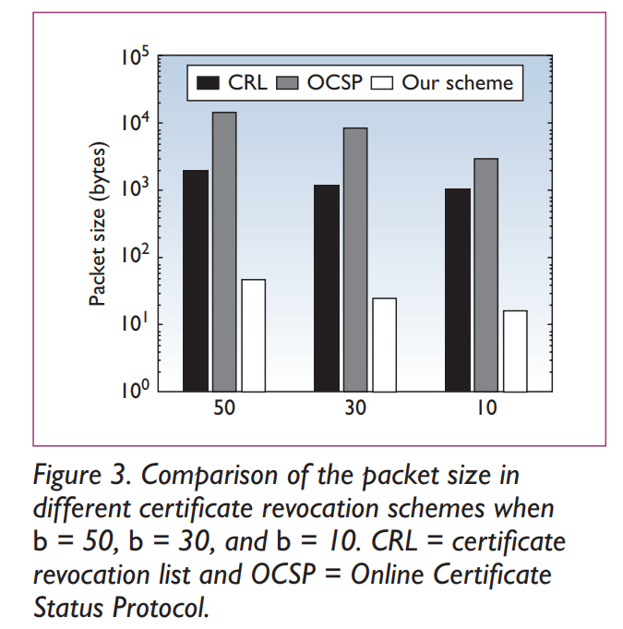
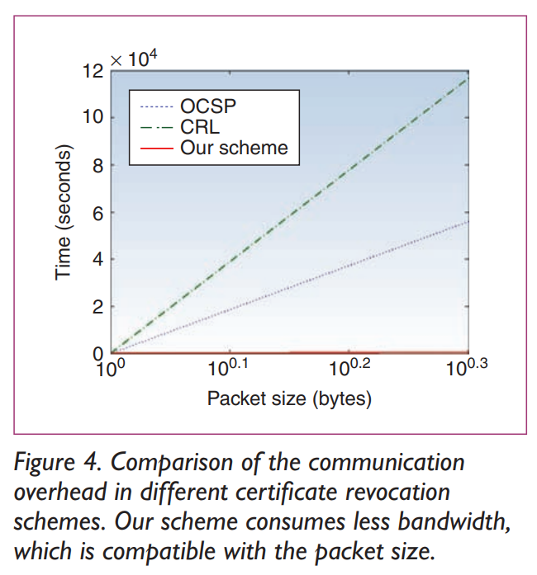
Results and Analysis
Communtication overhead

Slide 12
Open Research Issues: Fog Computing and Security and Privacy in IoT Environments
Privacy
It is challenged to run privacy-preserving techniques between Fog and IoT devices compared to Cloud and Fog.
homomorphic functions, differential privacy… which has big computational overhead.
location privacy: distribute data among several fog nodes, identity obfuscation.
Updating IoT devices
Many IoT devices is still vulnerable and need to handle security updates.
Fog computing can identify and track these update.
Secure and efficient protocols
wireless transmission protocol consumes lots of energy, which is not suitable for IoT device.

Slide 13
Open Research Issues: Fog Computing and Security and Privacy in IoT Environments
Authentication
Lightweight authentication algorithm can be applied between fog and IoT devices to improve the efficiency of authentication process.
Attack detection
Fog computing provides a new opportunity to design an intrusion-detection solution on both cloud and IoT devices.
Location verification
IoT devices can move in a fast and dynamic way(vehicles, railways ...), which complicaties location verification.
Access control
policy-based management
Fog can grant access tokens to authorized parties.

Slide 14
Conclusion
This paper investigated security and privacy challenges of introducing fog computing in IoT environments.
Proposed a case study of certificate revocation distribution to show the ability of fog.

