Slide 1
Learning Representations and Generative Models for 3D Point Clouds
Panos Achlioptas, Olga Diamanti, Ioannis Mitliagkas, Leonidas Guibas
Department of Computer Science, Stanford University, USA
MILA, Department of Computer Science and Operations Research, University of Montreal, Canada

Slide 2
Outline
Introduction
Background
Evaluation metrics
Models
Experimental evaluation
Conclusion

Slide 3
Introduction
GAN-based generative model (traditional GAN) is hard to train and unstable
No universally accepted method for evaluation
past work like PointNet focus on classification and segmentation
Contributions:
new AE for point cloud
find out Chamfer distance fails to identify the good/bad quality in certain cases

Slide 4
Outline
Introduction
Background
Evaluation metrics
Models
Experimental evaluation
Conclusion

Slide 5
Earth Mover’s distance (EMD)

Slide 6
Chamfer distance (CD)
the squared distance between each point and its nearest neighbor in the other set

Slide 7
Autoencoder (AE)
Encoder + Decoder

Slide 8
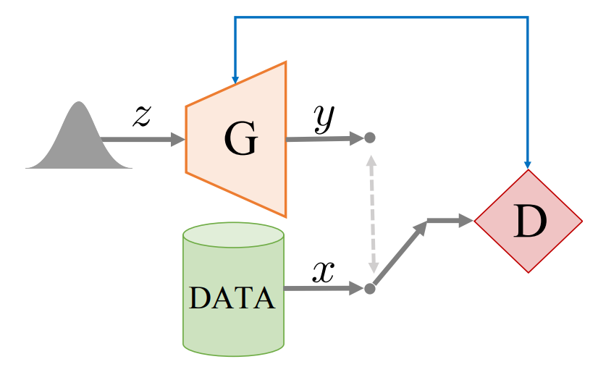
Generative Adversarial Network (GAN)
generator (G) + discriminator (D)

Slide 9
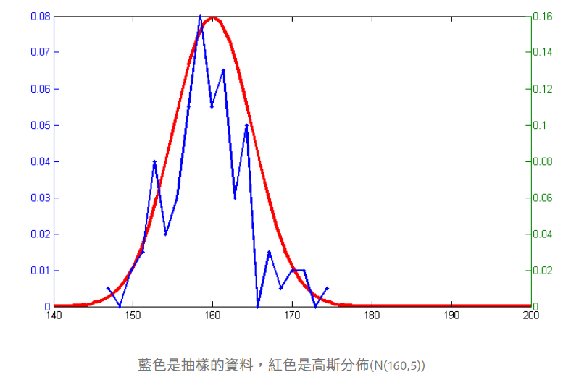
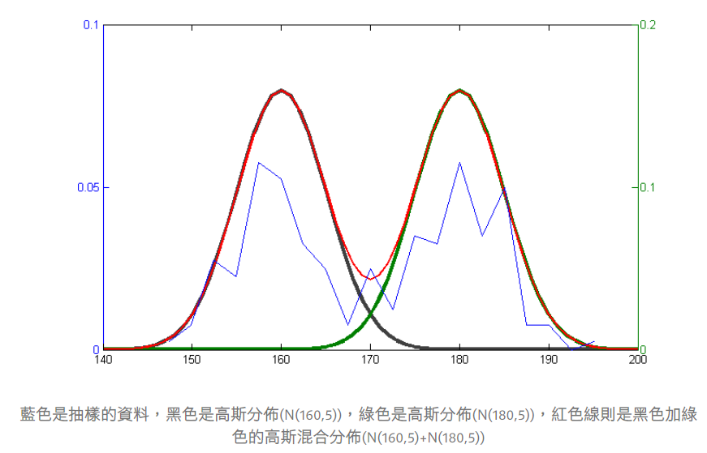
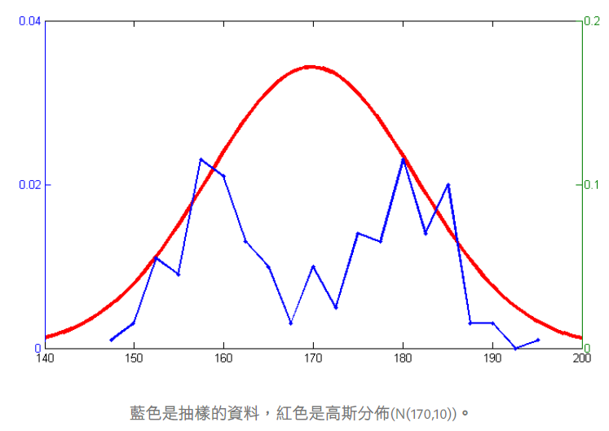
Gaussian Mixture Model (GMM)
機器學習: EM 演算法(Expectation-Maximization Algorithm, EM)、高斯混合模型(Gaussian Mixture Model, GMM)和GMM-EM詳細推導

Slide 10
GMM-EM
using Expectation-Maximization (EM) can learn the GMM parameters (i.e. means and variances of Gaussians) from random samples.

Slide 11
Outline
Introduction
Background
Evaluation metrics
Models
Experimental evaluation
Conclusion

Slide 12
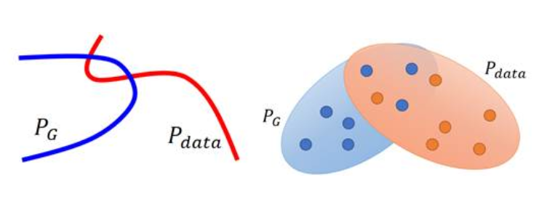
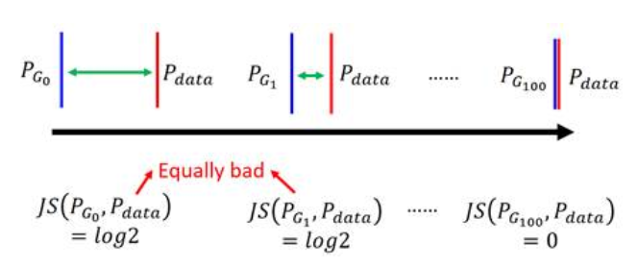
Jensen-Shannon Divergence (JSD)

Slide 13
Coverage
the fraction of the point clouds in B that were matched to point clouds in A
closest neighbor compute with CD and EMD
=> COV-CD, COV-EMD
75%

Slide 14
Minimum Matching Distance (MMD)
match each point cloud in B to set A
calculate the average of distance in the matching
=> MMD-CD, MMD-EMD

Slide 15
Outline
Introduction
Background
Evaluation metrics
Models
Experimental evaluation
Conclusion

Slide 16
Network Structure
Encoder :
5 * (1D convolutional layer + a ReLU + a batch-norm)
Decoder :
2 * (FC layer with ReLUs) + 1 * FC layer
Loss : EMD or CD => AE-EMD, AE-CD

Slide 17
Generative models for point cloud
Raw GAN (r-GAN)
without any batch-norm
use leaky ReLUs instead of ReLUs
Latent-space GAN (l-GAN)
trained for each object class with EMD or CD loss
generator (single hidden layer), discriminator (two hidden layers)
Gaussian Mixture model (GMM)

Slide 18
Outline
Introduction
Background
Evaluation metrics
Models
Experimental evaluation
Conclusion

Slide 19
Dataset : ShapeNet
train models with point clouds from a single object class
train/validation/test : 85%-5%-10%

Slide 20
latent space and linearity
well trained NN learn a latect representation where additive linear algebra works to that purpose
adding the mean vector of geometries with a certain characteristic in latent space

Slide 21
shape completion
feed incomplete version of expected output point cloud
the network will complete the partial point cloud

Slide 22
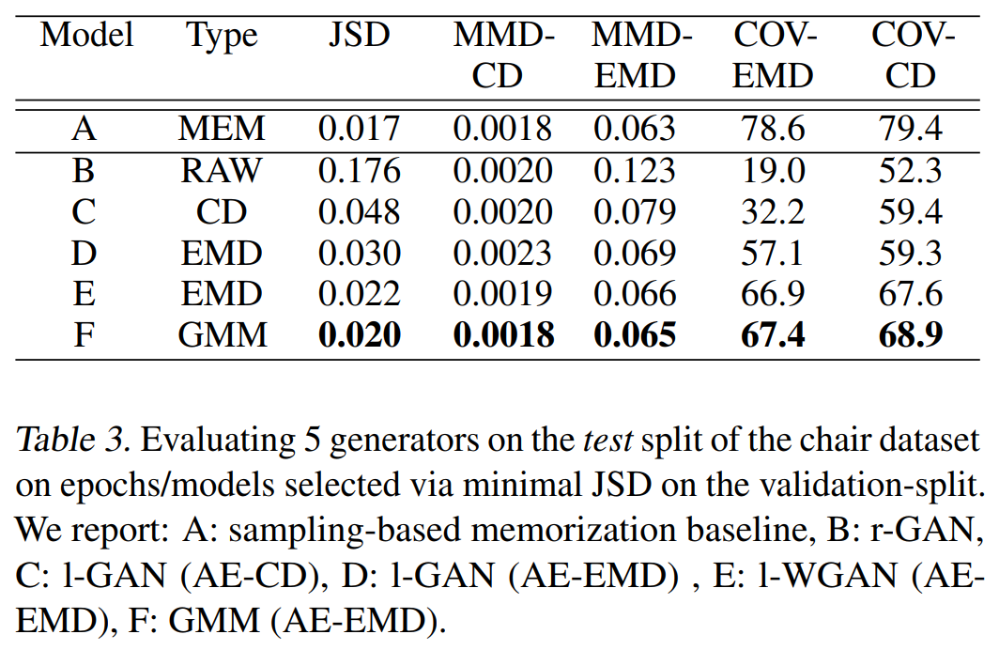

Slide 23
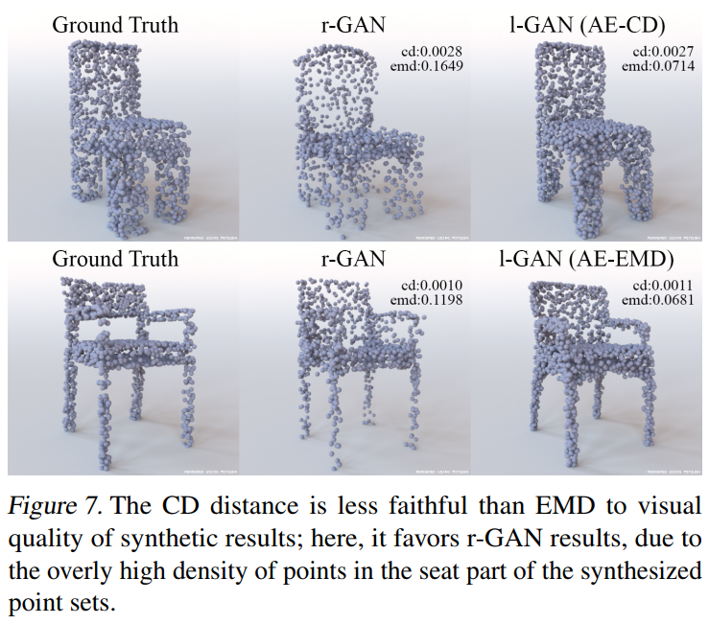
Chamfer’s blindness

Slide 24
Outline
Introduction
Background
Evaluation metrics
Models
Experimental evaluation
Conclusion

Slide 25
Conclusion
GAN with input on latent-space
bring out CD and EMD
Chamfer blindness in the certain cases
train the network with single object class

