Slide 1
View Selection for Virtual View Synthesis in Free Navigation Systems
ICSES’18

Slide 2
Outline
Introduction & Motivation
View Synthesis Problems
Quality of the Virtual View Synthesized using Different Real View
Neighboring Real View Chosing
Conclusions

Slide 3
Introduction & Motivation
virtual viewpoints have to be synthesized using the information from the real views.
This paper propose the algorithm which choose two views from source view to synthesize.

Slide 4
View Synthesis Problems
Common Scene Area
some part of virtual view can’t be projected because they be occluded by the foreground object in real view.
Finite Image Resolution
in different real views the width of the object would vary
Non-Lambertian Reflectances
the same object captured by different cameras has different brightness.

Slide 5
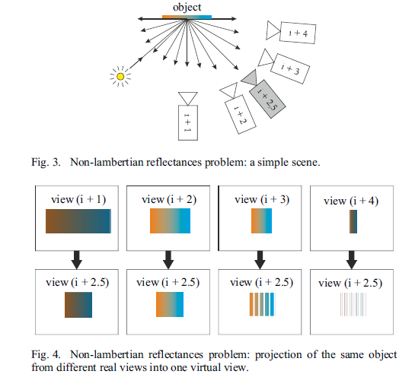
Finite Image Resolution

Slide 6
Non-Lambertian Reflectances

Slide 7
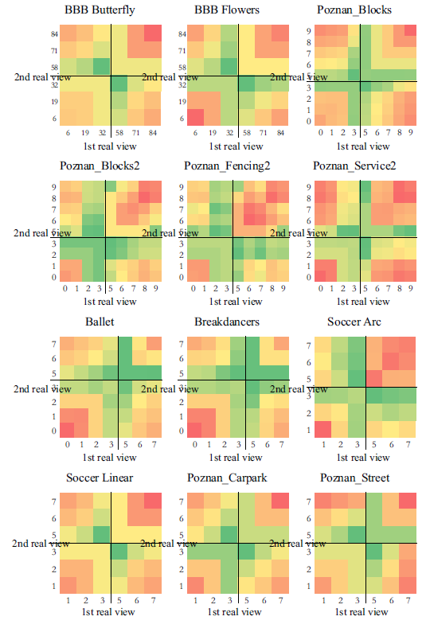
Quality of the Virtual View Synthesized using Different Real View

Slide 8
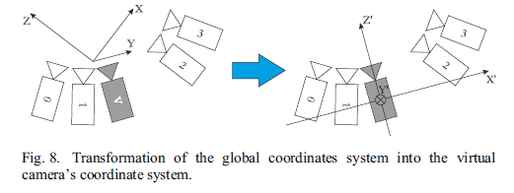
Neighboring Real View Chosing

Slide 9
Conclusions
Performed experiments prove, the nearest left and the nearest right view should be used for the view synthesis.
present an efficient method of selecting optimal real views

