Slide 1
Dynamic Graph CNN for Learning on Point Clouds
YUE WANG and YONGBIN SUN, Massachusetts Institute of Technology
ZIWEI LIU, UC Berkeley/ICSI
SANJAY E. SARMA, Massachusetts Institute of Technology
MICHAEL M. BRONSTEIN, Imperial College London/USI Lugano
JUSTIN M. SOLOMON, Massachusetts Institute of Technology

Slide 2
Why present this paper?
EdgeConv is easy to implement and integrate into existing deep learning-based algorithm
Improve the existing algorithm by extracting geometric features from the local information
They make their code public

Slide 3
Problem they want to solve
Inspired by PointNet and PointNet++, but PointNet extract features from independent point to guarantee permutation invariance
PointNet discard the local features store in the potential relationship of neighbor points

Slide 4
What is the proposed approach?
EdgeConv (based on Graph CNN)

Slide 5
EdgeConv Operation
edge features:
general
wighted sum
global only
local only
global + local

Slide 6
EdgeConv
Easily implement and integrate into existing deep learning-based algorithm by switch the MLP component to EdgeConv
EdgeConv is differentiable, which is important property in ML and DL (convex optimization problem)
Extract local features without destoring the permutation invariance
Dynamic Graph CNN => update the graph after each layer of network, i.e. recompute the k-nearest neighbors of every point and so does the edge features in the feature space

Slide 7
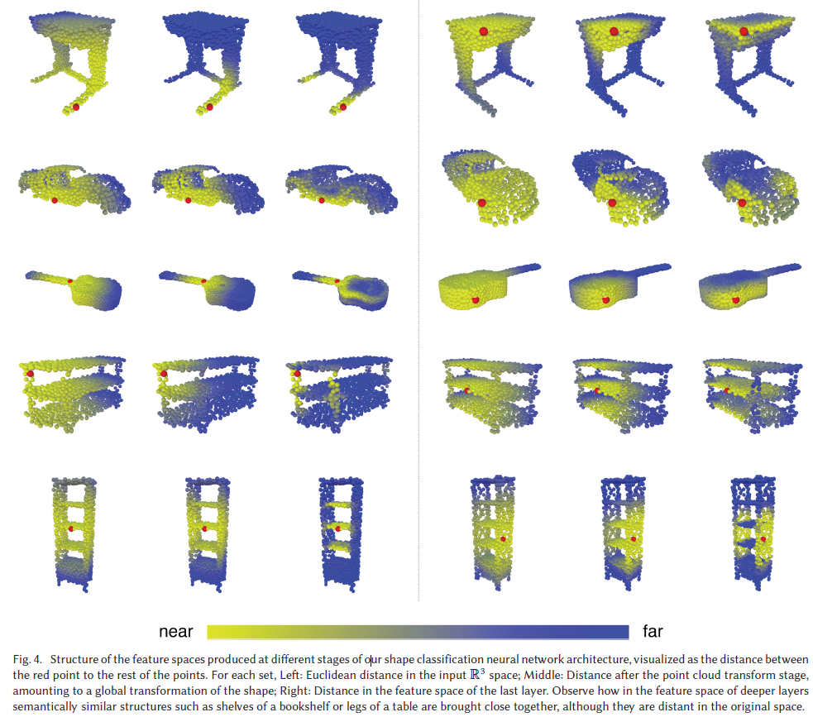

Slide 8
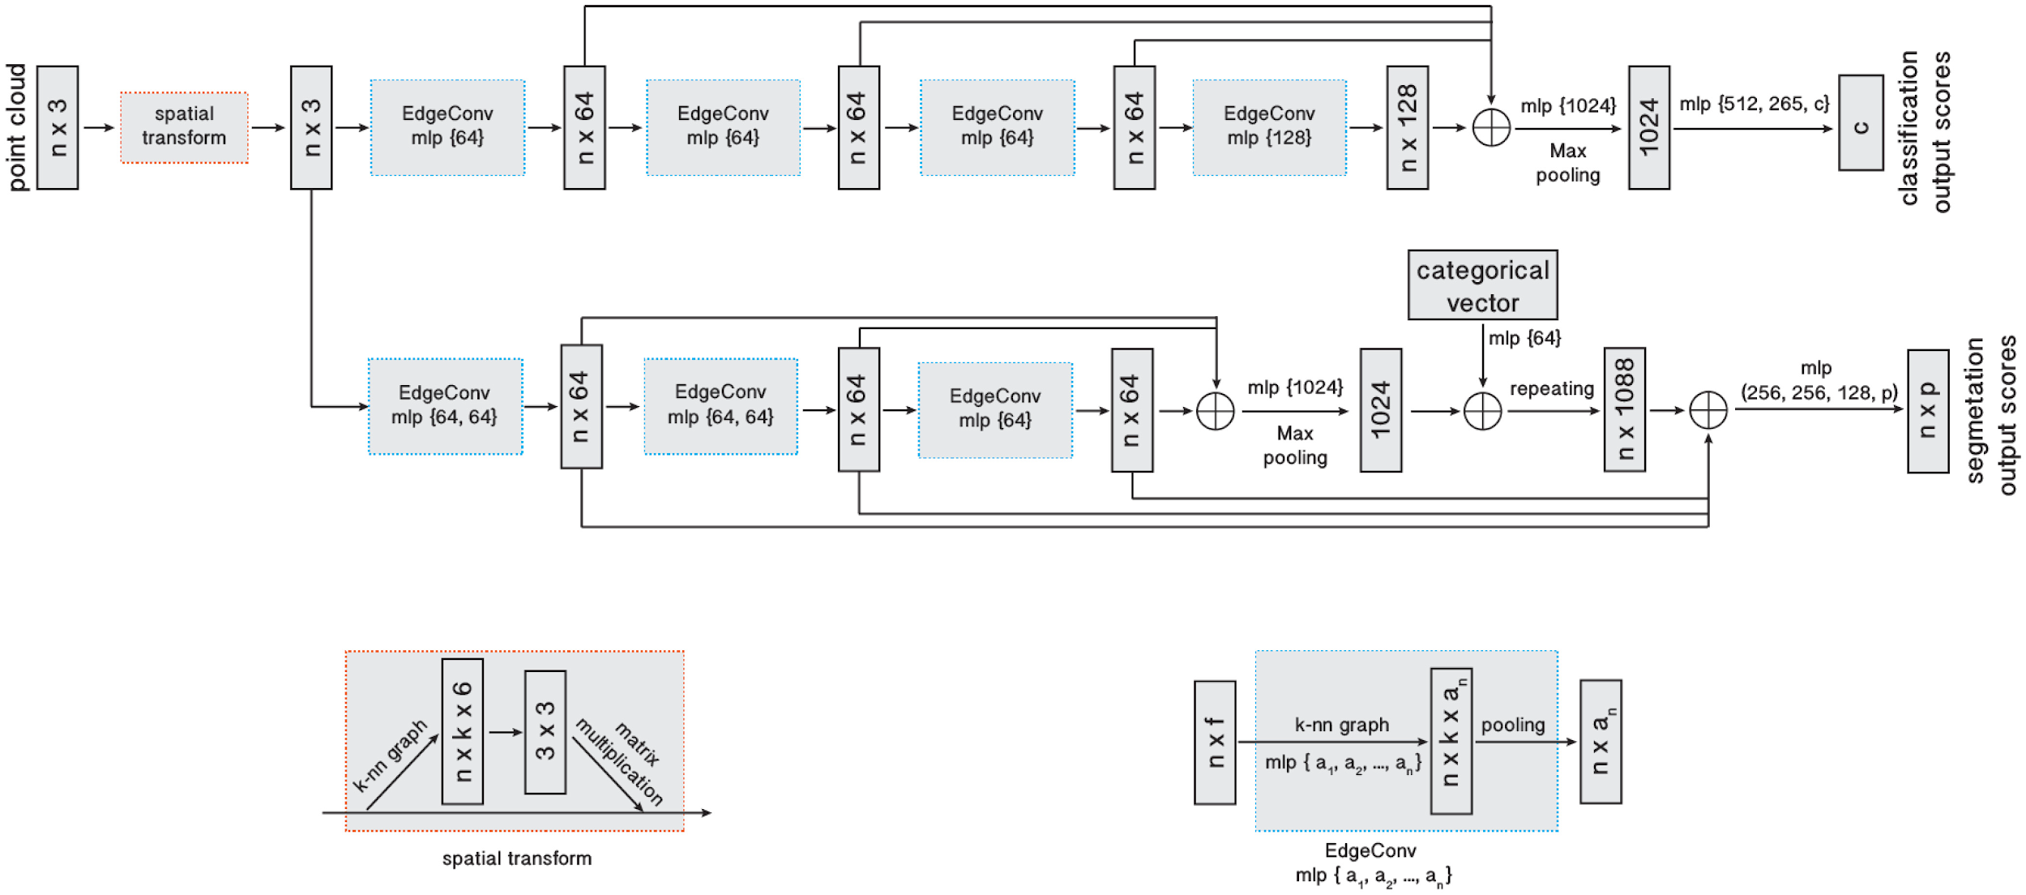
DGCNN

Slide 9
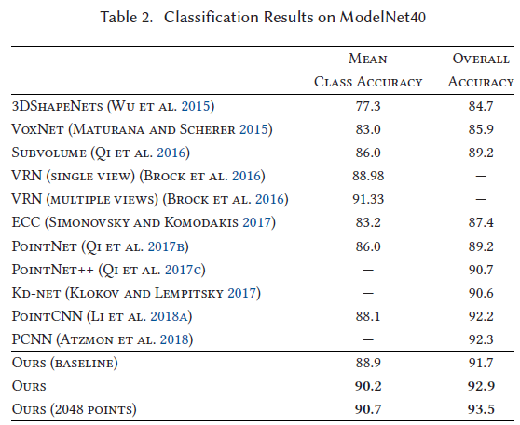
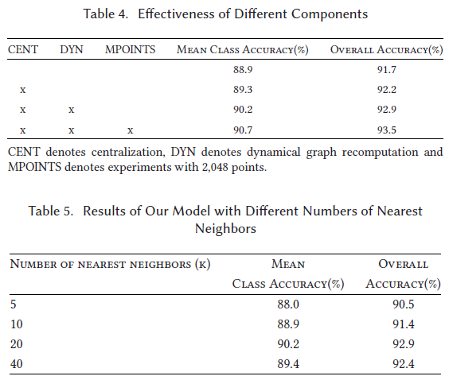
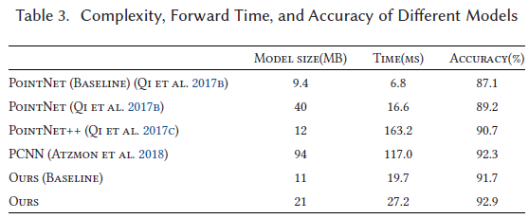

Slide 10
Any Question?

