Slide 1
DPPDL: A Dynamic Partial-Parallel Data Layout for Green Video Surveillance Storage
Zhizhuo Sun, Quanxin Zhang, Yuanzhang Li, and Yu-An Tan
IEEE TRANSACTIONS ON CIRCUITS AND SYSTEMS FOR VIDEO TECHNOLOGY, VOL. 28, NO. 1, JANUARY 2018

Slide 2
Problem
Energy consumption of storage in video surveillance increase rapidly.
Video acquisition, processing, and analysis on video surveillance require energy-efficient storage.
Common RAID supply surplus performance for write-dominant application
Not suitable for processing high-intensity fluctuating workload
In video surveillance, uneven workload is common.
Video standards (e.g., H.264/MPEG-4 AVC) based on spatial and temporal redundancy

Slide 3
Contribution
Dynamic Partial-Parallel Data Layout for video surveillance is proposed.
Dynamically providing degree of parallelism according to performance requirement
Be energy efficient on huge capacity condition that occurs in video surveillance.
Different from statically grouping disk or data, DPPDL schedule any number of disk concurrently to provide appropriate performance.

Slide 4
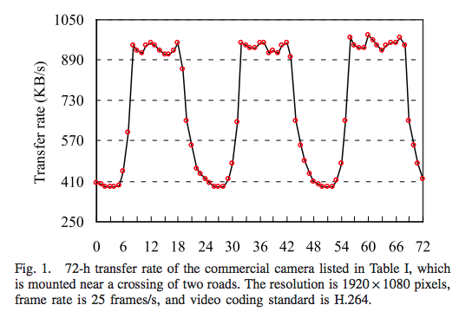
Observation
High intensity uneven workload
Buffering or data redirection performs less efficiently than writing dat directly.
Redundancy protection is also increase total cost.

Slide 5
Design and Policy
Objectives: 1. The degree of parallelism can be dynamically adjusting according to requirements. 2. Deleting data chronologically without conflicting to 1.
E.g., Deleted storage space where is 2-disk degree of parallelism (the oldest data) but the workload is 5-disk degree.

Slide 6
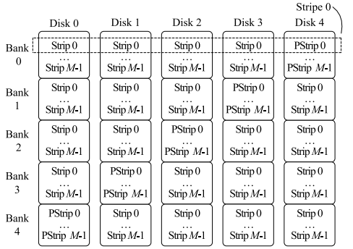
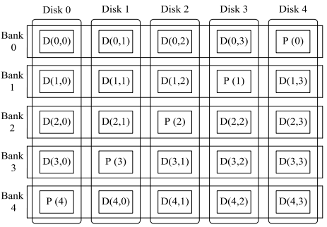
Design and Policy
Basic data layout

Slide 7
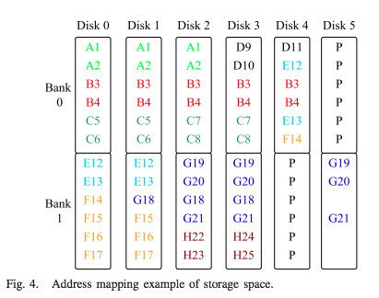
Design and Policy
Find the max stripe from current bank
No
Dynamic address mapping of storage space
Example workload
Macro level: Guarantee deleting the data obeying FIFO rules
Micro level: Stripe perform appropriate degree of parallelism for uneven workload
Find stripe from next bank
Yes
No
Workload | A | B | C | D | E | F | G | H
degree | 3 | 5 | 2 | 1 | 3 | 2 | 3 | 1
Yes
Release the space from next bank
Mapping to disk address

Slide 8
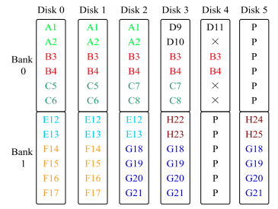
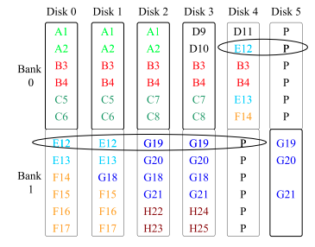
Design and Policy
Contention avoidance of disk access
make the storage space unable to be utilized totally.
However, they proove the unused ratio is low even in the worst case.
Workload perception

Slide 9
Evaluation
HD video surveillance system comprising 60 cameras
For each camera, avg. transfer rate is 712 KB/s
12 disks with 6 TB capacity and 1 disk for parity
Linux 3.2.81 kernel. Raid5.c under /driver/md to realize DPPDL
Storage server
Intel core and memory is 8 GB
LSI SAS storage controller on motherboard
Peak transfer rate: 1 MB/s; trough transfer rate: 410 KB/s; moderate file size(240-600 MB)
Baseline: PARAID, eRAID, MAID, Hibernator, CacheRAID, and Semi-RAID

Slide 10
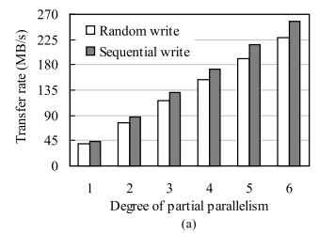
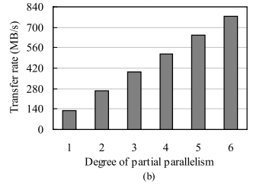
Evaluation
The random write performance is closed to sequential write because DPPDL converts random into sequential when addressing mapping.
Under same degree of parallelism, the read rate of DDPDL is higher because DPPDL mainly performs small write

Slide 11
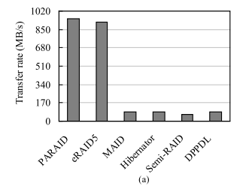
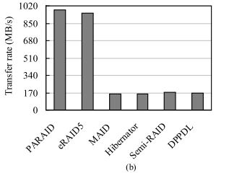
Evaluation
PARAID, eRAID5, and CacheRAID overprovided performance such that consumes extra energy
DPPDL has higher write performance than Semi-RAID due to the sequential write after the address mapping

Slide 12
Evaluation
PARAID requires enough storage space to save energy, which is difficult in video surveillance.
Hibernator has much higher disk migration frequency.
MAID require more storage devices
CacheRAID is second energy efficient after DPPDL, but higher cost on SSDs.

Slide 13
Conslusion
DPPDL is proposed for green surveillance storage.
Promote energy efficiency while tolerating single disk failure.
Meet the performance requirement but require almost fewest storage devices.

