Slide 1
Towards Low Latency Multi-viewpoint 360° Interactive Video: A Multimodal Deep Reinforcement Learning Approach
Haitian Pang, Cong Zhang, Fangxin Wang, Jiangchuan Liu, Lifeng Sun

Slide 2
Problem
contain 6DoF interaction
=> need to support high dimensional interactive space
need great deal of throughput and computation resources on viewer side
=> to mitigate the download latency and rendering latency
various viewpoint may occur at the same FoV
=> introduces extra switch latency and rebuffering latency
They want to do:
Find the solution which can achieve low latency and high quality in multi-viewpoint (MVP) 360 iteractive video.

Slide 3
Contribution
propose a low latency MVP 360 interactive video system (iView)
use multimodal learning to integrate the feature related to QoE.
use actor-critic-based DRL module to integrates all features and learn how to usher the tile selection
lower latency and higher video quality compare to other solutions.

Slide 4
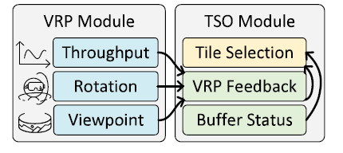
Basic Design
Viewing-Related
Prediction Module
Tile Selection
Optimization
3. Tile selection and optimization
1. Prediction
2. Send result of prediction

Slide 5
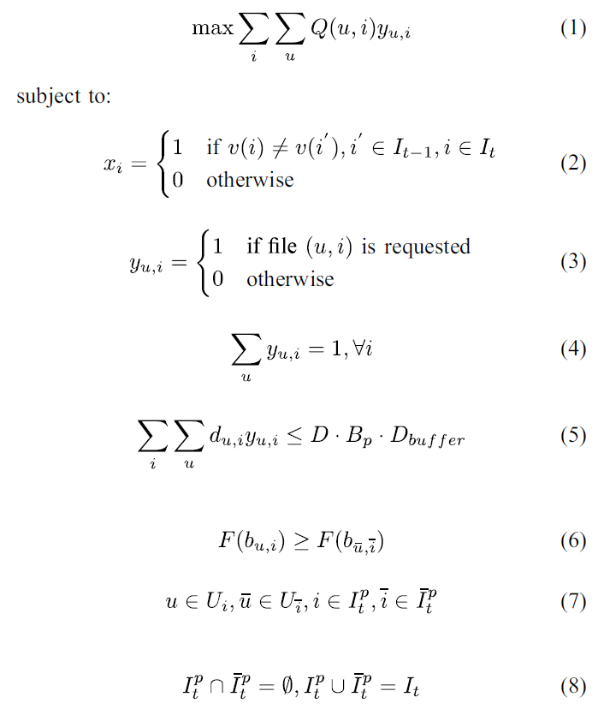
Problem formulation
Get the maximum QoE
the tile has one quality version be requested at least
amount of data can’t overflow the buffer
If viewer select new viewport, x = 1
otherwise, x=0
The quality of tile in FoV have to better than other
There is no overlap between the tiles and viewpoint in FoV and other regions

Slide 6
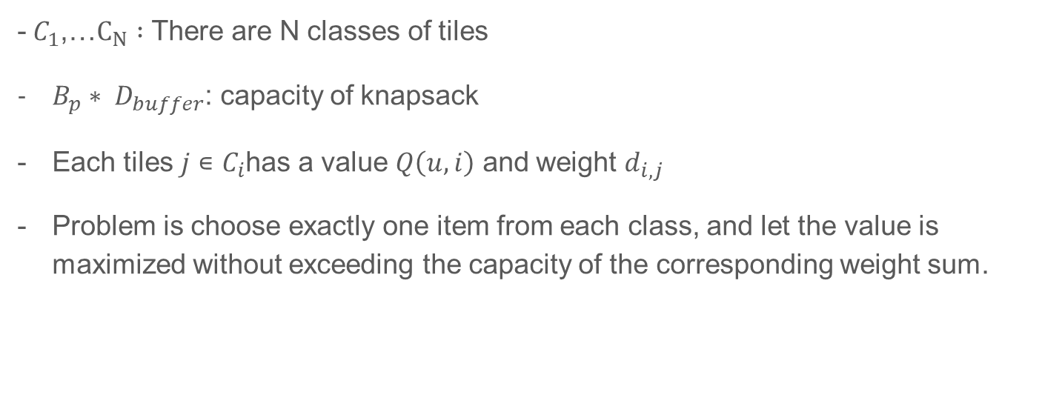
MCK problem (constraints(3)~(5))
[20] K. Poularakis, G. Iosifidis, A. Argyriou, I. Koutsopoulos and L. Tassiulas, "Caching and operator cooperation policies for layered video content delivery," IEEE INFOCOM 2016 - The 35th Annual IEEE International Conference on Computer Communications, San Francisco, CA, 2016, pp. 1-9.

Slide 7
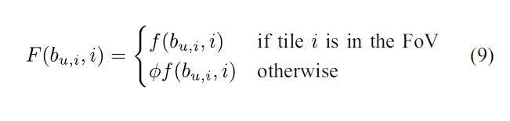
Bitrate function redefine (constraints(6)~(8))

Slide 8
Limitation
The TSO module cannot take the visual feature of the MVP 360° interactive video into account due to the limitation of the model-based solution.
The target of the VRP module is to improve the prediction accuracy (not latency), which is not related to the optimization objective directly.
Current decoupled design has a two-step delay, that is, the optimization step can only be started after receiving the prediction results from the prediction module.

Slide 9
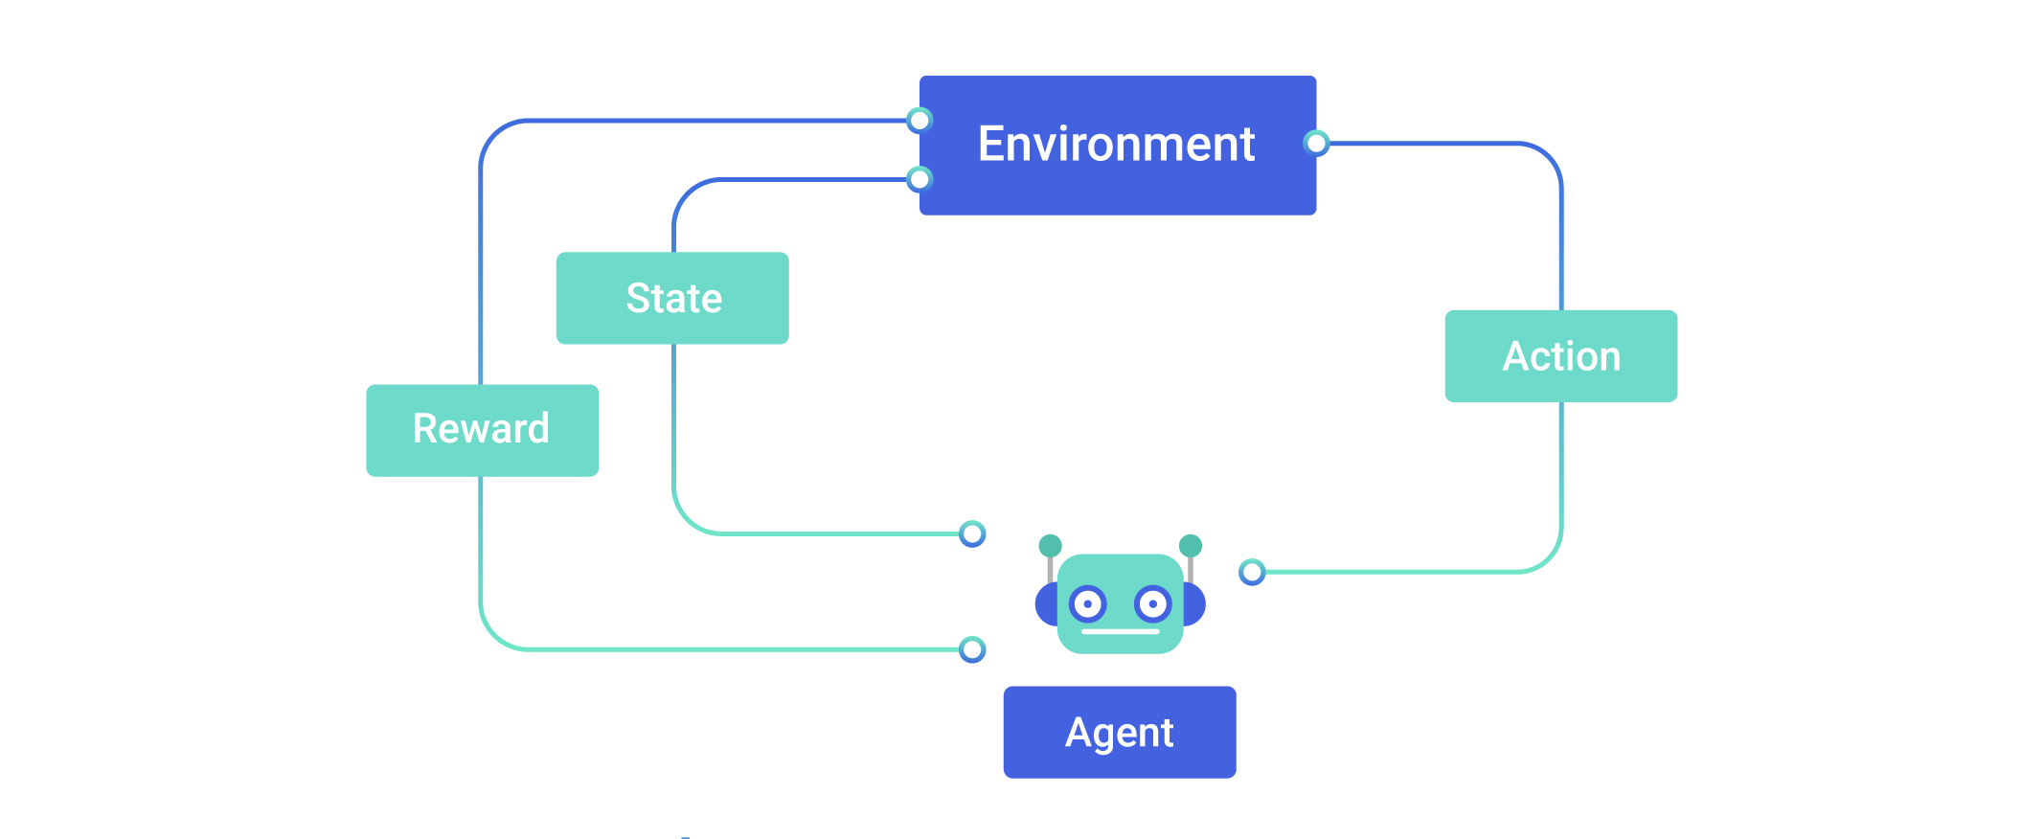
Multimodal Learning and Deep RL
Multimodal learning:
Enables fully exploration for the different types of data in multimodal dataset.
Deep Reinforcement Learning (DRL):

Slide 10
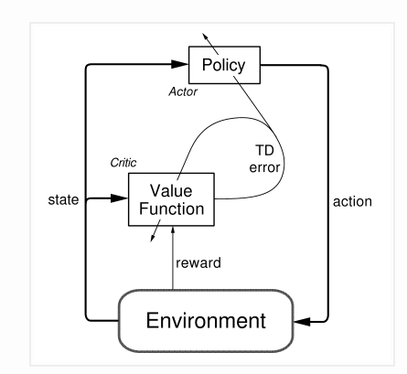
Advantage actor-critic (A3C) algorithm
Have two DNN structure, one is actor, the other is critic
Actor (policy-based) outputs the probability of each action
Critic (value-based) provides feedback about probability to action part

Slide 11
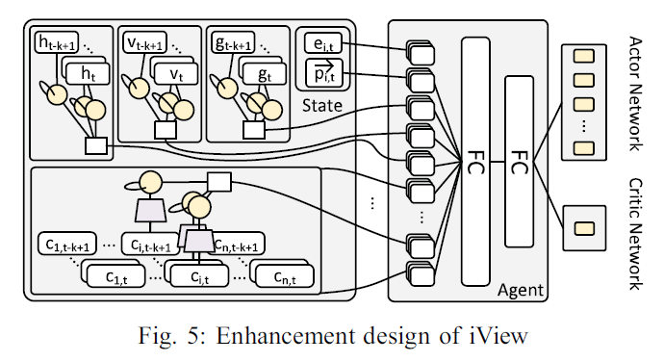
System architecture
Input feature processing:
Use CNN (grey trapezoid) reduce dimension
Use LSTM (yellow circle) capture temporal information
DRL-based training algo.
Actor
Cirtic

Slide 12
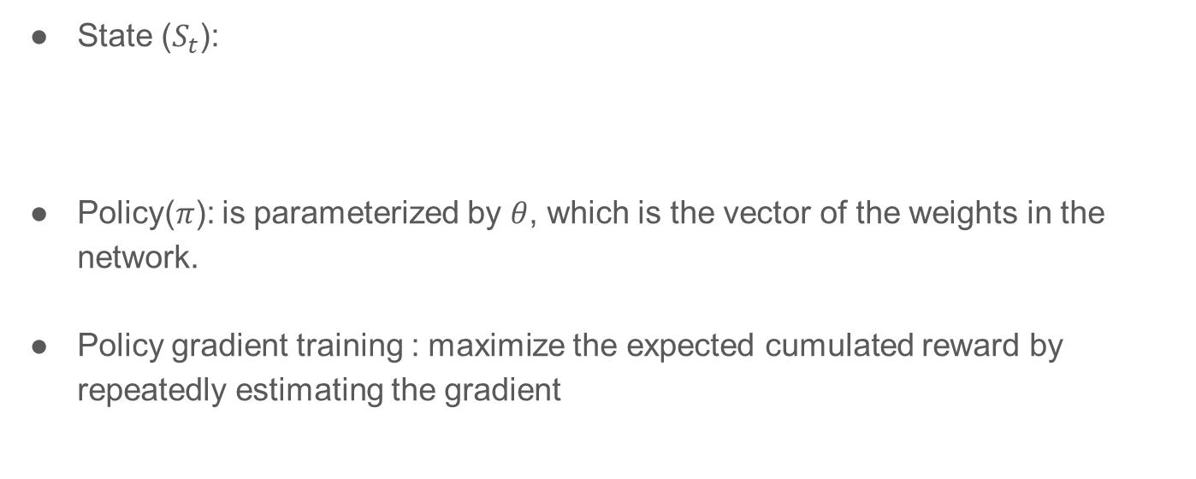

DRL-based training algo.

Slide 13
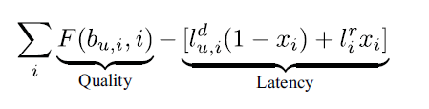
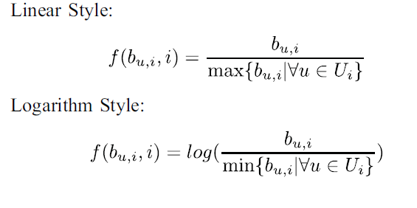
DRL-based training algo.
Reward function:
Reward: Quality
Penalty: Latency
Function of bitrate

Slide 14
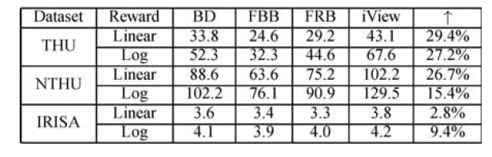
Evaluation
Basic Design (BD)
FoV-buffer-based (FBB)
FoV-Rate-based (FRB)
iView
Note that the first two datasets don’t have any viewpoint information. They add viewpoint switching decision according to the characteristics of third dataset.
The reason is the tile setting is 3X2, which reduce the benefit from tile selection
[28] D. Pisinger, “A minimal algorithm for the multiple-choice knapsack problem,” European Journal of Operational Research, vol. 83, no. 2, pp. 394–410, 1995.

Slide 15
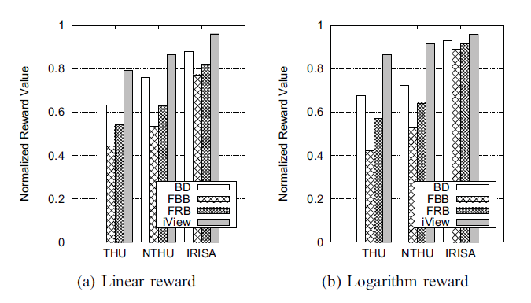
Evaluation
Different tile setting show significant impacts on performance of each method

Slide 16
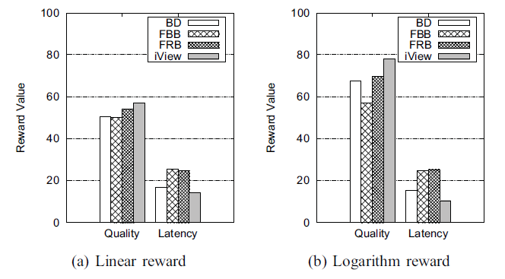
Evaluation
iView reduces 18%-48% of latency part and increases 14%-15% of quality part.

Slide 17
Conclusion
Propose basic design of iView, optimize the tile selection problem by prediction module and optimization module.
Use multimodal learning and Deep reinforcement learning to combine the feature and achieve high quality and low latency.
Achieve at least 27.2%, 15.4%, 2.8% improvement

