Slide 1
QIRG
Architectural Principles for a Quantum Internet

Slide 2
Introduction
We need the capability of managing and transmitting entangled state in the quantum internet
The physical devices have been proposed, but no proposal for how to work the Internet.

Slide 3
Contribution
Give the principle of the quantum Internet with a high-level perspective
Quantum Internet is different from the classical Internet. There are challenges along with these difference.
According to these challenges, the architecture principle and goal has been proposed and give a general set of recommended guidelines for quantum Internet

Slide 4
Quantum Internet features
No-cloning
Entanglement
Measurement
Fidelity
...

Slide 5

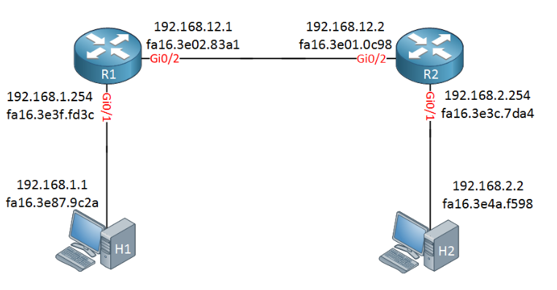
The difference between quantum and classical network
The quantum network is different from classical network. Nodes in quantum network are first entangled then transmit quantum messages, but classical networks transmit classical messages by forwarding.
Quantum network teleportation
Classical network forwarding
Dahlberg, Axel, et al. "A link layer protocol for quantum networks." Proceedings of the ACM Special Interest Group on Data Communication. ACM, 2019.
https://networklessons.com/cisco/ccna-routing-switching-icnd1-100-105/ip-routing-explained

Slide 6
Challenge
There is no quantum equivalent of a payload carrying packet
Quantum Internet use entanglements as the basic unit of networking. It isn’t like packets in classical Internet and thus also has no header. It use classical message to control.
An entangled pair is only useful if the locations of both qubits are known
When qubits change, nodes entangled in the Internet should all know the information to coordinate all its actions. The nodes location is thus needed.

Slide 7
Challenge
Generating entanglement requires temporary state
Classical control messages and entanglement generations often will not arrive at the destination at the same time. We need to store the state until classical messages arrive.
Generating end-to-end entanglement is a parallelisable operation.
Entanglements generating isn’t needed to generate in order, it can generate at the same time. The parallelizable operation has to be exploited to maximize resource utilization.

Slide 8
Goal
Support distributed quantum applications
There are many quantum applications based on distribution. We need to ensure that distributing states with a sufficiently high fidelity at a reasonable rate for a majority of potential applications.
Be flexible with regards to hardware capabilities and limitations
There are many different repeaters and maybe more kinds in the future. The Internet should allow for a large variety of hardware implementations

Slide 9
Principle
Bell Pairs are the fundamental building block
The entanglements are the basis unit in quantum Internet, and Bell pairs can be used to generating more complex entangled state (three qubits or more)
Fidelity is part of the service
Different applications may need different fidelity. The network should allocate fidelity according to applications’ demand.

Slide 10
Principle
Time as an expensive resource
The quantum memory lifetime is short and Bell pairs generation rate is low. Thus, the entanglements can be decoherence in a short time. We should prepare and provision resources when no quantum operations are not processed.
Limit classical communication
Quantum state will wait for classical message arriving. We should decrease the classical messages as much as possible.

Slide 11
Future work
Generating multi-partite entanglement
How to distributingmulti-partite entanglement is the problem when consider realistic senario and above priciple
Security in network operations
The attack at repeaters may break the whole entanglements. There should have some protocol to avoid it.

Slide 12
QIRG - Connection Setup in a Quantum Network

Slide 13
Introduction
The quantum network is controlled by classical network nodes with classical messages. The overall behavior is like coordinated computation distributed on nodes.
The hardware is heterogenetic, so the information about hardware should be collected.

Slide 14
Contribution
Set up connection processes
Set the main content in request connection messages
Process the request messages

Slide 15
Concepts and Glossary
Initiator: Establishing the connection by sending a message toward the Responder.
Responder: The classical endpoint of the connection setup process
QCap: An information block describing the quantum capabilities of a particular node and link in the request
RuleSet: Describes the actions that a nodes should take in response when certain conditions occur
response(Ruleset)
response
(Ruleset)
Initiator
repeater
Responder
request
(QCap)
request
(QCap)

Slide 16
Message Contents and Elements
PathSetupRequest:
node addresses for the Initiator and Responder
the class of service requested
minimum performance parameters (fidelity and throughput)
Quantum Capabilities (QCap):
fidelity of Bell pairs created by the quantum channel
fidelity of local operations performed by the node
the entanglements creating rate
RuleSets
Action: operations like swapping, duscard…
Resource ID: define entanglement resource

Slide 17
Connection Setup Phases
Consists of three basic phases:
The request send generating entanglements request and accumulate information about the node on the path in a stack of QCaps.
Initiator
repeater
Responder
request
request
QCap2
QCap3
QCap2
QCap1
QCap1
QCap1
Request
Request
Request

Slide 18
2. When the request arrives at the Responder, the Responder uses that information to create a complete RuleSet for every node.
3. The RuleSets are sent back along the original path, with each node removing its RuleSet from the message (popping the stack). Then node perform the actions it should do.
Ruleset1
Ruleset2
Ruleset3
Ruleset2
Ruleset1
Ruleset1
Response
Response
Response
response
response
Initiator
repeater
Responder

Slide 19
Why does a single node create the RuleSets for all nodes?
Centralization of RuleSet creation allows a Responder to upgrade its policies independently and to improve the process if its developers have found better tuning mechanisms.
A distributed mechanism would require that all nodes in the path upgrade at the same time to avoid the creation of inconsistent policies.

Slide 20
Conclusion
Connection use stack to record each node quality. Then responser use ruleset stack to control each node.
The responser determines the ruleset on itself

Slide 21
QIRG - The Link Layer service in a Quantum Internet

Slide 22
Introduction
The quantum link layer make the ad-hoc entanglement generating be a reliable service.
It provide the entanglement ID to be identify which entanglement is used. It make higher layer can use entanglement deterministically

Slide 23
Contribution
It define the higher layer to link layer and link layer to higher layer request header.
Propose the services in link layer

Slide 24
Services
Allow both node A and B to initialize entanglement generation.
Specify a desired minimum fidelity and maximum waiting time.
For a successful request, provide an entanglement identifier to allow higher layers to use identify the entangled pair

Slide 25
Interface between Higher layer and link layer
Higher layer send CREATE message to link layer to create entanglements local or remote
Link layer send Ack and OK message to response. Ack message tell higher layer it receive and OK message tell the request result.

Slide 26
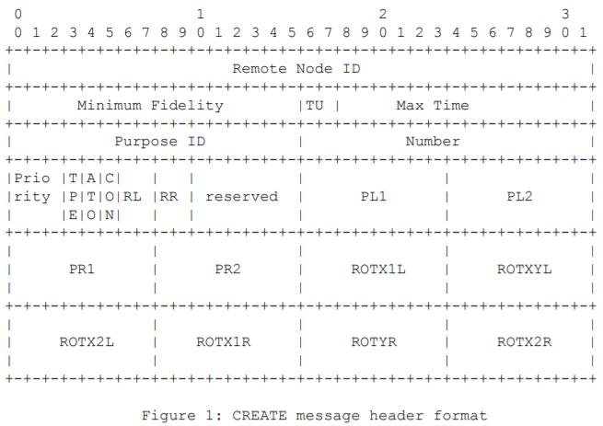
Higher layer to link layer
Higher layer tell what are desired entangled nodes and other parameter describing qubit state
Specify request ID as part of distant path
number of created entanglements
Parameter for local and remote probability distribution
Request priority
Type of request
Rotation of measurement basis
random basis in local and remote node

Slide 27
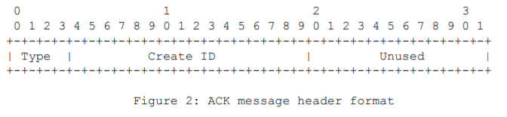
Link layer to higher layer
Link layer return Ack which include Create ID. It notifies the higher layer whether requests will be scheduled for generation. The higher layer also record node ID as create ID may not be unique.
Measure or keep entanglements operations have different OK message.

Slide 28
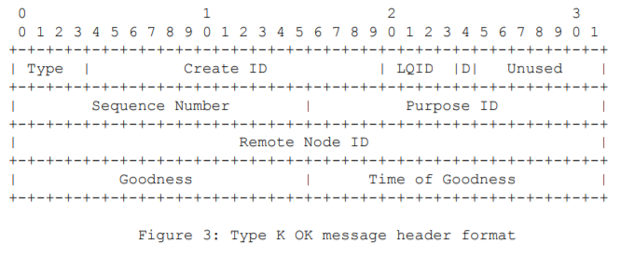
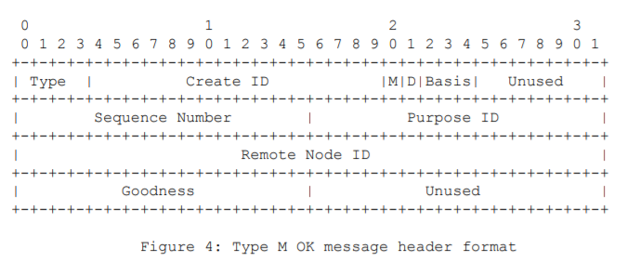
M and K OK message
A sequence number combined with node ID for identifying the entangled pair
A ID of the logical qubit in entanglement.
request from local or remote
M type include measurement basis and outcome.
K type include the time of estimate goodness (fidelity) and logical qubit holding entangle- ment
estimate of fidelity
measurement outcome

Slide 29
Conclusion
Higher layer request should contain min fidelity, max waiting time and other parameter to link layer.
Link layer return OK including ID information and fidelity information and Ack message to higher layer

Slide 30
OpenSSL+QKD
2019/11/5-6 in Pan-European Quantum Internet Hackathon

Slide 31
Introduction
OpenSSL is an open source cryptography library widely used on Internet application. QKD is the protocol to generate keys for encryption. The project want to use QKD in OpenSSL.
The other goal is implementing it on the simulator, SimulaQron, and work applications on simulated quantum network.

Slide 32
Contribution
Add European Telecommunications Standards Organization (ETSI) QKD API into OpenSSL. They try to make OpenSSL support API and provide the QKD to API.
Hacking the existing engine in openSSL to insert QKD

Slide 33
OpenSSL architecture
Has the engine mechanism allowing third parties add extension with library into OpenSSL and doesn’t change source code.
The engine provide API to offload particular operation on special-purposed acceleration hardware
Diffie-Hellman (DH) key exchange algorithm which is a excrytion algo has been used in the engine

Slide 34
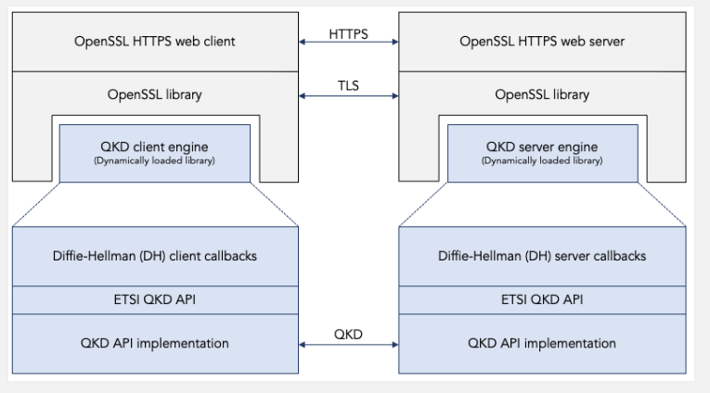
Hacking the existing engine
Modify the existing DH engine to the engine consist of QKD API and implementation

Slide 35
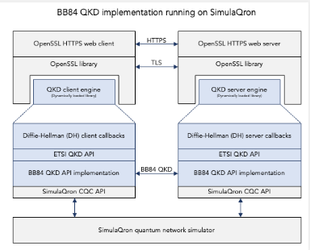
Mock QKD versus BB84 QKD running on SimulaQron
The project just use mock QKD implementation but it proposed a architecture can be used in SimulaQron simulator in the future.
It will run on simulated network using BB84 QKD protocol.

Slide 36
What it doesn’t do
It doesn’t create a new first-class abstraction. It only modify existing DH engine.
The right way is modifying OpenSSL source code to introduce new algo like QKD engine which include ETSI QKD API

Slide 37
Conclusion
OpenSSL can be extended by modified the engine without modifying source code
The implementation on simulated network or real QKD deviced is not done yet.

