Slide 1
AutoML: A Survey of the State-of-the-Art
X. He, K. Zhao, X. Chu
Department of Computer Science,
Hong Kong Baptist University

Slide 2
What is AutoML
Process of automating the end-to-end process of applying appropriate data-preprocessing, feature engineering, model selection, and model evaluation
Combination of automation and machine learning
Automatically build a machine learning pipeline with limited computational budgets
Only concerns about model building

Slide 3
Overview of AutoML Pipeline

Slide 4
Data Preparation
Data Collection
MNIST, CIFAR10 & CIFAR100, ImageNet, etc
Data synthesis
Augmentation: torchvision, Augmentor, Synonym imsertion, etc
Simulator: OpenAI Gym
GAN
Data Searching
Filtering
Active learning, semi-supervised learning self-labeling
Synthetic Minority Over-Sampling Technique (SMOTE)
Data Cleaning: standardization, binarization, one-hot encoding, etc

Slide 5
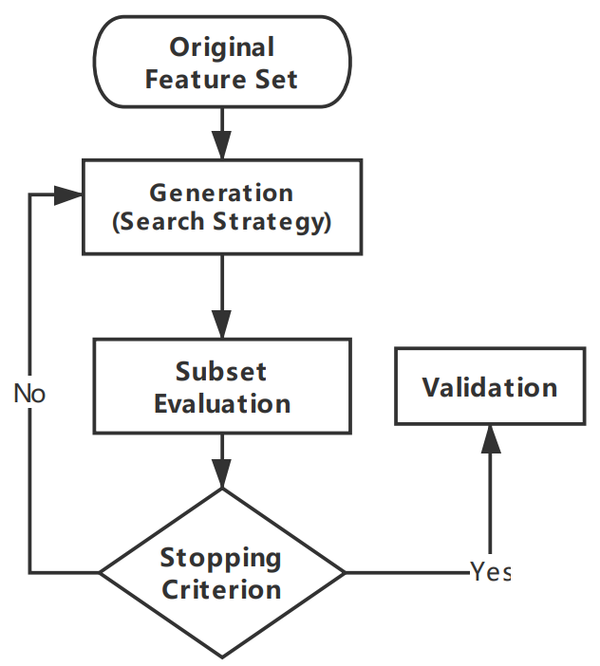
Feature Engineering - Selection
Search strategy
Complete: exhaustive and non-exhaustive
BFS, Branch and Bound, Beam Search, Best First Search
Heuristic:
Sequential Forward Search (SFS): add feature from empty set
Sequential Backward Search (SBS): remove from full set
Bidirectional: Use both SFS and SBS
Random:
Simulated Annealing (SA) and Genetic Algorithms (GA)
Evaluation methods
Filter, wrapper, embedded

Slide 6
Feature Engineering – Construction & Extraction
Construction: Preprocessing transformation
Standardization, normalization, feature discretization
Boolean features: conjunctions, disjunctions, negations
Numerical features: min, max, addition, subtraction, mean, etc
Extraction: Dimensionality reduction process
Mapping function
Principal Component Analysis (PCA), isomap, etc
Feed-forward neural networks approach
Autoencoder

Slide 7
Model Generation
Traditional Model Selection
Select the best-performing model from SVM, KNN, decision tree, etc
Network Architecture Search (NAS)
Model Structures
Entire, cell-based, hierarchical, network morphism based
Hyperparameter optimization
Grid and random, RL, evolutionary algorithm, Bayesian optimization

Slide 8
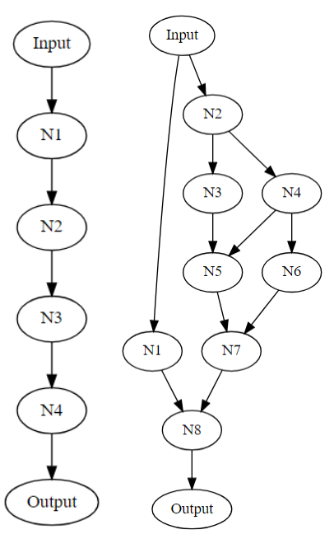
Model Structures – Entire Structure
Chained model:
Similar to the traditional neural network structure
Have been proved effective in practice
Likely to be very deep → huge search base
Lacks transferability

Slide 9
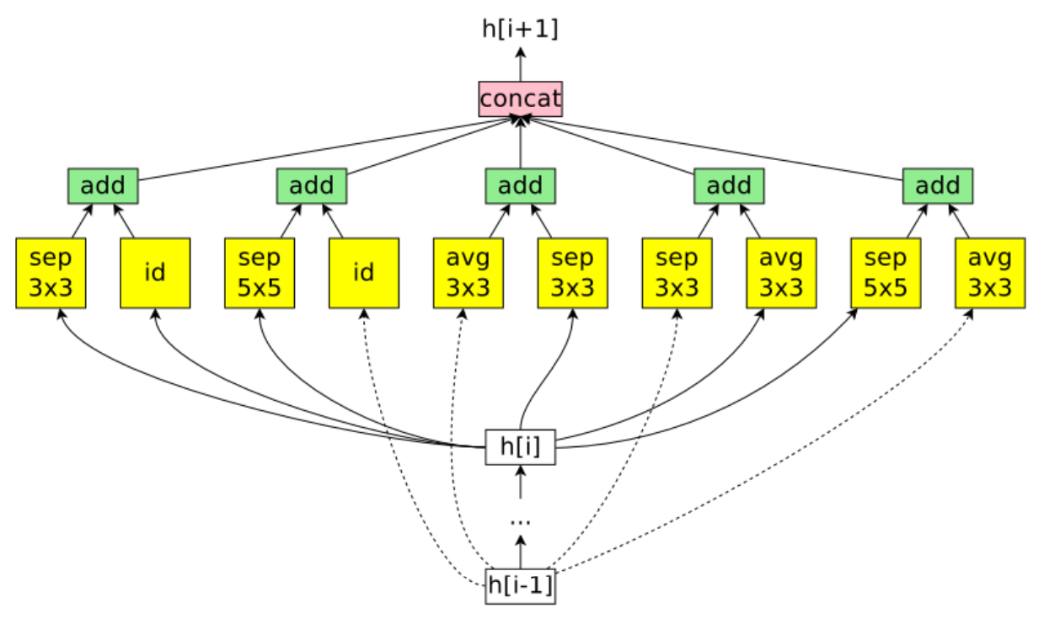
Model Structures – Cell-based Structure
Search for a cell structure and then stack cells to generate a whole structure
Reduce search complexity
Suppose 6 predefined operations, 8 nodes per cell
For layer L_{j}, there are j-1 layers can connect to it
Entire: when L = 12 → 6^{L}*2^{L(L-1)/2} =1.6*10²⁹ possible networks
Cell: (6*(8-2)!)⁴ = 3.5*10¹⁴
Transferability: stacking more cells

Slide 10
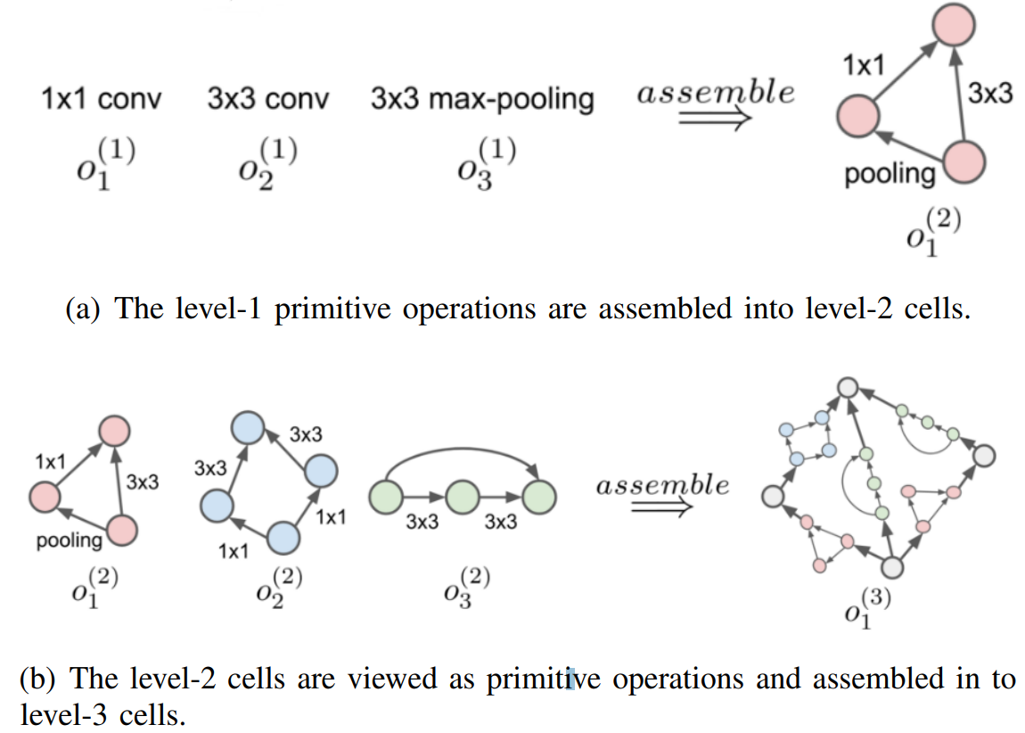
Model Structures – Hierarchical Structure
The number of cell nodes are not fixed
Higher-level cell is generated by incorporating lower-level cell iteratively
Use a learnable matrix G to represent the higher cell
Can discover more types of network with complex and flexible topologies

Slide 11
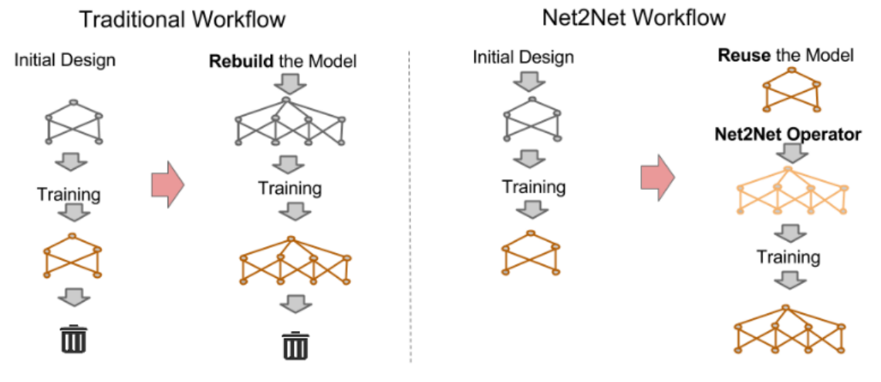
Model Structures – Network Morphism based
Transfer the information stored in an existing neural network
New network is guaranteed to perform better or equivalent to the old network

Slide 12
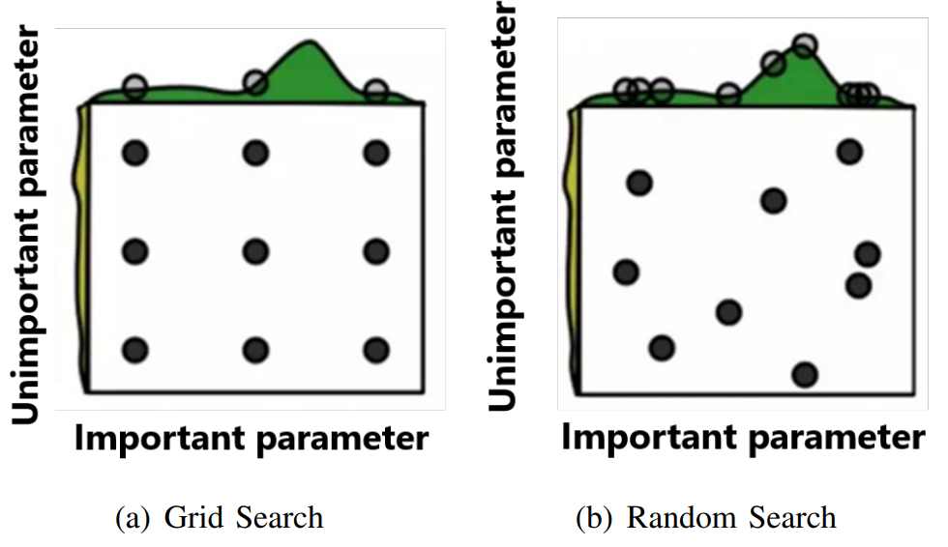
HPO – Grid and Random Search
Hyperparameter: parameter whose value is set before the learning process begins
Grid search:
Divides the space of possible hyperparameters into regular intervals
(a) Can only test 3 distinct config for 9 trails
Coarse grid first
Random search:
Practical but unable to find optimal
Hyperband: use more resource to tune the promising space

Slide 13
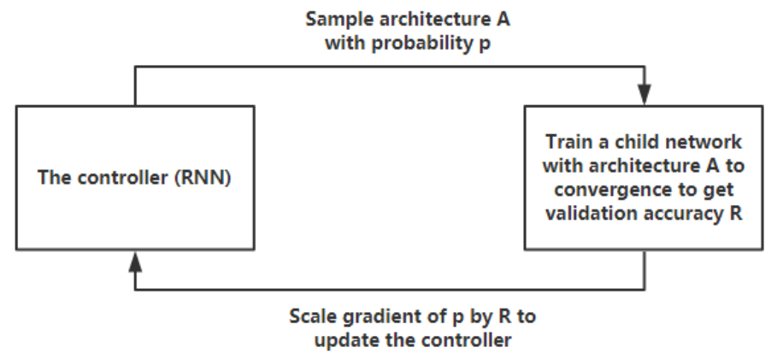
HPO – Reinforcement Learning
NAS: Train an RNN to automatically generate network architectures
MetaQNN: Use Q-learning to sequentially search neural architectures
Both achieved state-of-the-art results of CIFAR10
Took 28 days and 800 K40 GPUS to search the best-performing architecture → unafforadable for researchers and companies
ENAS[1]: share parameters to eschew training each valid model from scratch to convergence
[1] H. Pham, M. Y. Guan, B. Zoph, Q. V. Le, and J. Dean, “Efficient neural architecture search via parameter sharing,” vol. ICML. [Online]. Available: http://arxiv.org/abs/1802.03268

Slide 14
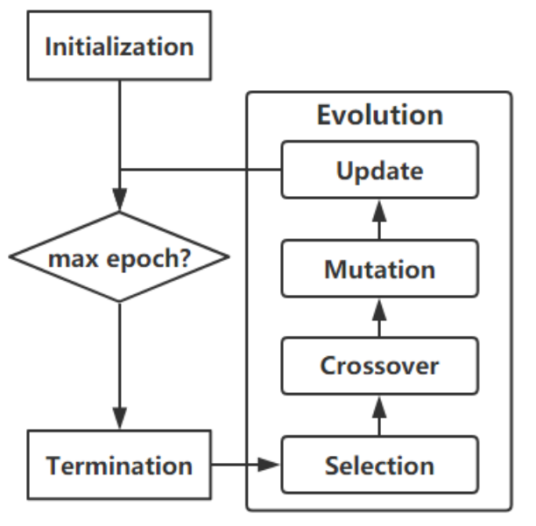
HPO – Evolution Algorithm
Network encoding
Directed encoding: binary, DAG, Cartesian genetic programming, etc
Indirected encoding: use functions to represent network
Selection: by fitness, select random then by fitness
Crossover: generate offspring by 2 parents
Mutation: flipping bits randomly, add or remove connections, etc.
Update: remove some generated networks to avoid waste of computation resource
Notes:
DAG → directed acyclic graphs

Slide 15
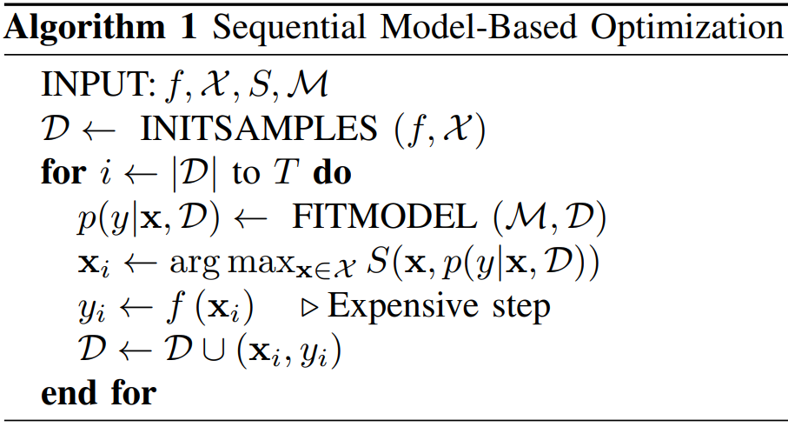
HPO – Bayesian Optimization
Build probability model of the objective function
Sequential model-based optimization (SMBO)
Randomly initialized model M using a small portion of search space X D is consisting (x_{i}, y_{i}), where y_{i} = f(x_{i})
Tune M to fit the dataset D
Select new set of hyperparameters by predefined acquisition function S
Notes:
DAG → directed acyclic graphs

Slide 16
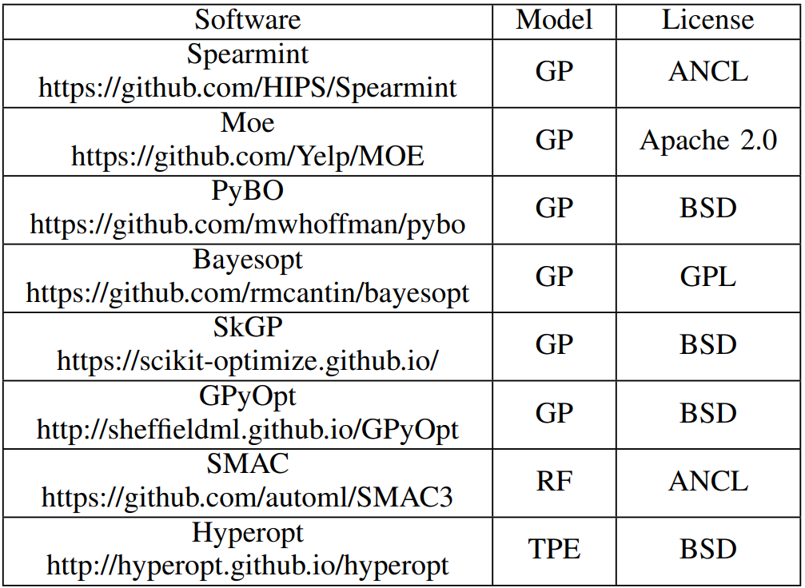
HPO – Bayesian Optimization
Gaussian Processes (GPs)
Suppose f has a mean u and a covariance K
Random Forest
Allow the use of conditional variables
Tree Parzen Estimators (TPE)
Use 2 hierarchical processes, l(x) and g(x), and model the domain variables when the objective function is below and above a specified quantile y*
Notes:
DAG → directed acyclic graphs

Slide 17
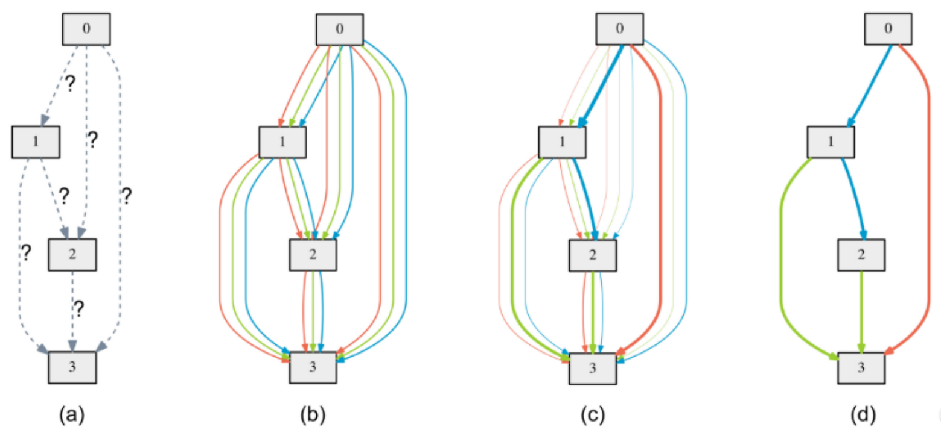
HPO – Gradient Descent
Attempts to search parameters over continuous and differentiable search space instead of discrete sample-based approach
Reduce search time but require large GPU memory (grow linearly)
SharpDARTS[2]: 50% faster than DARTS, accuracy of CIFAR10 improved by 20%~30%
An Overview of DARTS
[2] G. D. H. Andrew Hundt, Varun Jain, “sharpDARTS: Faster and More Accurate Differentiable Architecture Search,” Tech. Rep. [Online]. Available: https://arxiv.org/pdf/1903.09900.pdf
Notes:
DAG → directed acyclic graphs

Slide 18
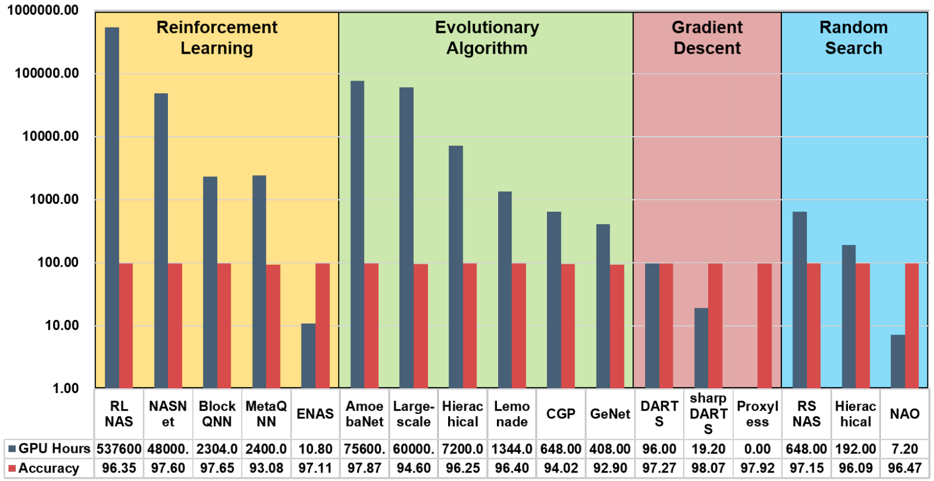
NAS Performance Summary
Results are all very close
GD based are more efficient
EA is time consuming
Result of random search is comparable
Test on CIFAR10
Notes:
DAG → directed acyclic graphs

Slide 19
Open Problems and Future Work
Complete ML pipeline
Existing pipeline are all lack of data collection
Interpretability
No evidence to prove why some specific operations performs better
Reproducibility
Flexible Encoding Scheme
Is there a more general way of representing a network architecture and primitive operation?
Lifelong Learn
Notes:
DAG → directed acyclic graphs

Slide 20
Kubeflow Katib
A Kubernetes native system for HPO and NAS
Experiments: objective, search space, search algorithm
Suggestion: a set of parameters or a list of assignments
Trial: one iteration of the optimization process
Worker job: a process responsible for evaluating a trial Currently support
random search
grid search
hyperband
BO
NAS based on RL

