Slide 1
Online Proactive Caching in Mobile Edge
Computing Using Bidirectional Deep
Recurrent Neural Network
Laha Ale, Ning Zhang, Huici Wu, Dajiang Chen, and Tao Han
IEEE INTERNET OF THINGS JOURNAL, VOL. 6, NO. 3, JUNE 2019

Slide 2
Problems
Wireless traffic has skyrocketed
Mobile edge computing can serve the demands from the devices locally and quickly
Requests may exhibit certain similarity among different users over time
Proactive caching can reduce traffic loads in backhaul and service latency of end users
The performance of proactive caching depends on the accuracy of the prediction of content popularity
Machine Learning Methods: assume the popularity of files is time-invariant
An online proactive caching scheme which can predict the time-varying popularity with high accuracy and low complexity is required
Notes:
decentrailze cloud service to base stations

Slide 3
Contributions
A online proactive caching scheme to predict the future requests and manage the cache, considering the hidden association of requests in time steps.
The model can achieve above 60% prediction accuracy

Slide 4
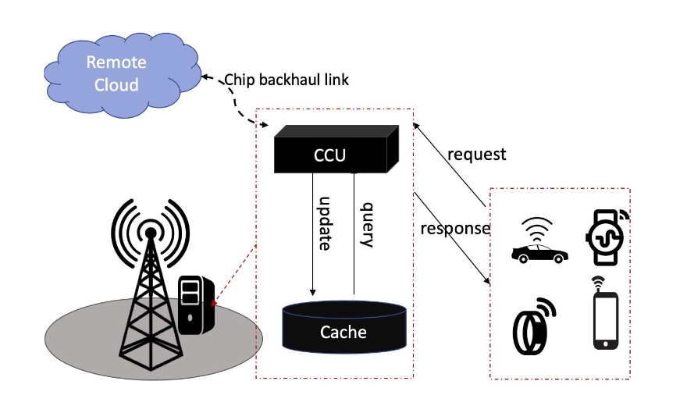
System model
When request arrives,
check if the file is in the cache
hit: return the content
miss: send request to the remote cloud and reterive the content
deep learning model keep predicting based on requests in service zone and time steps
cached file updated using the predicted files (replace)
model keep learning
Goal: improve service response time, reduce traffic loads in core network
Key: predict users’ requests, maximize the cache hit rate

Slide 5
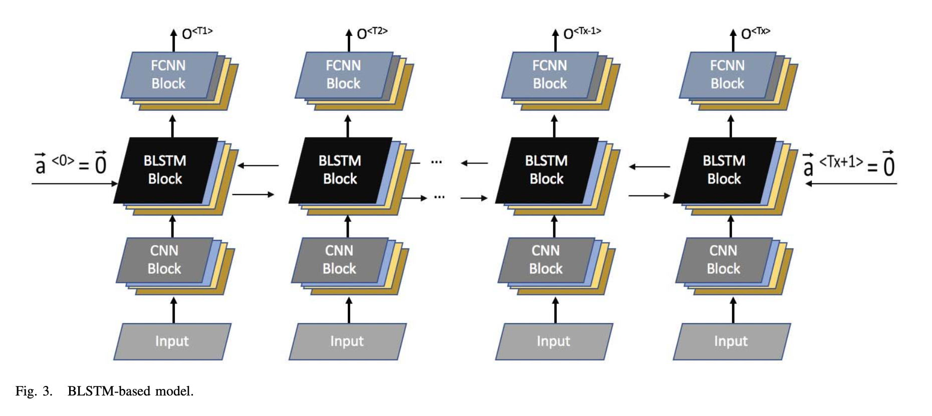
Online proactive caching model
CNN (Convolution Neural Network)
BRNN (Bidirectional Recurrent Neural Network)
Traditional deep NN can’t preserve learned information from previous time slots
RNN with loops passes learned information from one steps to the next
BRNN passes the learned information in both directions
This paper uses LSTM (Long Short-Term Memory) neural network as RNN
FCNN (Fully Connected Neural Network)

Slide 6
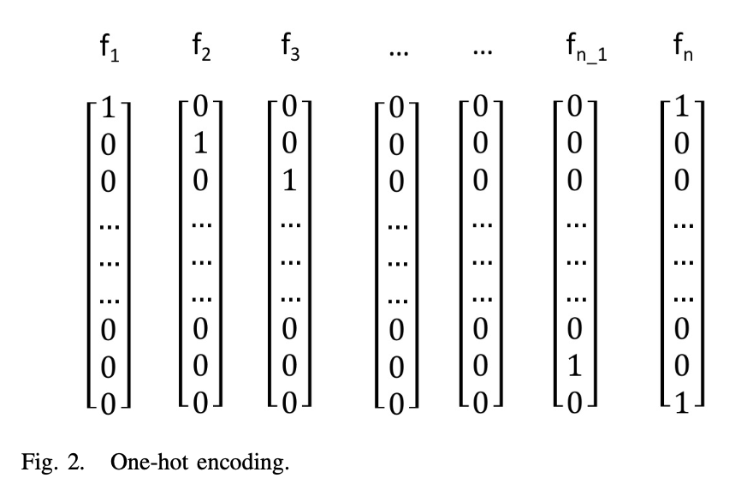
Proactive Caching
CNN:
encoding files into the one-hot matrix
size of the convoluted values reduced, representation information of the files remains
reduce dimensious of input data, reduce computational cost
BRNN:
adopt bidirectional LSTM to predict users’ sequential requests
learn association of requests over time steps and output time-series user requests
FCNN:
sample and learn from outputs of BRNN
further improve prediction performance
Notes:
沒用fcnn就是高prob就留，低的丟掉，用一個threshold

Slide 7
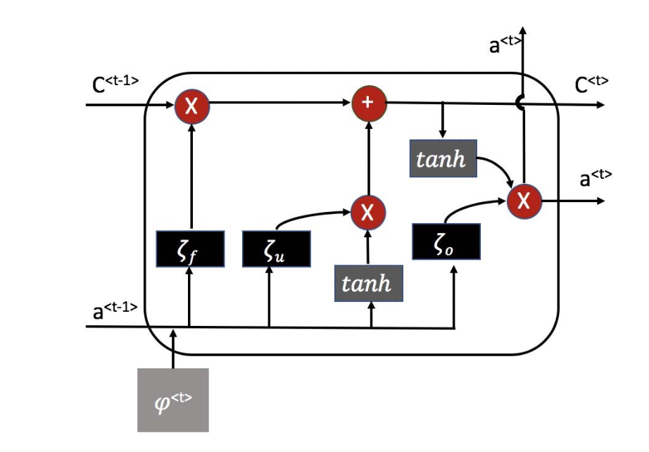
LSTM cell
Forget gate
decides what information to be kept or removed
Update gate
decide which candidate files created are actually related to the previous files
Output gate
determine the outputs, based on the cell state
memory
ltsm’s output
input
Notes:
c serves as the memory, while h acts a copy of it that can be passed to further process the inputs in the next time-step. Perhaps that may have been the motivation in GRUs to merge the two.
為了克服梯度消失問題，我們需要一個二階導數在趨近零點之前能維持很長距離的函數。tanh是具有這種屬性的合適的函數。

Slide 8
Notes:
fcnn output: predicted files with max prob

Slide 9
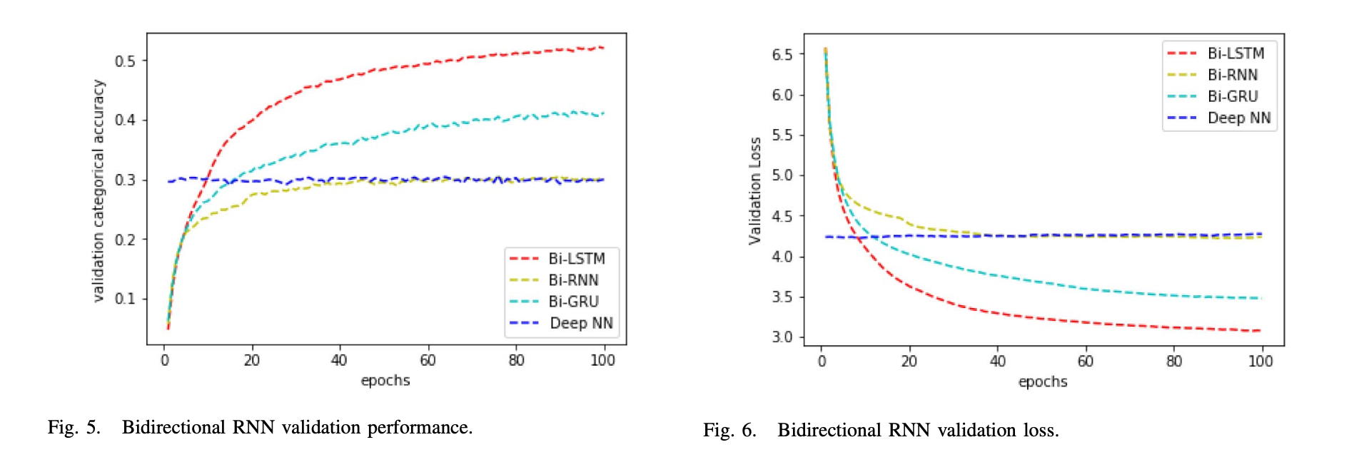
Evaluation
GRU: gated recurrent unit, speed up the execution speed and reduce memory consumption of LSTM
BRNN-based models can perform better than the deep NN model
More epochs are required to learn the hidden information over time steps
Notes:
LSTM&GRU都是為了改良ＲＮＮ長期記憶力差的問題提出的
GRU similar to LSTM but smipler
Categorical accuracy is the percentage of request files that are successfully pre- dicted by the model.

Slide 10
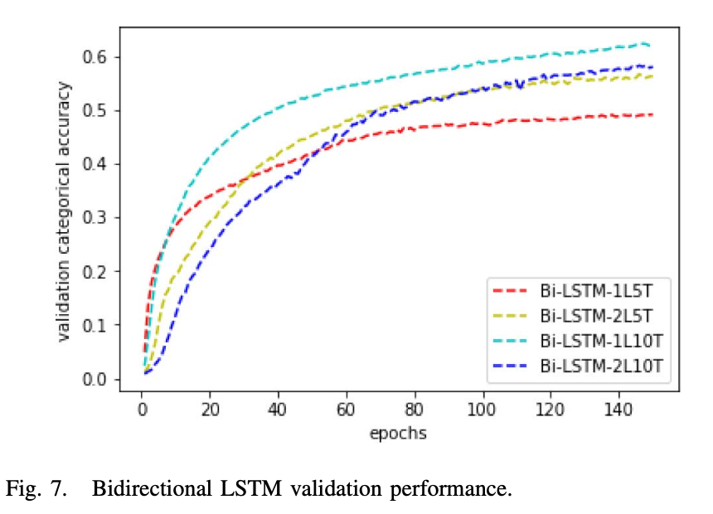
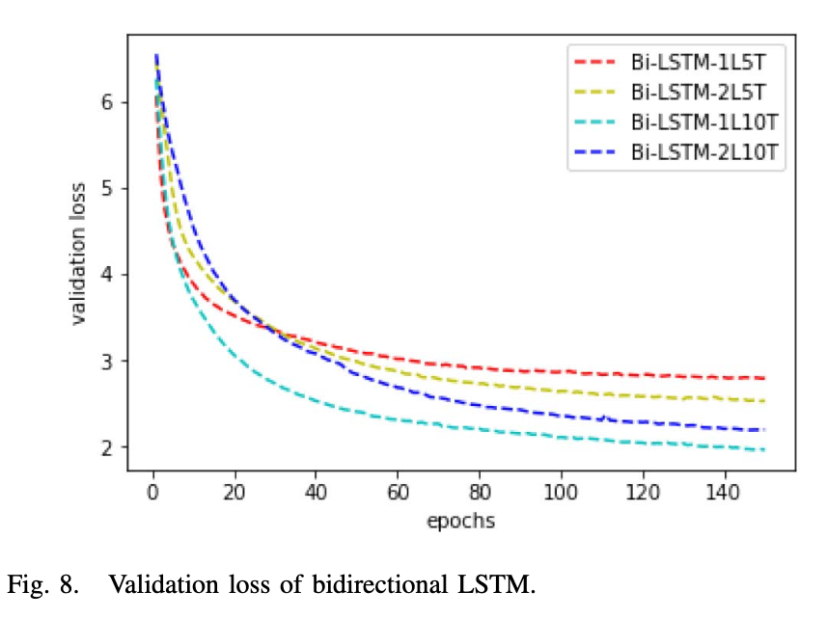
Longer time steps and deeper network can improve the performance, long time steps do not compromised the performance
Notes:
each cache unit can fit a request file
2L coverge slower…

Slide 11
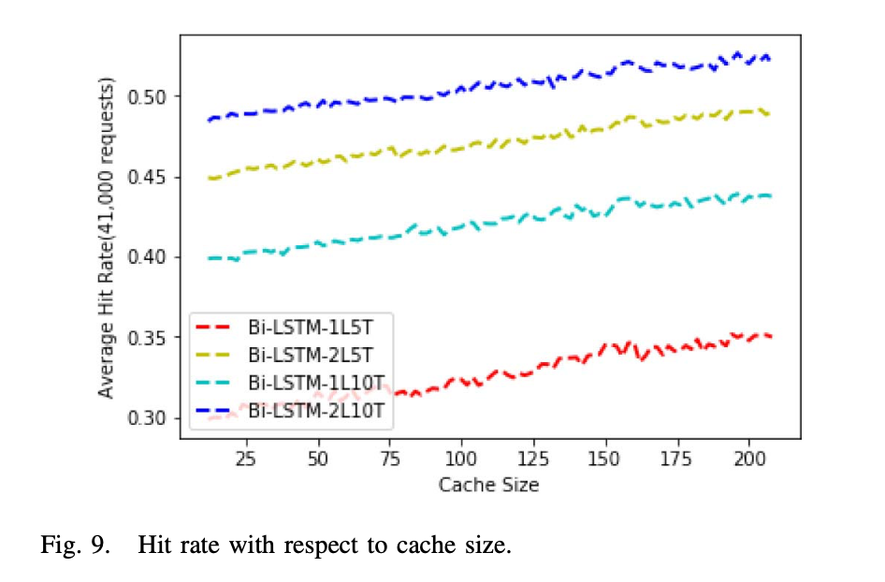
Deeper and long time steps can improve the accuracy

Slide 12
Conclusion
Proposed a deep learning model based on BRNN model to predict the time-series user requests
Relatively deeper LSTM layers with longer time steps can improve the performance of the models

