Slide 1
QARC: Video Quality Aware Rate Control for Real-Time Video Streaming based on Deep Reinforcement Learning
MM’18, October 22-26, 2018, Seoul, Republic of Korea
Tianchi Huang3,1, Rui-Xiao Zhang1, Chao Zhou2∗, Lifeng Sun1∗
1 Dept. of Computer Science and Technology, Tsinghua University, Beijing, China
2 Beijing Kuaishou Technology Co., Ltd., China
3 Dept. of Computer Science and Technology, Guizhou University, Guizhou, China

Slide 2
Introduction
This paper proposes the DRL-based approach to select sending bitrate in real-time video streaming.
Different previous work, this work tries to maximize video quality rather from than bitrate.
They derive the neural network into two parts to reduce state space:
First part: a neural network used to precisely predict future video quality based on the previous video frames
Second part: an RL model used to determine the proper bitrate based on the output of the first model.

Slide 3
Motivation
In real-time live streaming scenario, high video bitrate is equaled to high video quality.
However, in some siuation, high video quality only requires a low bitrate.
=> If making the right decision, it can save a lot of bandwidth.

Slide 4
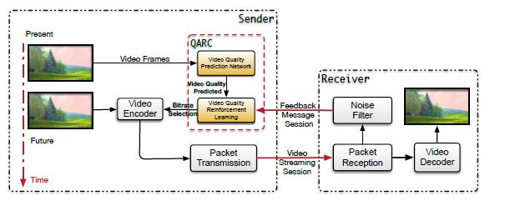
System Architecture
There are two part in their propose method:
Video Quality Prediction Network (VQPN) predicts the future video quality metrics based on historical video frames
Video Quality Reinforcement Learning (VQRL) select bitrates for future video frames based on network status observations and the future video quality metrics predicted by VQPN.

Slide 5
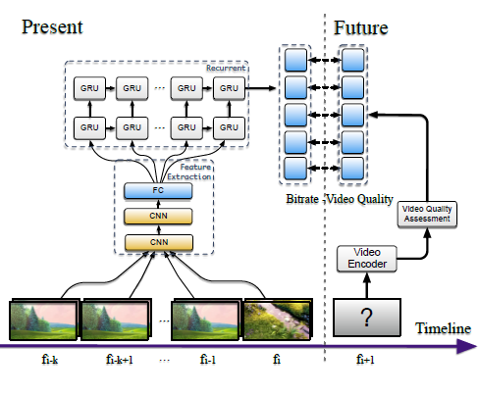
VQPN
Input: historical video frames (Fi = [fi−k , fi−k+1, · · · , fi ])
Output: prediction of the video quality assessment in the next time slot t + 1 of candidate bitrates
Loss function: (MSE with regulation)
Using CNN to extract feature
Using a double-layered recurrent layer [5] to extract temporal characteristics of the video frames Fi in past k sequences
[5] Junyoung Chung, Caglar Gulcehre, Kyunghyun Cho, and Yoshua Bengio. 2014. Empirical Evaluation of Gated Recurrent Neural Networks on Sequence Modeling. arXiv: Neural and Evolutionary Computing (2014).

Slide 6
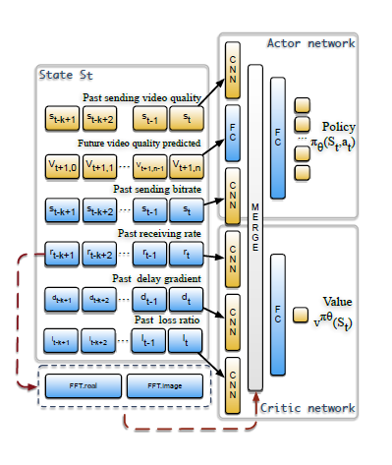
VQRL
Using A3C algorithm [21]
State:
Reward: QoE [20]
(N: time slot, V: video quality, B:bitrate, D:delay gradient)
[20]Hongzi Mao, Ravi Netravali, and Mohammad Alizadeh. 2017. Neural adaptive video streaming with pensieve. In Proceedings of the Conference of the ACM Special Interest Group on Data Communication. ACM, 197–210.
[21] Volodymyr Mnih, Adria Puigdomenech Badia, Mehdi Mirza, Alex Graves, Timothy Lillicrap, Tim Harley, David Silver, and Koray Kavukcuoglu. 2016. Asynchronous methods for deep reinforcement learning. In International Conference on Machine Learning. 1928–1937.

Slide 7
Evaluation - setup
Video dataset:
VideoSet: a large-scale compressed video quality dataset based on JND measurement
self-collected: involves live-casts, music-videos, and some short movies.
Network traces:
Packet-level network traces
Chunk-level network traces
Synthetic network traces: using a Markovian model where each state represented an
average throughput in the aforementioned range[20]
Metric:
QoE
Video quality (VMAF, and normalize in [0,1])
Sending bitrate (Mbps)
Queuing delay (s)
[20]Hongzi Mao, Ravi Netravali, and Mohammad Alizadeh. 2017. Neural adaptive video streaming with pensieve. In Proceedings of the Conference of the ACM Special Interest Group on Data Communication. ACM, 197–210.

Slide 8
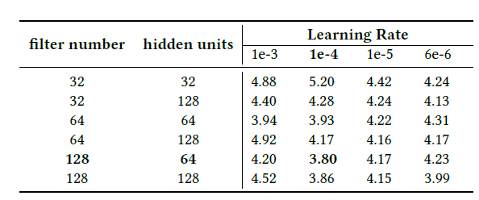
Evaluation - implementation

Slide 9
Evaluation - baseline
QARC can achieve good video quality, high bitrate and low delay in the same time.
with improvements in average video quality of 18% - 25% and decreases in average queuing delay of 23% - 45%.
QARC v.s. Compund TCP

Slide 10
Evaluation - coefficient α, β, and γ
Initialize QoE reward with small latency coefficient α yield high-performance improvement over the one with a bigger α in wired network conditions
However, in 4G network environments, it performs a very different performance.

Slide 11
Conclusion
Propose a RL-based rate control algorithm in the real-time video streaming scenario
Try to get a higher video quality with possibly lower sending rate.
To reduce the state space of the RL model, we derive the neural network into two parts and train them respectively
QARC outperforms existing rate control algorithms

