Slide 1
Privacy-Preserving Content-Oriented Wireless Communication in Internet-of-Things
K. Gai, K. R. Choo, M. Qiu and L. Zhu, "Privacy-Preserving Content-Oriented Wireless Communication in Internet-of-Things," in IEEE Internet of Things Journal, vol. 5, no. 4, pp. 3059-3067, Aug. 2018.

Slide 2
Contribution
Proposed a dynamic privacy protection model
Ensuring mobile device user privacy even in large volume of data transmissions
Content-oriented data pairs: data that may leak privacy when examined collectively

Slide 3
Problem Definition
Maximizing total privacy weights problem
maximize the total privacy weights value under the configured timing constraint
Input :
data types D_{i} , data amount N(D_{i}), constraint C^{s} ( including timing T(D_{i}) & energy E(D_{i}) etc.) computing cost & privacy weight in low level security C^{n}(D_{i}), W^{n}(D_{i}) computing cost & privacy weight in high level security Ce(D_{i}), W^{e}(D_{i})
Output: sum of all privacy weights

Slide 4
Problem formulation
ℙ denotes total privacy, ℂ denotes total constraints, s(i) is binary function indicating high or low level security
Goal: maximize ℙ under condition

Slide 5
Dynamic Privacy Protection Model

Slide 6
Content-oriented data pairs
Simultaneously obtaining D_{p} and D_{q} can compromising privacy, but only access to D_{p} or D_{q} will not result in privacy leakage
Example: user name & GPS location
Encrypt one of them can deal with this kind of threat

Slide 7
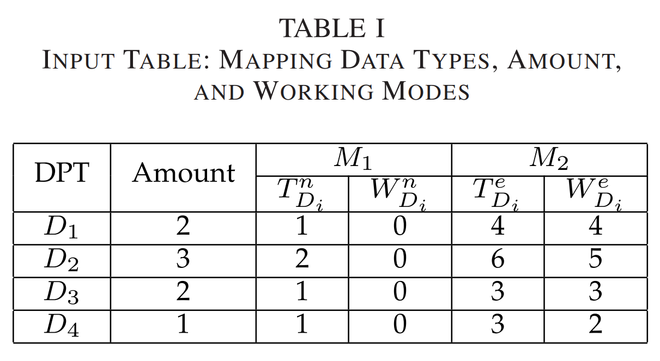
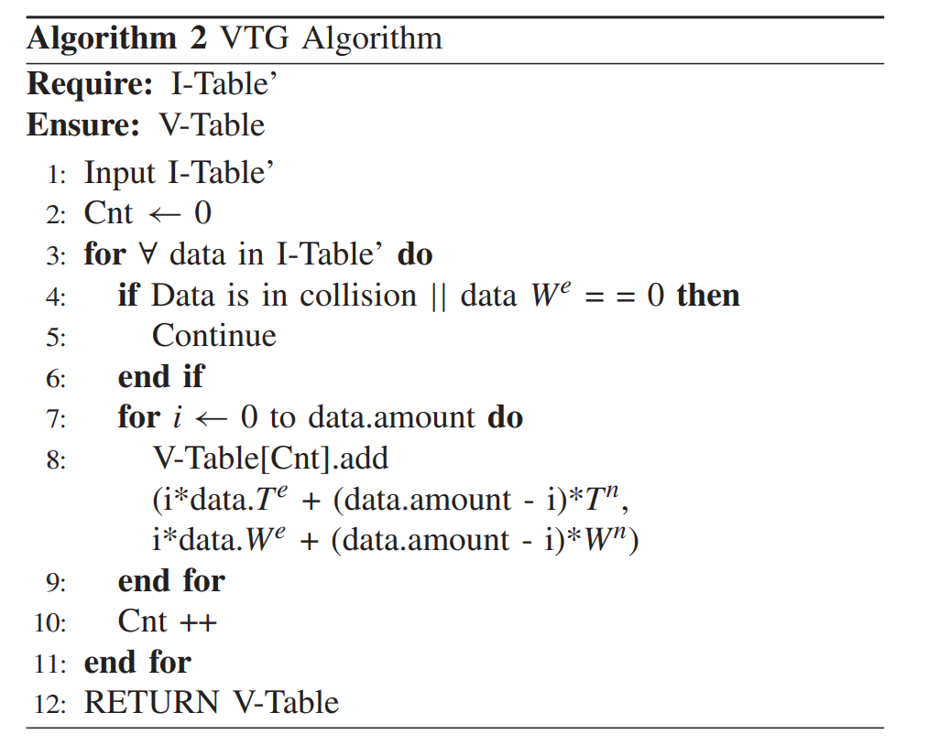
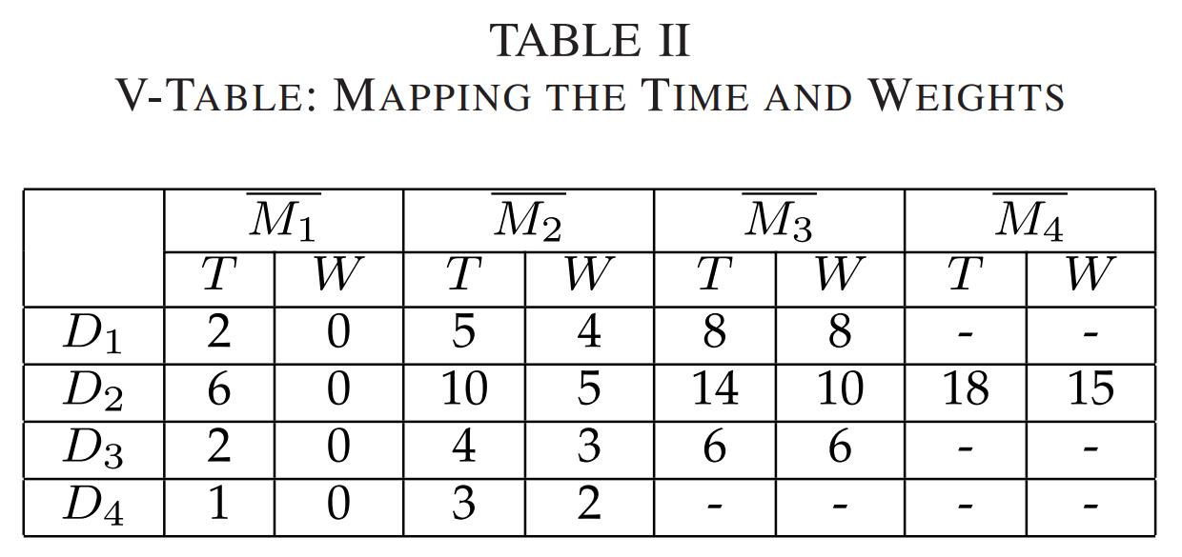
Proposed Algorithm - VTG

Slide 8
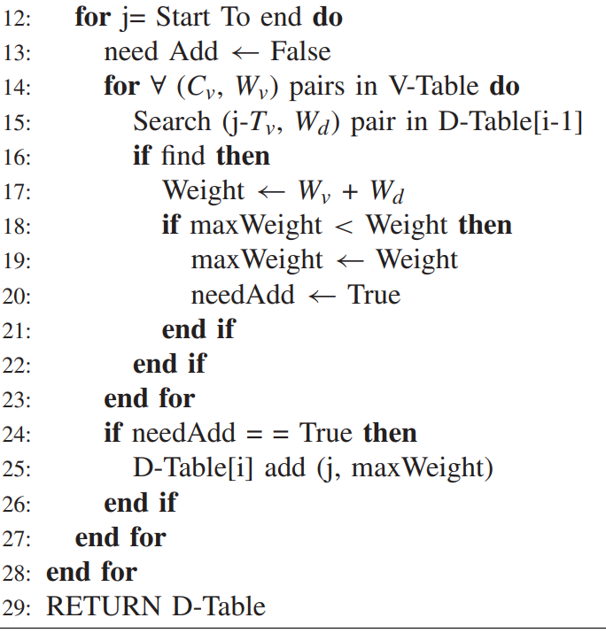
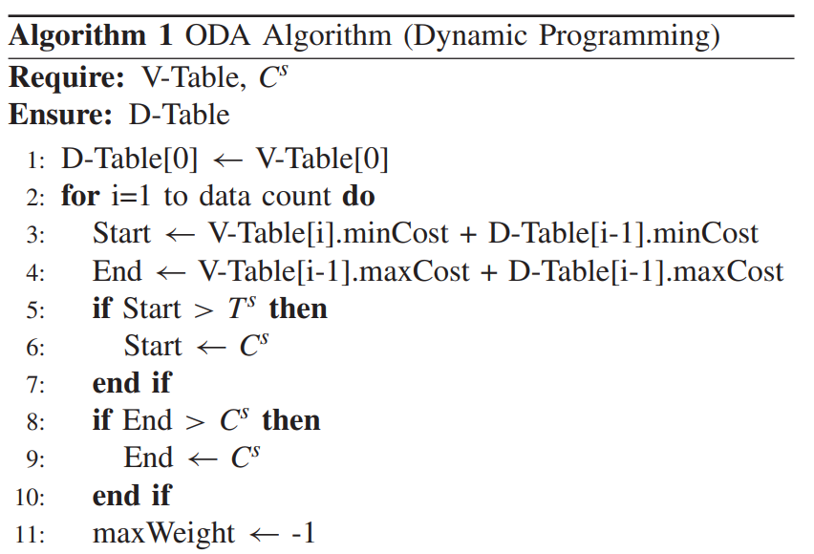
Proposed Algorithm - ODA

Slide 9
D-Table Example

Slide 10
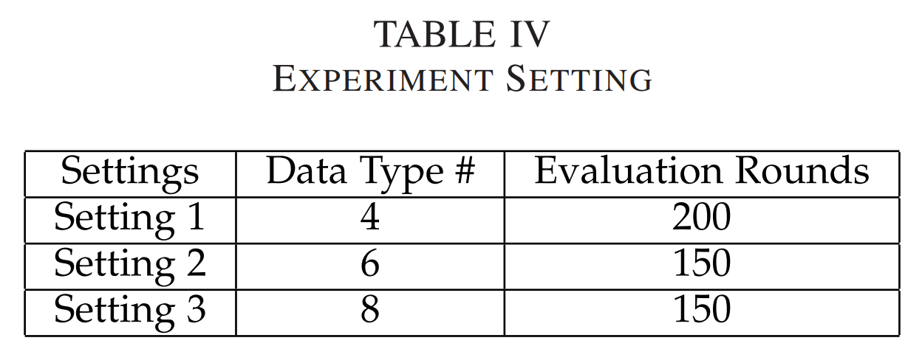
Evaluation - Setup
Algorithm comparison
OA: an improved A* algorithm, used for assess solution
DCMMS: an advanced greedy algorithm, used for assess performance
DPP: Proposed algorithm

Slide 11
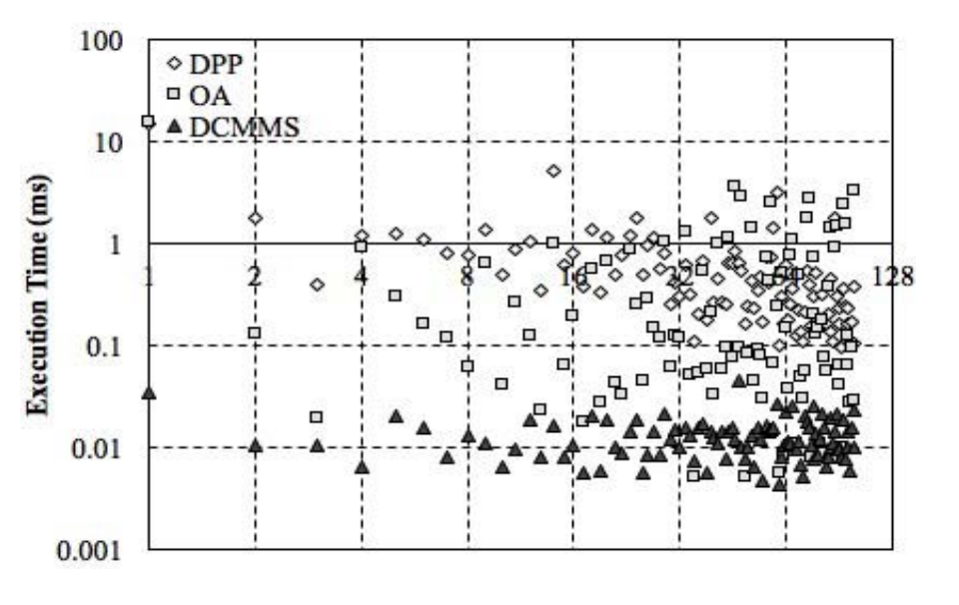
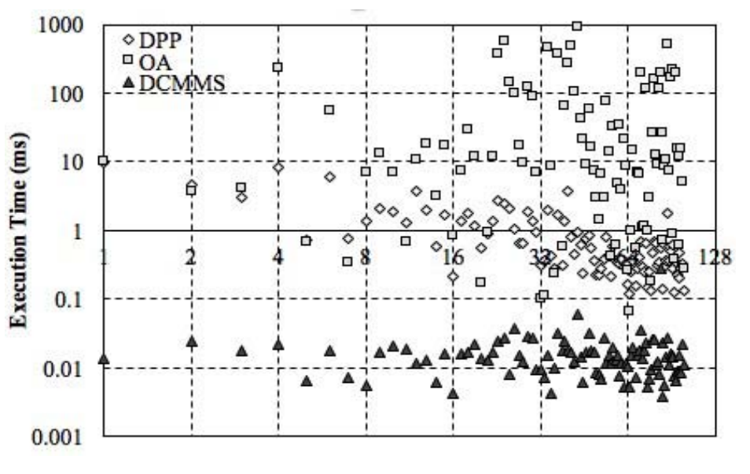
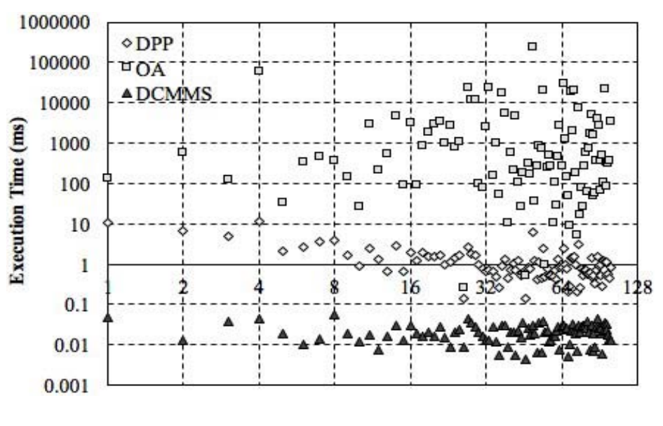
Evaluation - Execution time
Setting 1
Setting 2
Setting 3

Slide 12
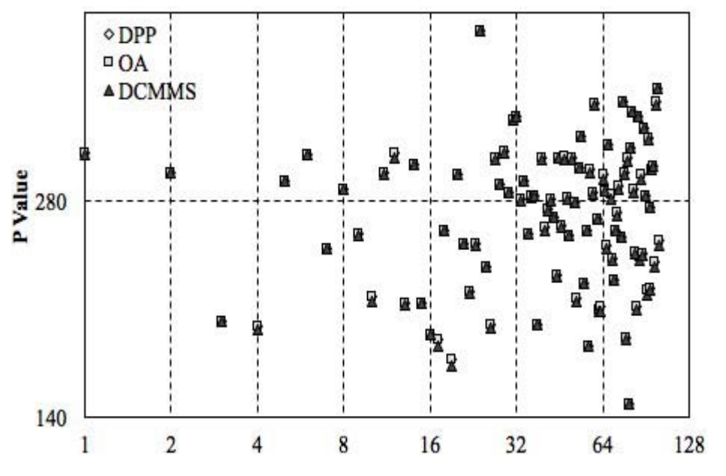
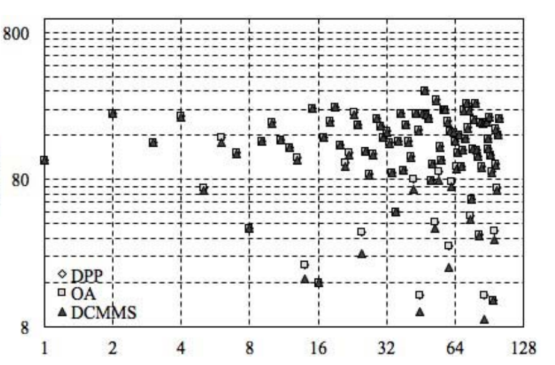
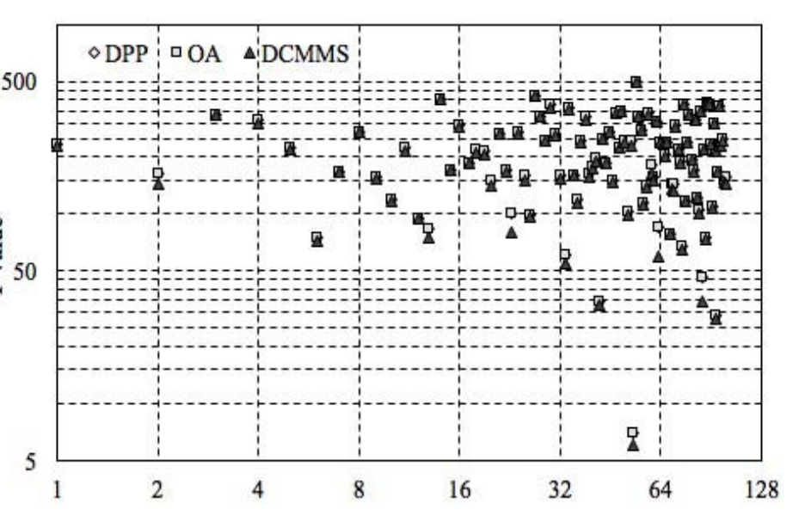
Evaluation - Privacy weight
Setting 1
Setting 2
Setting 3

Slide 13
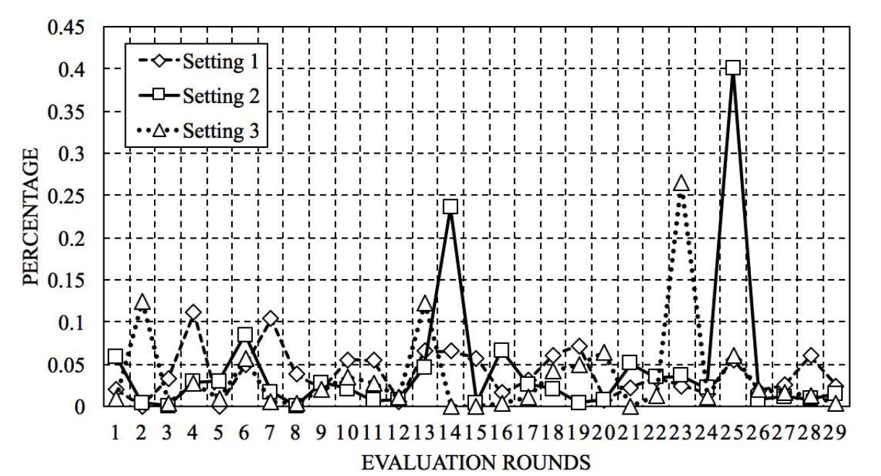
Evaluation - privacy weight difference weight

Slide 14
Conclusion
Propose a content-oriented privacy protection model based on dynamic programming to enhance overall privacy protection level.

