Slide 1
Modeling Local Geometric Structure of 3D Point Clouds using Geo-CNN
Shiyi Lan¹ Ruichi Yu¹ Gang Yu² Larry S. Davis¹
¹University of Maryland, College Park ²Megvii Inc (Face++)

Slide 2
Key Contribution
Propose a generic operation called GeoConv
Extract more local features than the-state-of-art
Enable to apply data augmentation on feature-level

Slide 3
What’s the problem they want to solve?
The previous methods to extract the local features ignore the geometric structure
The closest related work, EdgeConv, extracts edge features among k-NN points
But they ignore the direction of the vector

Slide 4
How do they solve it?
GeoConv → applied to each points and its local spherical neighborhood with a radius
Decompose each vectors to three orthogonal bases and weights
Aggregate those bases with the weights to get the edge feature for each points

Slide 5
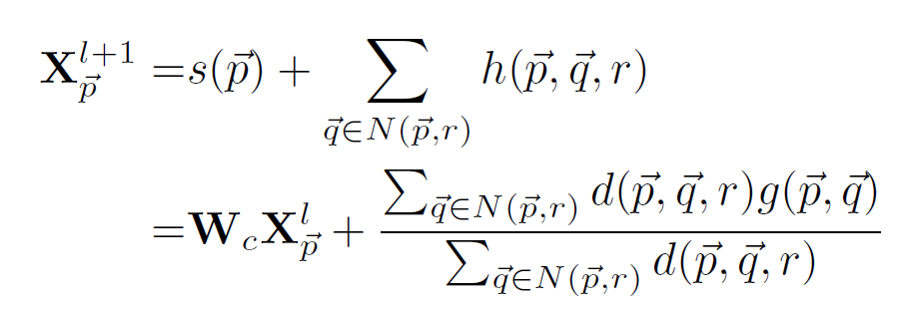
General Formula of GeoConv
Function to model edge featrues

Slide 6
Modeling Edge Features (Key Component of Geo-CNN)
Straightforward way → apply NN or MLP on edge vector
May suffer overfitting or project the edge features into some high dimensional space and loss the Euclidean geometric structure
They use three orthogonal bases (x, y, z) to represent the edge vector
Norm of the edge vector represents the weight on that direction
In practice, they use six bases

Slide 7
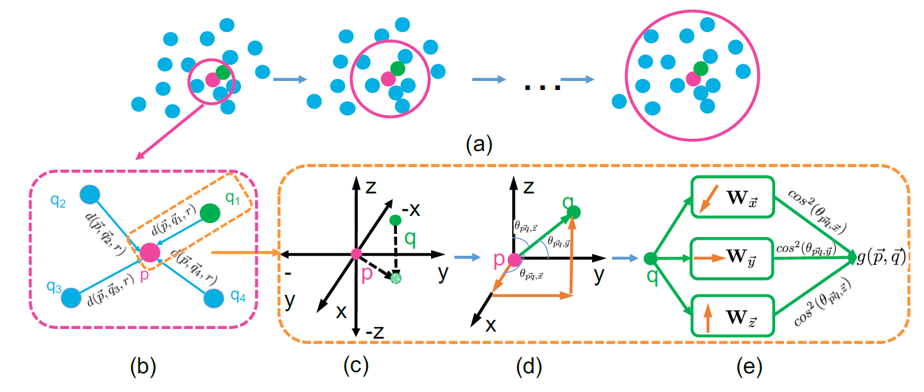

Slide 8
Multi-view Data Augmentation
Input level → Rotate the point cloud as data augmentation
Feature level → approximate rotation by only changing the aggregation model

Slide 9
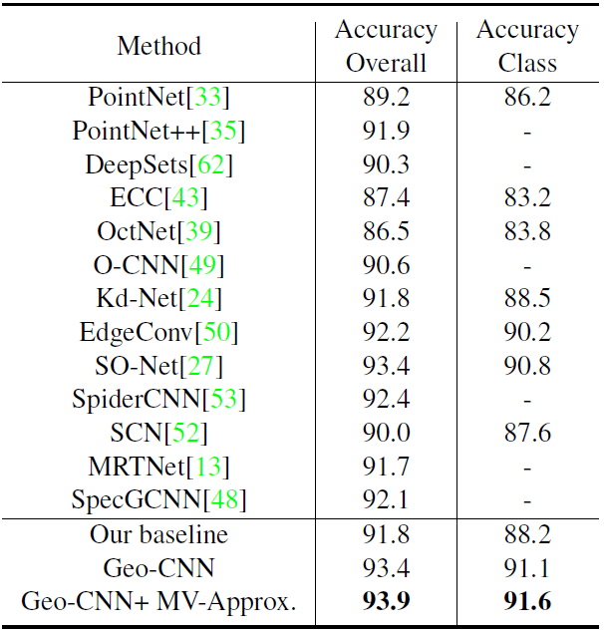
Classification
Baseline
→ aggregate the edge features from different points by taking average
→ use a single weight matrix instead of separate weights on each directions to extract the edge features

Slide 10
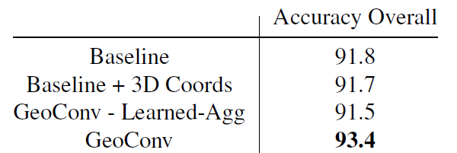
Can we model local geometry by directly learning from 3D coordinates?
Use FC to learn Euclidean geometry structure on every layer of baseline model
Learn the aggregation coefficients directly, not by function

Slide 11
Does the performance gain of GeoConv come from increasing model complexity?

Slide 12
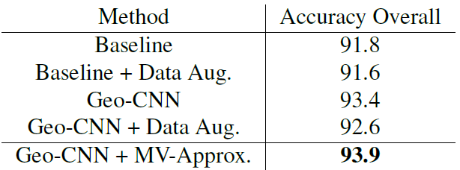
Multi-view Augmentation
Input-level leads to performance degradation on both baseline and Geo-CNN
Large variance among different views?
→ cannot be properly learned with a single compact model
Input-level vs. Feature-level

Slide 13
Connect to My Work
A better way to extract the local features to overcome the loss on the local details
GeoConv is an operation → possible to integrate with exist models

