Slide 1
An overview of ongoing point cloud compression standardization activities: video-based (V-PCC) and geometry-based (G-PCC)
D. Graziosi¹, O. Nakagami², S. Kuma², A. Zaghetto¹, T. Suzuki² and A. Tabatabai¹
¹R & D Center US San Jose Laboratory, Sony Corporation of America, San Jose, USA
²R & D Center, Sony Corporation, Shinagawa-ku, Japan

Slide 2
Use Cases
VR/AR Telepresence Autonomous car World heritage
V-PCC G-PCC

Slide 3
PCC Standardization
LIDAR point cloud compression (L-PCC) for dynamically acquired data
Surface point cloud compression for (S-PCC) for static point cloud data
Video-based point cloud compression (V-PCC) for dynamic content
Video-based (V-PCC)
Geometry-based (G-PCC)

Slide 4
V-PCC

Slide 5
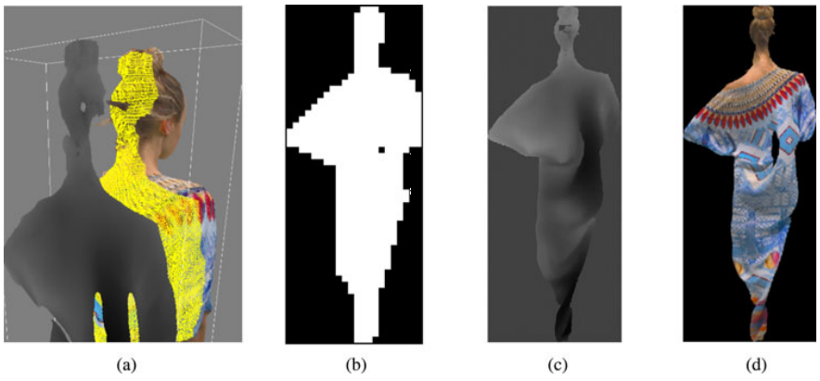
(a) 3D patch, (b) 3D Patch Occupancy Map, (c) 3D Patch Geometry Image, (d) 3D Patch Texture Image.

Slide 6
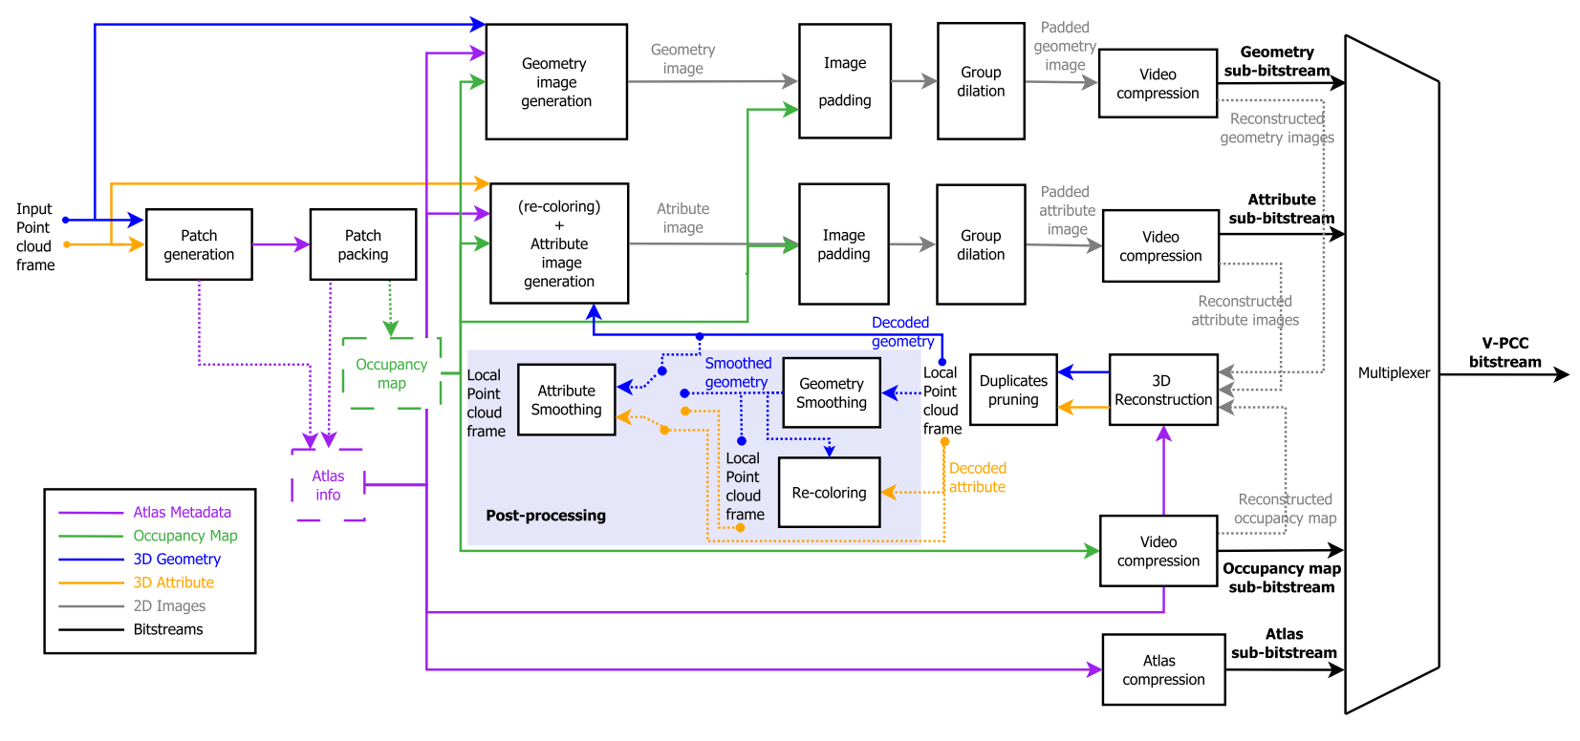

Slide 7
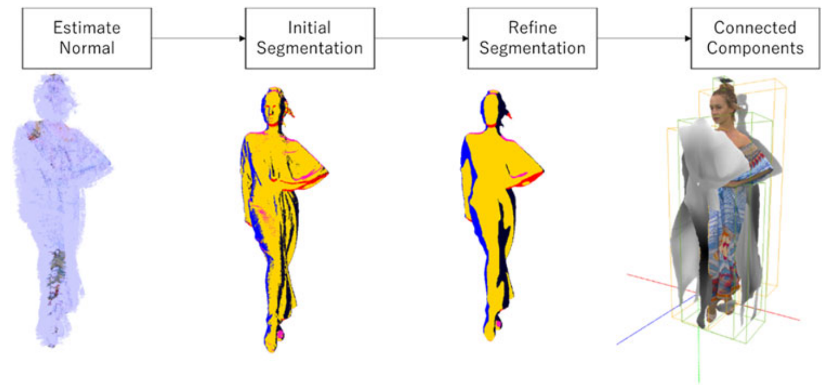
Patch Generation

Slide 8
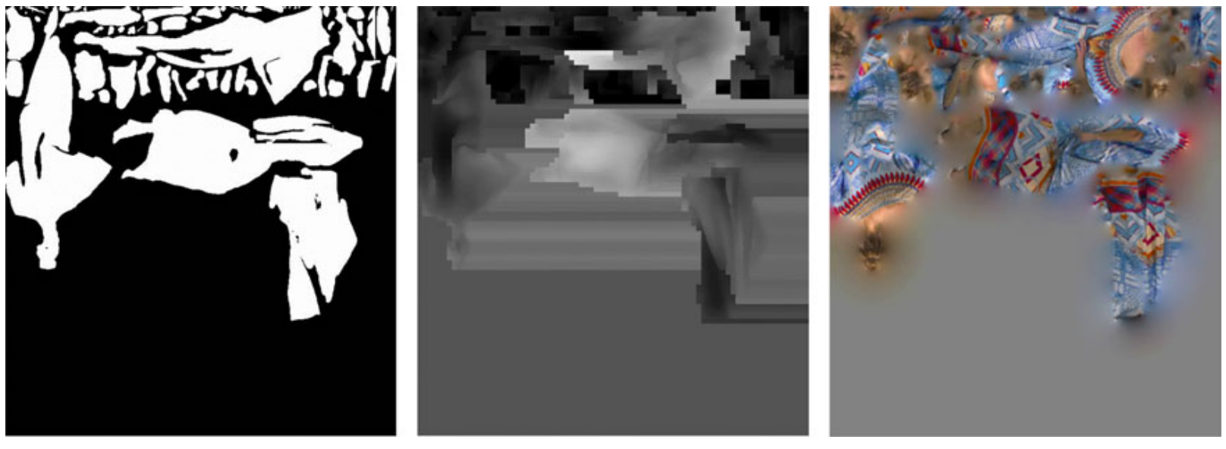
Patch Packing

Slide 9
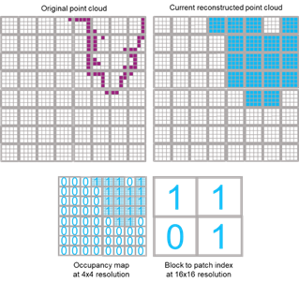
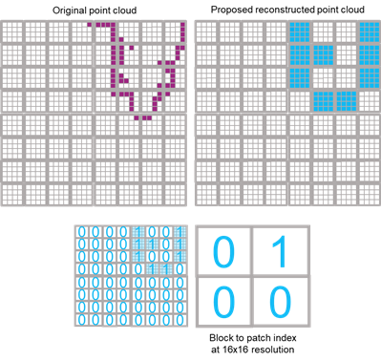
Geometry and Occupancy Maps

Slide 10
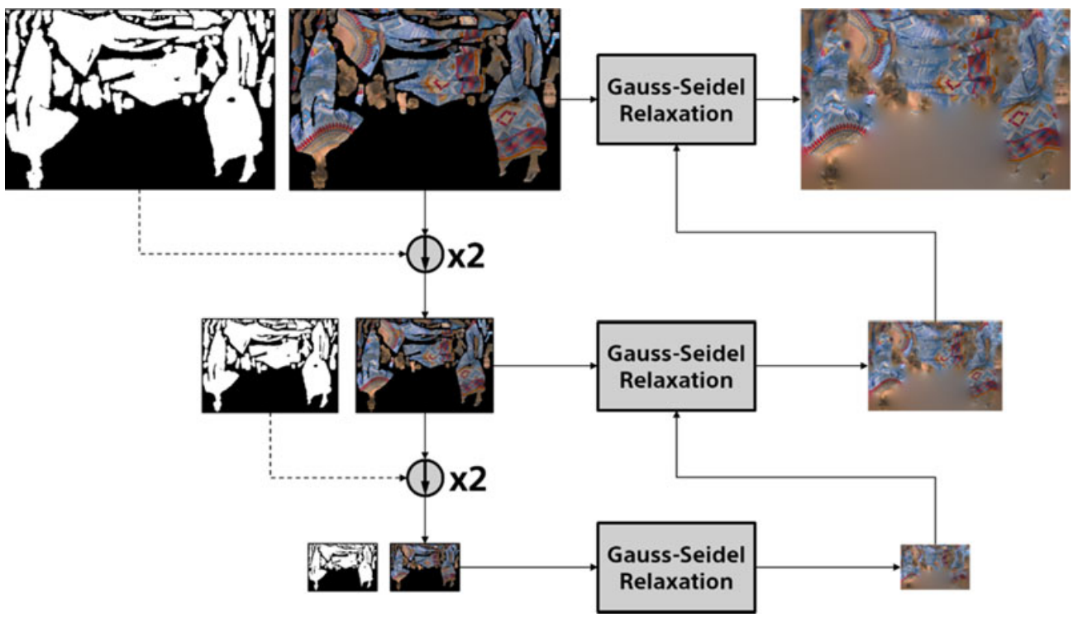
Image Padding and Group Dilation

Slide 11
Re-Coloring and Video Compression
Nearest point from the original point cloud
Color converted from RGB444 to YUV420

Slide 12
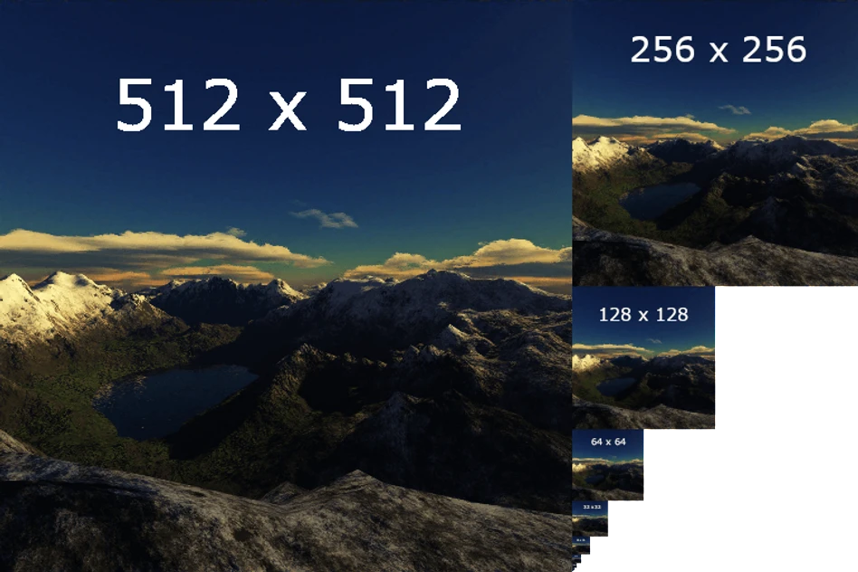
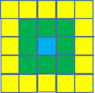
Duplicates Pruning and Smoothing
Geometry Smoothing
Trilinear filter (pixel-wise + Mipmap-wise)
Attribute Smoothing
Perform in 3D space (find correct neighborhood)

Slide 13
G-PCC

Slide 14
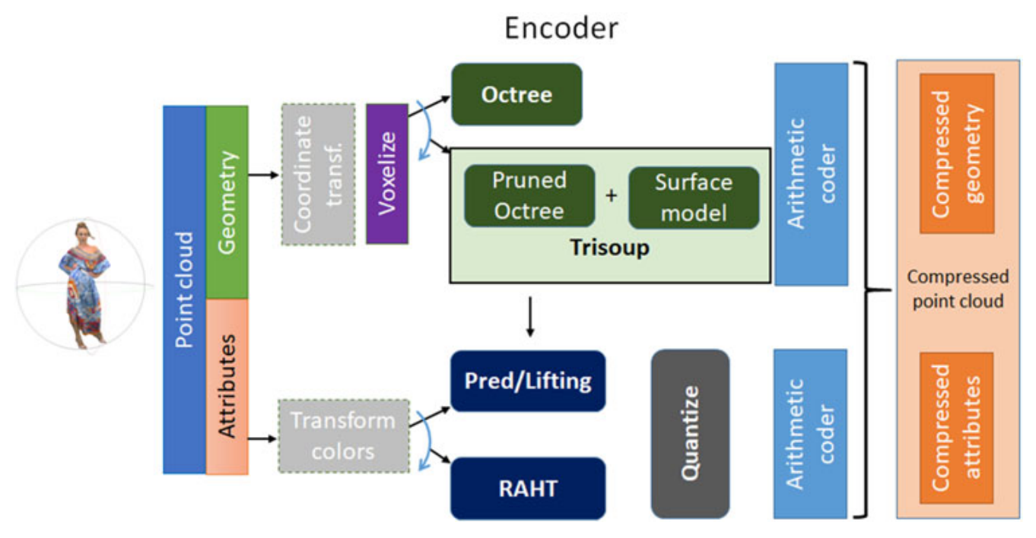

Slide 15
Octree Coding
For isolated points, Direct Coding Mode (DCM) is adopted

Slide 16
Attribute Encoding
RAHT (Region-Adaptive Hierarchical/Haar Transform)
Predicting Transform
Lifting Transform

Slide 17
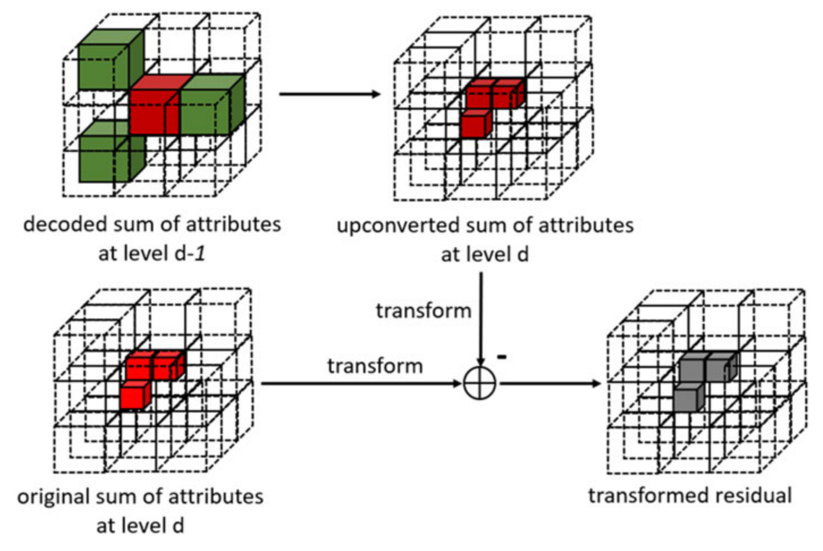
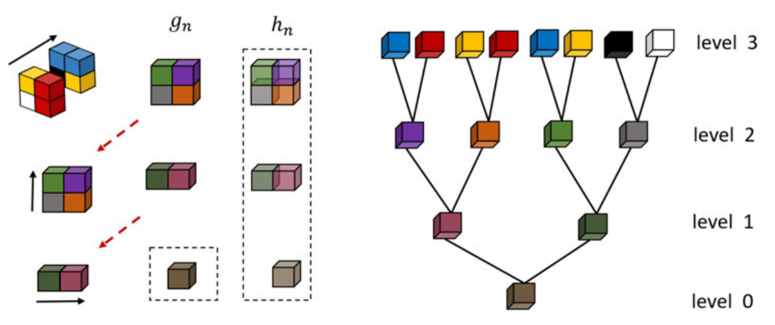
RAHT (Region-Adaptive Hierarchical/Haar Transform)
Transform Domain Prediction

Slide 18
Predicting Transform
Level of Order (LoD)

Slide 19
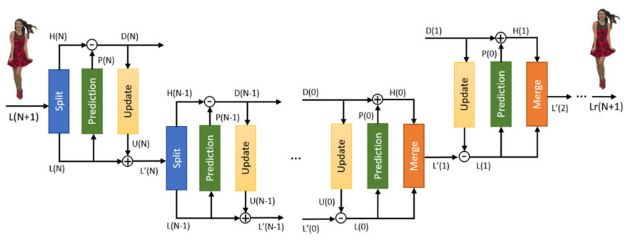
Lifting Transform
Predicting Transform + update operator (adaptive quantization strategy)

