Slide 1
A color-based objective quality metric for point cloud contents (QoMEX’20)
Irene Viola¹, Shishir Subramanyam¹², and Pablo Cesar¹²
¹Centrum Wiskunde & Informatica, Amsterdam, The Netherlands
²TU Delft, Delft, The Netherlands

Slide 2
Motivation
Existed objective quality metrics for point clouds are either evaluate geometry or color only
Need a more reliable color-based objective metrics for point cloud contents

Slide 3
Related Work
Point based
Mesh based
Point to plane
Angular distortions
Projection based
SSIM
VIF
PSNR

Slide 4
Proposed Metrics
Histogram-based
Global perspective
Distribution difference
Consider Y channel only and weighted YUV combination
Correlogram-based
Probability of the same color among k-NN points
Both two metrics consider L1, L2, L∞, χ2 (Chi-square), EMD, and a feature vector f_{k} (contains diagonal energy, entropy, contrast, homogeneity and energy ratio)

Slide 5
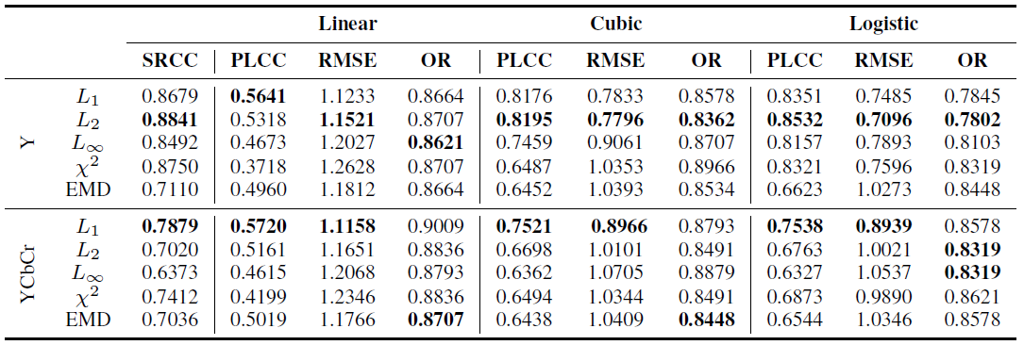
Pearson Linear Correlation Coefficient (PLCC) → linearity
Spearman Rank Correlation Coefficient (SRCC) → monotonicity
Root Mean Square Error (RMSE) → accuracy
Outlier Ratio (OR) → consistency
L2 performs best in most cases
UV channels do not correlate with visual quality distortion

Slide 6
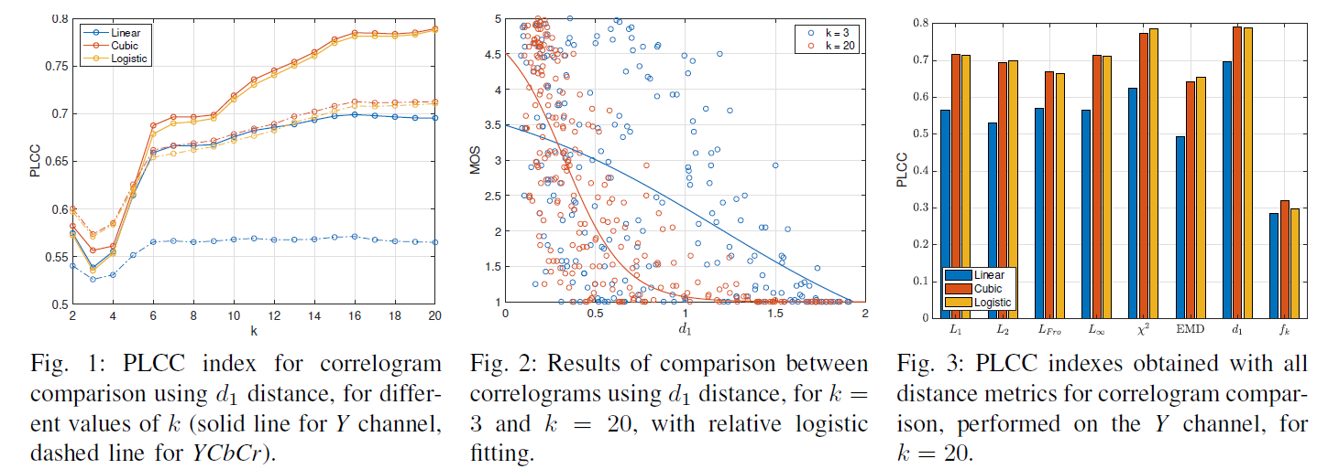
Fig. 1, 2 → Correlation with close neighbors leads to poor results
Fig. 3 → f_{k} contains the features which have high correlation in 2D images. The result shows that the same features cannot not extend to point clouds.

Slide 7
Observation
k-NN, higher k → better performance
Except for EMD, all the histogram-based metrics perform better than correlogram-based.

Slide 8
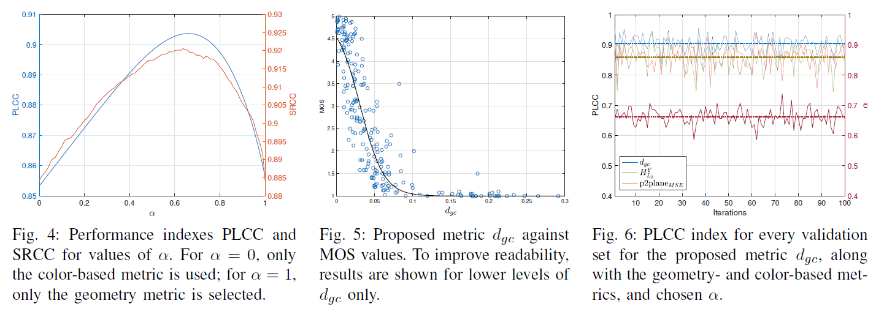
Combine geometry and color
Linear combination
Fig. 6 → proof the result α is not overfitting

Slide 9
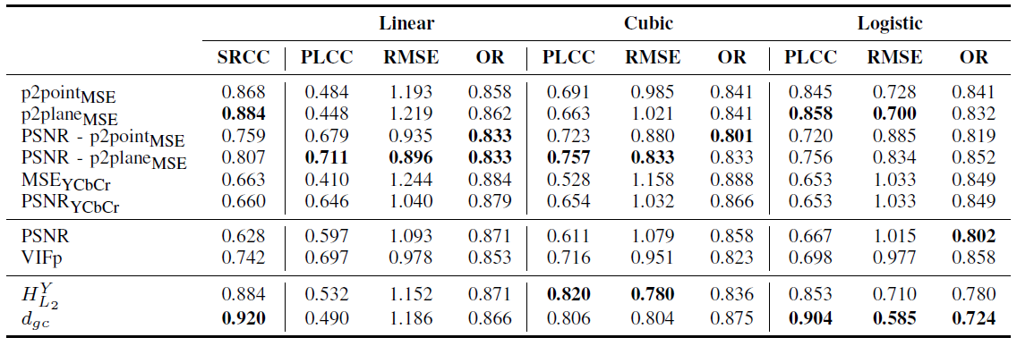
Comparison
Histogram-based outperform point-to-point approach (red boxes)

Slide 10
Contribution
An better objective quality metric for point cloud which considers both geometry and color aspects.

